Slide 1

SECURITY SYSTEM
Department of Electronics and Communication Engineering
Jaypee Institute of Information Technology, Noida, U.P., India
Presented by:
Aakash Mehta (20102004)
Rishika Bahl (20102169)
Under the supervision of
Mr. Mandeep Narula

Slide 2
CONTENTS
INTRODUCTION
PRINCIPLE
FLOWCHART
WORKING
APPLICATIONS
COMPONENTS AND FEATURES
ADVANTAGES
DISADVANTAGES
SCOPE OF OUR PROJECT
REFERENCES

Slide 3
INTRODUCTION
Our project consists of a gate, which can be integrated in the prior metal detecting gates present in areas like malls, shopping complexes, airports, bus and railway stations etc. The temperature sensor present in the gate would measure the temperature without a person to operate it while simultaneously detecting metal components when the person is passing through the gate. If the person’s temperature is higher than the permissible range, they would be asked to give their contact details such as email id and address.

Slide 4
PRINCIPLE
We are using a Contactless Infrared (IR) Digital Temperature Sensor(MLX90614) that can be used to measure the temperature of a particular object ranging from -70° C to 382.2°C.
The sensor uses IR rays to measure the temperature of the object without any physical contact and communicates to the microcontroller using the I2C protocol.
This is made possible with a law called Stefan-Boltzmann Law, which states that all objects and living beings emit IR Energy and the intensity of this emitted IR energy will be directly proportional to the temperature of that object or living being. So the sensor calculates the temperature of an object by measuring the amount of IR energy emitted from it.

Slide 5
For the metal sensor, we have used an Arduino Nano to build this metal detector project. Wherever this detector detects any metal near it, the buzzer starts beeping very rapidly.
Whenever some current passes through the coil, it generates a magnetic field around it, this change in the magnetic field generates an electric field. According to Faraday's law, due to Electric field, a voltage develops across the coil which opposes the change in magnetic field known as Inductance.
When any metal comes near to the coil then coil changes its inductance. This change in inductance depends upon the metal type. It's decreases for non-magnetic metal and increases for ferromagnetic materials like iron.

Slide 6
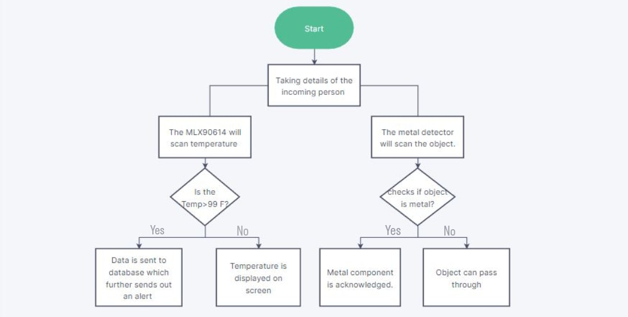
FLOWCHART

Slide 7
WORKING OF OUR PROJECT
The temperature sensor uses IR rays to measure the temperature of the object without any physical contact and communicates to the microcontroller using the I2C protocol. Then the sensor calculates the temperature of an object by measuring the amount of IR energy emitted from it according to Stefan-Boltzmann Law.
In case of the metal detector, we provide the block wave or pulse, generated by Arduino, to the LR high pass filter. Due to this, short spikes will be generated by the coil in every transition. The pulse length of the generated spikes is proportional to the inductance of the coil those spikes are of very short duration (approx. 0.5 microseconds) and that is very difficult to be measured by Arduino.
So instead , we use a capacitor that is charged by the rising pulse or spike. After a few pulses to charge the capacitor to the point where its voltage can be read by the analog pin A5. The Arduino reads the voltage of this capacitor by using ADC. After which, the capacitor quickly discharges as capPin pin is set as output and set to low. This whole process takes around 200 microseconds to complete. After getting the result we transfer the results to the LED and buzzer to detect the presence of metal.

Slide 8
APPLICATIONS
Our model can be implemented in various in important sites like airport, railways, hotels, military facility, and various other government buildings for providing security whilst being cost effective. As they can filter out the category of people sick from a large crowd and sense those carrying metal simultaneously.
This model can also be used at archeological sites to recover various artifacts which may be metallic in nature and the temperature sensor used can sense minimum radiation level of extinct species in fossils.

Slide 9
FEATURES
Many features of our project are-
The key feature of this project is that it makes the detection contactless and has high accuracy.
Our project has very low running cost as it does not require additional workforce to be hired. Due to its high accuracy and precision, it can also be used in a wide range of commercial, health care, and household applications like room temperature monitoring, body temperature measurement, etc.
Remote Monitoring : The detector can take be monitored using voice controls or via remote control.
Language/Software we are going to use : Arduino Programming (C++)

Slide 10
COMPONENTS
NodeMCU ESP8266 BOARD - NodeMCU is an open source firmware for which open source prototyping board designs are available. The name "NodeMCU" combines "node" and "MCU" (micro-controller unit). Strictly speaking, the term "NodeMCU" refers to the firmware rather than the associated development kits.
MLX90614 INFRARED TEMPERATURE SENSOR - The MLX90614 is a Contactless Infrared (IR) Digital Temperature Sensor that can be used to measure the temperature of a particular object ranging from -70° C to 382.2°C. The sensor uses IR rays to measure the temperature of the object without any physical contact and communicates to the microcontroller using the I2C protocol.
PIEZO SOUND BUZZER - Piezo buzzers are simple devices that can generate basic beeps and tones. They work by using a piezo crystal, a special material that changes shape when voltage is applied to it. If the crystal pushes against a diaphragm, like a tiny speaker cone, it can generate a pressure wave which the human ear picks up as sound.

Slide 11
SOFTWARE
ARDUINO NANO-
The Arduino nano is a small version of ATmega328P released in 2008.The features of this board are similar to Arduino uno board .It has an operating voltage of 5 volts .It has a flash memory of 32KB.It supports 12C and SPI communication.
ARDUINO IDE- The Arduino IDE is an open-source software, which is used to write and upload code to the Arduino boards. The IDE application is suitable for different operating systems such as Windows, Mac OS X, and Linux. It supports the programming languages C and C++. Here, IDE stands for Integrated Development Environment.

Slide 12
ADVANTAGES
Contactless detection
Does not endanger the lives of people hired to regulate social distancing norms.
Cost effective
No additional expenses required for extra equipment or workforce.
Time efficient
It can scan and present result in a few seconds.

Slide 13
High accuracy
It is very precise while detecting of temperatures
Can be implemented on a large scale basis
Due to the project being time efficient, cost efficient and precise it can be used to screen the individuals.
Makes the screening process hassle free
Has low operational voltage
The operational voltage of the NodeMCU board is very low (around 3.3 V)

Slide 14
DISADVANTAGES:
The project may take a longer time than expected to implement on a real time basis
It covers only one aspect of covid symptoms hence those who present with other minor symptoms may not be detected.

Slide 15
SCOPE OF OUR PROJECT
This security system can really be a technological boon and advancement in the market as it is very precise while screening.
These prototypes of these gates can be implemented wherever possible making the screenings of the individuals hassle free while also protecting the lives of the employees hired by various institutions to regulate social distancing norms.
Our Concept of Proximity sensing can be made more efficient by using a big database and making it into a real time firmware application connected to the national database. So, if by chance, we find a person suspicious, we can search the database making it possible to reach out and alert people nearby.

Slide 16
REFERENCES :
https://www.javatpoint.com/Arduino-ide#:~:text=The%20Arduino%20IDE%20is%20an,stands%20for%20Integrated%20Development%20Environment
https://en.wikipedia.org/wiki/
https://www.amazon.in/

