Slide 1
Wavelet Transform
Aakash Khot, IMT2020512

Slide 2
INDEX
Introduction
Limitations of Fourier Transform
Short Time Fourier Transform and its Drawbacks
Wavelet Transform
Continuous Wavelet Transform
Discrete Wavelet Transform
Properties of Wavelets
History / Timeline
Advantages of Wavelets
Uses and Applications of Wavelets
Refrences

Slide 3
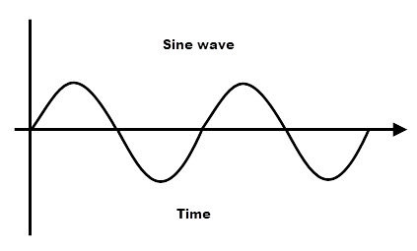
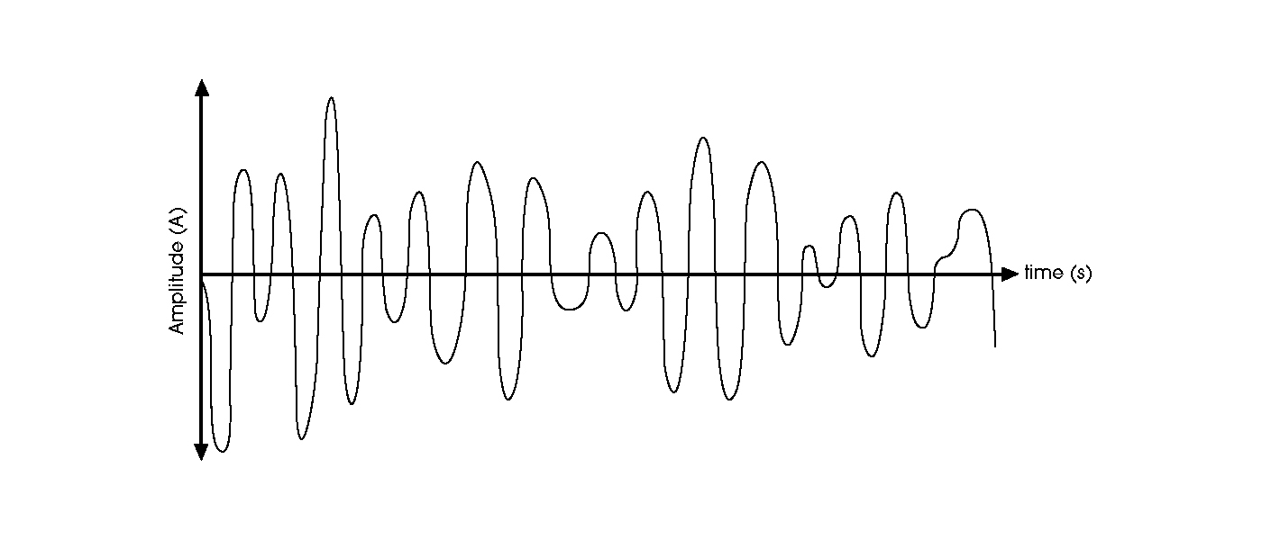
Introduction
Let’s discuss about signals before going to wavelets. Signals from a source are usually in time domain and by Fourier transform which will convert the time domain signal into frequency domain signal, we can analyse the signal in frequency domain.
Stationary signal :- Normally for a signal, if frequency content is not changing w.r.t time is called stationary signals, Here we can say that time period and spectral content value is constant. Ex. Sin wave.
Non-stationary signal :- Signals whose frequency content keep changing. Ex, Real time signals, ECG.

Slide 4
Limitations of Fourier Transform
Fourier transform completely fails for a non-stationary signal. As the Fourier transform only gives the information of frequency components. It cannot tell at what time a particular frequency component occurs.
Let’s take an example of two non stationary signals i.e. chirp signal, one with increasing frequency and one with decreasing frequency.
Firstly, What is chirp?
A chirp is a signal in which frequency increases or frequency decreases with respect to time.
If frequency is increasing with time than its called up-chirp signal.
If frequency is decreasing with time than its called down-chirp signal.

Slide 5
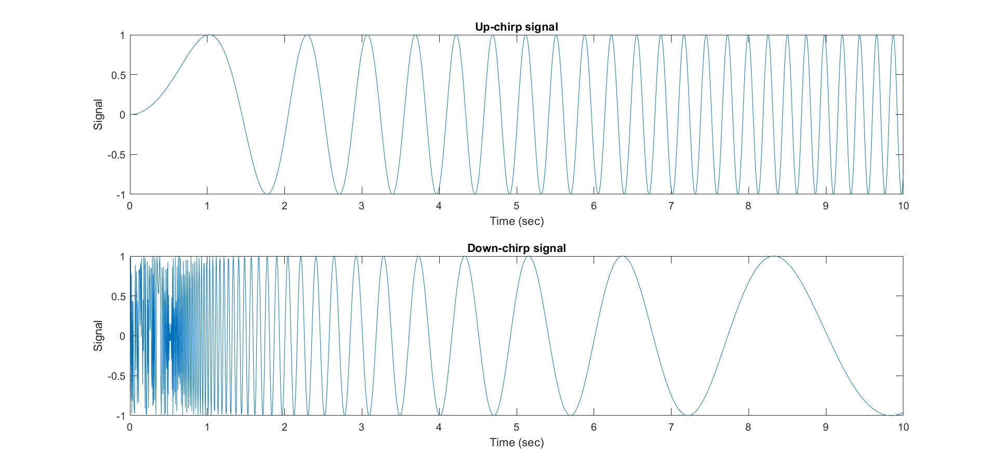
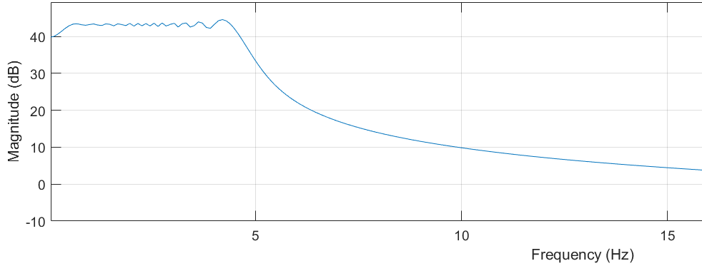
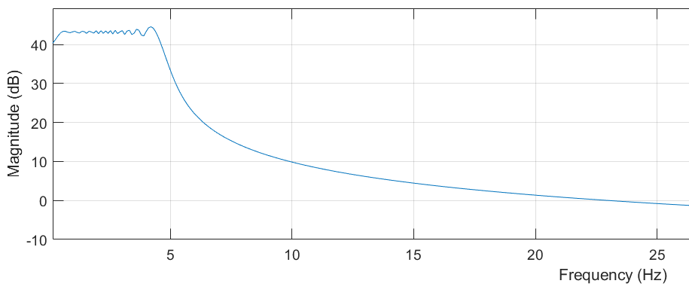
Here we can clearly see that frequency spectrum of both are same but the signals are different.

Slide 6
Limitations of Fourier Transform
Fourier Transform gives the frequency content of a signal but it has no relation between time as we can see from the example.
So we need a distribution which can relate frequency with time so that we can get values frequency components at a particular moment of time.
So a new transform is required which will provide both timing and frequency information.
So What we can do further?

Slide 7
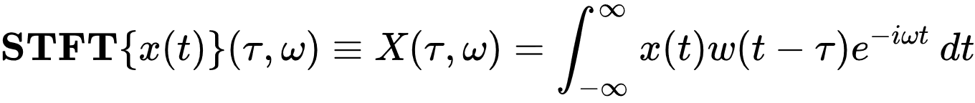
Short Time Fourier Transform (STFT)
Here it considers that there is a possibility that some small portion of non-stationary signal is stationary.
So whole signal has to be cut in small portions to find the frequency components of all portions to know the frequency components of entire signal.
As you can see from equation, window is been used for taking small portions (duration of ‘τ‘) of signal and taking Fourier transform of them. So we are assuming that for a period of ‘τ‘, the signal is stationary.
Selection of width of the window play a very important role. As narrow width will lead to poor frequency resolution and good time resolution and opposite for wider width window. Trade off !!

Slide 8
Drawback of STFT
The Resolution is fixed because of constant width of the window for all portions of the signal.
As any signal can have both high and low frequency components, to capture all, we need to vary the width of the window which is not done in STFT.
Also as per Heisenberg’s principle, one cannot get infinite time and frequency resolution beyond Heisenberg’s limit.
So here we get a range of frequency for particular range of time and not exact time and frequency distribution.
So a new transform is required which solves this problem.
So What we can do further?

Slide 9
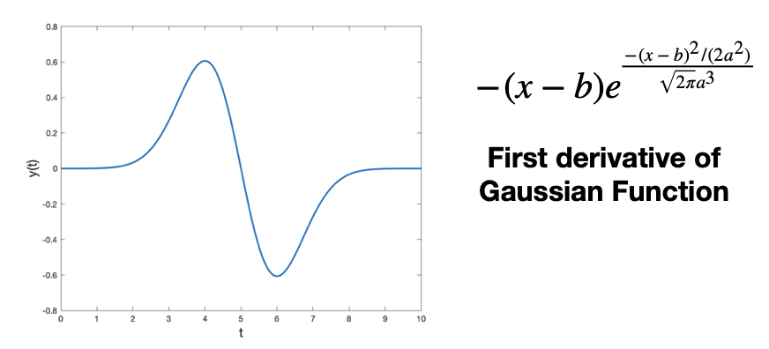
Wavelet Transform
Firstly, what is wavelet ? => A wavelet is a wave-like oscillation which is localized in time.
Two properties of wavelet ?
“Scale” which determines how stretched a wavelet is.
“Location” which determines the position of wavelet at a time.
As from the equation, Parameter
‘a’ is to change the scale.
‘b’ is to change the location.

Slide 10
Wavelet Transform
So how do we get the Wavelet transform of a signal?
So we first pick a wavelet (of any particular scale) and slide the wavelet over entire signal by changing the location and multiplying the wavelet with signal at each time step. This gives us the coefficients for wavelet scale at each time step. Then increase the scale and repeat the same process again.
In short, the signal is convolved with set of wavelets at different scales.
Heisenberg’s principle still holds.
Types of Transforms:-
– Continuous Wavelet Transform (CWT) –> Uses infinite number of scales and locations.
– Discrete Wavelet Transform (DWT) –> Uses finite set of wavelets i.e. finite set of scales and locations.

Slide 11
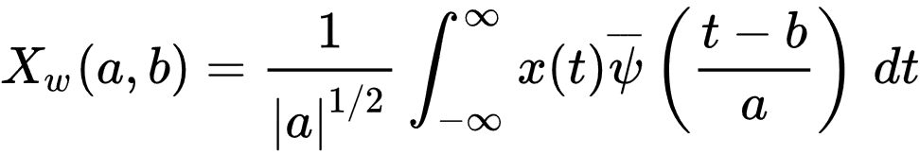
Continuous Wavelet Transform
CWT of a function x(t) where scale, a>0 and b is any real number can be expressed as
Here, X(a, b) is called wavelet coefficient, ‘a’ is scaling factor and ‘b’ is shifting parameter. ψ(t) is called mother wavelet.
We can say that Wavelet acts as window function (basis function).
Let’s see some of the popular examples of wavelet…

Slide 12
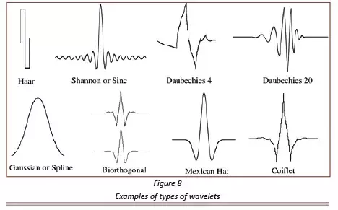
Examples of Mother wavelets

Slide 13
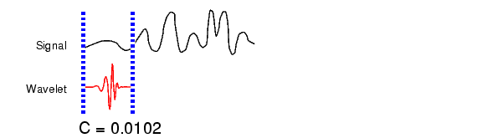
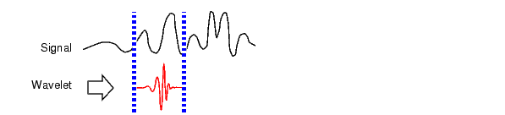
Steps to Compute CWT
We first pick a wavelet (of any particular scale) and compare it from the section of start of the signal.
The calculate the correlation coefficient c.
3. Now shift the wavelet to right an repeat steps 1 and 2 until whole signal is covered.

Slide 14
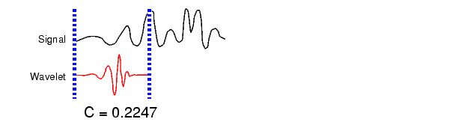
Steps to Compute CWT
As we have chosen a wavelet of particular scale only, now scale it and repeat steps 1 to 3.
Now repeat steps 1 to 4 for all scales.

Slide 15
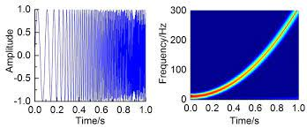
CWT of up-chirp signal

Slide 16
Discrete Wavelet Transform
Why DWT ?
CWT is computable but not implementable as scaling (‘a’) and shifting (‘b’) parameters are infinite which makes it difficult to implement.
That’s why DWT is efficient in terms of implementations as finite sets of wavelets are taken.
From the same equation, replace ‘a’ by ‘2^{−j} ’ and ‘b’ by ‘ c2^{−j} ’ i.e. proportional to ‘a’. Made as powers of 2 (dyadic).
So Here ‘j’ is called as scaling parameter and ‘c’ is called as shifting parameter.
Behaves like a Filter Bank.
A multiresolution analysis (MRA) or multiscale approximation (MSA) is the design method of most of the practically relevant discrete wavelet transforms (DWT).

Slide 17
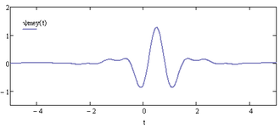
Properties of Wavelets
Compactness:-
Wavelets which have finite duration are called compactly supported in time domain which means its not band-limited in frequency. It can be implemented using FIR filters.
Examples Haar, Daubechies etc
Narrow band wavelets are called compactly supported in frequency domain. It can be implemented using IIR filters.
Examples Meyer’s wavelet.

Slide 18
Properties of Wavelets
Vanishing moment:-
Nth vanishing moment is given as Mn(f)=∫(t^n)f(t)dt
If we use a wavelet with enough number of vanishing moments, then all detail coefficient will be zero. So more the number of moments of a wavelets are zero, more is its compressive power.
A vanishing moment limits the wavelets ability to represent polynomial behaviour or information in a signal.

Slide 19
History / Timeline
In 1909, Alfred Haar discovers a “basis” of functions that are now known as first wavelets.
In 1930, John Littlewood and R.A.E.C Paley worked on localizing the energies of a function.
In 1946, Dennis Gabor used STFT.
In 1975, George Zweig discovered a version of CWT.
In 1984, Joint paper by Morlet and Grossman brings the word “wavelet” in mathematical lexicon (dictionary) for first time.
In 1985, Yves Meyer discovers the first smooth orthogonal wavelets.
In 1986, Staphane Mallat Idea of Multiresolution analysis (MRA) for DWT.
In 1990, Davis Donoho and Iain Johnstone used wavelets to “denoise” images.
In 1992, FBI chose a wavelet method to compress the huge data of fingerprints.

Slide 20
Advantages of using Wavelets
Wavelet Transform can be used to analyse the signal simultaneously w.r.t time and frequency domain both.
Wavelets are able to separate fine details in a signal.
High flexibility of choosing wavelet functions.
Wavelet transform is itself multi-resolution descriptions of video or image.
Signals can be stored more efficiently than Fourier transform.

Slide 21
Use of Wavelet Transform in Different Fields
Signal Processing
Audio compression
Image Processing
Video compression
Speech recognition
Signal De-noising
Nuclear engineering
Musical Note synthesis
Let’s see some more detailed Applications…

Slide 22
Applications
1) Storing Fingerprints Electronically using wavelets
FBI (Federal Bureau of Investigation) in the USA uses wavelets to store fingerprints electronically.
As there are over 30 million sets of fingerprints and it keep increasing day by day, this huge data needs to be compressed first to store in such a way that structure of fingerprints is not changed.
As wavelets are a good form to represent these types of signals using few coefficients, FBI uses wavelets to store fingerprints.
Infact, FBI uses biorthogonal spline wavelets.
The algorithm used is called “The Wavelet Scalar Quantization Gray- scale Fingerprint Image Compression Algorithm”.

Slide 23
Applications
2) Fingerprints verification used in AFIS
Manual fingerprint indentification is so tedious, time-consuming and expensive because of the large amount of data.
Need of Automatic Fingerprint Identification System (AFIS).
Wavelet transform is used here which describes design and implementation of fingerprint verification system.
Less response time with high accuracy comparing from different methods.
It plays very important role in forensic and civilian applications.

Slide 24
Applications
3) Biomedical applications
Wavelet transform are used effectively with Artificial Intelligence (AI) for many different problems.
Bio-medical signals are mostly 1-D time series data example ECG,EEG etc and in images like Xray, MRI etc. Wavelet transforms can be used to process these signals.
The transform coefficients are also used as a feature for classifying the signal and this method can be used in variety of applications.
Use of wavelets in Cancer detection and also in research for COVID-19 (Cough detection) .

Slide 25

Applications
4) Electroencephalogram (EEG) Signal processing
Given below is general block level representation for classification of EEG signal to detect abnormality type.
DWT step is to divide the signal into different sub-bands. And then the required sub-bands are further passed through Thresholding step to remove unwanted things which do not contribute in Abnormalities.
Then DWT coefficients are passed as input to Classifier to classify signals based on its abnormality.
Here the selection of wavelets is very important challenge to be done.

Slide 26
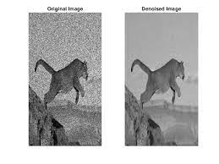
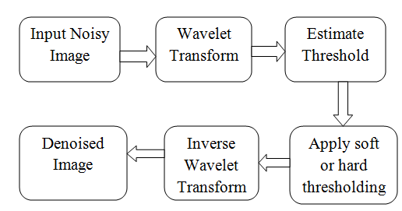
Applications
5) Image De-noising using Wavelets
The basic idea behind this is the wavelet transform leads to a sparse representation of images. Example:-

Slide 27
What we learnt !
We studied how we come up with Wavelet transform from Fourier Transform from STFT and using chirp signals as an example.
How signals can be represented in time-frequency domain and how wavelets provide an efficient way to analyze a signal in finest details with few coefficients.
We saw many types of wavelets and I am sure that there can be infinite varieties of these which will be discovered later.
We also saw many advantages and applications of wavelets in real-world and more applications will be there in future.

Slide 28
Refrences
http://disp.ee.ntu.edu.tw/tutorial/WaveletTutorial.pdf
https://www.intechopen.com/chapters/61705
https://www.slideshare.net/RajEndiran1/introduction-to-wavelet-transform-51504915
https://www.intechopen.com/chapters/74766
https://towardsdatascience.com/the-wavelet-transform-e9cfa85d7b34
https://www.youtube.com/watch?v=kuuUaqAjeoA&t=5s&ab_channel=AndrewNicoll

Slide 29
Thank you…

