Slide 1

‘Advanced Automation In Agriculture’
Mechanical Engineering Department
Guided by
Prof. R.D.Rakhade
Submitted by
Ms. Patil Mrunalini Vijay

Slide 2
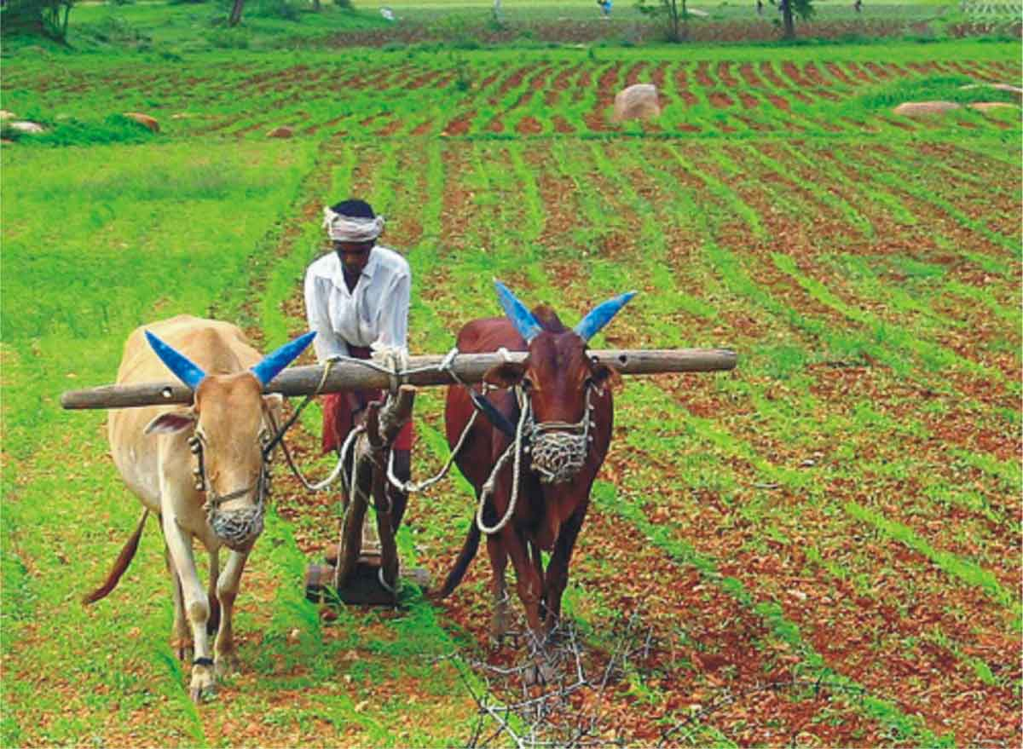
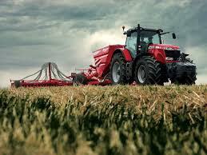
INTRODUCTION
Traditional Vs Modern Agriculture
Image Courtesy: images.google.com

Slide 3
NEED OF AUTOMATION
Pros
Improved Safety.
Better Product Quality.
Shorter workweeks for labour.
Increased in Productivity.
More efficient use of materials.
Cons
Workers Displacement.
High Capital Expenditure required to invest in automation.
Higher maintenance level.

Slide 4
Possible Phases/Stages
Stages | Status of Automation (India)
Land Preparation. | Partially Exists
Seed Sowing | Partially Exists
Weeding | Decent Level of Automation
Irrigation + Pesticide + Some Fertilizers | No Automation
Harvesting | Decent Level of Automation

Slide 5
Center Pivot Irrigation System
Also known as Water Wheel or Circle Irrigation System.
Involves self-propelled system.
It contains several segments of pipes mounted on wheel towers with sprinklers to fed water to crops in circular manner.
In this, the equipment rotates around central pivot.
Centre Pivot are not used in US because this system irrigates water in a circular plot and did not cover corners of the square field.

Slide 6
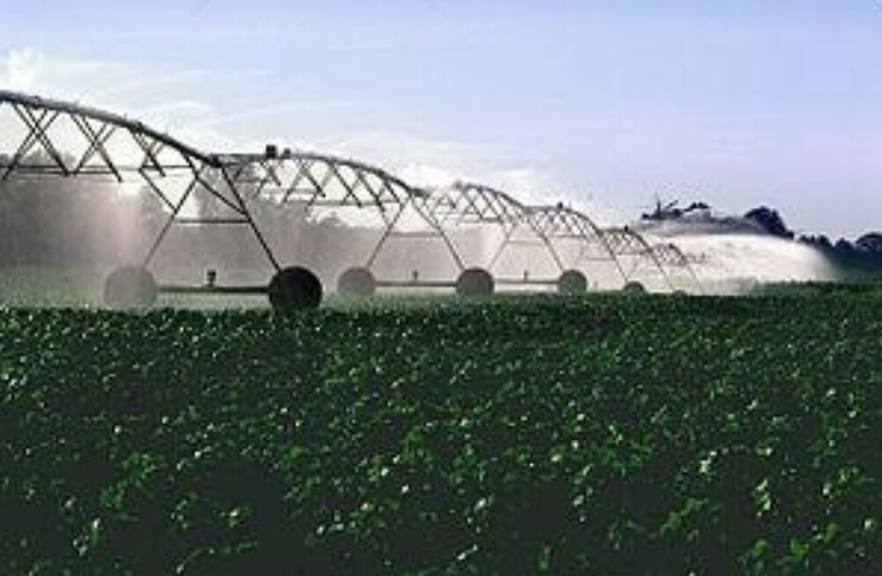
Image adopted from [1]

Slide 7
Lateral Move Irrigation System
It contains series of pipes with drip tubes having sprinklers connected to it which feds water to crop.
It distributes equal amount of water in a straight line .

Slide 8
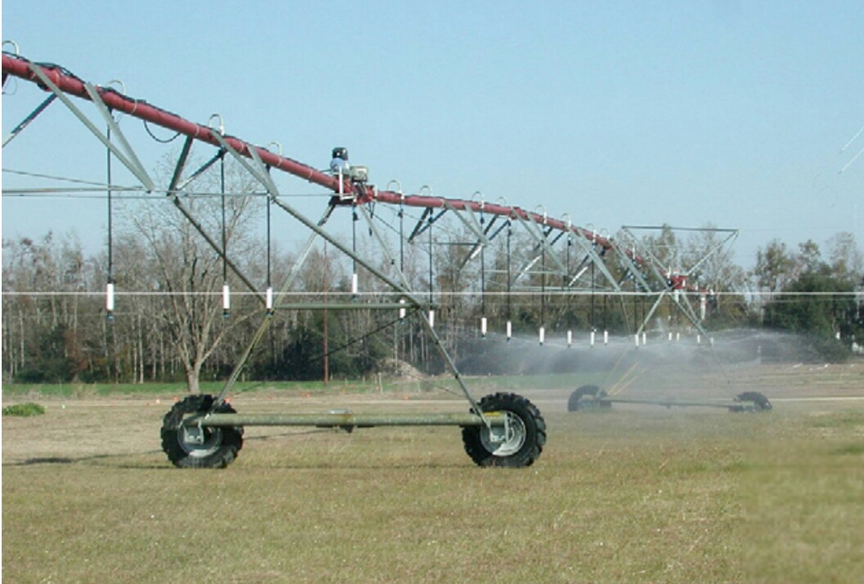
Image adopted from [2]

Slide 9
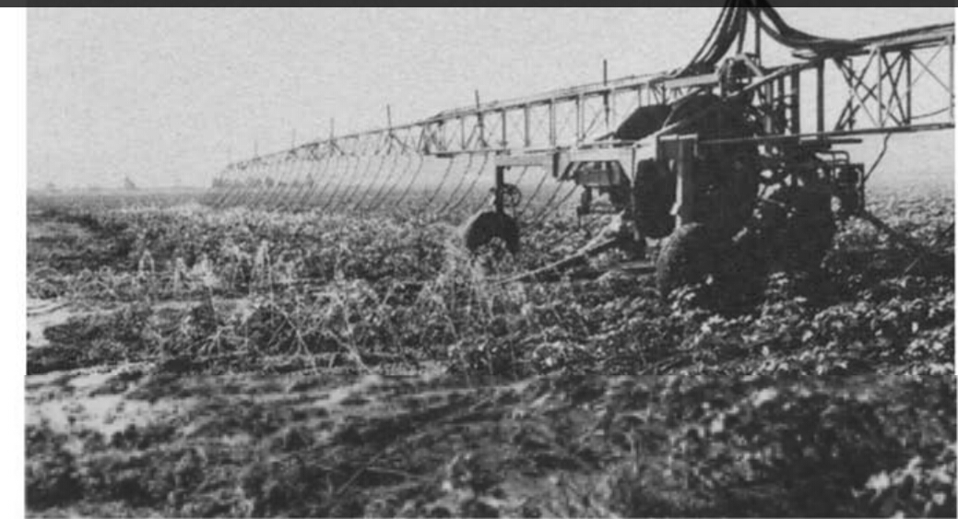
Image adopted from [3]

Slide 10
Lateral Move Irrigation
Green is farm, red is the lateral move irrigation system and black dotted arrow is the direction of movement

Slide 11

Lateral Move Irrigation
Green is farm, red is the lateral move irrigation system.

Slide 12
Engineering Considerations
Dimension of Wheels.
Length and material of the main beam.
Supports for length of the beam across the width of field.
Power requirement.

Slide 13
Engineering Considerations
Dimension of Wheels
Choose from readily available type and sizes.
Tyres and other replacement parts should be easily available.
Consider the use of standard wheel dimensions for eg. that of a truck, bus or tractors.

Slide 14
Engineering Considerations
Length and material of the main beam
Length of the beam should be chosen based on the width of the area to be irrigated.
Material of the beam should be chosen based on the strength requirement for support and other irrigation equipments on the beam, for eg. the number of sprinklers.

Slide 15
Engineering Considerations
Supports for the main beam.
Depending on area, multiple beams with support have to be installed.
Support wheels also have to be installed depending on the requirement.
The number of supports required would increase as we the width of the field increases.

Slide 16
Engineering Considerations
Power Requirement.
Motor units, for example, mini-tractors could be used to drive the irrigation system across the length of the field.
Electrical power could also be used to drive depending on the availability.
Either a single driving unit in the center of the field or one driving unit on each side of the main beam could be used.

Slide 17
Practical Considerations
Costs calculations per unit area to be irrigated.
Possible multiple use of the same system, for eg. to spray pesticides.
Possible to supply water from a fixed source (for eg., a well) or from a moving truck?

Slide 18
Future Scope
Higher return on investment.
Growth Opportunities.
Growing demand for water due to water scarcity.

Slide 19
Conclusion
Various aspect of the Centre Pivot System are studied and looking towards this method in Indian perspective, it may be concluded that there are vast opportunities to practice it in India. Specially, when we note the advantages of this system, such as its effectiveness to irrigate large area of land, this could ultimately help Indian farmers in a great way.

Slide 20
References
Montero, J & Martínez, A & Valiente, M & Moreno, Miguel & M. Tarjuelo, J. . Analysis of water application costs with a centre pivot system for irrigation of crops in Spain. Irrigation Science (2012), DOI 31. 10.1007/s00271-012-0326-4.
Moreno, Miguel & Medina, D & F. Ortega, J & M. Tarjuelo, J. (2012). Optimal design of center pivot systems with water supplied from wells. Agricultural Water Management. 107. 10.1016/j.agwat.2012.01.016.
J. Han, Young & Khalilian, Ahmad & Owino, Tom & J. Farahani, Hamid & Moore, Sam. (2009). Development of Clemson variable-rate lateral irrigation system. Computers and Electronics in Agriculture. 68. 108-113. 10.1016/j.compag.2009.05.002.
Amir, Ilan & J. McFarland, Marshall & L. Reddell, Donald. (1986). Energy analysis of lateral move irrigation machines. Energy in Agriculture. 5. 325-337. 10.1016/0167-5826(86)90031-8.
Omary, M., Camp, C.R. and Sadler, E.J., 1997. Center pivot irrigation system modification to provide variable water application depths. Applied Engineering in Agriculture, 13(2), pp.235-239.
Tolson, H.N., Hlavinka Equipment, 2000. Pivoting lateral move irrigation system which waters in the pivot mode. U.S. Patent 6,068,197.
Cornelius, G., WADE AND CO RM, 1971. Laterally moving automatic irrigation system. U.S. Patent 3,583,428.

