Slide 1
Customer Churn Prediction
Customer Churn Prediction Using Machine Learning
Machine Learning for Business Applications | MBA - Business Analytics

Slide 2
Business Problem
Telecom companies lose recurring revenue when customers churn.
Manual identification of at-risk customers is inefficient.
Goal: predict churn risk early and prioritize retention actions.

Slide 3
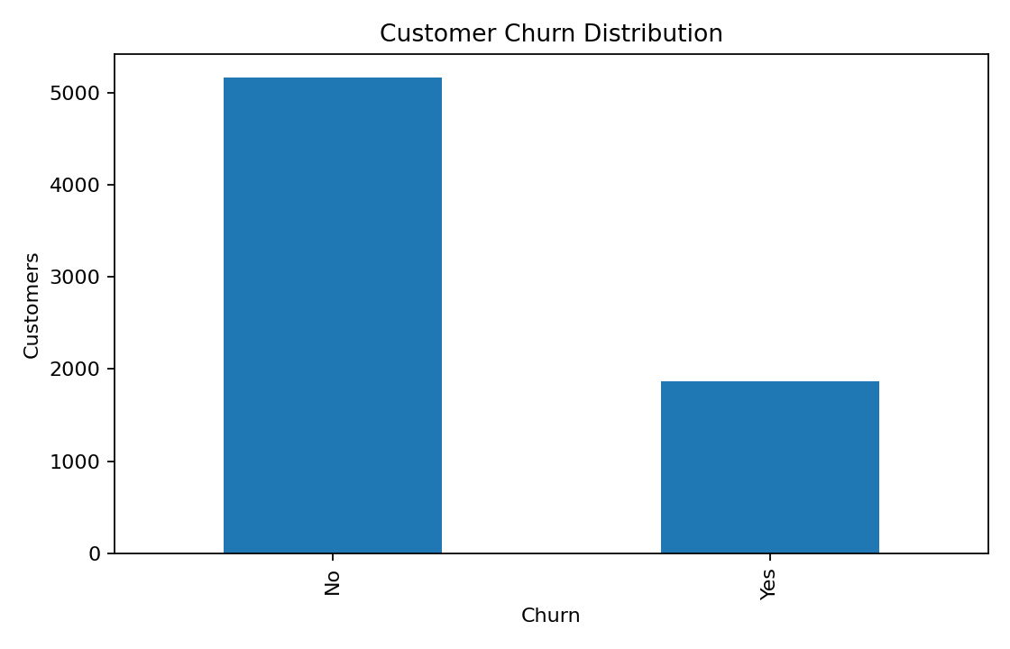
Dataset Overview
Source: Kaggle Telco Customer Churn Dataset.
7,032 customer records after cleaning.
Target variable: Churn (Yes/No).
Features cover demographics, services, contracts and billing.

Slide 4
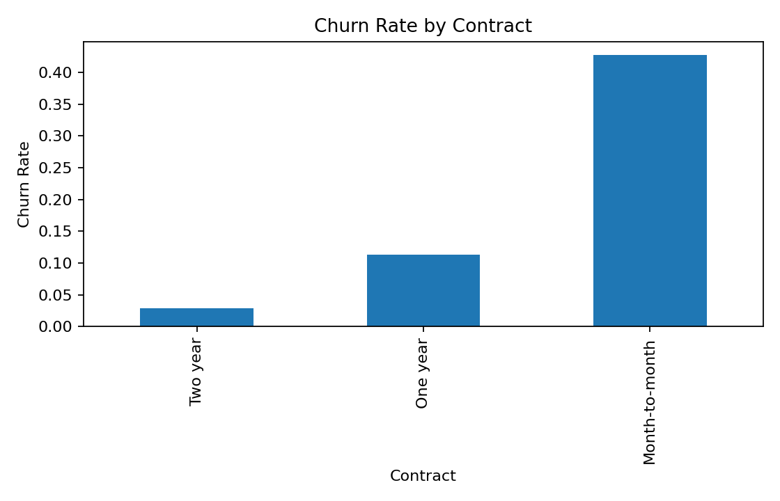
EDA: Contract Matters
Churn rates differ substantially by contract type.
Shorter contracts generally have higher churn.
Contract information can support retention segmentation.

Slide 5
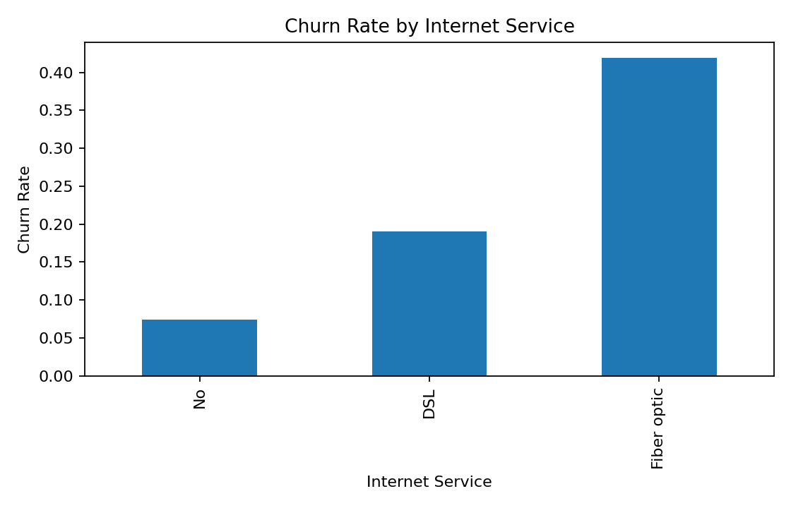
EDA: Service & Tenure
Internet service category is associated with different churn rates.
Customers with shorter tenure generally show higher churn risk.
These patterns can help prioritize customer engagement.

Slide 6
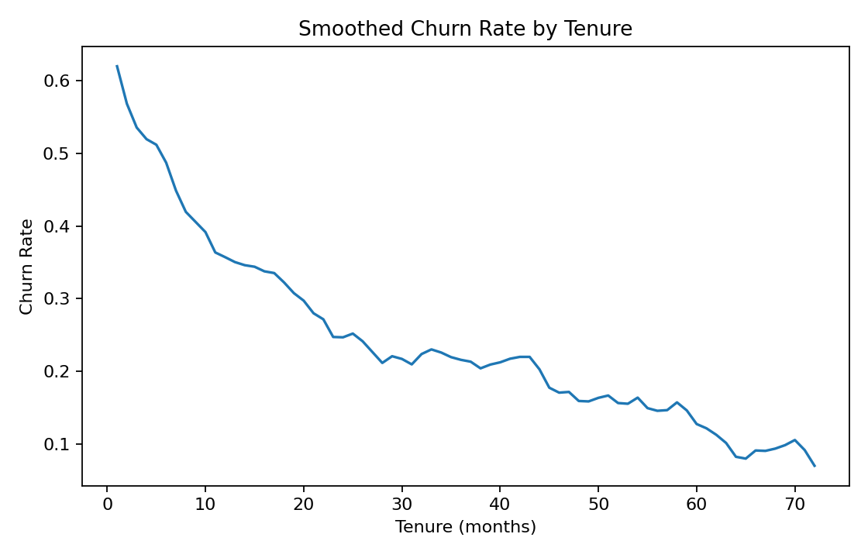
Machine Learning Methodology
Converted TotalCharges to numeric and handled missing values.
Removed customerID because it is an identifier.
Used one-hot encoding for categorical features.
Used an 80:20 stratified train-test split.
Compared Logistic Regression and Random Forest.

Slide 7
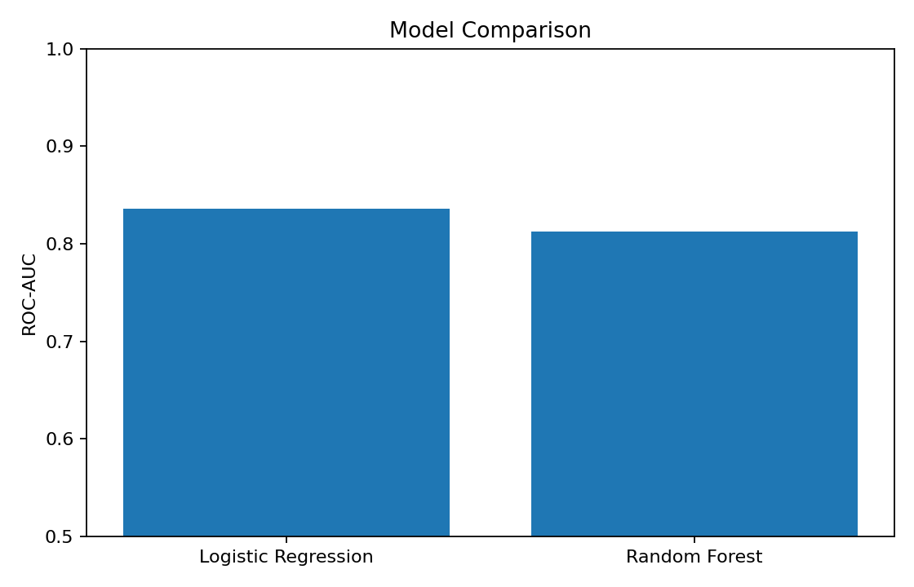
Model Evaluation
Logistic Regression ROC-AUC: 0.836
Random Forest ROC-AUC: 0.812
Logistic Regression accuracy: 0.805
Final model: Logistic Regression.

Slide 8
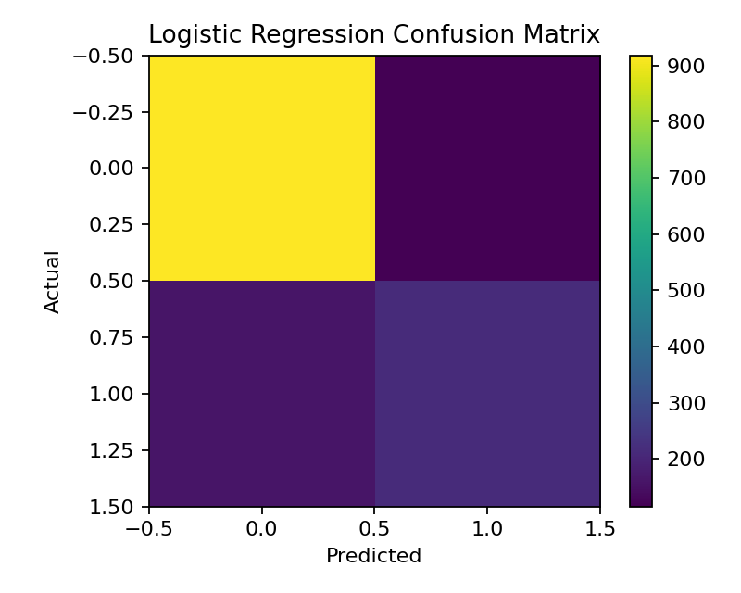
Confusion Matrix
Logistic Regression identifies a meaningful share of actual churners.
Recall: 0.575
F1 score: 0.611
Use the probability output to prioritize retention resources.

Slide 9
Streamlit Application
Business Problem page explains the business use case.
Data Insights page presents churn patterns.
Prediction page accepts customer details.
Output: churn probability, risk category and recommended action.

Slide 10
Business Recommendations
Prioritize customers with high predicted churn probability.
Give special attention to shorter contracts and lower-tenure customers.
Combine model scores with customer value and service history.
Retrain periodically as new customer data becomes available.

