Slide 1

social Network Analysis using Graph Database AND Neo4j
June 13, 2019
Aakash Bashyal
Computer Engineering, Master, 2018

Slide 2
Outline
Introduction to graphs
Property Graph Data Model
Neo4j
Querying Graphs: introduction to Cypher
Data Import
Developing Applications

Slide 3
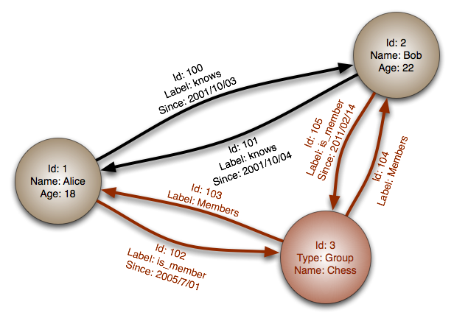
Graph Database
A graph is a pictorial representation of a set of objects where some pairs of objects are connected by links
It is composed of two elements - nodes (vertices) and relationships (edges)
A graph database is a database designed to treat the relationships between data as equally important to the data itself

Slide 4
Why Graph Databases?
Nowadays, most of the data exists in the form of the relationship between different objects and more often, the relationship between the data is more valuable than the data itself
Relational databases is used to store structured data of same type and they do not store the relationships between the data
Relational databases compute relationships at query time through expensive JOIN operations,
Whereas, a graph database stores connections (relationship) alongside the data in the model

Slide 5
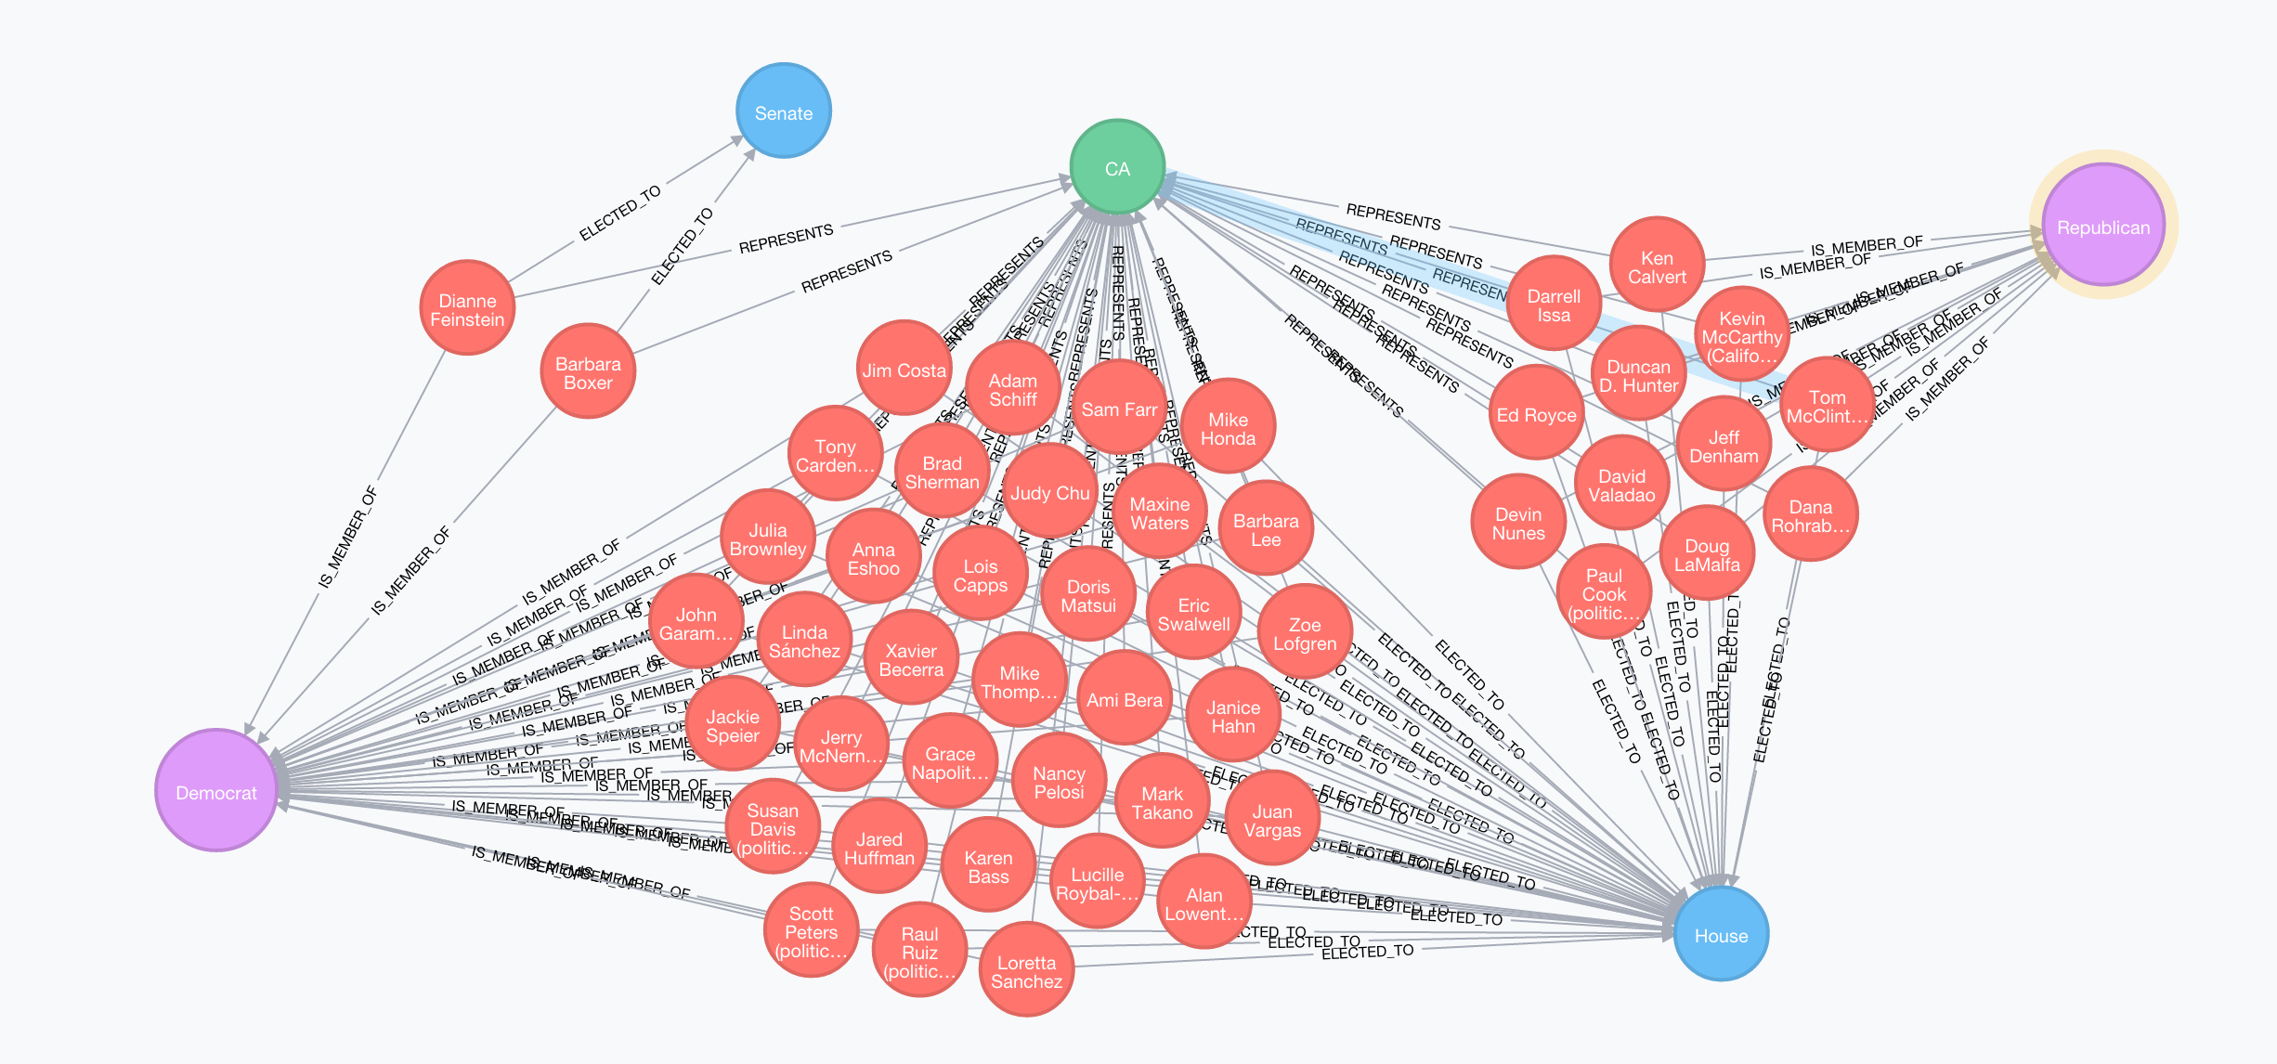
The world is a graph-everything is connected
People, places, events
Companies, markets, shares
Countries, history, politics
Sciences, art, teaching
Technology, networks, machines, applications, users
Software, code, dependencies, architecture, deployments
Criminals, fraudsters and their behavior

Slide 6
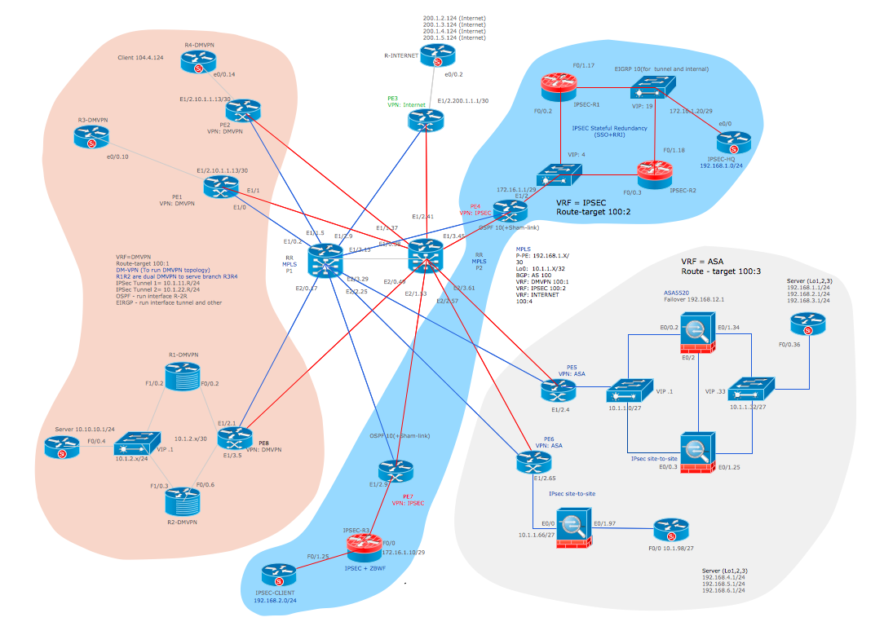
The world is a graph-everything is connected
People, places, events
Companies, markets, shares
Countries, history, politics
Sciences, art, teaching
Technology, networks, machines, applications, users
Software, code, dependencies, architecture, deployments
Criminals, fraudsters and their behavior

Slide 7
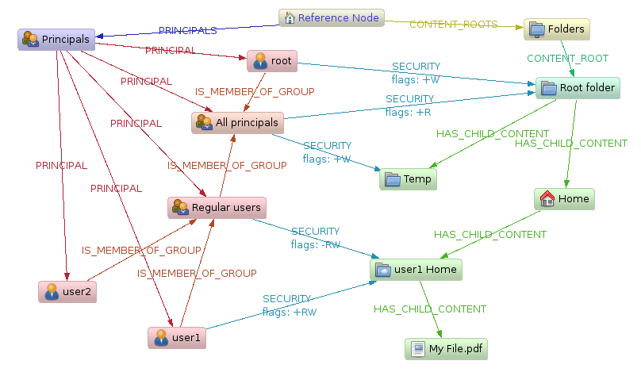
The world is a graph-everything is connected
People, places, events
Companies, markets, shares
Countries, history, politics
Sciences, art, teaching
Technology, networks, machines, applications, users
Software, code, dependencies, architecture, deployments
Criminals, fraudsters and their behavior

Slide 8
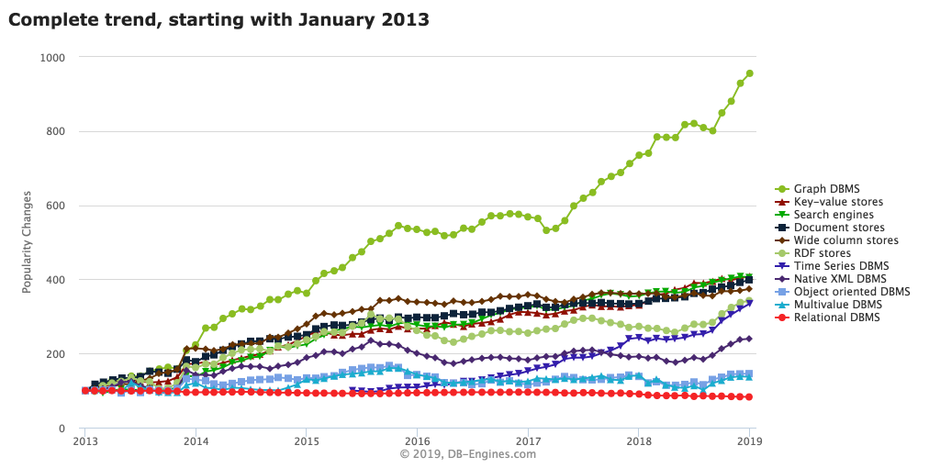
Popularity of Graph Database

Slide 9
Property Graph Data Model
Nodes
Properties
Labels
Attributes

Slide 10
Nodes
Nodes represent the objects (or, Entity, Things) in the graph
PERSON
MOVIE
PERSON

Slide 11
Nodes
Nodes Represent the objects (or, Entity, Things) in the graph
Can hold any number of attributes (key-value pairs) called properties
PERSON
MOVIE
PERSON
name: ‘Tom Hanks’
born: 1956
title: ‘Forrest Gump’
released: 1994
name: ‘Robert Zemeckis’
born: 1951
Node having properties as key/value paired

Slide 12
Relationships
provide directed, named, semantically-relevant connections between two node entities (e.g. Person ACTED_IN Movie, Person DIRECTED MOVIE)
PERSON
:ACTED_IN
MOVIE
:DIRECTED
PERSON
name: ‘Tom Hanks’
born: 1956
title: ‘Forrest Gump’
released: 1994
name: ‘Robert Zemeckis’
born: 1951
Node having properties as key/value paired

Slide 13
Relationships
provide directed, named, semantically-relevant connections between two node entities (e.g. Person ACTED_IN Movie)
Like nodes, relationships can also have properties
PERSON
:ACTED_IN
roles=[“forest”]
MOVIE
:DIRECTED
PERSON
Relationship having properties as key/value paired
name: ‘Tom Hanks’
born: 1956
title: ‘Forrest Gump’
released: 1994
name: ‘Robert Zemeckis’
born: 1951
Node having properties as key/value paired

Slide 14
Properties
Metadata or attributes expressed as key-value pairs
PERSON
:ACTED_IN
roles=[“forest”]
MOVIE
:DIRECTED
PERSON
Relationship having properties as key/value paired
name: ‘Tom Hanks’
born: 1956
title: ‘Forrest Gump’
released: 1994
name: ‘Robert Zemeckis’
born: 1951
Node having properties as key/value paired

Slide 15
What is Neo4j?
Neo4j is an open-source, NoSQL, native graph database
Neo4j is referred to as a native graph database because it efficiently implements the property graph model down to the storage level
which means that the data is stored exactly as we whiteboard it
Neo4j also provides full database characteristics, including ACID transaction compliance, cluster support, and runtime failover

Slide 16
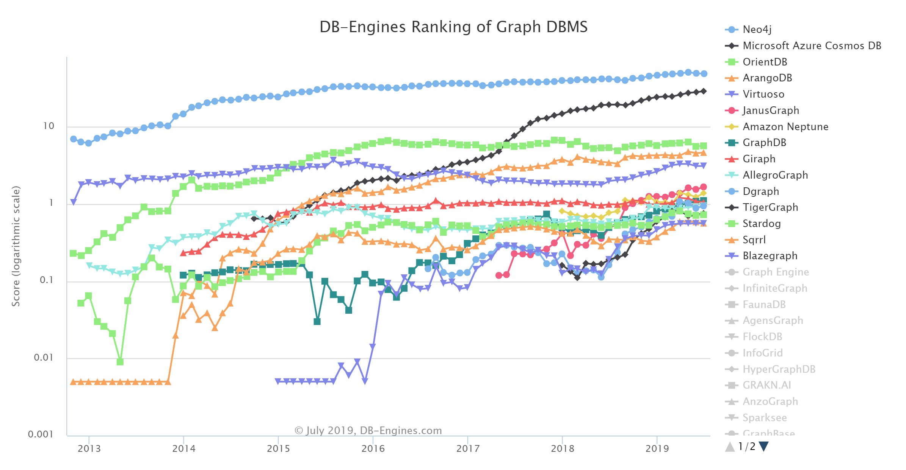
Trend of Graph DBMS Popularity

Slide 17
Neo4j features
Cypher, a declarative query language similar to SQL, but optimized for graphs
Constant time traversals in big graphs for both depth and breadth due to efficient representation of nodes and relationships. Enables scale-up to billions of nodes on moderate hardware
Flexible property graph schema that can adapt over time, making it possible to materialize and add new relationships later to shortcut and speed up the domain data when the business needs change
Drivers for popular programming languages, including Java, JavaScript, .NET, Python, and many more
Neo4j is a native graph database and takes advantage of index-free adjacency for relationship traversals

Slide 18
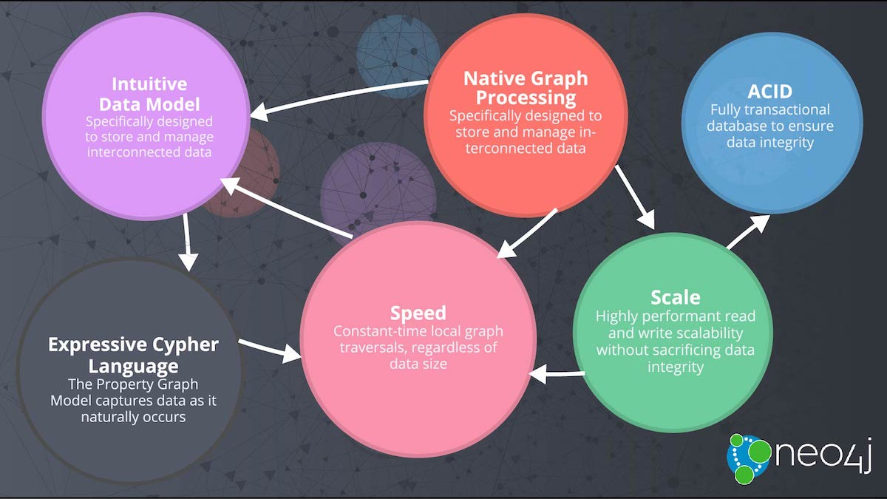
Neo4j Overview

Slide 19
Querying Graphs: Introduction to Cypher
Bolt/Driver
Declarative Query Language
Open Cypher
Human Readable
Graph Pattern Matching

Slide 20
Declarative Query for Graphs
Nodes
Nodes are drawn with parentheses
( )

Slide 21
Declarative Query for Graphs
Relationships
Relationships are drawn as arrows, with additional details in brackets
-->
-[:DIRECTED]->

Slide 22
Patterns
In Cypher, patterns are drawn by connecting nodes and relationships with hyphens, optionally specifying a direction with > and < signs
( )-[ ]-( )
( )-[ ]->( )
( )<-[ ]-( )

Slide 23
Pattern in Graph Model
Dan
LOVES
Ann
Node
Relationship
Node
(:Person { name: ‘Dan’ } ) –[:LOVES]-> (:Person { name: ‘Ann’ })

Slide 24
Pattern in Graph Model
Dan
LOVES
Ann
Node
Relationship
Node
(:Person { name: ‘Dan’ } ) –[:LOVES]-> (:Person { name: ‘Ann’ })
LABEL
PROPERTY
LABEL
PROPERTY

Slide 25
Pattern in Graph Model : Create
Dan
LOVES
Ann
Node
Relationship
Node
CREATE (:Person { name: ‘Dan’ } ) –[:LOVES]-> (:Person { name: ‘Ann’ })
LABEL
PROPERTY
LABEL
PROPERTY

Slide 26
Pattern in Graph Model : MATCH
Dan
LOVES
???
Relationship
Node
Node
MATCH (:Person { name: ‘Dan’ } ) –[:LOVES]-> (whom) RETURN whom
LABEL
PROPERTY
VARIABLE

Slide 27
Components of a Cypher Query
MATCH (m:Movie)
RETURN m
MATCH and RETURN are Cypher keywords
m is a variable
:Movie is a node label

Slide 28
Components of a Cypher Query
MATCH (p:Person)–[r:ACTED_IN]->(m:Movie)
RETURN p, r, m
MATCH and RETURN are Cypher keywords
p, r, and m are variables
:Movie is a node label
:ACTED_IN is a relationship type

Slide 29
Case Sensitivity
Case sensitive Case insensitive
:Person MaTcH
:ACTED_IN return
name

Slide 30
DEMO

Slide 31
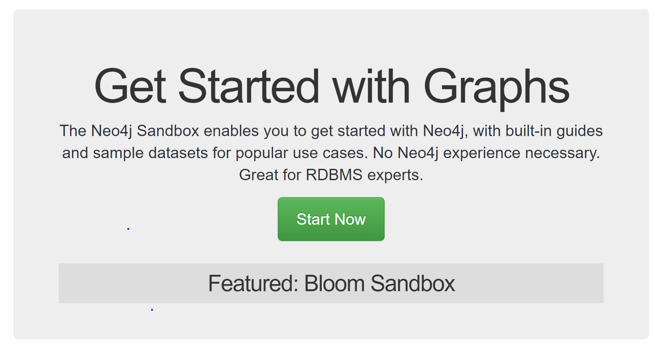
Sandbox
Browse the Link: https://neo4j.com/sandbox-v2/
Press Start Now
This will prompt for login page
You can signup for the new account or,
Login with the GitHub, Twitter , Gmail or Linkedin

Slide 32
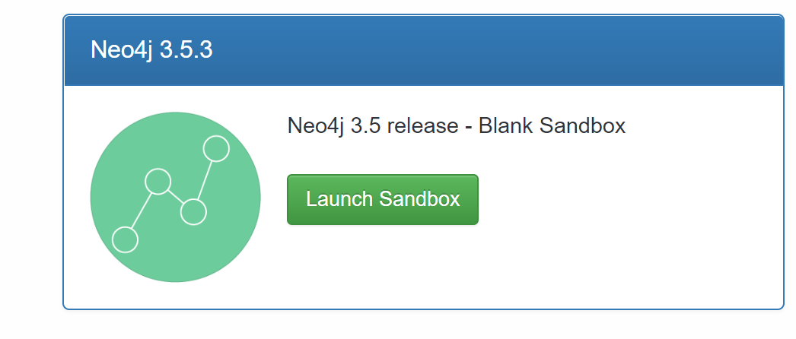
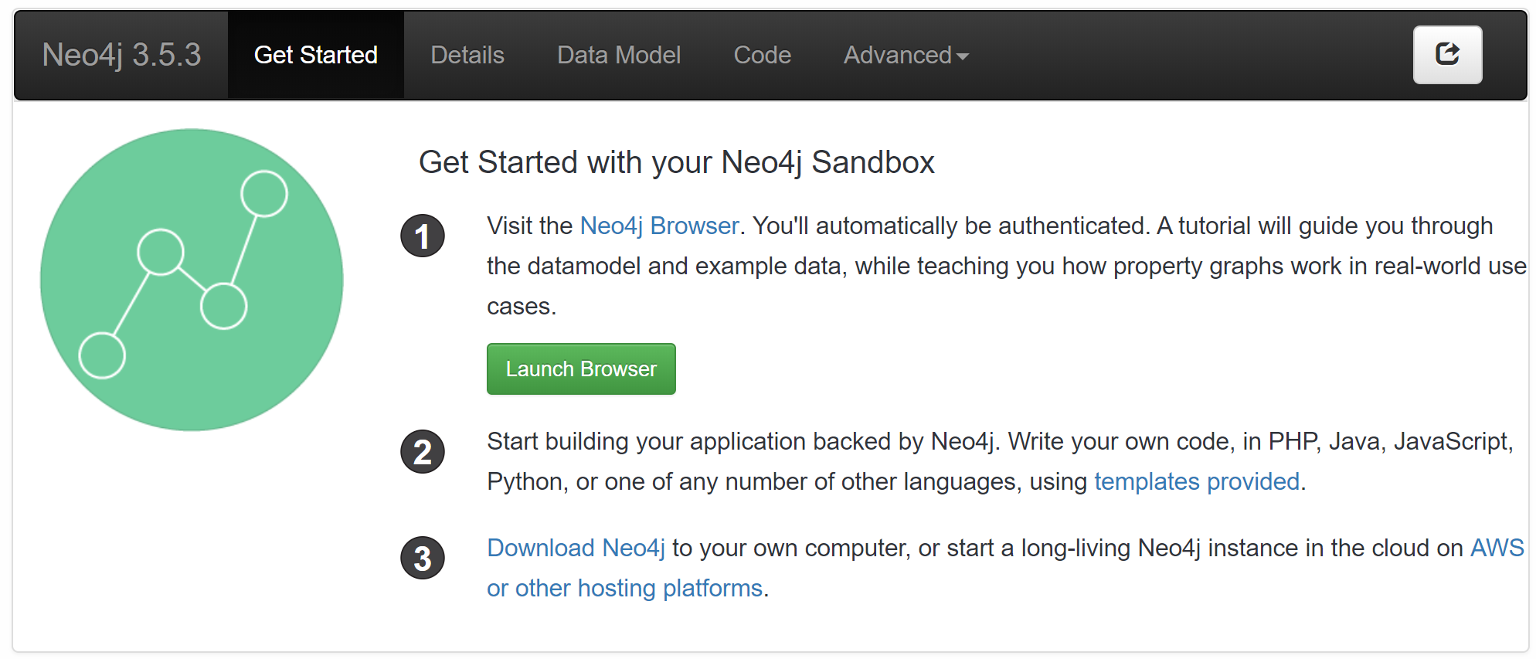
Search for the Neo4j 3.5.3
Now Press the Launch Sandbox
Now Press the Launch Browser

Slide 33
Designing a Social Platform
We are designing a social platform where we have a person who is a friend of multiple persons who likes the restaurant at different location that serves multiple cuisine.

Slide 34
NODE: PERSON
CREATE

Slide 35
NODE: PERSON
CREATE ()

Slide 36
NODE: PERSON
CREATE (:Person { })
Now add a node, Person is node here

Slide 37
NODE: PERSON
CREATE (:Person {
id: 'c7f96281’,
name:'Jimmy Bayer’, email:'dudley22@joysclick.ru’,
dob:'1995-12-16 ‘
})
-Now add a node, Person is node here
-id, name, email, dob are are the attribute

Slide 38
Similarly,
CREATE (:Person {
id: '3ae2fdf0', name:'Rosalind Senger', email:'agustin.rohan@lagooorka.ru', dob:'1991-04-28’
})
-Now add a node, Person is node here
-id, name, email, dob are are the attribute

Slide 39
CREATE: person_address
CREATE(:person_address {person_id:'c7f96281', street_address:'806 Red Dog Road', city:'Charlotte', state:'NC’})
CREATE(:person_address {person_id:'3ae2fdf0', street_address:'4230 Cliffside Drive', city:'Andover', state:'NY’})

Slide 40
Creating a Relationship with existing node
MATCH (p:Person {id:'c7f96281'}),(add:person_address {person_id:'c7f96281’}) CREATE (p)-[:LIVES_IN]->(add)
MATCH (p:Person {id:'3ae2fdf0'}),(add:person_address {person_id:'3ae2fdf0’}) CREATE (p)-[:LIVES_IN]->(add)

Slide 41
Further creating relationship and node
CREATE (p1:Person {id: 'c437f2b7', name:'Bobbie Anderson', email:'BobbieJAnderson@rhyta.com', dob:'1996-10-11’})
CREATE(add1:person_address {person_id:'c437f2b7', street_address:'2620 Ryder Avenue', city:'Madison', state:'WI'})
CREATE (p1)-[:LIVES_IN]->(add1)
CREATE (p2:Person {id: 'df134b31', name:'James Porter', email:'JamesPPorter@teleworm.ru', dob:'1992-03-16’})
CREATE(add2:person_address {person_id:'df134b31', street_address:'4040 Lightning Point Drive', city:'Kent', state:'TN'})
CREATE (p2)-[:LIVES_IN]->(add2)

Slide 42
View a Relationship
MATCH (p:Person)-[r:LIVES_IN]->(add:person_address)
RETURN p,r,add
//view relationship with email
MATCH (a:Person {email: 'dudley22@joysclick.ru'})-[r:LIVES_IN]-(b) RETURN type(r), a.name AS `Name`,a.email AS `Email`, b.street_address AS `Address`
//view all relationship
MATCH (a:Person)-[r]-(b) RETURN type(r), a.name AS `Name`,a.email AS `Email`, b.street_address AS `Address`

Slide 43
LOAD CSV
LOAD CSV WITH HEADERS FROM "https://a.uguu.se/HWPA1K57hALu_restaurant_location.csv" AS row
CREATE (n:restaurant_location)
SET n = row
LOAD CSV WITH HEADERS FROM
"https://a.uguu.se/8taatoV334Lc_cusine.csv" AS row
CREATE (n:Cusine)
SET n = row

Slide 44
THANK YOU

