Slide 1

social Network Analysis using Graph Database AND Neo4j
June 13, 2019
Aakash Bashyal
Computer Engineering, Master, 2018

Slide 2
Outline
Introduction to graphs
Property Graph Data Model
Neo4j
Querying Graphs: introduction to Cypher
Data Import
Developing Applications

Slide 3
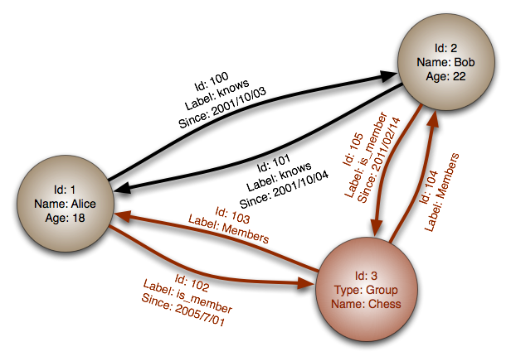
Graph Database
A graph is a pictorial representation of a set of objects where some pairs of objects are connected by links
It is composed of two elements - nodes (vertices) and relationships (edges)
A graph database is a database designed to treat the relationships between data as equally important to the data itself

Slide 4
Why Graph Databases?
Nowadays, most of the data exists in the form of the relationship between different objects and more often, the relationship between the data is more valuable than the data itself
Relational databases is used to store structured data of same type and they do not store the relationships between the data
Relational databases compute relationships at query time through expensive JOIN operations,
Whereas, a graph database stores connections (relationship) alongside the data in the model

Slide 5
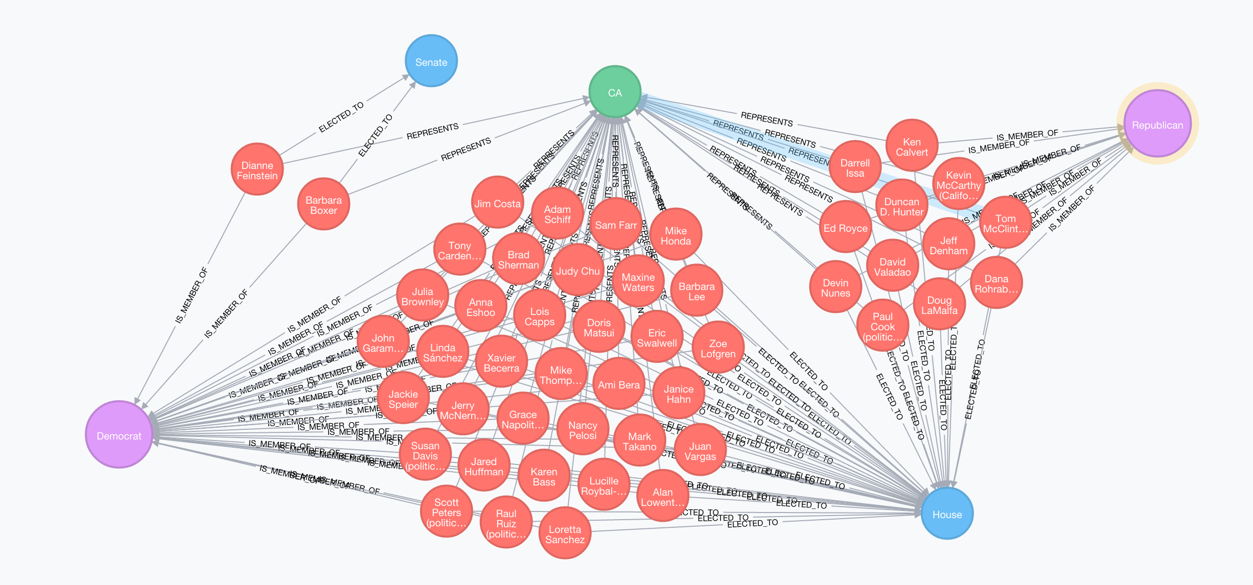
The world is a graph-everything is connected
People, places, events
Companies, markets, shares
Countries, history, politics
Sciences, art, teaching
Technology, networks, machines, applications, users
Software, code, dependencies, architecture, deployments
Criminals, fraudsters and their behavior

Slide 6
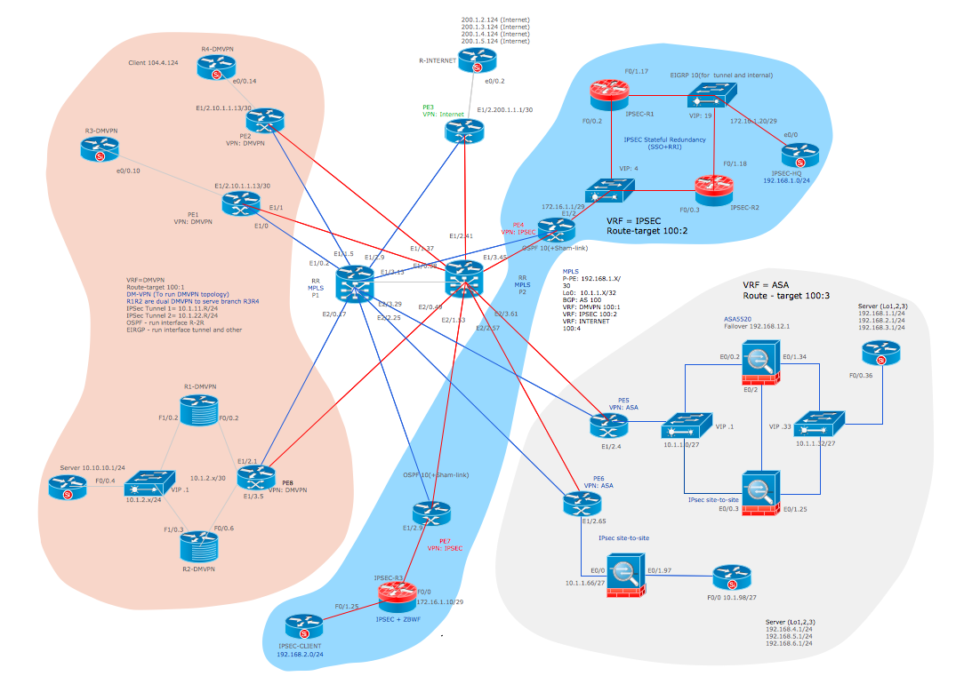
The world is a graph-everything is connected
People, places, events
Companies, markets, shares
Countries, history, politics
Sciences, art, teaching
Technology, networks, machines, applications, users
Software, code, dependencies, architecture, deployments
Criminals, fraudsters and their behavior

Slide 7
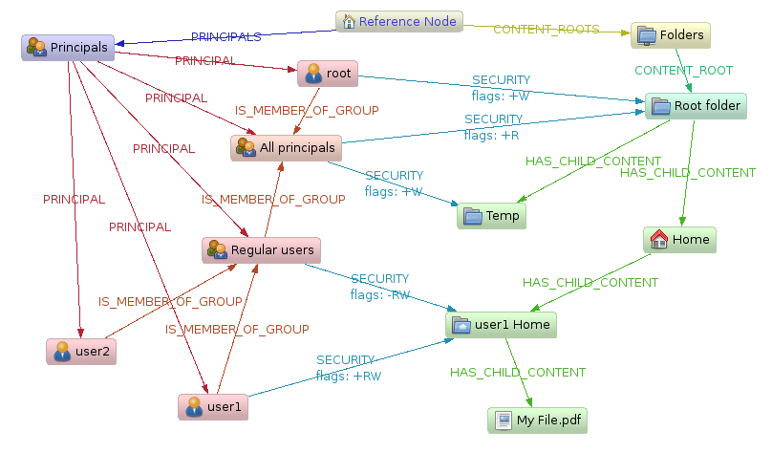
The world is a graph-everything is connected
People, places, events
Companies, markets, shares
Countries, history, politics
Sciences, art, teaching
Technology, networks, machines, applications, users
Software, code, dependencies, architecture, deployments
Criminals, fraudsters and their behavior

Slide 8
Property Graph Data Model
Nodes
Properties
Labels
Attributes

Slide 9
Nodes
Nodes represent the objects (or, Entity, Things) in the graph
PERSON
MOVIE
PERSON

Slide 10
Nodes
Nodes Represent the objects (or, Entity, Things) in the graph
Can hold any number of attributes (key-value pairs) called properties
PERSON
MOVIE
PERSON
name: ‘Tom Hanks’
born: 1956
title: ‘Forrest Gump’
released: 1994
name: ‘Robert Zemeckis’
born: 1951
Node having properties as key/value paired

Slide 11
Relationships
provide directed, named, semantically-relevant connections between two node entities (e.g. Person ACTED_IN Movie, Person DIRECTED MOVIE)
PERSON
:ACTED_IN
MOVIE
:DIRECTED
PERSON
name: ‘Tom Hanks’
born: 1956
title: ‘Forrest Gump’
released: 1994
name: ‘Robert Zemeckis’
born: 1951
Node having properties as key/value paired

Slide 12
Relationships
provide directed, named, semantically-relevant connections between two node entities (e.g. Person ACTED_IN Movie)
Like nodes, relationships can also have properties
PERSON
:ACTED_IN
roles=[“forest”]
MOVIE
:DIRECTED
PERSON
Relationship having properties as key/value paired
name: ‘Tom Hanks’
born: 1956
title: ‘Forrest Gump’
released: 1994
name: ‘Robert Zemeckis’
born: 1951
Node having properties as key/value paired

Slide 13
Properties
Metadata or attributes expressed as key-value pairs
PERSON
:ACTED_IN
roles=[“forest”]
MOVIE
:DIRECTED
PERSON
Relationship having properties as key/value paired
name: ‘Tom Hanks’
born: 1956
title: ‘Forrest Gump’
released: 1994
name: ‘Robert Zemeckis’
born: 1951
Node having properties as key/value paired

Slide 14
What is Neo4j?
Neo4j is an open-source, NoSQL, native graph database
Neo4j is referred to as a native graph database because it efficiently implements the property graph model down to the storage level
which means that the data is stored exactly as we whiteboard it
Neo4j also provides full database characteristics, including ACID transaction compliance, cluster support, and runtime failover

Slide 15
Neo4j features
Cypher, a declarative query language similar to SQL, but optimized for graphs
Constant time traversals in big graphs for both depth and breadth due to efficient representation of nodes and relationships. Enables scale-up to billions of nodes on moderate hardware.
Flexible property graph schema that can adapt over time, making it possible to materialize and add new relationships later to shortcut and speed up the domain data when the business needs change.
Drivers for popular programming languages, including Java, JavaScript, .NET, Python, and many more.

Slide 16
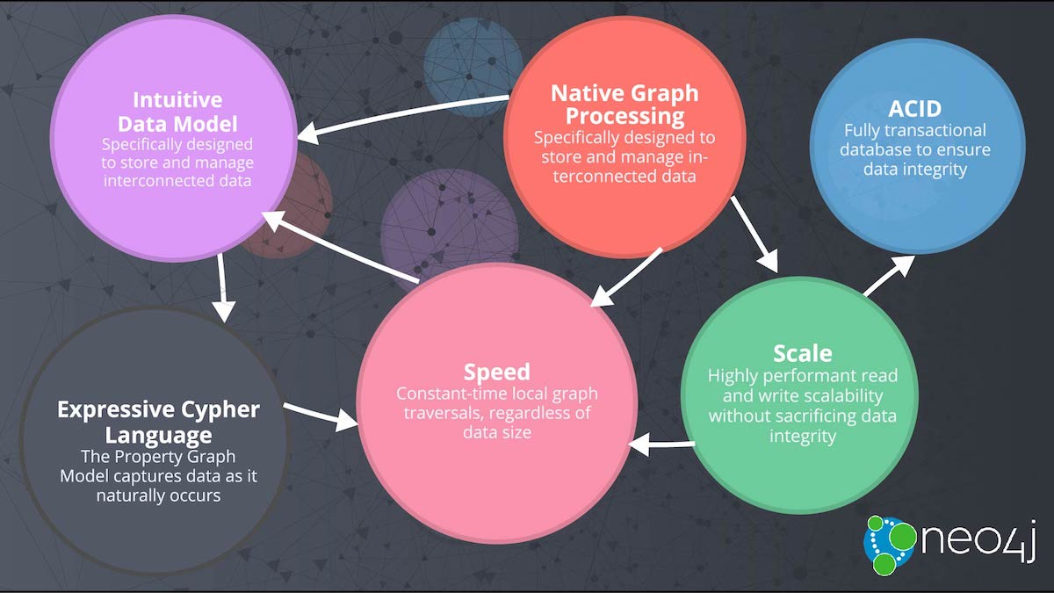
Neo4j Overview

Slide 17
Querying Graphs: Introduction to Cypher
Bolt/Driver
Declarative Query Language
Open Cypher
Human Readable
Graph Pattern Matching

Slide 18
Declarative Query for Graphs
Nodes
Nodes are drawn with parentheses
( )

Slide 19
Declarative Query for Graphs
Relationships
Relationships are drawn as arrows, with additional details in brackets
-->
-[:DIRECTED]->

Slide 20
Patterns
In Cypher, patterns are drawn by connecting nodes and relationships with hyphens, optionally specifying a direction with > and < signs
( )-[ ]-( )
( )-[ ]->( )
( )<-[ ]-( )

Slide 21
Pattern in Graph Model
Dan
LOVES
Ann
Node
Relationship
Node
(:Person { name: ‘Dan’ } ) –[:LOVES]-> (:Person { name: ‘Ann’ })

Slide 22
Pattern in Graph Model
Dan
LOVES
Ann
Node
Relationship
Node
(:Person { name: ‘Dan’ } ) –[:LOVES]-> (:Person { name: ‘Ann’ })
LABEL
PROPERTY
LABEL
PROPERTY

Slide 23
Pattern in Graph Model : Create
Dan
LOVES
Ann
Node
Relationship
Node
CREATE (:Person { name: ‘Dan’ } ) –[:LOVES]-> (:Person { name: ‘Ann’ })
LABEL
PROPERTY
LABEL
PROPERTY

Slide 24
Pattern in Graph Model : MATCH
Dan
LOVES
???
Relationship
Node
Node
MATCH (:Person { name: ‘Dan’ } ) –[:LOVES]-> (whom) RETURN whom
LABEL
PROPERTY
VARIABLE

Slide 25
Components of a Cypher Query
MATCH (m:Movie)
RETURN m
MATCH and RETURN are Cypher keywords
m is a variable
:Movie is a node label

Slide 26
Components of a Cypher Query
MATCH (p:Person)–[r:ACTED_IN]->(m:Movie)
RETURN p, r, m
MATCH and RETURN are Cypher keywords
p, r, and m are variables
:Movie is a node label
:ACTED_IN is a relationship type

Slide 27
Case Sensitivity
Case sensitive Case insensitive
:Person MaTcH
:ACTED_IN return
name

Slide 28
DEMO

Slide 29
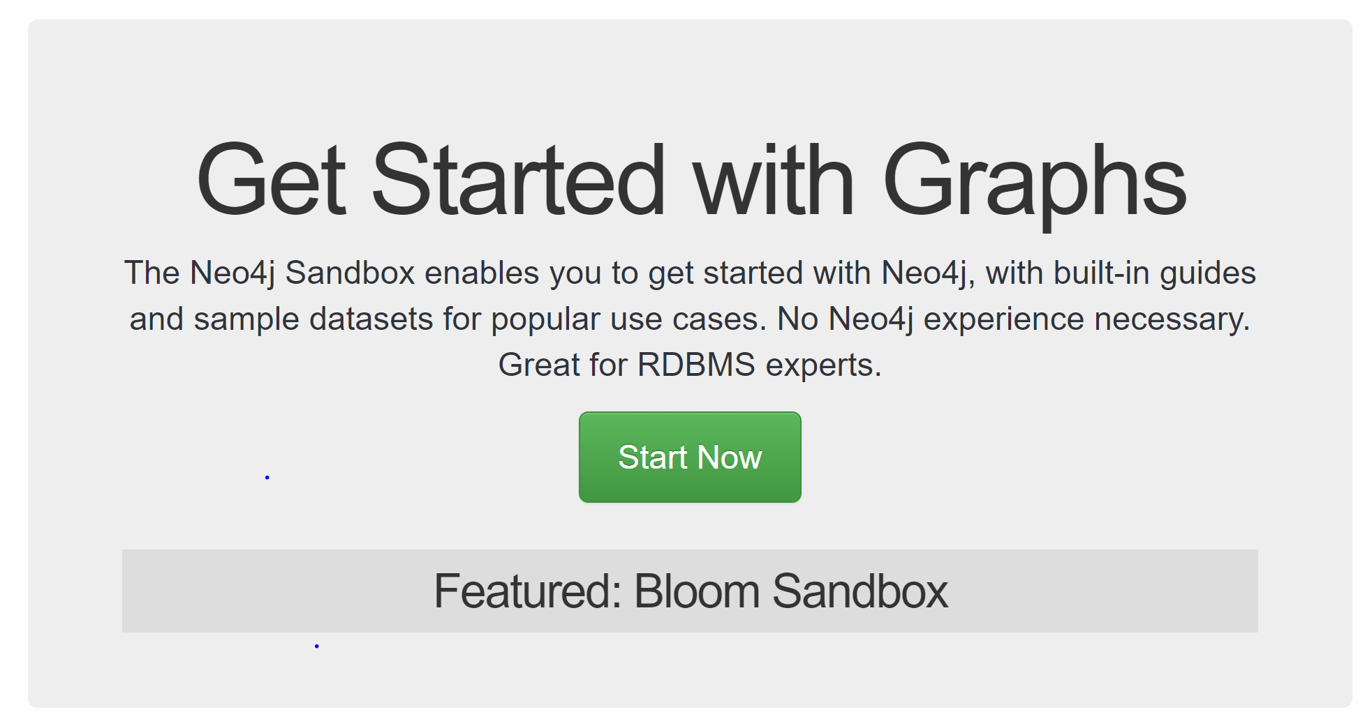
Sandbox
Browse the Link: https://neo4j.com/sandbox-v2/
Press Start Now
This will prompt for login page
You can signup for the new account or,
Login with the GitHub, Twitter , Gmail or Linkedin

Slide 30
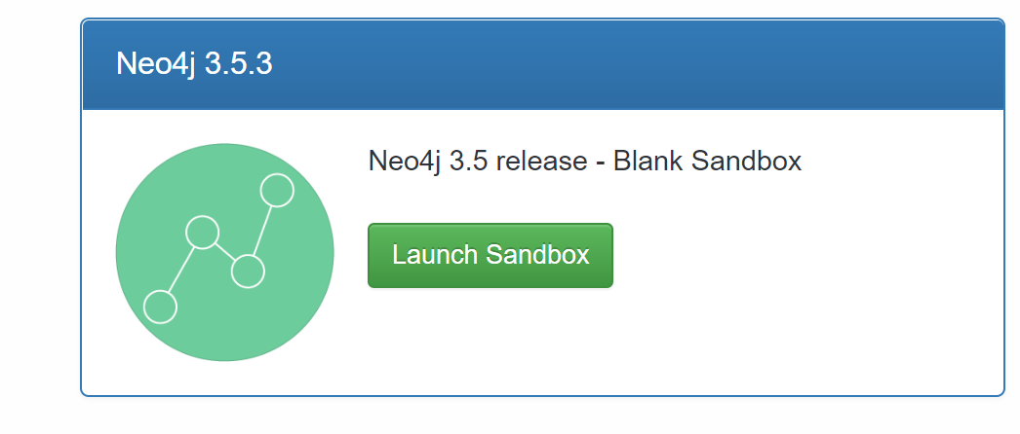
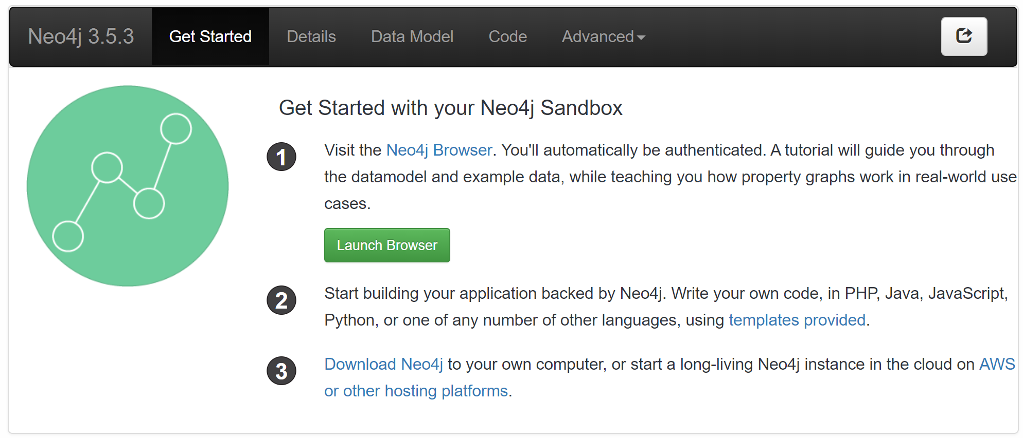
Search for the Neo4j 3.5.3
Now Press the Launch Sandbox
Now Press the Launch Browser

Slide 31
Designing a Social Platform
We are designing a social platform where we have a person who is a friend of multiple persons that likes the restaurant at different location and serves multiple cuisine.

Slide 32
Components of a Cypher Query
CREATE

Slide 33
Components of a Cypher Query
CREATE ()

Slide 34
Components of a Cypher Query
CREATE (:Person { })
Now add a node, Person is node here

Slide 35
Components of a Cypher Query
CREATE (:Person {
id: 'c7f96281’,
name:'Jimmy Bayer’, email:'dudley22@joysclick.ru’,
dob:'1995-12-16 ‘
})
-Now add a node, Person is node here
-id, name, email, dob are are the attribute

Slide 36
Similarly,
CREATE (:Person {
id: '3ae2fdf0', name:'Rosalind Senger', email:'agustin.rohan@lagooorka.ru', dob:'1991-04-28’
})
-Now add a node, Person is node here
-id, name, email, dob are are the attribute

Slide 37
CREATE: person_address
CREATE(:person_address {person_id:'c7f96281', street_address:'806 Red Dog Road', city:'Charlotte', state:'NC’})
CREATE(:person_address {person_id:'3ae2fdf0', street_address:'4230 Cliffside Drive', city:'Andover', state:'NY’})

Slide 38
Creating a Relationship with existing node
MATCH (p:Person {id:'c7f96281'}),(add:person_address {person_id:'c7f96281’}) CREATE (p)-[:LIVES_IN]->(add)
MATCH (p:Person {id:'3ae2fdf0'}),(add:person_address {person_id:'3ae2fdf0’}) CREATE (p)-[:LIVES_IN]->(add)

Slide 39
Further creating relationship and node
CREATE (p1:Person {id: 'c437f2b7', name:'Bobbie Anderson', email:'BobbieJAnderson@rhyta.com', dob:'1996-10-11’})
CREATE(add1:person_address {person_id:'c437f2b7', street_address:'2620 Ryder Avenue', city:'Madison', state:'WI'})
CREATE (p1)-[:LIVES_IN]->(add1)
CREATE (p2:Person {id: 'df134b31', name:'James Porter', email:'JamesPPorter@teleworm.ru', dob:'1992-03-16'})
CREATE(add2:person_address {person_id:'df134b31', street_address:'4040 Lightning Point Drive', city:'Kent', state:'TN'})
CREATE (p2)-[:LIVES_IN]->(add2)

Slide 40
View a Relationship
MATCH (p:Person)-[r:LIVES_IN]->(add:person_address) RETURN p,r,add
view relationship with email
MATCH (a:Person {email: 'dudley22@joysclick.ru'})-[r:LIVES_IN]-(b) RETURN type(r), a.name AS `Name`,a.email AS `Email`, b.street_address AS `Address`
view all relationship
MATCH (a:Person)-[r]-(b) RETURN type(r), a.name AS `Name`,a.email AS `Email`, b.street_address AS `Address`

Slide 41
THANK YOU

