Slide 1
System Configuration Made EASY ANSIBLE

Slide 2
What is Ansible
First of all ... Ansible is SIMPLE and EASY
It is used for ...
Configuration Management
Application Deployments
Service Orchestration
easy to install
easy to configure
and easy to understand
Simple.
Compared to Other Tools ...
Other tools in the market can be
really complicated ...
huge overhead
lot of learning required
complicated to setup

Slide 3
Feature set of Ansible
Based on an agent-less architecture (unlike Chef or Puppet).
Accessed mostly through SSH.
No custom security infrastructure is required.
Configurations (playbooks, modules etc.) written in the easy-to-use YML format.
Shipped with more than 250 built-in modules.
Full configuration management, orchestration, and deployment capability.
Ansible interacts with its clients either through playbooks or a command-line tool.

Slide 4
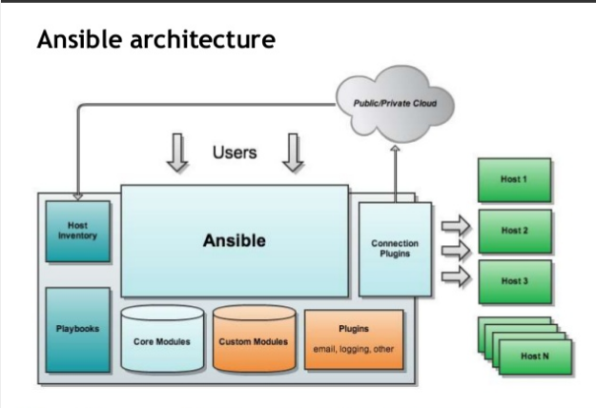
Notes:
CIDR.xyz site

Slide 5
Ansible Installation
Installation Commands
$ sudo apt-get update
$ sudo apt-get install software-properties-common
$ sudo apt-add-repository ppa:ansible/ansible
$ sudo apt-get update
$ sudo apt-get install ansible
Installation check commands
$ ansible –version
$ ansible-playbook –version
$ ansible-galaxy --help
Ansible Installion Documentaiion:
http://docs.ansible.com/ansible/latest/intro_installation.html

Slide 6
Ansible Inventory
Collections of hosts is known as Inventory
Types of Inventory :
Static Inventory
Dynamic Inventorys

Slide 7
Static Inventory
Path “/etc/ansible/hosts” contains static inventory details. This default path is defined in /etc/ansible/ansible.cfg file. You can change the default path here in case you want to use a different path.
--------------------------------------------------
## [webservers]
web-server-linux_static ansible_host=ec2-52-87-163-140.compute-1.amazonaws.com ansible_user=ubuntu ansible_ssh_private_key_file=/home/ubuntu/.ssh/id_rsa
## alpha.example.org
## 192.168.1.100
--------------------------------------------------
ubuntu@ip-172-31-89-165:/etc/ansible$ ansible -m ping all
web-server-linux_static | SUCCESS => {
"changed": false,
"ping": "pong"
}

Slide 8
Static Inventory
 | # file: production [balancers] www.example.com [webservers] www[0-9].example.com [dbservers] db[a:f].example.com [monitoring] monitor.example.com
Group
Host
Numeric Range
Alphabetic Range

Slide 9
Static Inventory
Like the default path in static you can create your own defined inventory file and use it using the –i flag and inventory file name
--------------------------------------------------
[host]
#54.89.182.185 ansible_user=ubuntu ansible_ssh_private_key_file=/home/ubuntu/.ssh/id_rsa
web-server-linux ansible_host=ec2-52-87-163-140.compute-1.amazonaws.com ansible_user=ubuntu ansible_ssh_private_key_file=/home/ubuntu/.ssh/id_rsa--------------------------------------------------
ubuntu@ip-172-31-89-165:~/ansible$ ansible -i inventory/hosts -m ping all
web-server-linux | SUCCESS => {
"changed": false,
"ping": "pong"
}
Notes:
How to run commands to fetch hard drives utilization
ansible -m command -a 'df -h' Servers
How to run commands to fetch system uptime
ansible -m command -a ‘uptime' Servers

Slide 10
Dynamic Inventory
A file mostly like a script and it contains additional information in form of API to populate all the host information and variable data.
In below command the ec2.py is a dynamic inventory which use aws API to populate the host information
#ansible -i ec2.py tag_Name_client* -m ping

Slide 11
Playbook
$> ansible-playbook [–i <inventory>] <playbook.yml>
What is a Playbook?
Describes policies your managed machines shall enforce
Consist of vars, tasks, handlers, files, templates and roles
Expressed in the YAML format (dictionaries, lists and scalars)

Slide 12
Playbook
--- # file: webservers.yml
- hosts: webservers
handlers:
- name: reload apache2
service: name=apache2 state=reloaded
tasks:
- name: Install Apache HTTP Server
apt: name=apache2 update_cache=yes
- name: Install Apache Modules
apache2_module: name={{ item }} state=present
with_items:
- proxy
- proxy_httpd
notify: reload apache2
remote_user: deploy
sudo: yes
Play
Module
Arguments
Variable
ami-97785bed
Notify Handler

Slide 13
Roles
High Level Structure :
site.yml – starting point of our ansible playbook
hosts – carrying hosts information
roles/ - defining what each type of server has to perform
webservers/
tasks/ - tasks performed on webservers
main.yml
handlers/ - running tasks under particular events
main.yml
templates/ - configuration files which can reference variables
index.html.j2
files/ - files to be copied to webservers
cloud.png

Slide 14
Roles
Hosts : The inventory file
Playbook :
---
- name: install and configure webservers
hosts: webservers
remote_user: ec2-user
sudo: yes
roles:
- webservers

Slide 15
Roles
Tasks – main.yml :
---
# This task installs and enables apache on webservers
- name: ensure apache is installed
yum: pkg=httpd state=latest
- name: ensure apache is running
service: name=httpd state=running enabled=yes
- name: copy files to document root
copy: src=cloud.png dest=/var/www/html/cloud.png
- name: copy application code to document root
template: src=index.html.j2 dest=/var/www/html/index.html
notify: restart apache
cloud.png (files) : – The regular image file to be copied to hosts.

Slide 16
Roles
Handlers – main.yml :
---
- name: restart apache
service: name=httpd state=restarted
index.html.j2 (template) :
<html>
<head>
<title>CloudAcademy Ansible Demo</title>
</head>
<body>
<h1>
Thank you for reading this post.
My IP Address is {{ ansible_eth0.ipv4.address }}
</h1>
<br/><br/><br/>
<p>
<img src="cloud.png" alt="CloudAcademy Logo"/>
</p>
</body>
</html>
Notes:
#ansible-playbook site.yml -i hosts
PLAY [install and configure webservers] ***************************************
GATHERING FACTS ***************************************************************
ok: [10.0.0.156]
TASK: [webservers | ensure apache,php related packages are installed] *********
changed: [10.0.0.156] => (item=httpd,php,php-mysql)
TASK: [webservers | ensure apache is running] *********************************
changed: [10.0.0.156]
TASK: [webservers | copy files to document root] ******************************
changed: [10.0.0.156]
TASK: [webservers | copy application code to document root] *******************
changed: [10.0.0.156]
TASK: [dbservers | ensure mysql is installed] *********************************
changed: [10.0.0.156] => (item=mysql-server,MySQL-python)
TASK: [dbservers | ensure mysql is running] ***********************************
changed: [10.0.0.156]
TASK: [dbservers | create application database] *******************************
changed: [10.0.0.156] => (item=ansible_db01)
changed: [10.0.0.156] => (item=ansible_db02)
TASK: [dbservers | create application user] ***********************************
changed: [10.0.0.156]
NOTIFIED: [webservers | restart apache] ***************************************
changed: [10.0.0.156]
PLAY RECAP *******************************************************************
10.0.0.156 : ok=10 changed=9 unreachable=0 failed=0

Slide 17
PROJECT
Install and configure Apache2 in remote machine using Ansible.

Slide 18
Project Help
$> ansible-playbook [–i <inventory>] <playbook.yml>
Know how to define a playbook
Know your module
Know your Tasks4
Know your configurations
Know your notification and and handlers
A working .yml file is attached in notes of this slide
Notes:
---
- hosts: db
sudo: yes
tasks:
- name: install apache
apt: name=apache2 update_cache=yes state=latest
- name: enabled mod_rewrite
apache2_module: name=rewrite state=present
notify:
- restart apache2
- name: apache2 listen on port 8081
lineinfile: dest=/etc/apache2/ports.conf regexp="^Listen 80" line="Listen 8081" state=present
notify:
- restart apache2
- name: apache2 virtualhost on port 8081
lineinfile: dest=/etc/apache2/sites-available/000-default.conf regexp="^<VirtualHost \*:80>" line="<VirtualHost *:8081>" state=present
notify:
- restart apache2
handlers:
- name: restart apache2
service: name=apache2 state=restarted

Slide 19
Thanks!
Any questions?

