Slide 1
Jenkins Continuous Build System

Slide 2
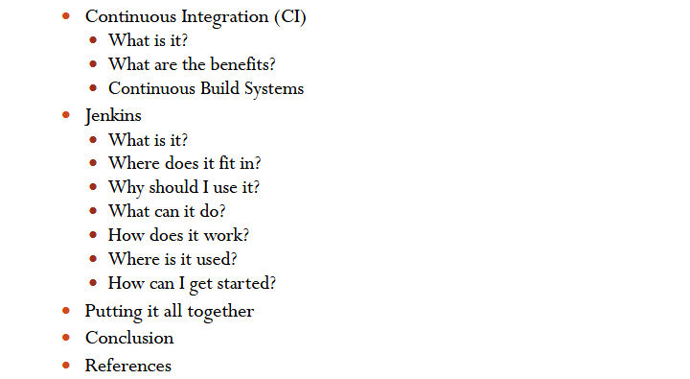
Agenda

Slide 3
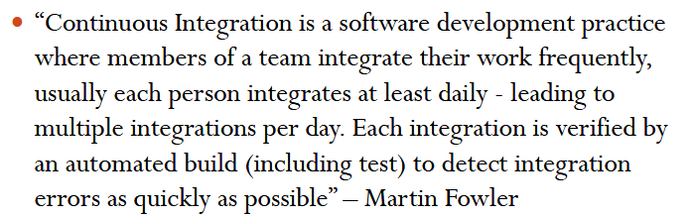
CI - Defined

Slide 4
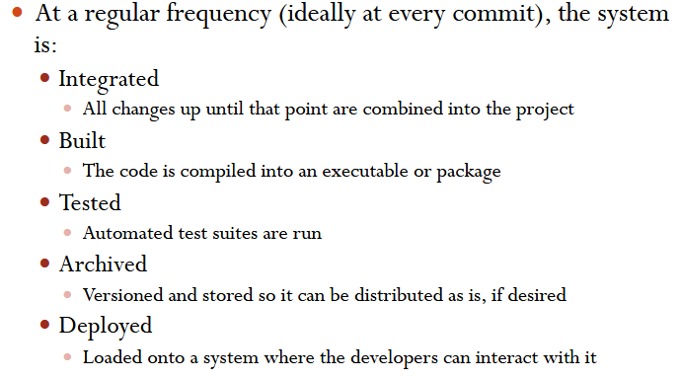
CI – What does it really mean?

Slide 5
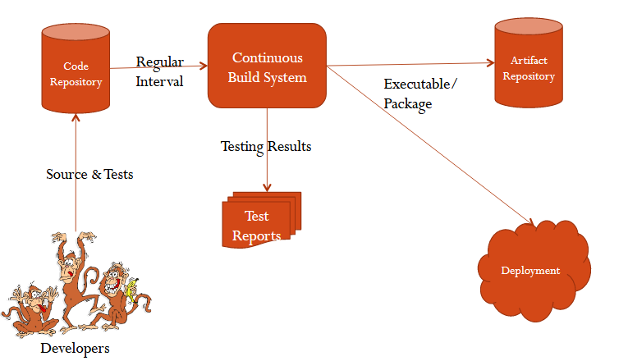
CI - Workflow

Slide 6
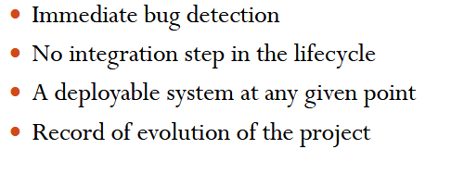
CI - Benifits

Slide 7
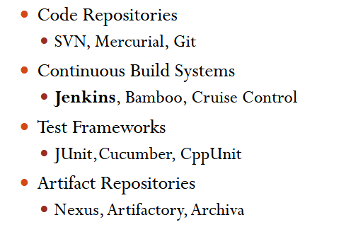
CI - Tools

Slide 8
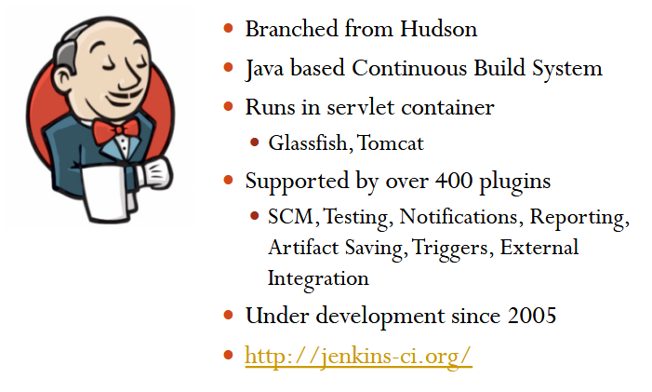
Jenkins

Slide 9
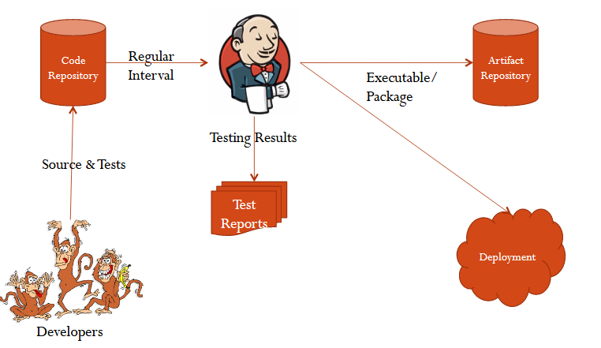
Jenkins – Fitting In

Slide 10
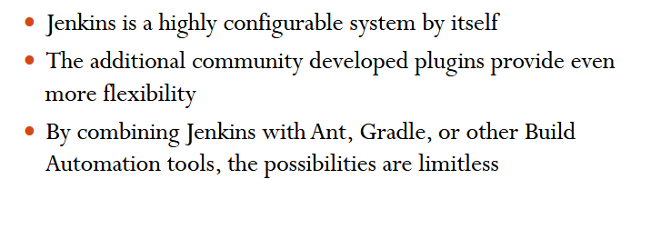
Why Jenkins? – Flexibility!

Slide 11
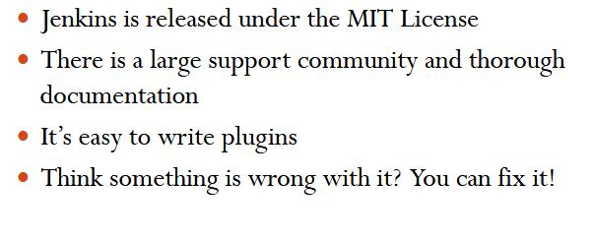
Why Jenkins? – Free OSS

Slide 12
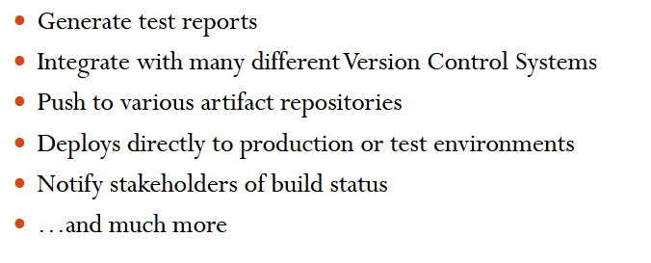
What Jenkins Can Do?

Slide 13
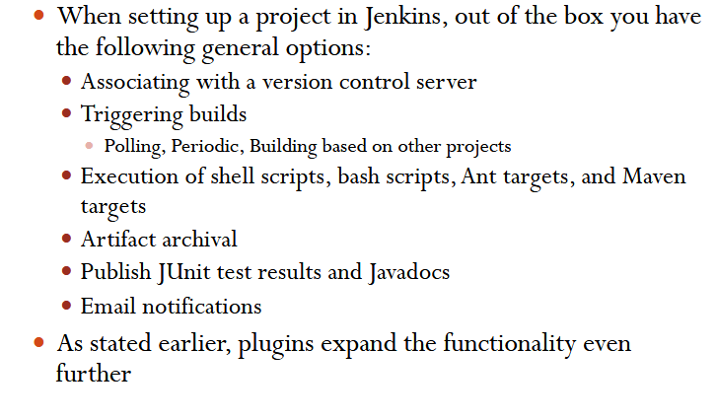
How Jenkins Works - Setup

Slide 14
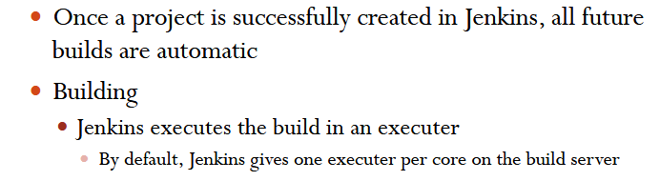
How Jenkins Works - Build

Slide 15
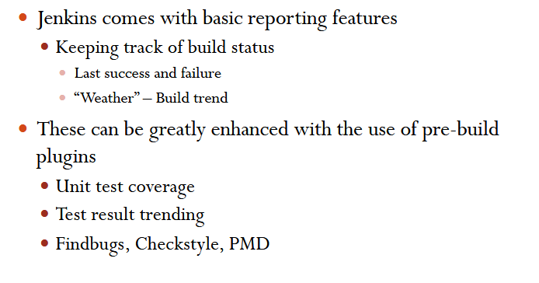
How Jenkins Works - Report

Slide 16
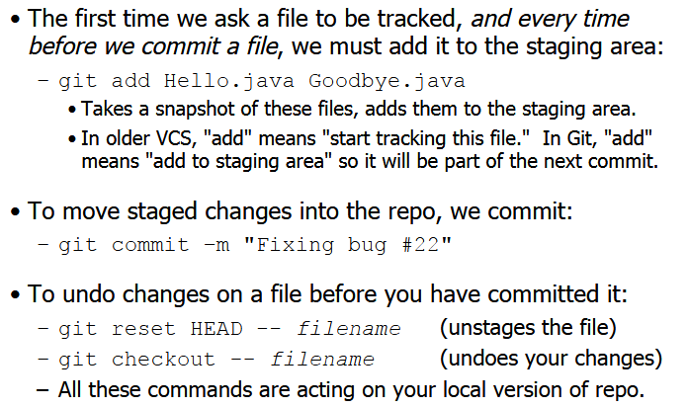
Add and Commit a File

Slide 17
Jenkins/Git Project : Maven Build
Notes:
Jenkins Setup EC2
-----------------------
1. sudo apt-get install language-pack-en #to fix up the local in earlier ubuntu version
Pre Requiste : Java
sudo add-apt-repository ppa:webupd8team/java; sudo apt-get update
sudo apt-get install oracle-java8-installer
Set below path for Java
sudo vi /etc/init.d/jenkins
PATH=/bin:/usr/bin:/sbin:/usr/sbin:/usr/lib/jvm/java-8-oracle/bin/
2. wget -q -O - http://pkg.jenkins-ci.org/debian/jenkins-ci.org.key | sudo apt-key add - # to add the package repository
3. echo "deb http://pkg.jenkins-ci.org/debian binary/" | sudo tee -a /etc/apt/sources.list.d/jenkins.list
4. sudo apt-get update
5. sudo apt-get install jenkins
6. ps -ef | grep jenkins #check the installation of jenkins
#jenkins is unprivlege user and it can not use port 80 and therfore it is using port 8080. to use this port to access we will proxy it from port 80 to port 8080 using apache
7. sudo apt-get install apache2
8. sudo a2enmod proxy
9. sudo a2enmod proxy_http
10. sudo vim /etc/apache2/sites-available/jenkins.conf
<VirtualHost *:80>
ServerName HOSTNAME<amazon ec2 hostname>
ProxyRequests Off
<Proxy *>
Order deny,allow
Allow from all
</Proxy>
ProxyPreserveHost on
ProxyPass / http://localhost:8080/
</VirtualHost>
11. sudo a2ensite jenkins
12. sudo service apache2 reload
13. Access web server and enter hostname to see the jenkins running
Configuring Jenkins
By default security is not enabled for jenkins
14. Manage Jenkins --> Configure Global Security --> enable jenkins and use jenkins own database --> uncheck allow user to sign up --> for simplicity we will use login user can do anything --> click on the jenkins on right pane ---you will get signup form --> add details
15. Install Plugin : Manage Jenkins --> Manage Plugins --> updates all --- in available search for github and install the plugin -- restart jenkins
16. To create user --> Manage Jenkin --> Add user
17. Get back to AWS and install some package before setting global configuration in jenkins
18. sudo add-apt-repository ppa:webupd8team/java; sudo apt-get update
19. sudo apt-get install oracle-java8-installer maven git-core
check using java -version and mvn -version
20 readlink -f /usr/bin/javac
/usr/lib/jvm/java-7-oracle(copy this part from the above command)
Global tool Configuration
21. Go to Manage Jenkins --> Configure System --> Add Java --> Paste that path in JAVA_HOME (uncheck install automatically)
22. Foe maven add the version and MAVEN_HOME. use command readlink -f /usr/bin/mvn and copy the path till bin (/usr/share/mvn)
23. unchek annonymous usage stats
24. disable ssh server
25. Set email notification(smtp server details)
Setup Jenkins project
Create a git hub project to be build using jenkins/maven
26. go to aws ec2 machine sudo su - jenkins
27 . pwd (/usr/lib/jenkins)
28 . ssh-keygen -t rsa
29. cd .ssh/;ls;cat id_dsa.rsa (copy the public key)
git@github.com:kevinsawicki/github-maven-example.git
30. go to your github -- settings --deploykeys
#####Apache 2 and Jenkins start and stop service#####
1. sudo systemctl start|stop|restart jenkins.service
2. sudo service apache2 start|stop|restart|reload
Create Git Repo in github.com
git init
git pull git@github.com:deepak2717/HelloWorldMaven.git (https urls can be added)
git status
git pull https://github.com/deepak-awslearn/TestRepo.git master
git push --set-upstream https://github.com/deepak-awslearn/TestRepo.git master
In case you have conflicts clean them by remiving or adding them
git rm README.md
You can create a sepearte folder and add the relevant files to be copied to the new repositories created by you.

Slide 18
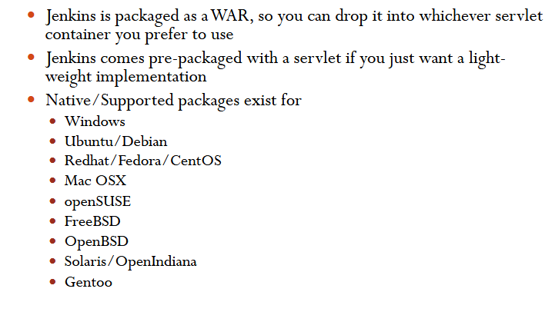
Running Jenkins yourself

Slide 19
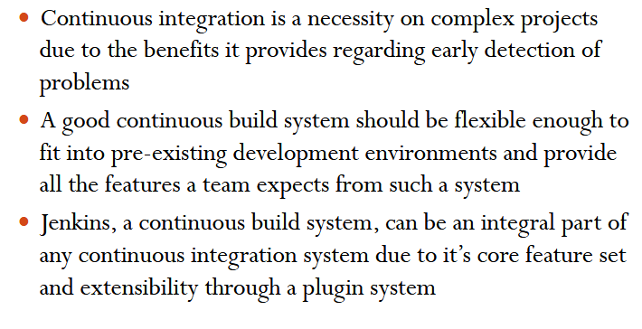
Conclusion

Slide 20
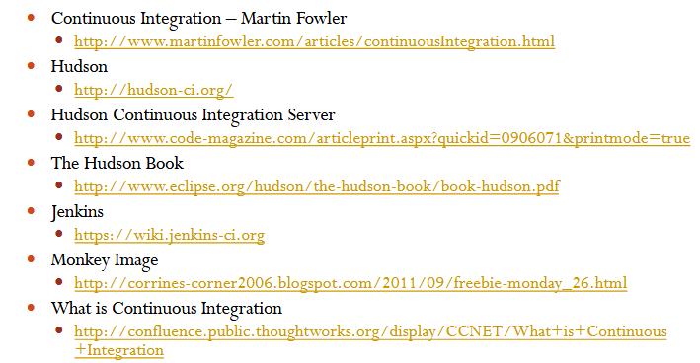
References

Slide 21
Thanks!
Any questions?
You can find me at deepak.awslearn@gmail.com

