Slide 1
PowerShell

Slide 2

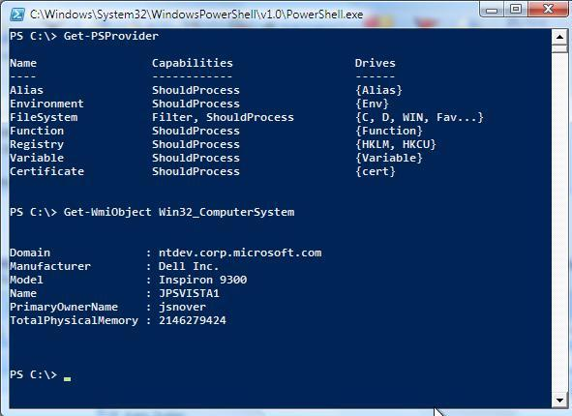
Command line and scripting language
As interactive and composable as BASH/KSH
As programmatic as Perl/Python/Ruby

Slide 3
Utilities - Discovery
Command | Function
Get-Help | Help about PowerShell commands and topics
Get-Command | Get information about anything that can be invoked
Get-Member | Show what can be done with an object
Get-Module | Shows packages of commands
Get-Process | Where-Object {($_.Name -eq "iexplore") -or ($_.Name -eq "chrome") -or ($_.Name -eq "firefox")}

Slide 4
Variables and Array
Variable names in PowerShell begin with a $, as in $UserName, and values are assigned using =, like $UserName = "John Smith" or $UserAge = 42. PowerShell supports a huge number of variable types; such as text strings, integers, decimals, arrays, and even advanced types like version numbers or IP addresses.
$website = "www.ethans.com" $myString = "My favorite website is" + $website $myString = "My favorite website is $website“
$secondsPerDay = 24 * 60 * 60 $weeksPerYear = 365 / 7
Array :
$nameArray = @("John","Joe","Mary")
$nameArray[0]
Hash :
$user=@{FirstName="John"; LastName="Smith"; MiddleInitial="J"; Age=40}
$user.LastName

Slide 5
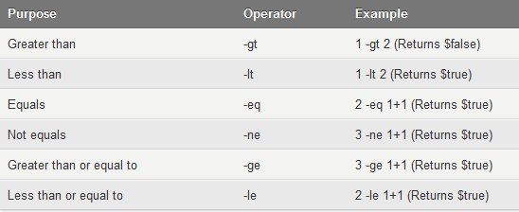
Comparison

Slide 6
Condition and Switches
if (Test-Connection www.google.com -Quiet) {
Write-Host “Internet connection is live.”
} elseif (Test-Connection 192.168.0.1 -Quiet) {
Write-Host “Only local network connectivity is available.”
} else {
Write-Host “Network connectivity is unavailable.”
}
Switch :
switch ((Get-Date).DayOfWeek) { "Saturday" {"Weekend"} "Sunday" {"Weekend"} Default {"Weekday"} }
Note : to run save the script as .ps1 extension and command – “Set-ExecutionPolicy Unrestricted”

Slide 7
Loops in Powershell
For Loop :
For ($i=0; $i -le 10; $i++) { "10 * $i = " + (10 * $i) }
$colors = @("Red","Orange","Yellow","Green","Blue","Indigo","Violet") For ($i=0; $i -lt $colors.Length; $i++) { $colors[$i] }

Slide 8
Loops in Powershell
While, Do While, Do Until:
$i=1 Do { $i $i++ } While ($i -le 10)
$i=1 Do { $i $i++ } Until ($i -gt 10)
Notes:
$i=1 While ($true) { $i $i++ if ($i -gt 10) { Break } }

Slide 9
Functions
Function Get-BatAvg{ Param ($Name, $Runs, $Outs) $Avg = [int]($Runs / $Outs*100)/100 Write-Output "$Name's Average = $Avg, $Runs, $Outs" }
Get-BatAvg Bradman 6996 70
Notes:
$i=1 While ($true) { $i $i++ if ($i -gt 10) { Break } }

Slide 10
Thanks!
Any questions?
You can find me at @Ethans & deepak2717@gmail.com

