Slide 1
Healthcare Claims Analysis
Excel Data Project
Presented by Aakash Biradar
1

Slide 2
1. Project Objective
The objective of this project is to analyze healthcare claims using Microsoft Excel.
I wanted to understand claim status, claim amount, denial reasons, monthly trends and provider performance.
I created PivotTables and PivotCharts and combined them into an interactive dashboard.
The dashboard allows the user to explore the data instead of looking only at the raw dataset.
2

Slide 3
2. Data Used in the Project
Main fields used for analysis -
Claim_ID – unique identification number for each claim.
Insurer and Claim_Status – used to compare approved, denied, paid, pending and other statuses.
Claim_Amount, Paid_Amount and Approved_Amount – used for financial analysis.
Diagnosis_Desc and Denial_Reason – used to understand medical categories and claim rejections.
Claim_Submitted_Date and Processing_Days – used for monthly trends and processing performance.
Provider_Name, Claim_Type and Plan_Type – used for provider and insurance-plan comparisons.
3

Slide 4
3. Dashboard KPIs
Values taken from the user's actual dashboard
TOTAL CLAIMS
TOTAL CLAIM AMOUNT
TOTAL PAID AMOUNT
AVERAGE PROCESSING DAYS
500
₹3,91,14,900
₹1,27,90,030
25.42424242
These KPI cards provide a quick summary of the dataset.
The KPI values can be linked to PivotTables using GETPIVOTDATA.
When a connected slicer filters the PivotTable, the KPI can update automatically.
4

Slide 5
4. PivotTable Analysis
Claims by Insurer: compares claim status categories for each insurer.
Claims Amount by Diagnosis: compares the claim amount across diagnosis categories.
Denial Reason Analysis: shows the financial amount associated with different denial reasons.
Provider Performance: compares paid amount and processing performance by provider.
Monthly Claim Trend: shows how claim count and claim amount change over time.
Claim Type by Plan Type: compares approved claim amounts across plan types and claim types.
5

Slide 6
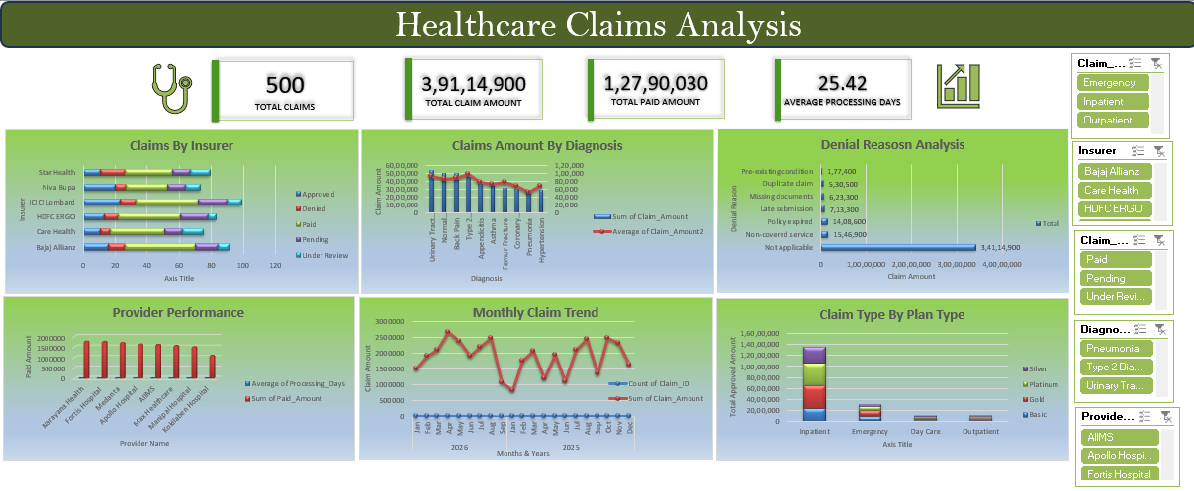
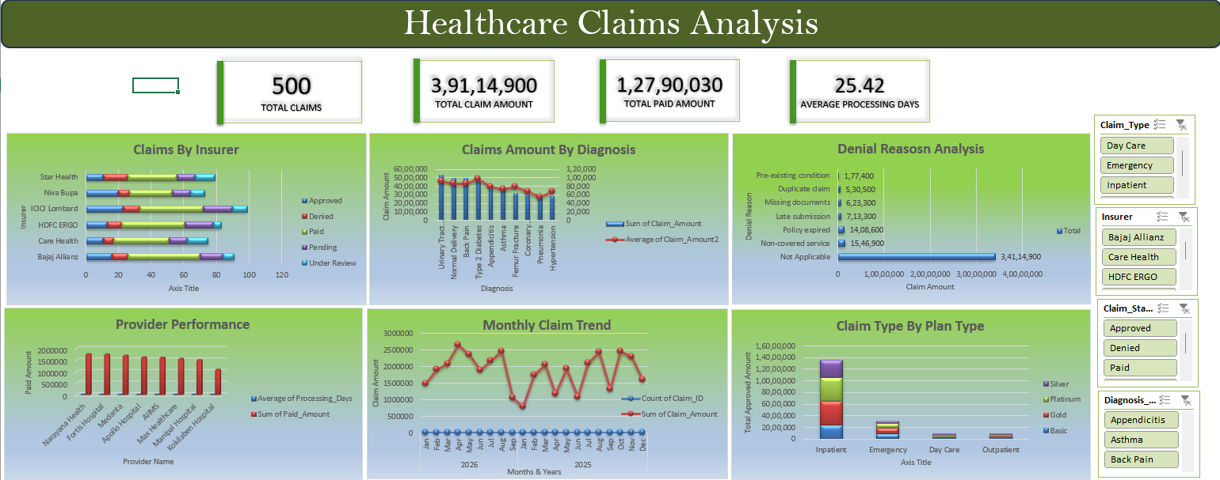
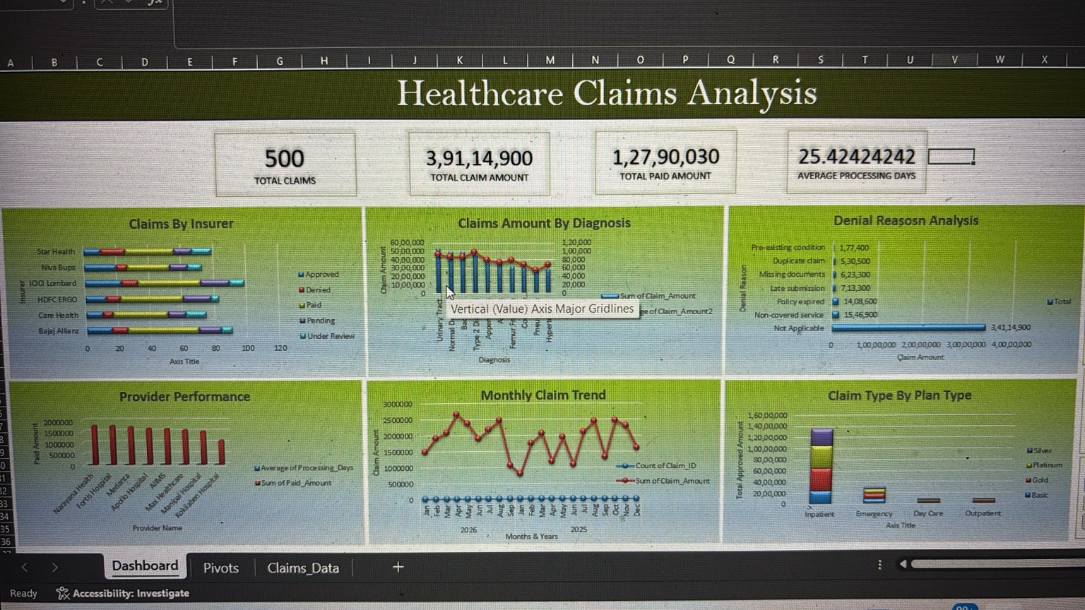
5. Final Excel Dashboard
Actual dashboard created from the project data
6

Slide 7
6. How I Made the Dashboard Interactive
First, I kept all PivotTables based on the same Excel Table source.
I created Slicers for fields such as Insurer, Claim Status, Claim Type and Plan Type.
Using Slicer → Report Connections, I connected the slicers to the required PivotTables.
I also link KPI cards to PivotTable results.
Therefore, selecting a filter changes the connected PivotTables, PivotCharts and KPI values.
7

Slide 8
7. What the Dashboard Helps Me Find
Which insurers have more claims in each status category.
Which diagnosis categories have larger claim amounts.
Which months have higher or lower claim activity.
Which providers have higher paid amounts and how processing time differs between providers.
How approved amounts vary across claim types and insurance plans.
8

Slide 9
8. Conclusion & Learning
This project helped me convert raw healthcare claims data into an interactive Excel dashboard.
I practiced data preparation, PivotTables, PivotCharts, KPI creation and dashboard design.
I also learned how Slicers and Report Connections make an Excel dashboard interactive.
The project demonstrates practical Excel skills that can be used for reporting and data analysis.
9

Slide 10
Thank You
Healthcare Claims Analysis – Excel Data Project
Aakash Biradar

