Slide 1


ECG Arrhythmia Classification using Deep Learning
Final Review
GITAM (Deemed-to-be) University
Major Project
Project ID: PROJ3999
AY 2021-25
Department of Electrical Electronics and Communication Engineering
Project Team:
Golla Vishnu Karthik Yadav
B. M. Aakash
P. V. Muni Krishna
Project Mentor:
Dr. Jaya Prakash Sahoo
www.gitam.edu

Slide 2




Project Group – Details
Photo
Track
Roll No
Name
EECE AI/ML
BU21EECE0100318
Golla Vishnu Karthik Yadav
EECE AI/ML
BU21EECE0100209
B. M. Aakash
EECE AI/ML
BU21EECE0100408
P. V. Muni Krishna

Slide 3
Objective and Goals
Objective
The primary objective of this project is to develop a accurate deep learning model for the automatic classification of ECG arrhythmias.
The goal is to leverage deep learning techniques to diagnosis of cardiac abnormalities.
Objective is to improve patient outcomes and reducing the workload on healthcare professionals.
Goals
Design and implement a deep learning architecture tailored for ECG signal
analysis, selecting the most effective model for arrhythmia classification.
Train the deep learning model using annotated ECG datasets and optimize
it to improve accuracy and generalization.
To develop a highly accurate deep learning model for classifying ECG arrhythmias
using deep learning techniques.

Slide 4
Literature Survey
S.NO | TITLE | AUTHOR | YEAR OF PUBLISHING | PARAMETERS MENTIONED
1 | Cardiologist-Level Arrhythmia Detection with Convolutional Neural Networks | Awni Y. Hannun, Pranav Rajpurkar | 2019 | 34-layer deep CNN (convolutional neural network) 30-second ECG segments MIT-BIH Arrhythmia Dataset
2 | ECG Heartbeat Classification Using Convolutional Neural Networks | Jiun-Yan Su, Wen-Chung Kao | 2020 | CNN with max-pooling layers Input: Pre-processed ECG signals with R-peak detection Datasets: MIT-BIH Arrhythmia Dataset
3 | A Deep Learning Approach to Predicting Cardiac Abnormalities Using ECG Data | Rajat K. Gupta, Arun K. Majumdar | 2021 | LSTM (Long Short-Term Memory) network Input: Raw ECG data Datasets: PTB Diagnostic ECG Database

Slide 5
Literature Survey
4 | Transfer Learning for Arrhythmia Classification Using Deep Neural Networks | Xueheng Zhou, Songnan Yang, Hongyi Wu | 2021 | Transfer learning with pre-trained ResNet Input: 12-lead ECG signals Datasets: PhysioNet Challenge 2017 dataset
5 | Arrhythmia Classification from 2-Lead ECG Signals Using Deep Neural Networks | Shashank Reddy, Rahul Mittal, Amritanshu Pandey | 2022 | Deep CNN with attention mechanism Input: 2-lead ECG data Datasets: MIT-BIH Arrhythmia Dataset Application: 2-lead ECG data could be in real-time arrhythmia monitoring for wearable health devices.

Slide 6
ECG signal parts and description:
P Wave
Description: The P wave represents the depolarization of the atria, which is the electrical activity that leads to the contraction of the atria. It is usually a small, rounded waveform that occurs before the QRS complex.
QRS Complex
Description: The QRS complex represents the rapid depolarization of the ventricles, leading to their contraction. This is the most prominent feature on the ECG signal and is typically composed of three parts:
Q wave: A small downward deflection following the P wave.
R wave: A large upward deflection following the Q wave.
S wave: A downward deflection following the R wave.

Slide 7
T Wave
Description: The T wave represents the repolarization of the ventricles, which is the process of the ventricles returning to their resting state after contraction. It typically appears as a modest, rounded waveform following the QRS complex.
PR Interval
Description: The PR interval is the time between the onset of the P wave and the start of the QRS complex. It represents the time taken for the electrical impulse to travel from the atria to the ventricles.

Slide 8
Introduction to Arrhythmia:
Arrhythmia refers to an irregular heartbeat caused by abnormal electrical activity in the heart. The heart may beat too fast (tachycardia), too slow (bradycardia), or with an erratic pattern. While some arrhythmias are harmless, others can lead to serious health issues, including stroke, heart failure, or sudden cardiac arrest.
The detection and classification of arrhythmias are critical for timely intervention and treatment. Electrocardiograms (ECGs), which record the electrical activity of the heart, are commonly used for this purpose. However, the manual interpretation of ECGs is time-consuming and prone to error, especially with large datasets. This has led to increased interest in automated arrhythmia detection using advanced deep learning techniques, which can analyze ECG signals with high accuracy and efficiency.

Slide 9
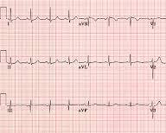
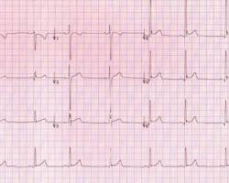
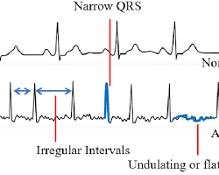
Normal Person
An Athlete
Arrhythmia Patient

Slide 10
Architecture
Structural Block Diagram
ECG Data Acquisition
Preprocessing
Feature Extraction
Deep Learning Model
Classification Output
Evaluation
Model Training
Deployment

Slide 11
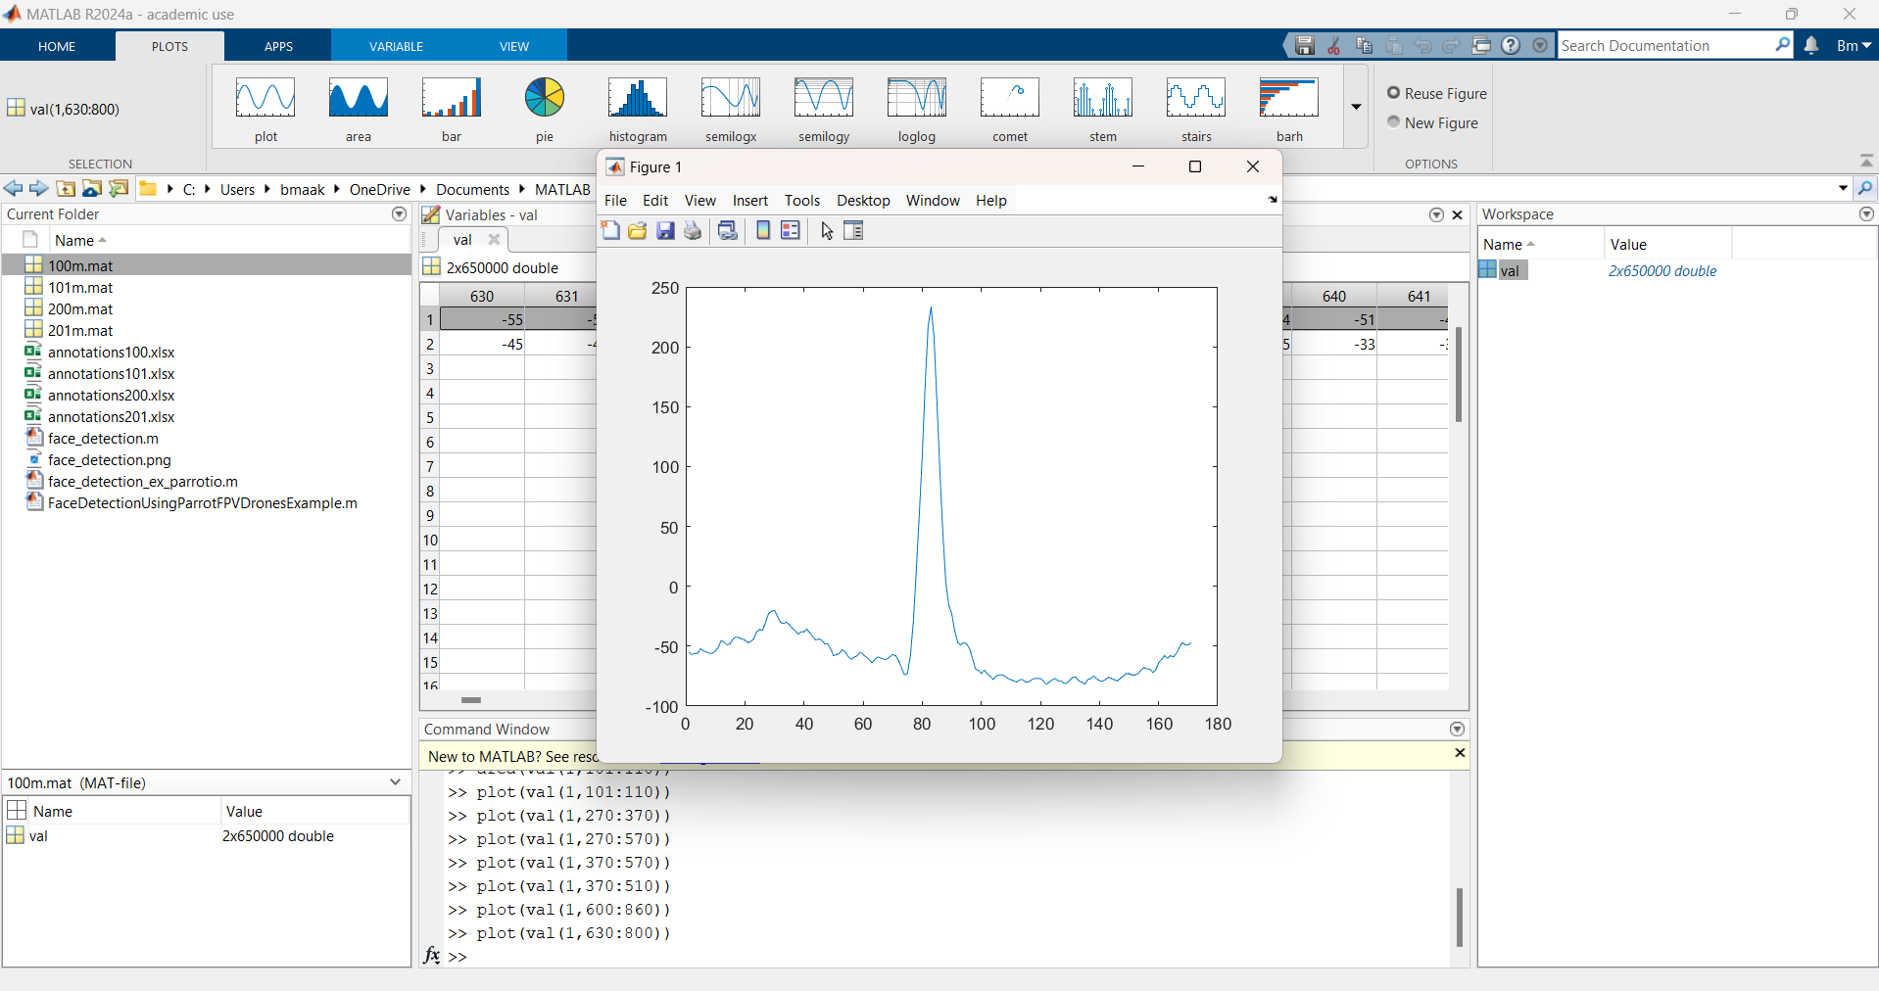
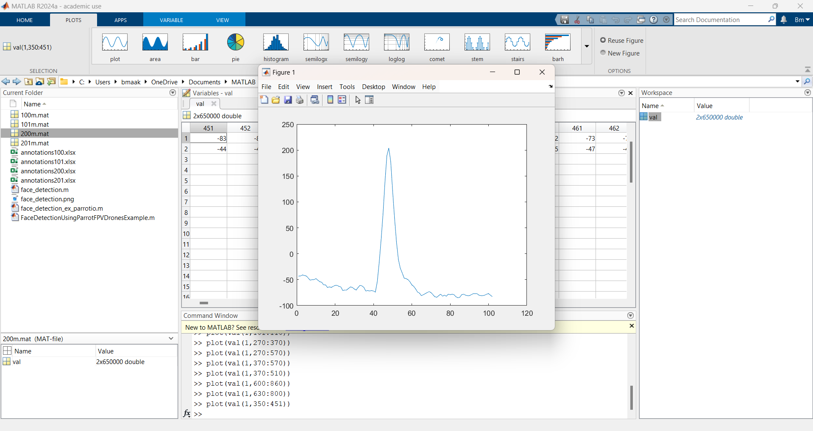
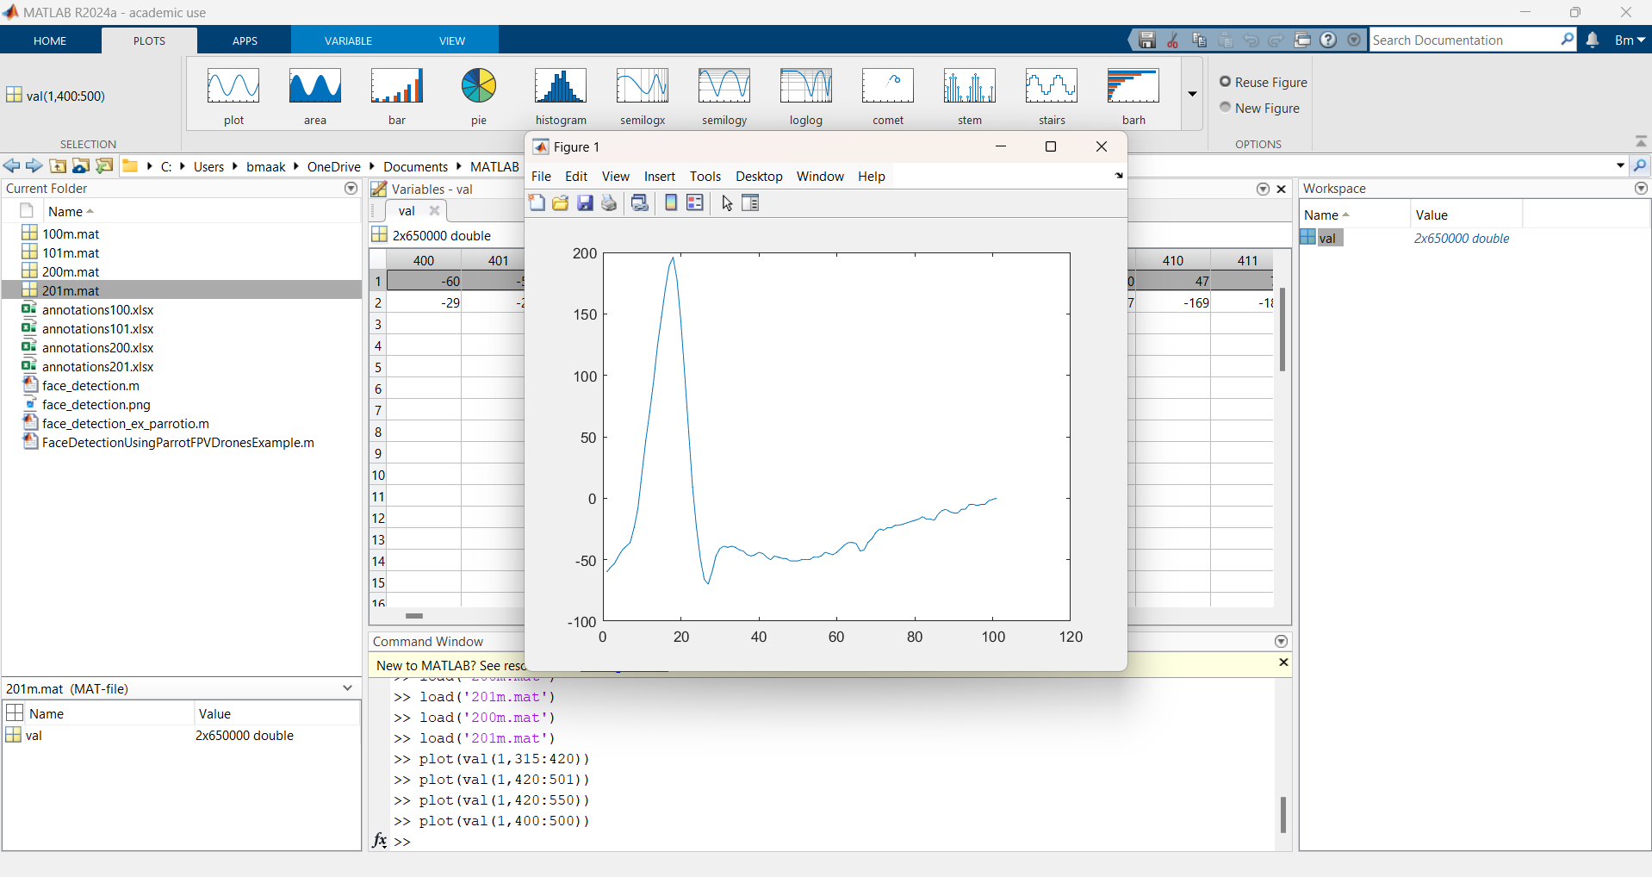
Implementation and Results

Slide 12
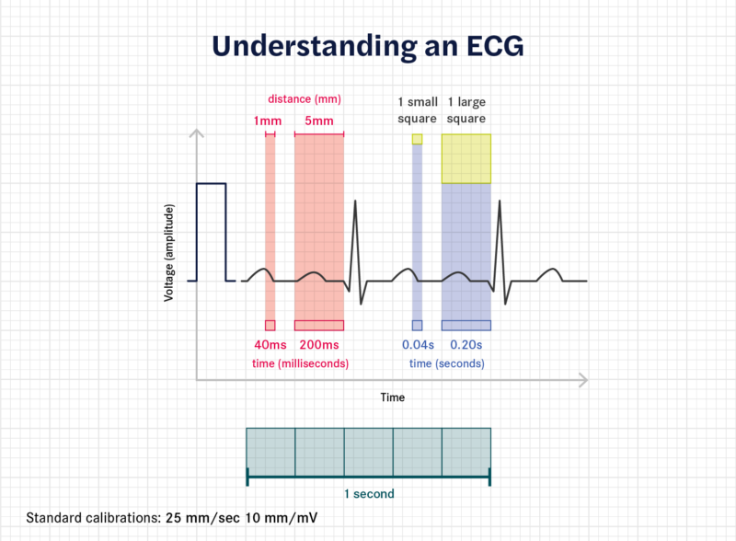
The above image explains the relationship between the time and voltage of an ECG (Electrocardiogram) waveform based on standard calibrations.
Voltage (Amplitude): The y-axis shows the voltage, which represents the heart's electrical activity. Each small square on the graph corresponds to a voltage of 0.1 mV.
Time: The x-axis shows time. Each small square represents 0.04 seconds (40 ms), and each large square (which contains 5 small squares) represents 0.2 seconds (200 ms).
Distance: Each small square is 1 mm, and each large square is 5 mm. This distance helps to measure time intervals in the ECG.
Calibration: The standard ECG calibration speed is 25 mm/sec, meaning the paper moves 25 mm every second, and the voltage scale is 10 mm/mV, so 10 mm represents 1 mV of electrical activity.

Slide 13
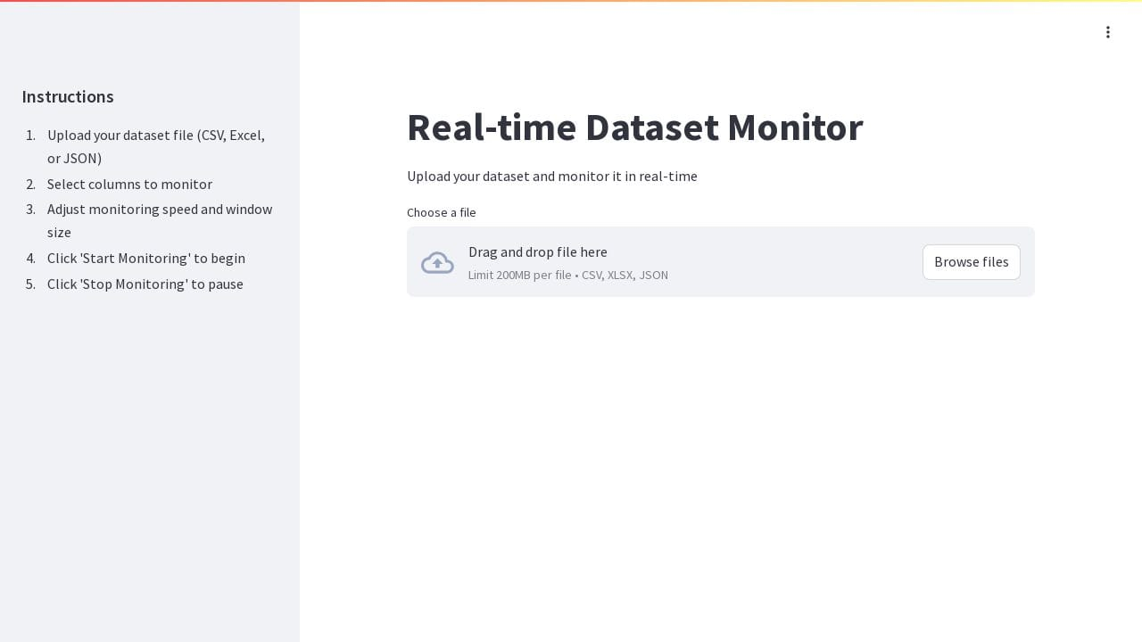
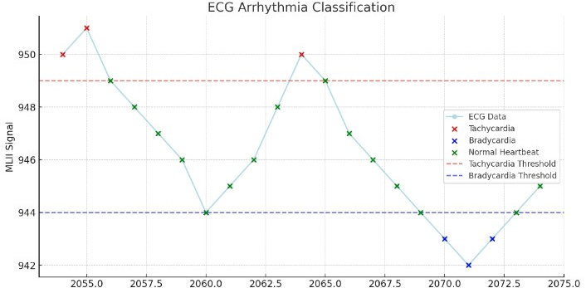
Real-Time Dataset Monitor
Here the Datasets of Pre-Recorded ECG signals will be uploaded to the website as a backend source.
By clicking the browse files option we can upload the datasets to the website to monitor the heartbeat in real-time and making a graph according to it.
The datasets we upload can be of the format (CSV, XSLX, JSON) we will be taking the Json format files for the reference.
The website is designed or hosted through the website called StreamLit application where we can create an environment to monitor the ECG signals in real-time and plot the graph according to it.
We can connect the ECG electrodes to mobile phone and record the signals and we can get the graph or required information in the website.
This website helps to monitor the heartbeat of a person through the connected electrodes.
Figure – 1:
Figure – 2:

Slide 14
Website Functionality
Content:
The website is designed to visualize ECG signals by plotting waveform graphs from uploaded datasets.
It provides graphical representations of the electrical activity of the heart but does not classify arrhythmias.
Users can upload ECG datasets to generate corresponding waveforms and analyze heart activity patterns.
The website is useful for researchers, medical professionals, and students who want to examine ECG waveforms without needing specialized software.
It acts as a data visualization tool, helping in the manual interpretation of ECG readings.
Reads datasets in CSV, TXT, or other structured formats containing ECG readings.
Processes data using Python libraries (NumPy, Pandas) to extract values and generate ECG waveforms.
No External Software Required: Unlike traditional ECG analysis tools, this website provides a browser-based alternative, eliminating the need for specialized software.
Dataset Uploading System: Users can upload pre-recorded ECG datasets, and the website extracts the data points to generate real-time plots.

Slide 15
Use Case & Importance
Content:
Who Can Use It?
Doctors & Cardiologists: Can use the website to manually review ECG waveforms for abnormalities.
Researchers & Data Scientists: Helps in studying ECG patterns for developing AI-based arrhythmia detection models.
Medical Students & Technicians: Aids in learning how ECG signals are structured and how heart activity is recorded.
Why Is It Important?
Accessible ECG Analysis: Users can analyze ECG signals without expensive software or hardware.
Training & Education: Medical students can study heart signal patterns and understand ECG readings using the plotted waveforms in the website.

Slide 16
Existing Solutions vs. Our Website
Existing Solutions
Many ECG visualization tools exist, but they often:
Require installation or high storage.
Do not allow users to manually analyze ECG graphs.
How Our Website is Different
Web-Based: No need to install software.
User-Uploaded ECG Data: Users can upload their own datasets.
Graph Visualization: Helps researchers analyze ECG signals easily.
User Accesses the Website: Open the website on any browser.
Dataset Upload: User selects and uploads a pre-recorded ECG dataset.
Graph Generation: The website processes the dataset and plots the ECG graph.
Manual Diagnosis: Researchers and students interpret the ECG waveform for arrhythmia classification.

Slide 17
Understanding ECG Patterns: A Quick Guide
Arrhythmia Type | Heart Rate (BPM) | Basic ECG Pattern
Normal Rhythm | 60 - 100 | Regular, evenly spaced peaks
Bradycardia | < 60 | Peaks are far apart (slow heartbeat)
Tachycardia | > 100 | Peaks are very close (fast heartbeat)
Atrial Fibrillation | Irregular, usually > 100 | Uneven, chaotic pattern
Ventricular Tachycardia | > 100 | Sharp, wide peaks, very fast
Ventricular Fibrillation | > 300 | Completely disorganized pattern
Heart Block | Varies | Some peaks are missing or irregularly spaced
Premature Beat (PVC) | Normal or fast | Occasional extra peaks

Slide 18
Conclusion & Final Remarks
The developed web application helps visualize ECG graphs from uploaded datasets.
It provides easy access to ECG signal analysis for medical students & researchers.
Though real-time monitoring is not available yet, future improvements can include:
AI-powered classification
Cloud-based storage & analysis
This website is a step forward in accessible ECG signal analysis and can be further developed into a real-time diagnostic tool.
Scalability & Research Potential: The website can be expanded to support multiple ECG datasets and be used as a research tool for further studies in arrhythmia classification.
Bridging the Gap Between Data & Diagnosis: By providing accessible ECG visualization, this project helps bridge the gap between raw ECG data and manual medical diagnosis, paving the way for AI-powered advancements in healthcare.

Slide 19

THANK YOU

