Slide 1

Understanding the Data Analytics Lifecycle
An Introduction to Structured, Data-Driven Insight Generation
Session Focus: Discover the importance and process of the data analytics lifecycle in modern decision-making.
Practical Relevance: Learn how structured analysis leads to impactful outcomes across industries.
Interactive Approach: Engage with concepts through real-world examples and thought prompts.
Photo by Luke Chesser on Unsplash
Notes:
Good morning/afternoon, everyone. Today’s session centers on the Data Analytics Lifecycle—a structured journey that transforms raw data into impactful decisions. We’ll explore not just what each phase entails but why following this lifecycle is crucial in today’s fast-paced, data-rich world.
Think of this lifecycle as a recipe for success. It ensures that data is not only collected but meaningfully analyzed and acted upon. Whether you work in business, healthcare, education, or research, this structured approach applies universally.
So, let’s begin with a brief roadmap of what to expect, followed by a deeper dive into each stage with live discussions and practical examples. Let’s get started!

Slide 2
Key Topics Covered
Today’s Roadmap
Understanding the Lifecycle: Define what the data analytics lifecycle is and its role in modern analytics.
Phase-by-Phase Breakdown: Explore each lifecycle stage with real-world examples.
Modeling Approaches: Compare statistical, machine learning, and simulation techniques.
Data Characteristics: Examine data quality, quantity, and types of measurement.
Case Study & Discussion: Apply the full lifecycle to a healthcare example and engage in open Q&A.
Notes:
Here’s our roadmap for today’s session. We’ll begin by understanding what the Data Analytics Lifecycle is and why it matters in practice. Then, we’ll take a guided walkthrough of each phase using relatable examples.
We’ll also delve into different types of models—statistical, machine learning, and simulations—and discuss how each fits into the lifecycle. Additionally, we’ll examine important data attributes such as quality, quantity, and measurement types.
To tie it all together, we’ll study a real healthcare scenario where all these elements are put into action. Throughout the session, jot down any questions you have—we’ll address them in our discussion at the end.

Slide 3
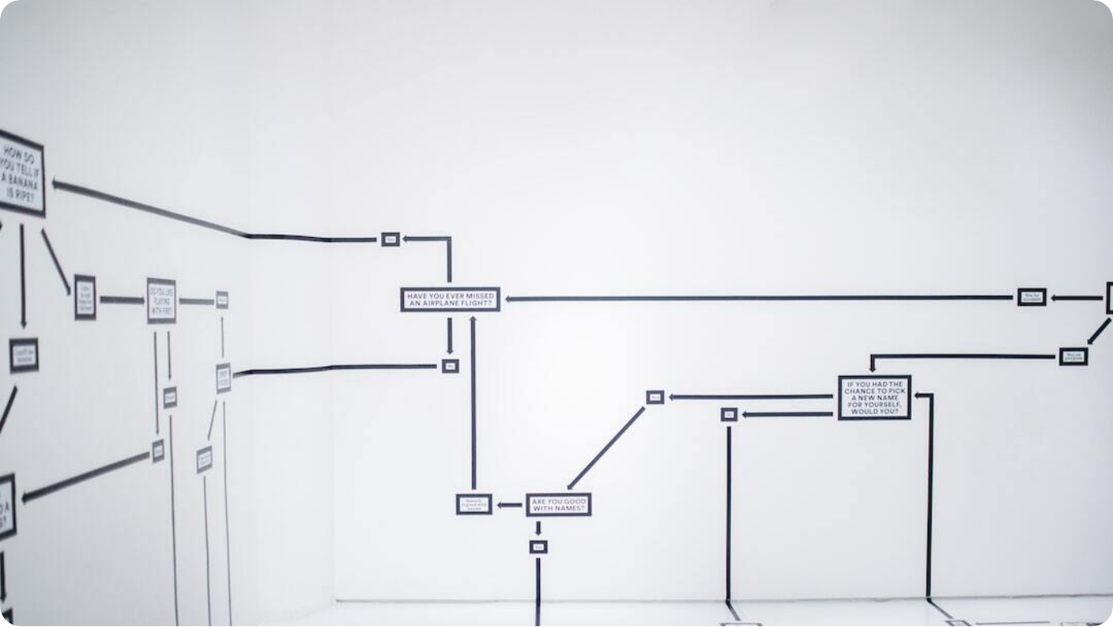
What is the Data Analytics Lifecycle?
A Structured Path from Data to Decision
Definition: A structured framework guiding how data is transformed into actionable insights.
Purpose: Ensures consistent, reliable, and repeatable outcomes in data-driven projects.
Risks of Ad-Hoc Analysis: Without a lifecycle, teams face inefficiency, misalignment, and flawed conclusions.
Photo by Hanna Morris on Unsplash
Notes:
The Data Analytics Lifecycle is a structured process—a roadmap that helps us convert raw data into decisions that matter. Much like following a recipe ensures a successful dish, this lifecycle ensures that the insights we derive from data are accurate, relevant, and actionable.
Why do we need such structure? Without it, efforts can become chaotic. Teams may duplicate work, overlook key steps, or draw conclusions from flawed analysis. It’s the structure that helps align teams, avoid wasted time, and ultimately deliver insights that matter.
Let’s think about this: Why do you think a defined process is important in analytics? What might go wrong if we simply ‘wing it’? Take a moment to reflect or share.

Slide 4



Visual Overview of the Lifecycle
A Cyclical and Iterative Process
Cyclical Structure
The lifecycle is not linear—steps are revisited as data and insights evolve.
Six Core Phases
Discovery, Data Preparation, Model Planning, Model Building, Operationalize, and Communicate Results.
Project Flexibility
Phases may loop depending on project needs and findings.
Notes:
Let’s take a step back and look at the Data Analytics Lifecycle as a whole. This diagram shows all the stages in a circular flow, which is crucial—it emphasizes that the process is iterative. You may not simply move from step one to step six and be done. Often, you’ll circle back to revise, refine, and improve your work as new data or feedback emerges.
The six key stages are Discovery, Data Preparation, Model Planning, Model Building, Operationalize, and Communicate Results. Each has a distinct purpose but must connect seamlessly with the others.
As we move through each step today, keep this big-picture structure in mind. It’s not just a checklist—it’s a dynamic cycle that supports effective, evolving analysis.

Slide 5



Phase 1 — Discovery
Define the Problem and Understand Stakeholders
Goal Setting
Clearly define the analytical problem and its expected business impact.
Data Sourcing
Identify what data is needed and where it resides (internal systems, external feeds).
Stakeholder Mapping
Understand who the decision-makers, users, and data owners are.
Notes:
The first phase of the lifecycle is Discovery. It starts with defining the problem you want to solve and understanding why it matters. A clearly articulated goal ensures your analysis is relevant and value-driven. For example, a hospital may aim to reduce patient readmission by 15%—a tangible, impactful target.
Next, brainstorm the types of data needed. In our healthcare case, this might include patient records, discharge notes, or past readmission logs. Knowing where the data lives and what’s accessible is critical before moving forward.
Equally important is understanding the people involved. Who will use the analysis? Who approves the project? These stakeholders will shape your priorities and success metrics. Think about your own field: can you recall a data problem worth solving?

Slide 6

Phase 2 — Data Preparation
Cleansing, Transforming, and Structuring Data
Data Cleaning: Remove duplicates, fix inconsistencies, and address missing values.
Toolset: Use platforms like Excel, SQL, or Python pandas to process datasets.
Real-World Relevance: Healthcare: Correcting birth dates or removing invalid patient IDs ensures analysis accuracy.
Photo by Hitesh Choudhary on Unsplash
Notes:
Once the problem is defined, we move to Data Preparation. This phase is about taking raw, messy data and turning it into something usable. Cleaning involves removing duplicate entries, fixing inconsistencies, and handling missing values.
The tools here are powerful: Python’s pandas, SQL queries, and even Excel can transform chaotic data into structured formats ready for analysis. Imagine a dataset where a patient’s age is listed as 200—errors like these can distort outcomes or even pose safety risks in fields like healthcare.
Think about your own environment. Have you encountered seemingly small data issues that led to major complications? That’s why proper preparation is so essential.

Slide 7



Phase 3 — Model Planning
Selecting Analytical Techniques and Tools
Technique Selection
Choose from statistical models, machine learning, or simulations based on project goals.
Objective Alignment
Determine whether the goal is explanation, prediction, or optimization.
Example Scenario
Use logistic regression or decision trees for predicting hospital readmissions.
Notes:
In Model Planning, we begin selecting the analytical methods best suited to answer our defined questions. Do we need to explain relationships, predict outcomes, or simulate future scenarios? Your answer drives the model choice.
Options range from classic statistical techniques like regression to modern machine learning algorithms and complex simulations. In healthcare, for instance, a team might compare logistic regression to a decision tree model when predicting whether a patient is likely to be readmitted.
Here’s a key question: what could go wrong if we choose the wrong model? Poor predictions, misleading insights, or wasted resources. Careful planning sets the foundation for valid and useful analysis.

Slide 8



Phase 4 — Model Building
Training, Testing, and Validating Models
Data Splitting
Separate datasets into training and test groups to validate model performance.
Iterative Refinement
Tune parameters and revisit earlier phases to improve accuracy.
Performance Metrics
Use tools like ROC curves and confusion matrices to evaluate models.
Notes:
Once a plan is in place, it’s time to build the model. This involves training it using historical data and then testing its performance. Typically, data is split—commonly 70% for training and 30% for testing—to prevent overfitting and ensure generalization.
Model building is rarely a one-and-done activity. You’ll often iterate: adjusting parameters, trying different features, or even going back to earlier phases to fetch new data.
For example, a hospital model predicting readmissions might begin with logistic regression. Analysts would evaluate it using tools like ROC curves or confusion matrices to measure how well the model distinguishes between high- and low-risk patients.

Slide 9

Phase 5 — Operationalize
Deploying and Embedding Models into Business Processes
Deployment Methods: Integrate models via dashboards, APIs, or embedded applications.
Pilot Testing: Run small-scale implementations to ensure safety and usability.
Workflow Integration: Hospital teams use predictions in rounds to prioritize follow-ups.
Photo by Jair Lázaro on Unsplash
Notes:
With a validated model, the next phase is Operationalization. This is where the insights become real-world tools. The model might be embedded in a clinical dashboard, delivered through an API, or incorporated into decision-support systems.
Before full rollout, most organizations conduct a pilot—a small-scale test to ensure accuracy, usability, and stakeholder acceptance. In our hospital example, the model flags patients at high readmission risk, which doctors then use during their rounds to plan interventions.
Where do you see analytics ‘showing up’ in your workplace? Many use dashboards or auto-generated alerts without realizing these are products of well-integrated analytics.

