Slide 1

Sampling Funnel & Inferential Statistics
Data Analytics – Unit 1.5
Sampling Funnel, CLT, Confidence Intervals
Date: 27 Aug 2025

Slide 2
Agenda
Overview of sampling and the sampling funnel
Central Limit Theorem (CLT)
Confidence Intervals
Sampling Variation & Conclusions
Unit 1.5 Topics
Sampling Funnel CLT CI Variation

Slide 3
Sampling Funnel
Define the population and objectives
Identify the sampling frame
Select a sampling method (random, stratified, cluster)
Apply successive filters to narrow down the sample
Check sample size & representativeness
Population
Sampling frame
Sample
[5]

Slide 4
Central Limit Theorem
Sample means approach a normal distribution
Applicable for large samples (n ≥ 30)
Enables probability calculations & hypothesis tests
Normalized statistic: Z = √n (̅X – μ)/σ
[1] [2]

Slide 5
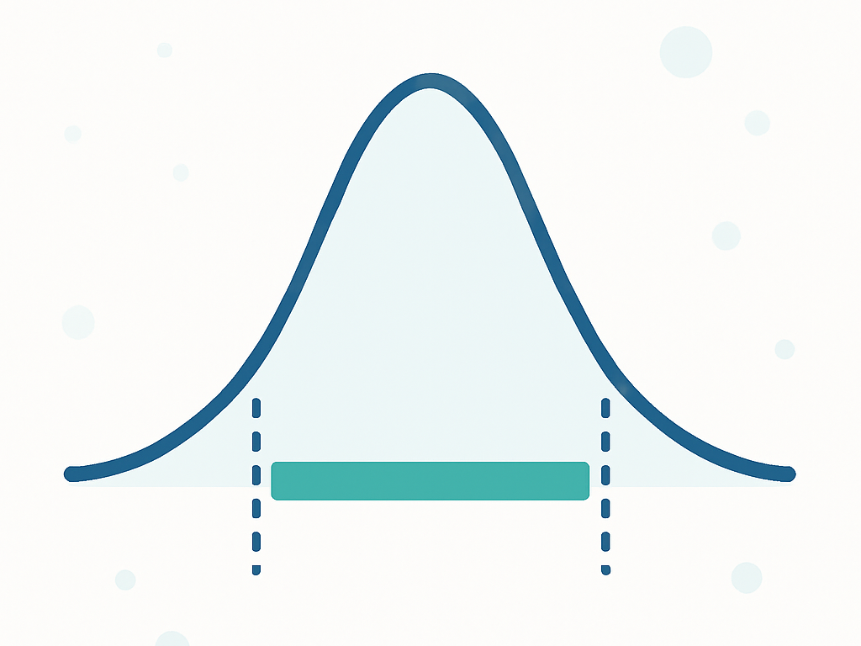
Confidence Intervals
A range used to estimate an unknown parameter
Specify a confidence level (e.g. 95%)
CI for the mean: ̅X ± z_{α/2} (S/√n)
Wider intervals ↔ higher confidence or greater variability
[3] [4]

Slide 6
Sampling Variation & Conclusions
Sampling error: difference between sample statistic and population parameter
Random variation: repeated samples rarely give identical results
Reduce error by increasing n or using stratified/cluster designs
CLT & CIs incorporate sampling variation for inference
Takeaways: design a representative funnel, use CLT responsibly, report CIs
[5] [1]

