Slide 1

DriverPass System Analysis
Aakash Thapa
Notes:
Hello everyone !! I am Aakash and today I will be going through the system analysis presentation.

Slide 2

System Requirements
Functional
Three different driving packages offered to users
Students will be able to book the reservations
Non-Functional
Unique password and case sensitive username
Two factor authentication
Notes:
The system will allow the user to pick the three different driving packages. Once the student decides the package, the student will make reservations based on available time and date.
Each user has to make an account first which will provide a unique username and password. The user will use this username and password to access into website. This is how different users will be distinguished from each other. The inputs will be case-sensitive. For extra-security purposes we will use two factor authentication; email and text.

Slide 3
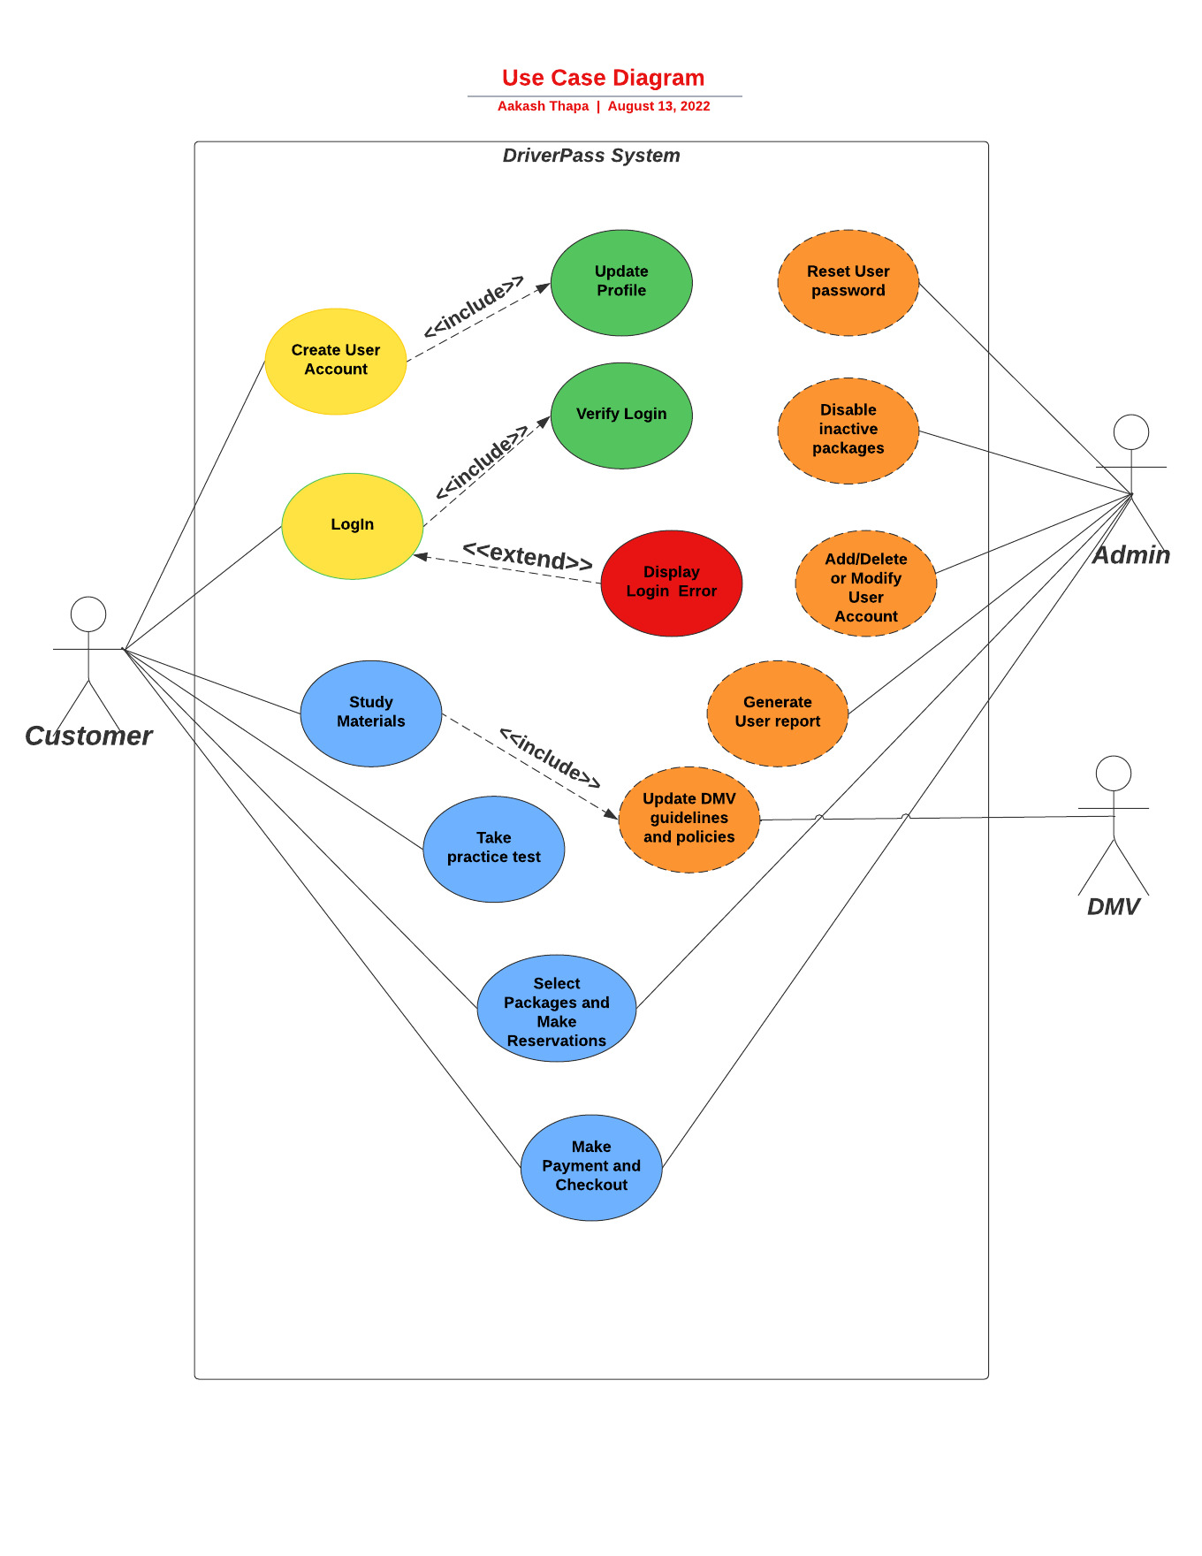
Use Case Diagram
Notes:
We have three different user for our system; customer, admin and DMV. The customer can create a user account, log in to the system, study material, take practice tests, select packages, make reservations and payments. The admin has the capacity of resetting user passwords, disabling inactive packages, adding and deleting user accounts, generating user reports, and verifying packages, reservations and payments. DMV will update their guidelines and policies which is the basis for making new study materials.

Slide 4
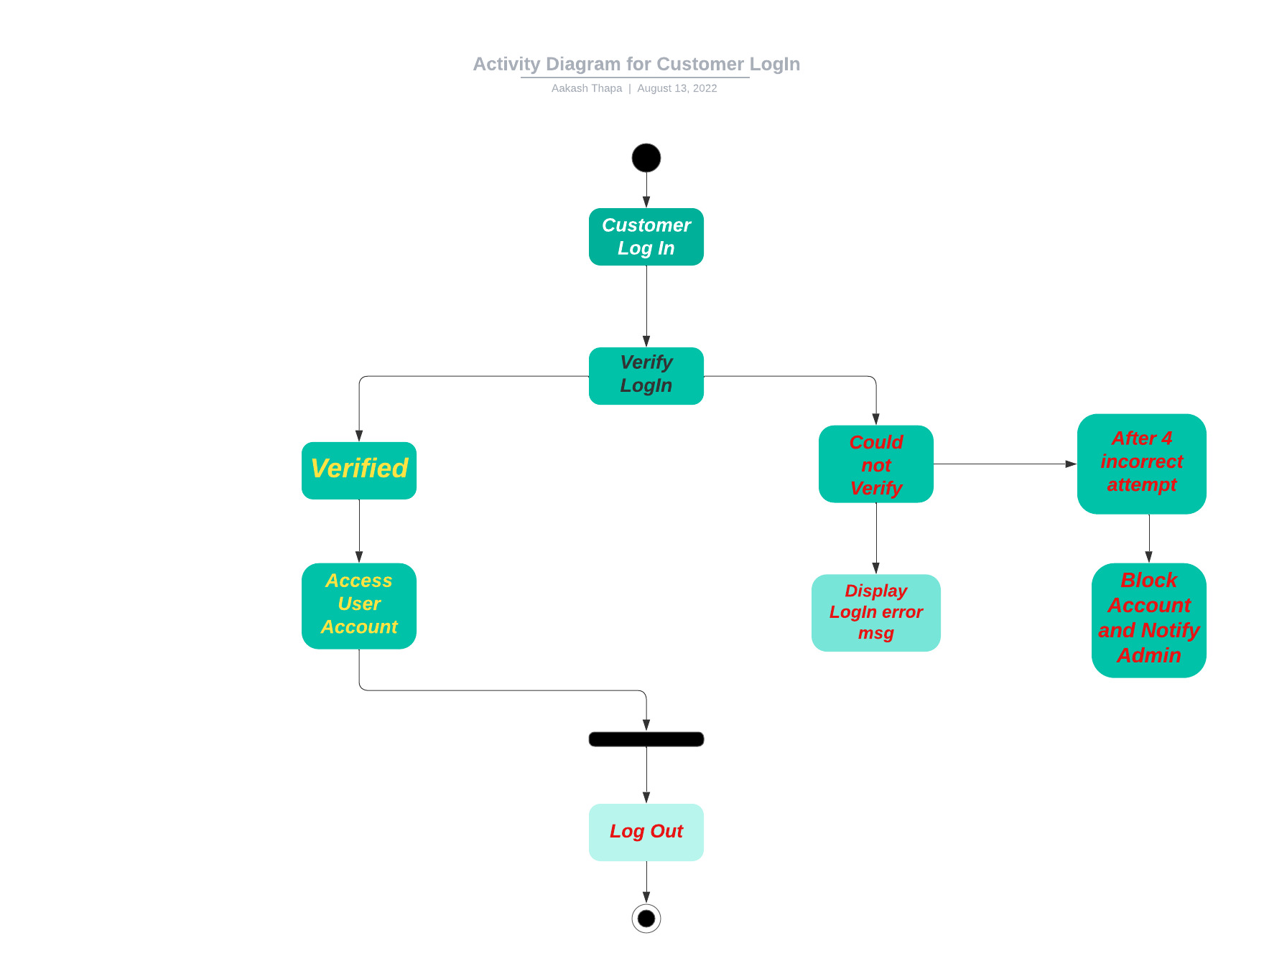
Activity Diagram
Notes:
This diagram shows the activity during the log in of the customer. The customer will browse Driver Pass webpage and use their username and password to log in. Once they login, the verification process starts. If it is verified , then the customer can access their account. If the customer inputs incorrect password, the login error message is displayed. If the customer still inputs incorrect password 4 times then their account is blocked and admin is notified. The customer has to contact admin to activate their account again.

Slide 5
Security
Cloud computing
Unique username and password
Case-sensitive
Account blocked after limited attempts
Notes:
Cloud computing will be used to secure the data exchange between client and server. The user will need a username and password to log in. It will be followed by two-factor authentication (text and email) for extra security purposes. The system will automatically disable the account if there are more than 4 incorrect attempts to log in. The admin will be notified immediately. If the user forgets their password, the system will ask the user for their email address where a password reset line will be sent.

Slide 6
System Limitations
Technological limitations
Time-limitation
Budget
DMV guidelines
Notes:
The first limitation will be always stuffs like the technology, devices, and internet. The second limitation is the time. As of now, the five-month time frame provided is not enough. The third limitation is the budget as it is not mentioned to us. The DMV guidelines are always a limitation as they keep updating it a lot.

