Slide 1
Optimizing CSS

Slide 2
This chapter covers
Reducing the size of your CSS by taking advantage of shorthand CSS properties, using shallow CSS selectors, and implementing the DRY principle
Segmenting your CSS by using unique page templates
Understanding the importance of mobile-first responsive web design
Knowing what makes a page mobile-friendly, and how this matters to Google search rankings
Improving the performance of your CSS by avoiding bad practices and using higher-performing CSS selectors, the flexbox layout engine, and CSS transitions

Slide 3
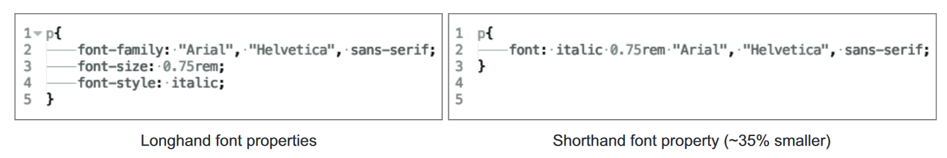
Write shorthand CSS
Using shorthand CSS means using the least verbose properties and values where possible. the rule on the left uses a set of verbose typography styles that takes up 94 bytes, and the rule on the right combines them into a single font property that takes up 60 bytes.

Slide 4
Example
Download Coyle Appliance Repair website and run the client’s website on your local machine by running these commands in a folder of your choosing:
git clone https://github.com/webopt/ch3-css.git
cd ch3-css
npm install
node http.js

Slide 5
When you run this command, a local web server running the client website will be accessible on your computer at http://localhost:8080 and will appear.
if you have another service running on port 8080, we can open the http.js file in your text editor and change the port number on line 8.
To stop the server from running, press Ctrl-C.

Slide 6
The following is a guide for shorthand properties using this syntax:
Use one value when all four sides of an element have the same value. If all four sides of an element have a margin of 20px, you can abbreviate to margin: 20px;.
Use two values when the top/bottom and right/left values are the same. If an element has a margin of 10px on the top and bottom sides, and 20px on the right and left sides, you can abbreviate to margin: 10px 20px;.
Use three values when only the right/left values are the same, but the top and bottom values are different. If an element has a top margin of 10px, a right/left margin of 20px, and a bottom margin of 30px, you can write margin: 10px 20px 30px;.
Use all four values when all of the values are unique.

Slide 7
Write shorthand CSS
Ex.
background-color: #000;
background-image: url(images/bg.gif);
background-repeat: no-repeat;
background-position: left top;
Replace with-
background: #000 url(images/bg.gif) no-repeat left top;

Slide 8
Write shorthand CSS
Ex.
font-style: italic;
font-weight: bold;
font-size: 0.8em;
line-height: 1.2;
font-family: Arial, sans-serif;
Replace with-
font: italic bold 0.8em/1.2 Arial, sans-serif;

Slide 9
Write shorthand CSS
Ex.
border-width: 1px;
border-style: solid;
border-color: #000;
Replace With-
border: 1px solid #000;

Slide 10
Use shallow CSS selectors
Shallowness refers to the specificity of a CSS selector. Overly specific selectors are those that are many levels deep, whereas shallow selectors are less so, specifying only what’s necessary to match an element.
In big style sheets, keeping CSS selectors brief can save space. By reducing complexity, you can keep style sheets lean and load times low, thus boosting the page’s performance.

Slide 11
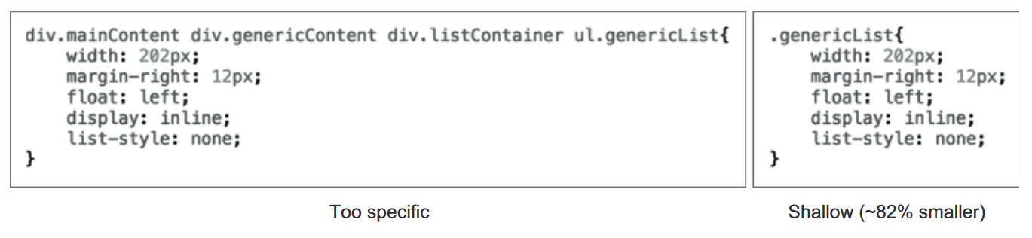
Use shallow CSS selectors
An example of an overly specific CSS selector (left) versus a more succinct one (right). The selector at the left is 67 characters, whereas the one at the right is at 12 characters.

Slide 12
uncss
Node program called uncss to remove all the unused CSS from the style sheet. With these two commands, you can install the program globally and run it against the CSS file from the root folder of the client’s site:
npm install -g uncss
uncss http://localhost:8080 -i .modal.open > css/styles.clean.css
This command takes an argument for a URL. In this case, you’re telling the program to look at the client website that you’re running locally. The -i option is an argument you use to tell the program which selectors you should keep. In this case, you want uncss to leave alone the .modal.open class that slides the modal window into view.

Slide 13
Ex.
Run command in vs code terminal:
uncss index.html styles.css > optimized-styles.css
Index.html
<!DOCTYPE html>
<html lang="en">
<head>
<meta charset="UTF-8">
<meta name="viewport" content="width=device-width, initial-scale=1.0">
<title>Sample Website</title>
<link rel="stylesheet" href="./styles.css">
</head>
<body>
<h1>Welcome to Sample Website</h1>
<p>This is a sample HTML file with some CSS styling applied.</p>
<p >This paragraph has a class that is not used in the HTML.</p>
</body>
</html>
Style.css (before using uncss)
/* styles.css */
body {
background-color: #f0f0f0;
font-family: Arial, sans-serif;
}
h1 {
color: #333;
}
p {
color: #666;
font-size: 16px;
}
.unused {
font-style: italic;
}
optimized-styles.css (after uncss)
/*** uncss> filename: styles.css ***/
/* styles.css */
body {
background-color: #f0f0f0;
font-family: Arial, sans-serif;
}
h1 {
color: #333;
}
p {
color: #666;
font-size: 16px;
}

Slide 14
LESS is more and taming SASS
Precompilers provide features not available in plain CSS , including variables, functions (called mixins) for reuse of styles, and importing capabilities to help make your CSS more modular.
These tools then compile files written in the precompiler language down to plain CSS that can be understood by the browser.
Popular precompilers are LESS (http://lesscss.org) and SASS (http://sass-lang.com).

Slide 15
Variables
These are pretty self-explanatory:
@width: 10px;
@height: @width + 10px;
#header {
width: @width;
height: @height;
}
Outputs:
#header {
width: 10px;
height: 20px;
}

Slide 16
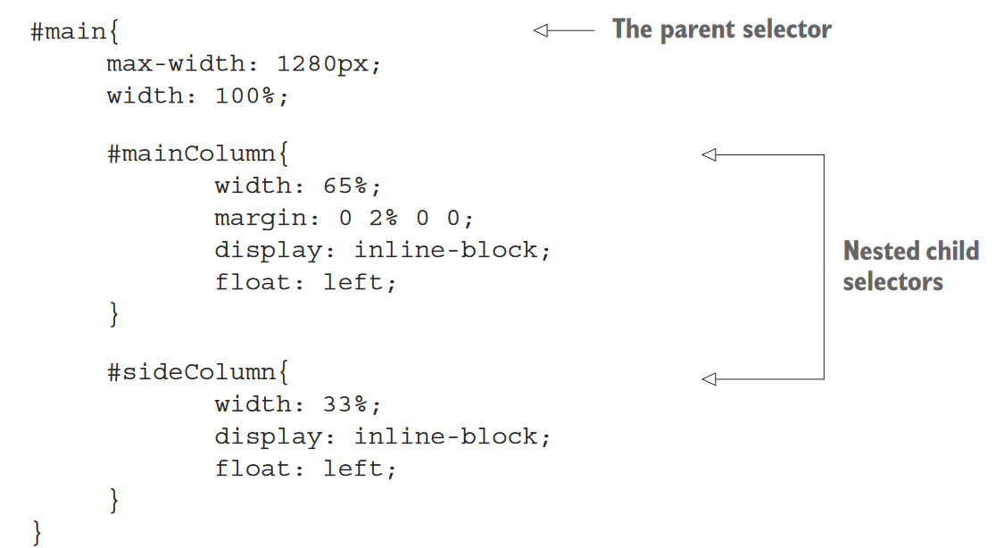
LESS and SASS selector nesting
If you use these tools instead of writing plain CSS , you may be taking advantage of a nested selector feature.
This looks nice, but it’s more of a service to the developer than anything else. It is
more readable, because it mimics the hierarchical structure of the HTML, but this convenience comes at a performance cost.

Slide 17
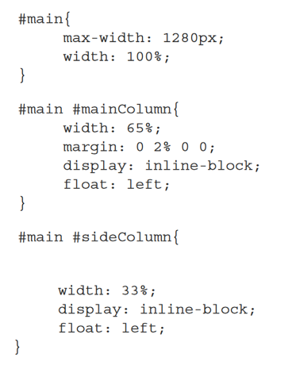
LESS/SASS nested selectors after compilation
When this code is compiled into plain CSS, it looks like this.
After compilation, the CSS selectors are too specific because of the nesting in the original LESS/ SASS code.
In this case, every child of #main is now too specific.
The deeper this nesting goes, the more problematic it’ll be.
Compression and minification do mitigate this somewhat, but these overly specific selectors can slow rendering time as well.

Slide 18
Mixins
Mixins are a way of including ("mixing in") a bunch of properties from one rule-set into another rule-set. So say we have the following class:
And we want to use these properties inside other rule-sets. Well, we just have to drop in the name of the class where we want the properties, like so:
.bordered { border-top: dotted 1px black; border-bottom: solid 2px black; }
#menu a {
color: #111;
.bordered();
}
.post a {
color: red;
.bordered();
}

Slide 19
Don’t repeat yourself
Another problem that front-end developers encounter in CSS is that properties are often duplicated across selectors.
An example is multiple selectors that specify the same background color or font style.
By minimizing the number of times a property is declared, you can cut down on bloat and make your CSS more maintainable.

Slide 20
Going DRY
The DRY principle is simple in that it seeks to reduce redundancy in CSS wherever practical and possible.
Two selectors contain identical background rules. DRY dictates that you should combine these not only to save space, but also to provide increased maintainability.
One method for finding redundancy is to look at common rules and combine them under multiple selectors.

Slide 21
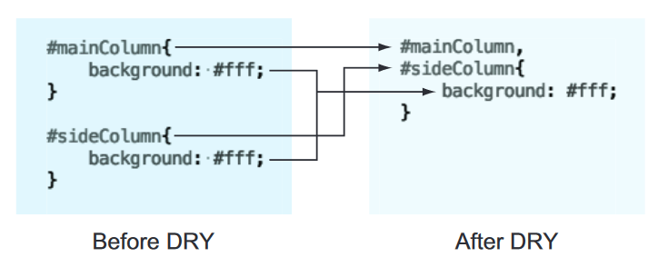
An example of the DRY principle. Two selectors have the same background property. To save space and
eliminate redundancy, the background property and the selectors are combined.

Slide 22
Finding redundancies with csscss
csscss is a command-line tool that finds redundancies in your CSS . To install csscss, you need Ruby’s gem installer, which is similar to Node’s npm executable, but for Ruby packages. If you have SASS installed, gem is already available to you.
To install Ruby on Windows, go to http://rubyinstaller.org/downloads and grab the installer that’s right for your system.
Installing the software is a simple and guided process.
After Ruby is installed, you can install csscss with gem by typing in the following command:
gem install csscss
After a moment, the gem package manager will install csscss, and you’ll be able to run it against a CSS file.

Slide 23
Finding redundancies with csscss
Try running it on styles.css from the client’s site:
csscss styles.css –v –-no-match-shorthand
This command examines styles.css for redundant rules by using two arguments.
The -v argument tells the program to be verbose and print out the matching rules.
The --no-match-shorthand argument keeps the program from expanding any matching shorthand rules such as border-bottom into more-explicit rules such as border-bottom-style. If you want to expand those rules, remove that switch.

Slide 24
A portion of csscss output
{#okayButton}, {#schedule} AND {.submitAppointment a} share 12 declarations
- background: #c40a0a
- border-bottom: 4px solid #630505
- border-radius: 8px
- color: #fff
- display: inline-block
- font-size: 20px
- font-weight: 700
- letter-spacing: -0.5px
- line-height: 22px
- padding: 12px 16px
- text-decoration: none
- text-transform: uppercase

Slide 25
This rule is a good one to start with, because the CSS for these selectors is consistent on all devices.
From here, you’ll employ a lather-rinse-repeat methodology starting from the top.
By the end of this short exercise, you’ll be able to shave off an additional 10% from styles.css.
Do the following for above example:
1. Combine selectors and rules—Combine the selectors #okayButton, #schedule, and .submitAppointment a into a single, comma-separated selector, and copy/paste the suggested rules from the program output.

Slide 26
Combined CSS rule from csscss output
#okayButton, #schedule, .submitAppointment a{
background: #c40a0a;
border-bottom: 4px solid #630505;
border-radius: 8px;
color: #fff;
display: inline-block;
font-size: 20px;
font-weight: 700;
letter-spacing: -0.5px;
line-height: 22px;
padding: 12px 16px;
text-decoration: none;
text-transform: uppercase;
}

Slide 27
2. Clean up the matching rules from the individual selectors—Go back and remove the redundant rules from the original #okayButton, #schedule, and .submitAppointment a selectors.
3. Rerun csscss, examine the output, and repeat—After you’ve cleaned up the redundant rules in the old selectors, rerun csscss to verify that the rule you’ve optimized is stricken from the list.

Slide 28
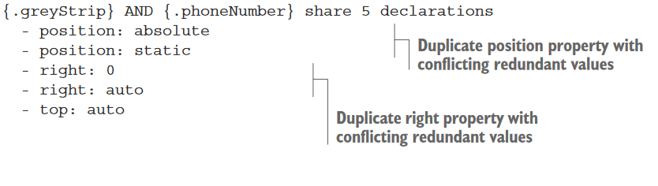
Problematic csscss output
The best approach for responsive sites is to combine values that are common across all breakpoints.

Slide 29
Segment CSS
One way to optimize your CSS is to segment it. Segmentation splits up CSS by styles specific to particular page templates.
It can make sense to combine all of your site’s CSS into one file so that the user already has all of the site’s CSS cached on the first visit.
Serving your CSS this way can be a gamble, however, because your users may never navigate to subpages.
This slows the initial visit to your site.
The safer bet is to spread the weight across a few pages, but intelligently.

Slide 30
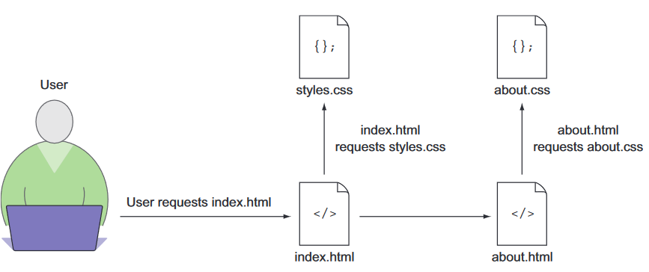
A data-driven method of determining how to segment your site’s CSS is to look at its analytics, and look at the path users take through your website.
With a tool such as Google Analytics, you can visualize this information and use it to make informed decisions on segmentation.
A user navigation flow to pages with CSS segmented by page template. The browser downloads only the CSS it needs for the current page.

Slide 31
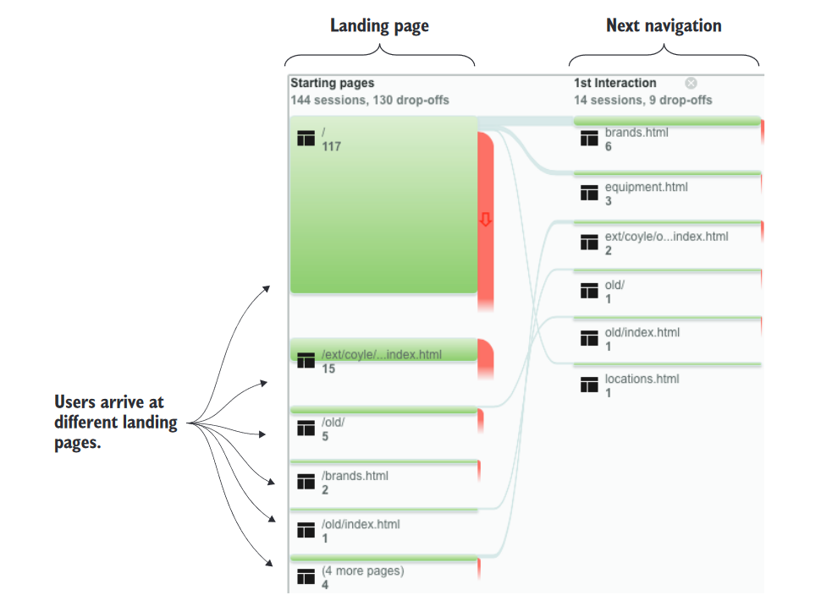
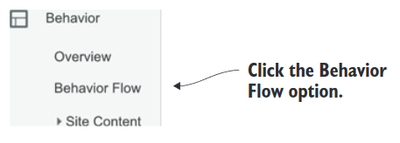
Logging into Google Analytics. Then find the visitor-flow information by navigating to the Behavior section in the left-hand menu, and selecting the Behavior Flow option in the submenu.

Slide 32
Customize framework downloads
CSS frameworks are a big part of the front-end development sphere, and with good reason.
They can be time-saving tools that offer a tremendous service to the developer.
If the benefit of using a CSS framework translates into a benefit for the user, they’re worth considering.
Popular frameworks such as Bootstrap and Foundation allow the developer to customize downloads.
You can have too much of a good thing, though, and it makes sense to prune what you don’t need from these libraries.

Slide 33
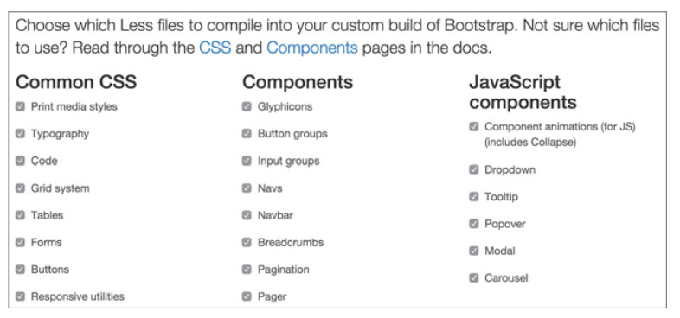
The download customization screen on the Twitter Bootstrap website. Bootstrap allows the developer to specify which parts of the framework the user wants in a custom download
After downloading the customized framework code, don’t be afraid to go further and remove anything else you don’t need.

Slide 34
Mobile-first is user-first
In years past, front-end development has gone from a simple discipline to a more nuanced one.
This is due in part to the emergence of the responsive web design principle pioneered by designer Ethan Marcotte.
In the past, developers would create separate sites for mobile devices with fewer capabilities than their desktop counterparts.
This approach has fallen out of favor, with developers embracing responsive web design instead.
Responsive web design uses one set of markup and modifies its presentation via CSS with respect to the device’s display dimensions.
These dimensions (usually the width) are examined by using a media query, and evaluated against a min-width or max-width value.
Because media queries are flexible, two methods of responsive web design arose: desktop-first and mobile-first responsive design.

Slide 35
@media only screen and (max-width: 600px) {...}
What this query really means is, “If [device width] is less than or equal to 600px, then do {...}.
@media only screen and (min-width: 600px) {...}
What this query really means is, “If [device width] is greater than or equal to 600px, then do {...}“.
@media only screen and (max-width: 600px) and (min-width: 400px) {...}
The query above will trigger only for screens that are between 600px and 400px wide.
The breakpoint is the screen width at which the design and layout of an HTML email or a web page will adapt to provide an optimal viewing experience.

Slide 36
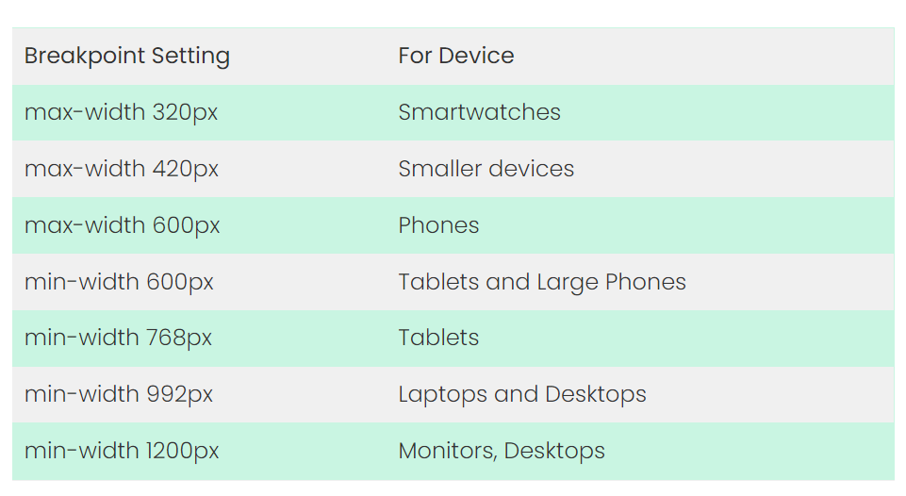

Slide 37
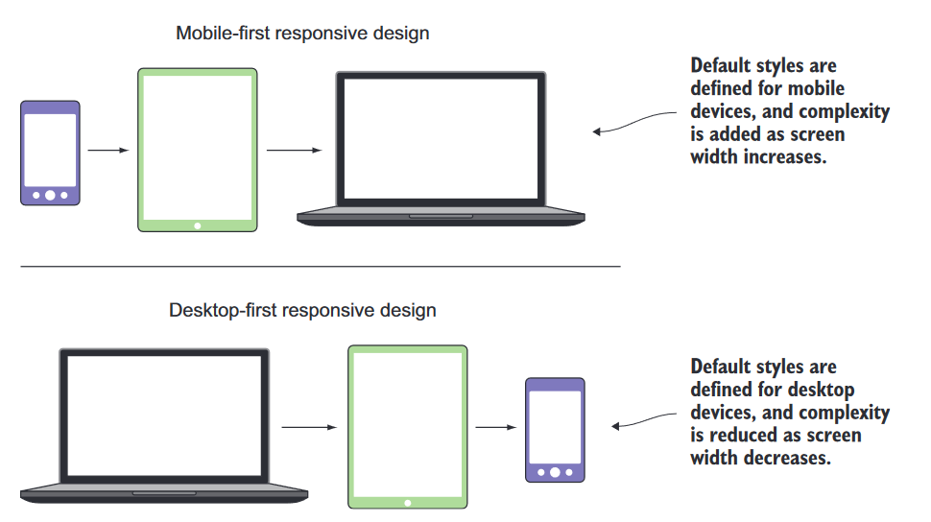
Mobile-first vs. desktop-first
Using the mobile-first method, the default appearance is the mobile version of the site.
In desktop-first sites, the default appearance is the desktop version of the site.

Slide 38
The advantage of mobile-first CSS is that you’re serving CSS intended for the devices that are most likely to consume it.
Because mobile devices often have less processing power and memory than desktop devices, the mobile device shouldn’t have to apply desktop styles, interpret media queries, and then apply mobile styles.
The benefit is in the ability to scale up as you go, rather than scaling down. If you start from the point of least complexity, you can optimize much more easily than if you remove pieces as you scale down.
Most of the time you’ll develop for three device types: mobile phones, tablets, and desktops.
All of these except for the foundational CSS lie within their own media query (commonly referred to as a breakpoint). A media query is a particular point in which new styles are applied. This point is typically a change in the screen’s width. In the case of mobile-first CSS, the mobile styles are the foundation, whereas the tablet and desktop are the breakpoints where changes in the layout occur.

Slide 39
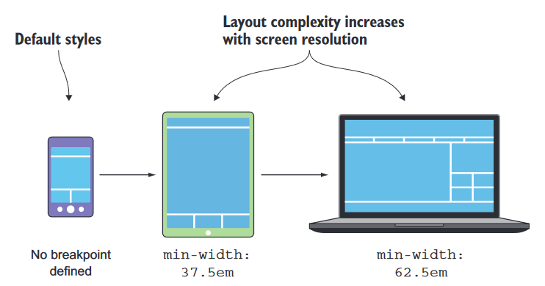
Breakpoints are set using em units rather than px units.
An em is a relative unit that’s calculated based on the document’s default font-size value (typically, 16px).
Calculating em values is done with a simple formula:
px / default font size = em
In this case, the tablet breakpoint of 600px is divided by the default document font-size of 16px to arrive to a value of 37.5em.
The desktop breakpoint of 1000px is converted using the same formula to a value of 62.5em.

Slide 40
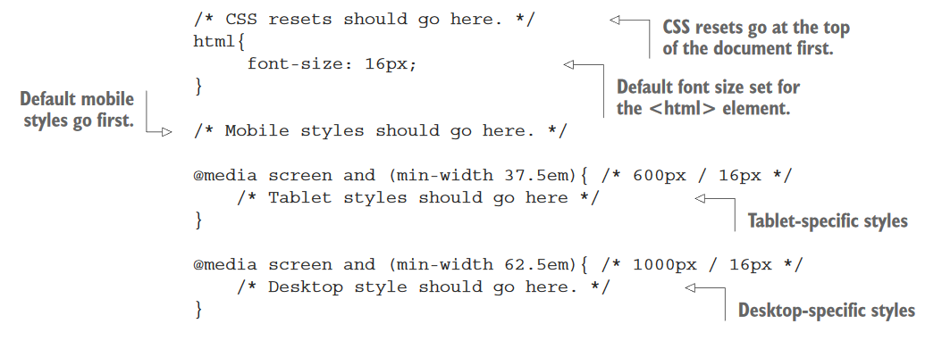
Mobile-first CSS boilerplate

Slide 41
At this point, you’ll include your CSS as you normally would inside a <link> tag.
To ensure that devices properly display your fancy new responsive CSS , you should add the following <meta> tag inside your <head> element:
<meta name="viewport" content="width=device-width,initial-scale=1">
This <meta> tag tells the browser two things: that the device should render the page at the same width as the device’s screen, and that the initial scale of the page should be 100%.

Slide 42
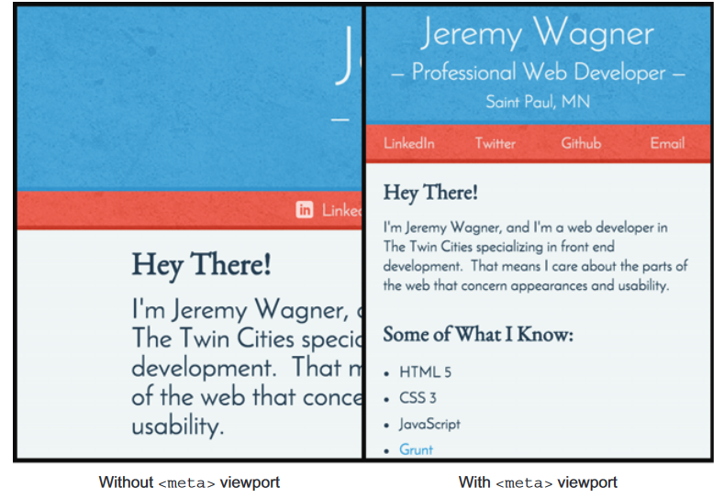
Using Google’s mobile-friendly guidelines
When Google looks at your site, it’s looking for two indicators of a good mobile user experience.
A properly configured viewport—As discussed earlier, the <meta> viewport tag is used by browsers to size content to the device’s screen.
Responsiveness—A site needs to respond to the size of the viewport as it changes. Users are fine with vertical scrolling, but horizontal scrolling is usually a bad user experience, and Google checks that content fits on a device’s screen without horizontal scrolling.

Slide 43
Verifying a site’s mobile-friendliness
Google developed the Mobile-Friendly Test tool, available at https://www.google.com/webmasters/tools/mobile-friendly/
This tool prompts the user to enter a URL to be analyzed.
After the site is analyzed, you’ll see that it passes the mobile-friendly test, and a success message is shown.
For sites that aren’t mobile-friendly, the tool will return a list of reasons that the site failed the test, along with next steps for correcting issues.

Slide 44
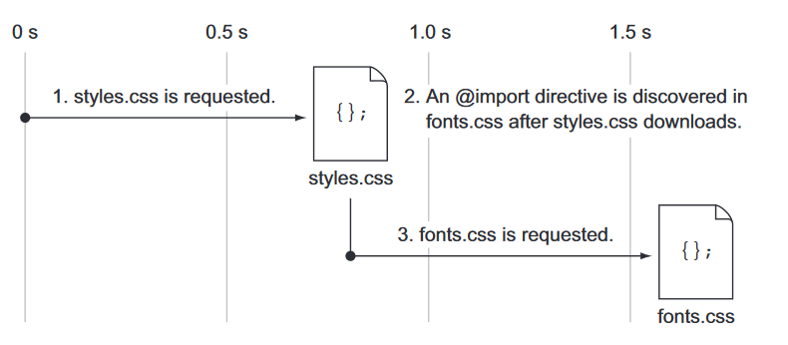
Performance-tuning your CSS
Avoiding the @import declaration:
@import directives in a style sheet aren’t processed until the entire style sheet is downloaded. This behavior causes a delay in the total load time for a web page.
@import serializes requests:
One of the goals of a performance-oriented website is to parallelize as many HTTP requests as possible. Parallel requests are those that are made at, or near, the same time.
Downloads for two style sheets are serialized one after the
other because of an @import directive in styles.css that requests fonts.css.

Slide 45
When @import is used to load a CSS file from within an external style sheet, the request for the initial style sheet must be loaded before the browser discovers the @import directive within it.
@import url("fonts.css");
This contributes to a poor performance pattern; requests are serialized one after the other.
This increases the overall loading and rendering time for a page.
Ideally, you should seek to bundle as many files of the same type as you possibly can.
But some CSS includes in your website can come from third parties, making bundling impractical.
In these cases, you should rely on the HTML <link> tag instead of @import.

Slide 46
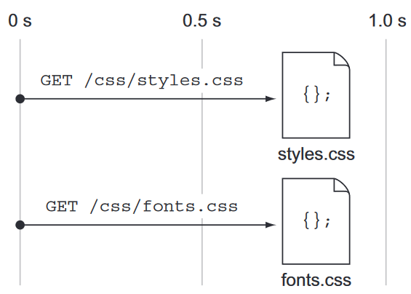
<link> parallelizes requests:
The HTML <link> tag is the best native method for loading CSS . Rather than serializing requests as @import does, it loads requests in parallel.
After the HTML document is scanned, all <link> tags found in the document are loaded.
Unlike the @import directive’s behavior in CSS files, whereby references to external files can be discovered only after a style sheet is downloaded, the <link> tag references are discovered when the HTML file downloads.
It’s better to stick with the <link> tag, because its behavior is predictable and relegates the task of importing CSS to the HTML.
Two requests for style sheets made by using the <link> tag.
The <link> tags are found by the browser after
downloading the HTML, and the browser executes these two requests at the same time.

Slide 47
Placing CSS in the <head>:
You should place references to your CSS as early in the document as possible, and the earliest place you can load your CSS is in the <head> tag.
By doing this, you mitigate two issues: the Flash of Unstyled Content effect, and improving the rendering performance of the page on load.
Preventing the Flash of Unstyled Content:
A compelling reason to keep CSS in the <head> of the HTML is that it prevents your users from seeing your site in an unstyled state.
This phenomenon is called a Flash of Unstyled Content, and it occurs when your users briefly (but noticeably) see your website without any CSS applied to it.
This occurs because browsers read HTML from top to bottom. As the HTML document is read, the browser finds references to external assets. In the case of CSS, browsers are so fast at rendering that the browser has a chance to render the unstyled page before the external CSS is loaded.

Slide 48
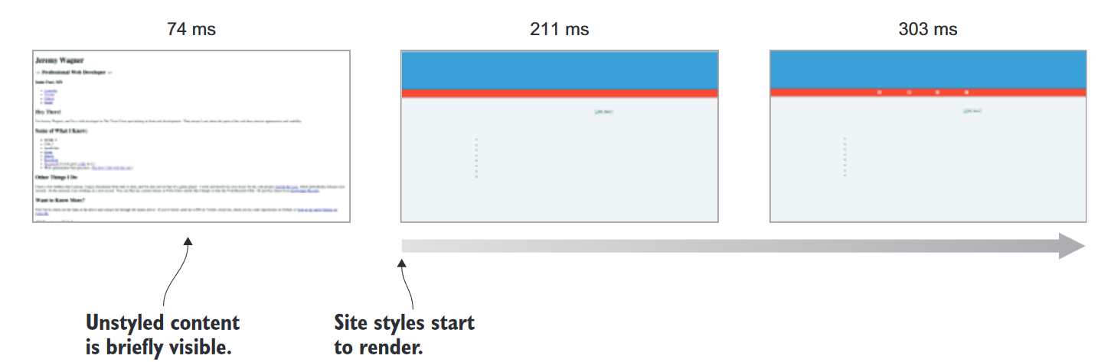
A rendering timeline in Chrome showing the Flash of Unstyled Content effect at left. The document eventually renders as intended, but with a brief display of the unstyled content. In this case, the effect is due to a <link> tag referencing a style sheet being placed at the end of the document.
Practical: Evaluate the effect of a <link> tag referencing a style sheet being placed in head section and in body section of the document.

Slide 49
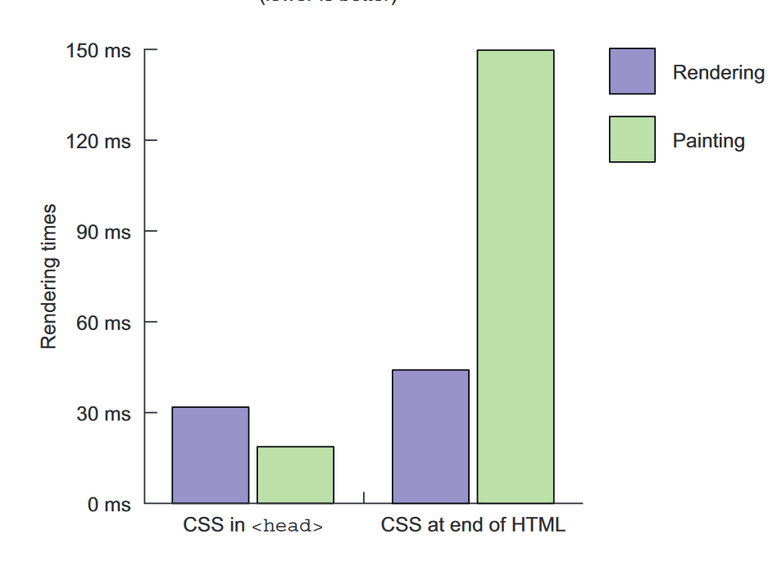
Increasing rendering speed:
Placing your CSS in the <head> of your HTML does more than prevent unstyled content from appearing; it also speeds up the rendering of your site on the initial page load.
The reason for this is that browsers are fast at rendering pages. If a style sheet is included later in the document, the browser has to do more work than if the style sheet was loaded in the <head>, because it has to re-render and repaint the entire DOM .
Rendering performance at load time for example website in Chrome with styles placed in the <head> versus at the end.

Slide 50
Using faster selectors: overall performance for most selector types are similar, but specialized selector types such as the sibling, pseudo class, and attribute selector types are especially expensive.
Using flexbox where possible: For years, laying out content on the web was a combination of floating elements, manipulating their CSS display properties, and using margins and padding.
Flexbox is a new CSS layout engine available in modern browsers. It simplifies laying out elements on a page.
It automatically takes care of spacing, alignment, and justification on both axes.
It not only is a more robust way of laying out elements on a page, but also tends to perform better than traditional methods.

Slide 51
Comparing box model and flexbox styles:
Practical:
You have two test documents, and both are identically styled as a four-column gallery of list items.
The first document uses the box model to lay out elements, and the second uses flexbox.
The structure of the HTML is a single <ul> element containing a little more than 3,000 <li> elements. Each <li> contains an <img> element and a <p> element.
The benchmark is run 10 times, and the figures are averaged.
The CSS is the same, except for the way the list and list item elements are styled.

Slide 52
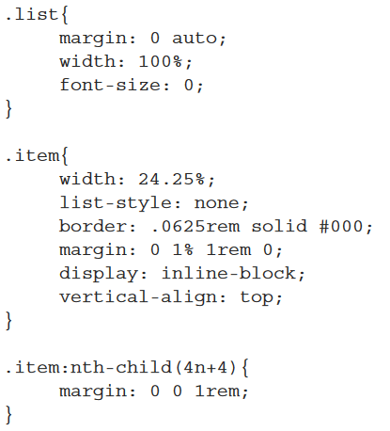
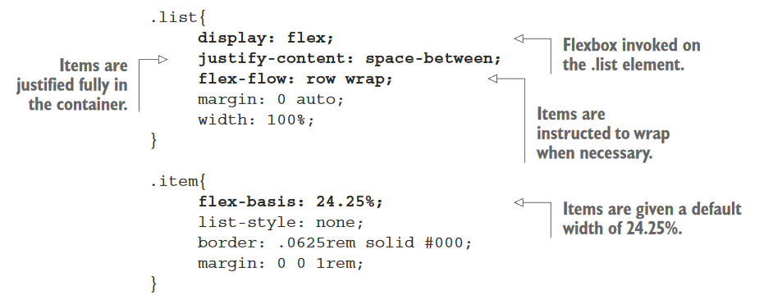
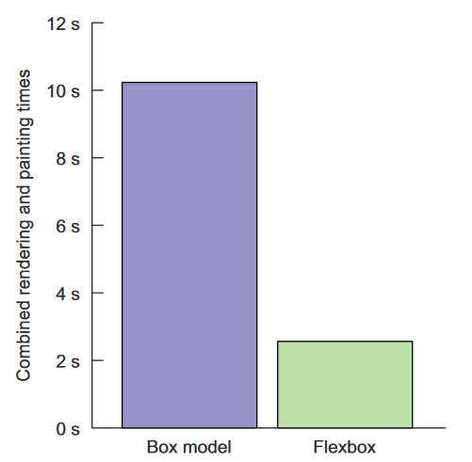
Box model styling
Flexbox styling with flexbox properties in bold
The conclusion you can draw is that when it comes to rendering content, flexbox tends to be a better-performing solution.

Slide 53
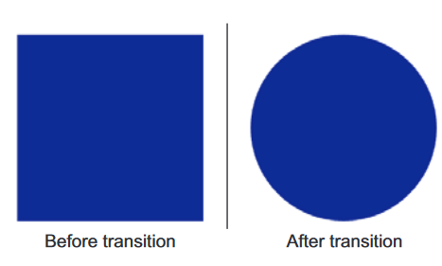
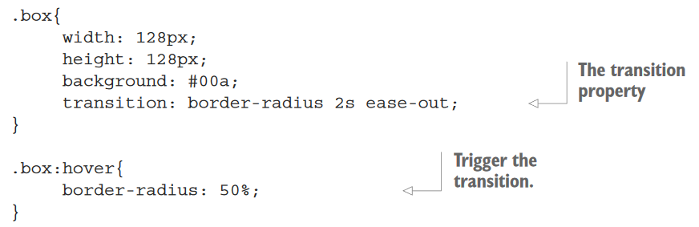
Working with CSS transitions
CSS transitions are a solid choice for simple, linear animations on websites with few animation requirements.
Here are a few advantages of this native CSS feature:
Wide support by modern browsers
More-efficient CPU usage when reflowing complex DOM s
No overhead— CSS transitions come with no overhead, as they ship with the browser.
Syntax- transition: transition-property transition-duration transition-timing-function transition-delay
The .box element on the page before and after a transition on its border-radius property when mouse is hover.

Slide 54
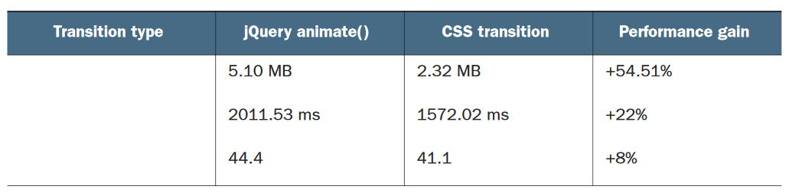
Practical: Observing CSS transition performance
Prepare an animation benchmark that tests the performance of CSS transitions and jQuery-driven animations.
Create two identical HTML documents, each with a <ul> element populated with 128 list items. In each test, animate the list items to grow from a width and height of 5rems to 24rems.
In the first test, use the jQuery animate() method, and in the second test use a CSS transition.
The test is structure should cause a massive amount of DOM reflow.
Test these scenarios by using Google Chrome’s Performance tool five times and recorde the average memory usage, CPU time, and average frame rate of each run.
If your requirements are simple and you can implement high-performance transitions using CSS rather than adding more weight to the page via a JavaScript animation library, then use CSS transitions.

Slide 55
Optimizing transitions with the will-change property
When the browser first executes a CSS transition, it must determine which aspects of that element will change.
developers discovered a CSS hack that would promote the targeted element to a new stacking context by using the translateZ property, it hints to the browser that this element’s rendering should be handled by the GPU in the event that it’s animated with CSS .
translateZ is now targeted for obsolescence with the new will-change property.
translateZ hack tells the browser, “Something’s going to happen here, but I can’t tell you what.”
With the will-change property, you can inform the browser as to which aspects of the element will change such as color, width, or height.
Syntax: will-change: property, [property]...
But be careful: understand that using it improperly can affect the way that resources are allocated on a device.

Slide 56
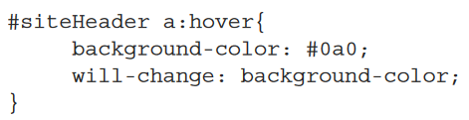
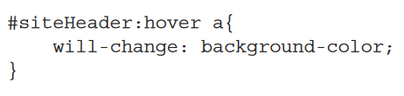
*,
*::before,
*::after{
will-change: all;
}
Don’t do this. This can have a detrimental effect on page performance, especially in heavily layered and complex pages.
If you use this, what you’re doing is preparing the browser for the possibility that every element on the page will change.
Another thing to consider when using will-change is that you need to give the property enough time to work. Ex.
This gives the browser enough time to prepare for changes to the element
This is a poor usage of the will-change property:

Slide 57
You can also use JavaScript to programmatically add will-change on demand.
If a modal window opens and there are background-color transitions on the <button> elements within it, you could use something similar to the following code:
document.querySelector("#modal").style.display = "block";
document.querySelector("#modal button").style.willChange = "background-color";
The key thing to remember about this property is that you anticipate potential changes on elements rather than assuming they’ll happen.

Slide 58
Understanding critical CSS
Critical CSS is an optimization task that enables you to rethink how CSS is loaded by the browser by prioritizing the CSS for above-the-fold content ahead of below-the-fold content.
When done properly, the user senses a perceived decrease in page-load time owing to faster page rendering.
It makes sense to think of the fold this way, because that’s where the concept originates.
When newspapers are printed, the most important story is printed at the top of the front page. This content strategy ensures that when the papers are folded, bundled, and distributed, the lead story is seen on top.

Slide 59
Designers, marketers, and content strategists have long stressed the importance of placing the most important content above the fold, and developers have been tasked with building websites that meet this goal.
The fold changes position depending on the device’s resolution, its orientation, and in the case of desktop devices, the size of the browser window.
The critical CSS, or above-the-fold content—These are styles for content that the user sees immediately and that need to be loaded as fast as possible.
The noncritical CSS, or below-the-fold content—These are styles for content that users don’t see until they begin scrolling down the page. This CSS should be loaded as quickly as possible too, but not before the critical CSS.

Slide 60
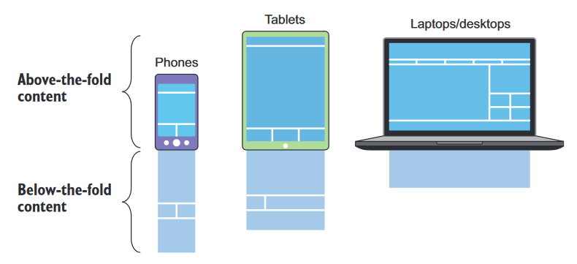
A depiction of above- and below-the-fold content on an array of devices. The above-the-fold content begins at the top of a website and ends at the bottom of the screen. Anything that’s out of the browser’s view is below the fold.
Understanding render blocking :
Render blocking delays the display of a site’s content to the screen. Knowing that time is of the essence and that your users won’t wait for long, you should seek to minimize render blocking.
To see render blocking in action, open the Coyle Appliance Repair website, and capture the activity in Chrome’s Timeline profiler.
Click the Event Log tab, and filter out all but the painting events. If you sort the Start Time column by ascending order, you’ll see the Time to First Paint event on the page.

Slide 61
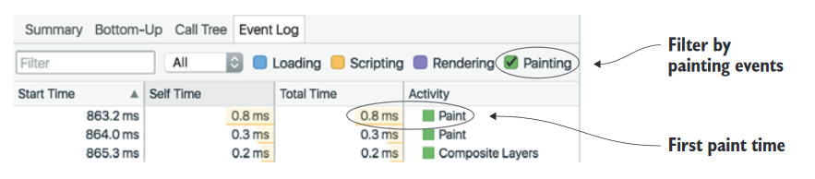
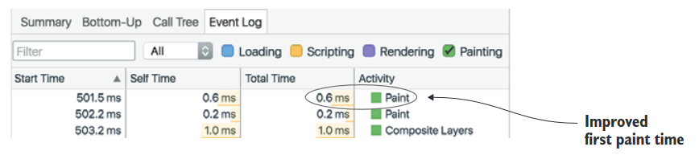
Waiting about 860 ms is a tad long for the document to begin painting. So how do you fix this? For starters, you can inline the website’s CSS directly into index.html, inside the <style> tags. This reduces the time it takes for content to begin rendering, as you can see

Slide 62
Critical CSS: is a technique used in web development to improve page load times by delivering the most important styling information to the browser as quickly as possible.
It involves identifying the CSS rules that are necessary to render the above-the-fold content of a webpage—the content visible in the viewport without scrolling—and delivering only those styles to the browser initially.
This helps in rendering the page quickly, giving users a better initial experience, while the remaining CSS can be loaded asynchronously.

Slide 63
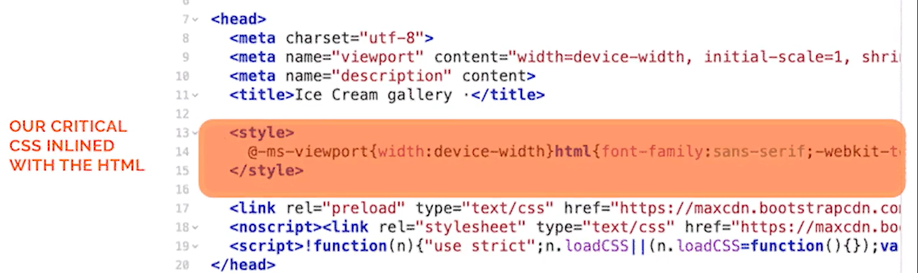
Implementing critical CSS typically involves the following steps:
Identifying Critical CSS: Analyze your webpage to determine which CSS rules are required to style the above-the-fold content. This can be done manually by inspecting the HTML and CSS, or by using tools and services that automate this process.
Node modules:- Critical, Critical-CSS, Penthouse
Extracting Critical CSS: Once identified, extract the critical CSS rules. You can do this manually or use tools and services that automate this process. There are also build tools and plugins available for popular web development frameworks and platforms that can help automate this step.
Inlining Critical CSS: Inline the critical CSS directly into the HTML document, usually within <style> tags in the <head> section. This ensures that the critical styles are available to the browser without needing to wait for an external stylesheet to be downloaded and parsed.

Slide 64
Loading Remaining CSS: Load the remaining CSS asynchronously or defer its loading until after the above-the-fold content has been rendered. This can be done using techniques such as asynchronous loading with JavaScript, or by deferring the loading of CSS files using the defer attribute or JavaScript.
Testing and Optimization: Test your implementation to ensure that it improves page load times without negatively impacting the rendering or functionality of your webpage. You may need to fine-tune your critical CSS selection and implementation based on performance testing and user feedback.
By implementing critical CSS, you can significantly improve the perceived performance of your webpages, leading to better user experiences and potentially higher engagement and conversion rates.

Slide 65
Penthouse GitHub Repository: https://github.com/pocketjoso/penthouse
Online Tools-
https://www.corewebvitals.io/tools/critical-css-generator
CriticalCSS: https://criticalcss.com/
PageSpeed Insights: https://developers.google.com/speed/pagespeed/insights/
WebPageTest: https://www.webpagetest.org/

Slide 66
critical module for Node.js
The critical module for Node.js is a tool that helps automate the process of extracting and inlining critical CSS for web pages. It's particularly useful for optimizing web performance by reducing render-blocking CSS.
How to use the critical module in a Node.js project:
Installation: First, you need to install the critical module. You can do this via npm:
npm install critical --save-dev
Require the Module: In your Node.js script, require the critical module:
const critical = require('critical');

Slide 67
Usage: Use the generate method of the critical module to generate critical CSS for a specific webpage.
example:
const options = {
// Specify the URL of the webpage to generate critical CSS for
base: 'https://example.com',
// Specify the path to the CSS file to extract critical CSS from
css: 'path/to/styles.css',
// Specify the viewport width for which to generate critical CSS
width: 1200,
// Specify the height of the viewport for which to generate critical CSS
height: 800,
// Specify the destination path for the generated critical CSS file
target: 'path/to/critical.css’, };

Slide 68
critical.generate(options)
.then(output => {
// Critical CSS has been generated successfully
console.log('Critical CSS generated successfully:', output);
})
.catch(error => {
// An error occurred while generating critical CSS
console.error('Error generating critical CSS:', error);
});
You can save this script in a file, for example, generate-critical-css.js, and then run it using Node.js:
node generate-critical-css.js
Customization: You can customize the options based on your specific requirements. The critical module provides various options for customization, such as specifying custom dimensions, ignoring certain CSS rules, and more. Refer to the documentation for a comprehensive list of available options.
Integration: You can integrate the critical module into your build process or deployment pipeline to automatically generate critical CSS for your webpages during development or deployment. This ensures that your webpages are optimized for performance before being served to users.

Slide 69
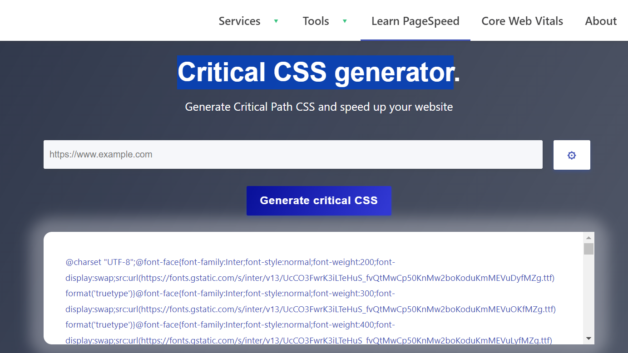
Online Critical CSS generator

