Slide 1
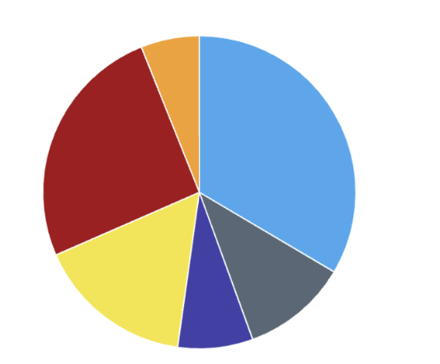
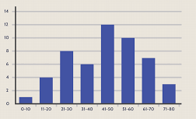
Smarter Charts
Mini Project SE391
By aakash gupta (2k17/SE/02)
UNDER THE SUPERVISION OF
Dr. Anil Singh Parihar

Slide 2
Introduction
There are times when the statistical data provided by graphs such as Pie Charts, Bar Graph etc. are needed so that they could be further processed and manipulated to generate the results or sometimes produce more related graphics at those instances of time we need the data in a flexible format so that we can easily and quickly use stylesheets tools such as Microsoft Excel and complete our goal with the data. Hence we need to extract the data from the image files. Smarter Charts is the tool to accomplish the same.
Although project is not based on a completely original idea and nor it is claimed but the implementation was aimed at creating an open source tool which had fully automation from Image classification to data output in MS Excel Files that too with an intuitive user interface. The product survey revealed that no tool had all the features or if it did it was not a free to use tool but was a proprietary software.

Slide 3
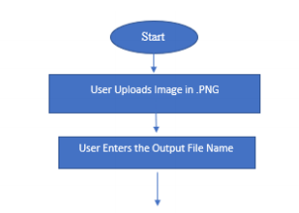
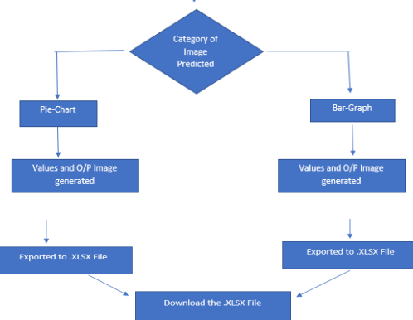
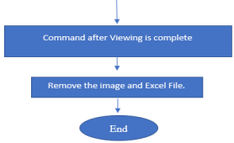
The Workflow of Smarter Charts.

Slide 4
The Web Application
Streamlit which is a python based framework is used to make the web application
There are 13 Streamlit calls which when used in combinations can create elaborate and interactive web applications in a matter of hours. Out of the 13 calls, 6 were used in making of Smarter Charts.
The web application for smarter charts aims for Ease of Use for the user and Intuitiveness for the user.
Few shortcomings of Streamlit are,
Major Bugs
Due to its young age, community support is not as strong as few other frameworks.

Slide 5
Image classification
Smarter charts classifies the input image using a deep neural network which are nothing but function approximators.
The neural network for smarter charts is made using the transfer learning technique where the user takes an existing neural network and then modify it according to our requirements and finally train the model.
Transfer learning makes the learning process quicker and reduces the data needed.
We have used the ImageNet competition winning neural network ResNet34 added a linear layer with 512 in features and 2 out features.

Slide 6
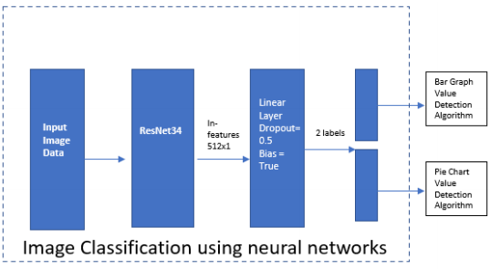
Architecture of our Network

Slide 7
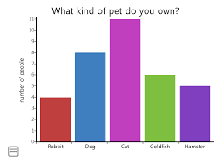
Bar graph value detection
Bar Graphs are a pictorial representation of categorical data. For example Sales of a car YoY.
The step by step approach used for value detection in a bar graph
X- axis detection using the list of corners,
Detecting a verification point on a bar
Scanning along the x-axis and storing all the gaps with their colors and sizes.
Calculating thickness of a bar(most occurring thickness of gap) and computing all the bars.
Calculating Vertical heights.

Slide 8
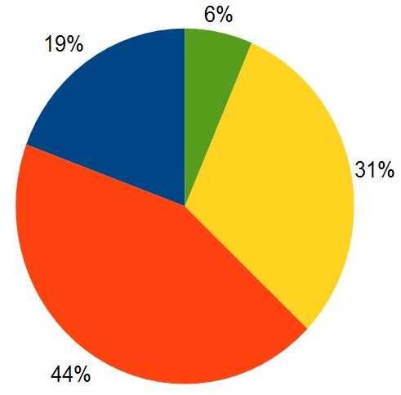
Pie Chart Value detection
In Pie Charts the value representation is very different from bar graph, and it is not used to represent the absolute values of a category but just the share of it in percentages. For example : Market Share of various car manufacturers in the market.
The step by step approach used for value detection in a pie chart.
We detect the center using 8 different points using a circle around the corners with a radius R which is defined on basis of the dimension of the image.
Calculating the radius by creating the circle around the center and then incrementing it and checking 4 points on that circle.
We detect the edges around the centre point.
Calculating points on the edge of the pie chart
Calculating the angle subtended by the detected sectors.

Slide 9
XLSX Writer
To export the data generated by the Bar graph or pie chart algorithm we use Xlsxwriter library Of Python. It is an open-source and free to use tool.
Using this tool, we can write text, merge cells, export images and it even has the support for Pandas so that one could directly put their data frame to an excel file.
We made use of it’s cell formatting feature to make the output Excel file legible and presentable.

Slide 10
XLSX Writer
Python Debugger
To export the data generated by the Bar graph or pie chart algorithm we use Xlsxwriter library Of Python. It is an open-source and free to use tool.
Using this tool, we can write text, merge cells, export images and it even has the support for Pandas so that one could directly put their data frame to an excel file.
We made use of it’s cell formatting feature to make the output Excel file legible and presentable.
Used throughout the code for debugging the code.
We just need to place the function pdb.set_trace() wherever we need to debug the code.

Slide 11
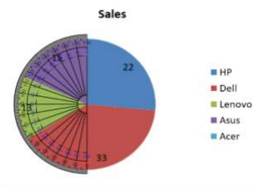
Result of Pie Chart
Categories | Actual value(Tracing) | Smarter Charts Result | Error
Asus | 19.16% | 18.68% | 2.5%
Lenovo | 15.83% | 15.44% | 2.52%
Dell | 40% | 38.84% | 2.9%
HP | 25.01% | 27.04% | 8.12%
Angle subtended by Lenovo Category. Courtesy : Ursupplier.com

Slide 12
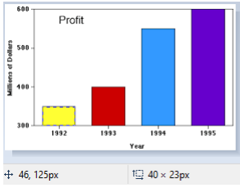
Result of Bar Graph
Categories | Actual value(Tracing) | Smarter Charts Result | Error
1992 | 23 | 21 | 8.69%
1993 | 47 | 45 | 4.25%
1994 | 117 | 114 | 2.56%
1995 | 141 | 138 | 2.13%
Dimension for Year 1992 using tracing technique.

Slide 13
End of Presentation
Thank you.

