Slide 1
Interrupt Driven Data Transfer Scheme

Slide 2
Why do we need data transfer schemes ?
Availability of wide variety of I/O devices because of variations in manufacturing technologies e.g. electromechanical, electrical, mechanical, electronic etc.
Enormous variation in the range of speed.
Wide variation in the format of data.

Slide 3
Interrupt driven data transfer
Basic Interrupt Structure
Interrupt is a mechanism by which the processor is made to transfer control from its current program execution to another program of more importance or higher priority.
The interrupt signal may be given to the processor by any external peripheral device.
Interrupts are in general generated by a variety of sources either internal or external to the CPU.
Interrupts are the primary means by which Input and Output devices obtain the services of the CPU.
Notes:
3

Slide 4
Interrupts
Interrupt is a process where an external device can get the attention of the microprocessor.
The process starts from the I/O device
Classification of Interrupts
Interrupts can be classified into two types:
Maskable Interrupts (Can be delayed or Rejected)
Non-Maskable Interrupts (Can not be delayed or Rejected)
Interrupts can also be classified into:
Vectored (the address of the service routine is hard-wired)
Non-vectored (the address of the service routine needs to be supplied externally by the device)

Slide 5
Interrupts
An interrupt is considered to be an emergency signal that may be serviced. The Microprocessor may respond to it as soon as possible.
What happens when MP is interrupted ?
When the Microprocessor receives an interrupt signal, it suspends the currently executing program and jumps to an Interrupt Service Routine (ISR) to respond to the incoming interrupt. Each interrupt will most probably have its own ISR.

Slide 6
Responding to Interrupts
Responding to an interrupt may be immediate or delayed depending on whether the interrupt is maskable or non-maskable and whether interrupts are being masked or not.
There are two ways of redirecting the execution to the ISR depending on whether the interrupt is vectored or non-vectored.
Vectored: The address of the subroutine is already known to the Microprocessor
Non Vectored: The device will have to supply the address of the subroutine to the Microprocessor

Slide 7
The 8085 Interrupts:
When a device interrupts, it actually wants the MP to give a service which is equivalent to asking the MP to call a subroutine. This subroutine is called ISR (Interrupt Service Routine)
The ‘EI’ instruction is a one byte instruction and is used to Enable the non-maskable interrupts.
The ‘DI’ instruction is a one byte instruction and is used to Disable the non-maskable interrupts.
The 8085 has a single Non-Maskable interrupt.
The non-maskable interrupt is not affected by the value of the Interrupt Enable flip flop.

Slide 8
The 8085 Interrupts
The 8085 has 5 interrupt inputs.
The INTR input.
The INTR input is the only non-vectored interrupt.
INTR is maskable using the EI/DI instruction pair.
RST 5.5, RST 6.5, RST 7.5 are all automatically vectored.
RST 5.5, RST 6.5, and RST 7.5 are all maskable.
TRAP is the only non-maskable interrupt in the 8085
TRAP is also automatically vectored

Slide 9
The 8085 Interrupts
Interrupt name | Maskable | Vectored
INTR | Yes | No
RST 5.5 | Yes | Yes
RST 6.5 | Yes | Yes
RST 7.5 | Yes | Yes
TRAP | No | Yes

Slide 10
Interrupt Vectors and the Vector Table
An interrupt vector is a pointer to where the ISR is stored in memory.
All interrupts (vectored or otherwise) are mapped onto a memory area called the Interrupt Vector Table (IVT).
The IVT is usually located in memory page 00 (0000H - 00FFH).
The purpose of the IVT is to hold the vectors that redirect the microprocessor to the right place when an interrupt arrives.

Slide 11
Cont..
Example:
Let , a device interrupts the Microprocessor using the RST 7.5 interrupt line.
Because the RST 7.5 interrupt is vectored, Microprocessor knows , in which memory location it has to go using a call instruction to get the ISR address. RST7.5 is knows as Call 003Ch to Microprocessor. Microprocessor goes to 003C location and will get a JMP instruction to the actual ISR address. The Microprocessor will then, jump to the ISR location

Slide 12
The 8085 Non-Vectored Interrupt Process
The interrupt process should be enabled using the EI instruction.
The 8085 checks for an interrupt during the execution of every instruction.
If INTR is high, MP completes current instruction, disables the interrupt and sends INTA (Interrupt acknowledge) signal to the device that interrupted
INTA allows the I/O device to send a RST instruction through data bus.
Upon receiving the INTA signal, MP saves the memory location of the next instruction on the stack and the program is transferred to ‘call’ location (ISR Call) specified by the RST instruction

Slide 13
The 8085 Non-Vectored Interrupt Process
Microprocessor Performs the ISR.
ISR must include the ‘EI’ instruction to enable the further interrupt within the program.
RET instruction at the end of the ISR allows the MP to retrieve the return address from the stack and the program is transferred back to where the program was interrupted.

Slide 14
The 8085 Non-Vectored Interrupt Process
The 8085 recognizes 8 RESTART instructions: RST0 - RST7.
each of these would send the execution to a predetermined hard-wired memory location:
Restart Instruction | Equivalent to
RST0 | CALL 0000H
RST1 | CALL 0008H
RST2 | CALL 0010H
RST3 | CALL 0018H
RST4 | CALL 0020H
RST5 | CALL 0028H
RST6 | CALL 0030H
RST7 | CALL 0038H

Slide 15
Issues in Implementing INTR Interrupts
How long must INTR remain high?
The microprocessor checks the INTR line one clock cycle before the last T-state of each instruction.
The INTR must remain active long enough to allow for the longest instruction.
The longest instruction for the 8085 is the conditional CALL instruction which requires 18 T-states.
Therefore, the INTR must remain active for 17.5 T-states.
If f= 3MHZ then T=1/f and so, INTR must remain active for [ (1/3MHZ) * 17.5 ≈ 5.8 micro seconds].

Slide 16
Issues in Implementing INTR Interrupts
How long can the INTR remain high?
The INTR line must be deactivated before the EI is executed. Otherwise, the microprocessor will be interrupted again.
Once the microprocessor starts to respond to an INTR interrupt, INTA becomes active (=0).
Therefore, INTR should be turned off as soon as the INTA signal is received.

Slide 17
Issues in Implementing INTR Interrupts
Can the microprocessor be interrupted again before the completion of the ISR?
As soon as the 1st interrupt arrives, all maskable interrupts are disabled.
They will only be enabled after the execution of the EI instruction.
Therefore, the answer is: “only if we allow it to”.
If the EI instruction is placed early in the ISR, other interrupt may occur before the ISR is done.

Slide 18
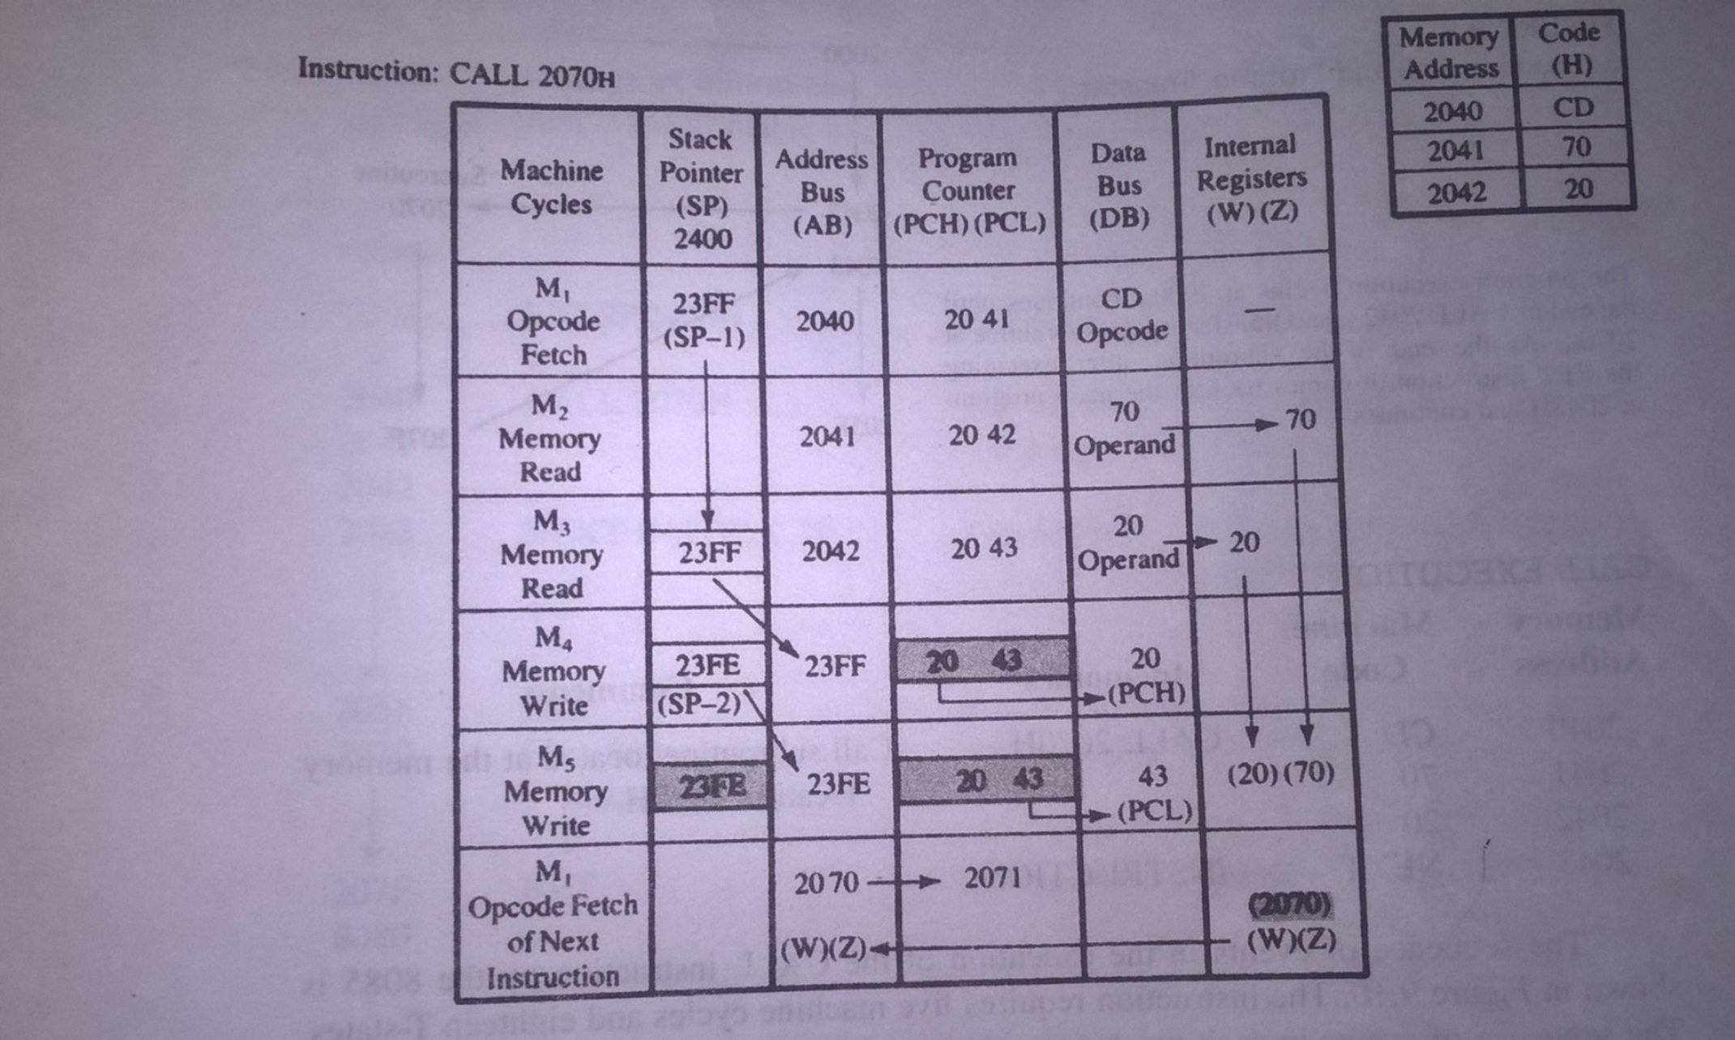
Call sequence..

Slide 19
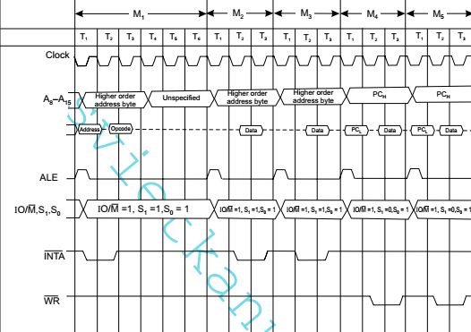

Slide 20
Restart Sequence
The restart sequence is made up of three machine cycles
In the 1st machine cycle:
The microprocessor sends the INTA signal.
While INTA is active the microprocessor reads the data lines expecting to receive, from the interrupting device, the opcode for the specific RST instruction.
In the 2nd machine cycles:
The address of stack pointer(next location address) is placed on address bus
then high-order bits of PC is stored on stack.
In the 3rd machine cycles:
The low order bits of PC is stored in the next location of the stack.
Then the microprocessor jumps to the address associated with the specified RST
instruction.

Slide 21
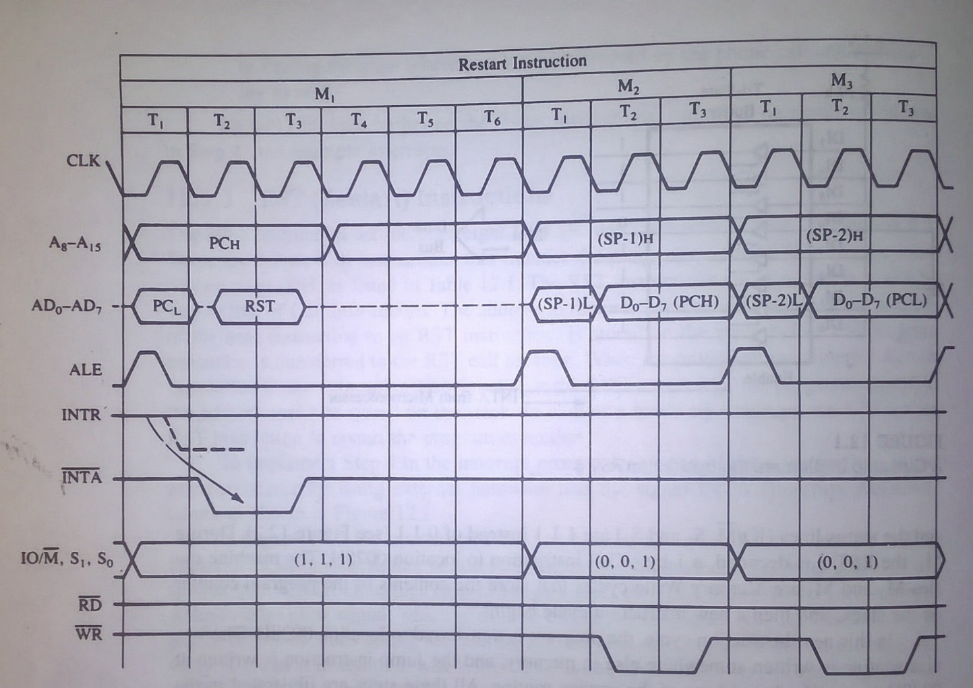

Slide 22
Hardware Generation of RST Opcode
How does the external device produce the opcode for the appropriate RST instruction?
The opcode is simply a collection of bits.
So, the device needs to set the bits of the data bus to the appropriate value in response to an INTA signal.

Slide 23
Hardware Generation of RST Opcode
The following is an example of generating RST 5:
RST 5’s opcode is EF =
D D
76543210
11101111

Slide 24
Hardware Generation of RST Opcode
During the interrupt acknowledge machine cycle, (the 1st machine cycle of the RST operation):
The Microprocessor activates the INTA signal.
This signal will enable the Tri-state buffers, which will place the value EFH on the data bus.
Therefore, sending the Microprocessor the RST 5 instruction.
The RST 5 instruction is exactly equivalent to CALL 0028H

Slide 25
The 8085 Maskable/Vectored Interrupts
The 8085 has 4 Masked/Vectored interrupt inputs.
RST 5.5, RST 6.5, RST 7.5
They are all maskable.
They are automatically vectored according to the following table:
The vectors for these interrupt fall in between the vectors for the RST instructions. That’s why they have names like RST 5.5 (RST 5 and a half).
Interrupt | Vector
RST 5.5 | 002CH
RST 6.5 | 0034H
RST 7.5 | 003CH

Slide 26
Masking RST 5.5, RST 6.5 and RST 7.5
These three interrupts are masked at two levels:
Through the Interrupt Enable flip flop and the EI/DI instructions.
The Interrupt Enable flip flop controls the whole maskable interrupt process.
Through individual mask flip flops that control the availability of the individual interrupts.These flip flops control the interrupts individually.

Slide 27
Maskable Interrupts and vector locations
RST7.5 Memory
RST 7.5
M 7.5
RST 6.5
M 6.5
RST 5.5
M 5.5
INTR
Interrupt
Enable
Flip Flop
** See Fig 12.5 of the Text Book for a detailed look

Slide 28
The 8085 Maskable/Vectored Interrupt Process
The interrupt process should be enabled using the EI instruction.
The 8085 checks for an interrupt during the execution of every instruction.
If there is an interrupt, and if the interrupt is enabled using the interrupt mask, the microprocessor will complete the executing instruction, and reset the interrupt flip flop.
The microprocessor then executes a call instruction that sends the execution to the appropriate location in the interrupt vector table.

Slide 29
The 8085 Maskable/Vectored Interrupt Process
When the microprocessor executes the call instruction, it saves the address of the next instruction on the stack.
The microprocessor jumps to the specific service routine.
The service routine must include the instruction EI to re-enable the interrupt process.
At the end of the service routine, the RET instruction returns the execution to where the program was interrupted.

Slide 30
Manipulating the Masks
The Interrupt Enable flip flop is manipulated using the EI/DI instructions.
The individual masks for RST 5.5, RST 6.5 and RST 7.5 are manipulated using the SIM instruction.
This instruction takes the bit pattern in the Accumulator and applies it to the interrupt mask enabling and disabling the specific interrupts.

Slide 31
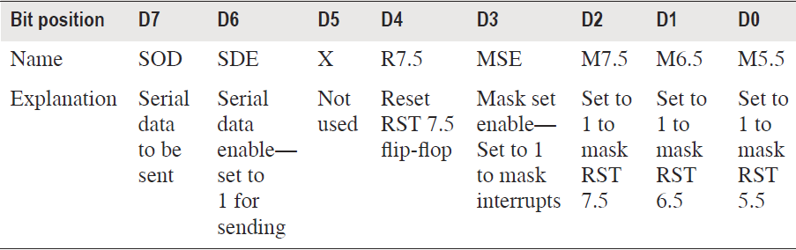
How SIM Interprets the Accumulator

Slide 32
SIM and the Interrupt Mask
Bit 0 is the mask for RST 5.5, bit 1 is the mask for RST 6.5 and bit 2 is the mask for RST 7.5.
If the mask bit is 0, the interrupt is available.
If the mask bit is 1, the interrupt is masked.
Bit 3 (Mask Set Enable - MSE) is an enable for setting the mask.
If it is set to 0 the mask is ignored and the old settings remain.
If it is set to 1, the new setting are applied.
The SIM instruction is used for multiple purposes and not only for setting interrupt masks.
It is also used to control functionality such as Serial Data Transmission. Therefore, bit 3 is necessary to tell the microprocessor whether or not the interrupt masks should be modified

Slide 33
SIM and the Interrupt Mask
The RST 7.5 interrupt is the only 8085 interrupt that has memory.
If a signal on RST7.5 arrives while it is masked, a flip flop will remember the signal.
When RST7.5 is unmasked, the microprocessor will be interrupted even if the device has removed the interrupt signal.
This flip flop will be automatically reset when the microprocessor responds to an RST 7.5 interrupt.
Bit 4 of the accumulator in the SIM instruction allows explicitly resetting the RST 7.5 memory even if the microprocessor did not respond to it.
Bit 5 is not used by the SIM instruction

Slide 34
Using the SIM Instruction to Modify the Interrupt Masks
Example: Set the interrupt masks so that RST5.5 is enabled, RST6.5 is masked, and RST7.5 is enabled.
First, determine the contents of the accumulator
- Enable 5.5 bit 0 = 0
- Disable 6.5 bit 1 = 1
- Enable 7.5 bit 2 = 0
- Allow setting the masks bit 3 = 1
- Don’t reset the flip flop bit 4 = 0
- Bit 5 is not used bit 5 = 0
- Don’t use serial data bit 6 = 0
- Serial data is ignored bit 7 = 0
M7.5
M6.5
SDO
MSE
M5.5
SDE
R7.5
XXX
0
0
0
0
1
0
1
0
Contents of accumulator are: 0AH
EI ; Enable interrupts including INTR
MVI A, 0A ; Prepare the mask to enable RST 7.5, and 5.5, disable 6.5
SIM ; Apply the settings RST masks

Slide 35
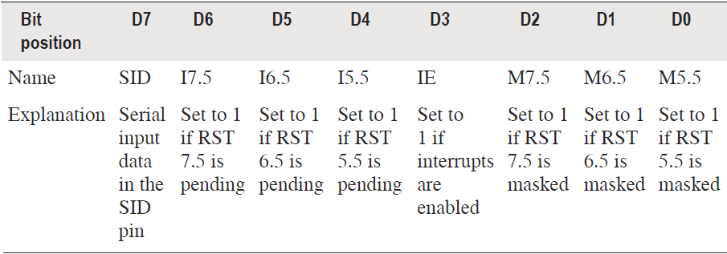
Determining the Current Mask Settings
RIM instruction: Read Interrupt Mask
Load the accumulator with an 8-bit pattern showing the status of each interrupt pin and mask.

Slide 36
The RIM Instruction and the Masks
Bits 0-2 show the current setting of the mask for each of RST 7.5, RST 6.5 and RST 5.5
They return the contents of the three mask flip flops.
They can be used by a program to read the mask settings in order to modify only the right mask.
Bit 3 shows whether the maskable interrupt process is enabled or not.
It returns the contents of the Interrupt Enable Flip Flop.It can be used by a
program to determine whether or not interrupts are enabled.

Slide 37
The RIM Instruction and the Masks
Bits 4-6 show whether or not there are pending interrupts on RST 7.5, RST 6.5, and RST 5.5
Bits 4 and 5 return the current value of the RST5.5 and RST6.5 pins.
Bit 6 returns the current value of the RST7.5 memory flip flop.
Bit 7 is used for Serial Data Input.
The RIM instruction reads the value of the SID pin on the microprocessor and returns it in this bit.

Slide 38
TRAP
TRAP is the only non-maskable interrupt.
It does not need to be enabled because it cannot be disabled.
It has the highest priority amongst interrupts.
It needs to be high and stay high to be recognized.
Once it is recognized, it won’t be recognized again until it goes low, then high again.
TRAP is usually used for power failure and emergency shutoff.

Slide 39
The 8085 Interrupts
Interrupt Name | Maskable | Masking Method | Vectored | Memory | Triggering Method
INTR | Yes | DI / EI | No | No | Level Sensitive
RST 5.5 / RST 6.5 | Yes | DI / EI SIM | Yes | No | Level Sensitive
RST 7.5 | Yes | DI / EI SIM | Yes | Yes | Edge Sensitive
TRAP | No | None | Yes | No | Level & Edge Sensitive

