Slide 1

Kritical Hacks 2026

Slide 2
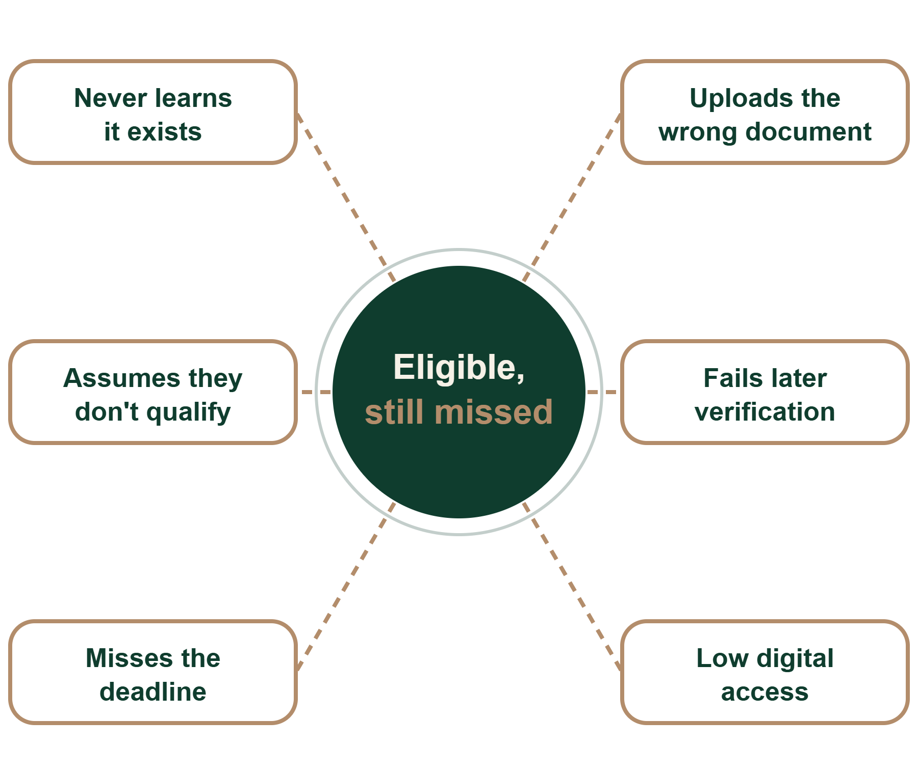
Benefits exist. Eligible people still miss them.
sound familiar?
The problem
Schemes are scattered across portals, formats and languages, so a first-generation student can lose out at any one of six steps.
A missed scholarship can cost
Fees
Books
Transport
Hostel

Slide 3
You bring the dream. We handle the paperwork.
(yes, all six!)
The solution
01
02
03
Unified knowledge base
Personalized matcher
Auto-fill, not auto-submit
One live catalogue of central, state and institutional schemes, in structured fields.
Build a profile once. See only schemes you qualify for, ranked by fit and deadline.
Pre-fills verified details and checks documents. You review and confirm every submission.
04
05
06
Deadline and status tracker
Multilingual, low-bandwidth
Trust and privacy
Encrypted documents, explicit consent and a log of every action taken.
Follows every stage after submission and nudges you by WhatsApp, SMS or app.
Voice, WhatsApp and SMS access in Indian languages, built for low-literacy users.

Slide 4
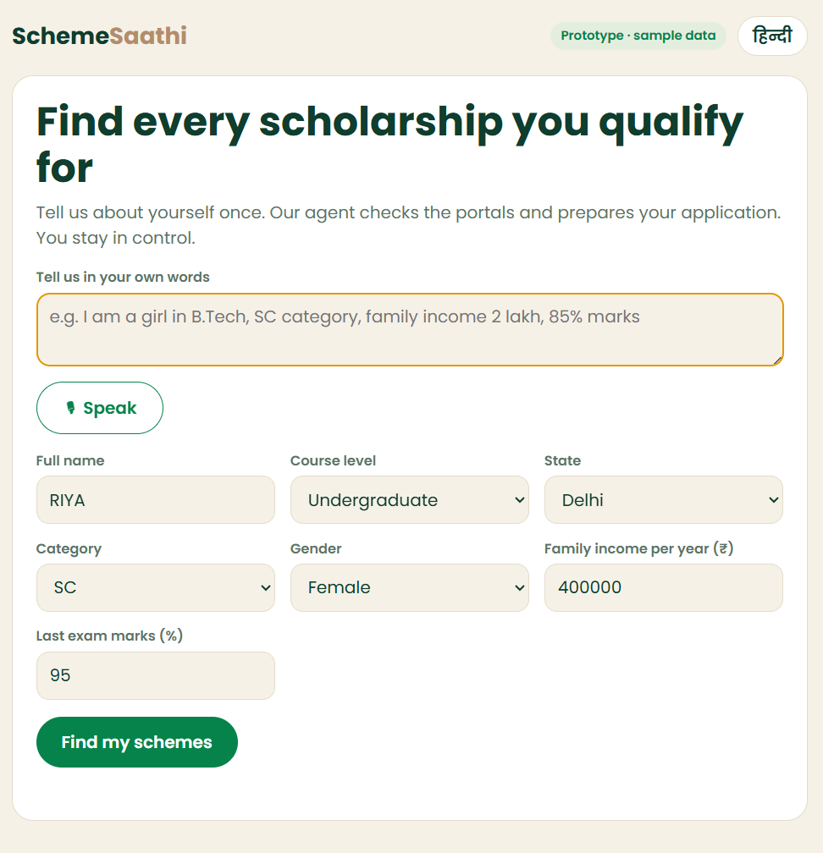
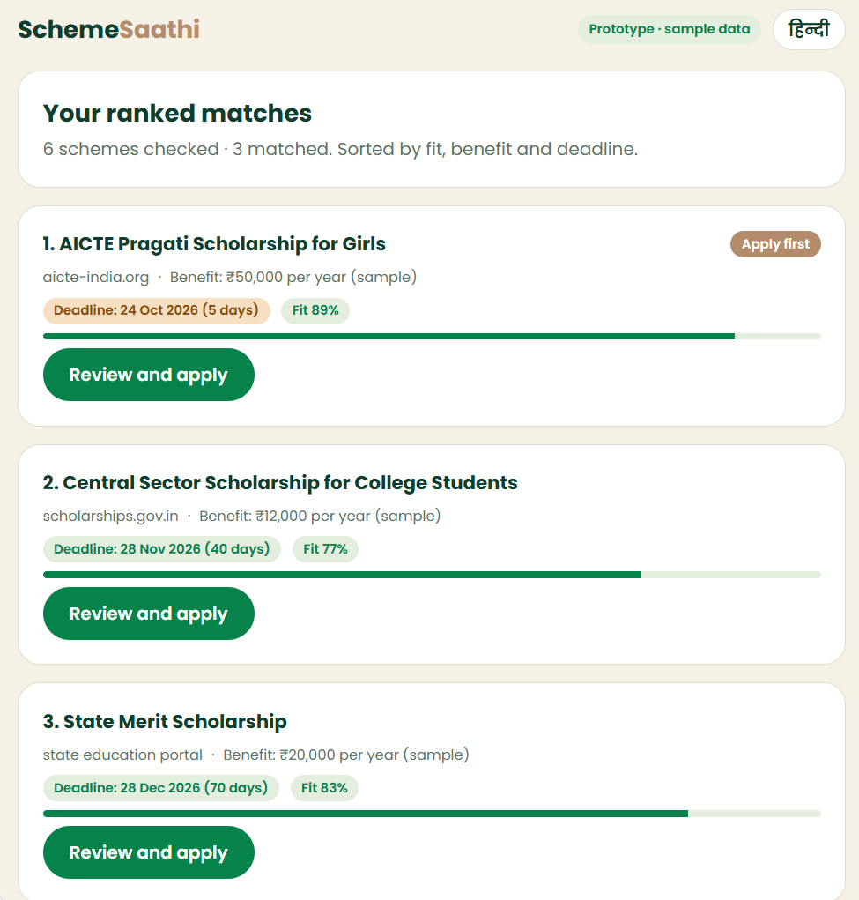
From a messy portal to a pre-filled form
built = live in the demo
Tech stack
BUILT 1. Ask
Web form, text + voice, Hindi and English
PLANNED 2. Discover
TinyFish Search + Fetch (simulated in demo)
PARTLY BUILT 3. Understand
Rule engine live. NLP model is next.
BUILT V1 4. Rank
Fit, benefit, deadline score. ML is next.
PARTLY BUILT 5. Apply
Pre-fill + review live. TinyFish Agent is next.
Working prototype: type or speak
Working prototype: ranked matches
PLANNED STACK
FastAPI
PostgreSQL + pgvector
Redis + Celery
Tesseract OCR
S3 or R2
Docker

Slide 5
Under ₹200 to fully assist one application
small cost. big unlock.
Price economics
Estimated fully assisted cost
TinyFish Agent: 40 steps × $0.016
$0.64, about ₹55–₹60
₹94–₹195
LLM explanation, matching, document checks
₹5–₹20
per application with human review. About ₹64–₹95 without it.
OCR/document processing
₹2–₹10
₹10 crore
Cloud, storage, notifications
₹2–₹5
of benefits unlocked when 10,000 students access an average ₹10,000 scholarship
Human review for premium cases
₹30–₹100

Slide 6
Free for students. Paid by institutions and funders.
free for students, always
Revenue model
Freemium upgrades
School and college SaaS
Government SaaS
Outcome-based contracts
Students and parents
Schools, colleges, coaching centers
State education departments, welfare departments, districts
Free discovery; ₹99–₹299 per premium assisted application; ₹299–₹499/year for priority support
Governments, CSR funders, foundations
₹1–5 lakh/year, or ₹20–₹100 per student/year
₹10 lakh–₹1 crore+ depending on scale
₹50–₹300 per completed application, or a percentage of tracked disbursals
CSR and NGO programs
API/data licensing
Counselor marketplace
Sponsorships
NGOs, foundations, corporate CSR teams
Banks, edtechs, career platforms, insurers
Independent counselors, CSC operators, NGOs
Banks, NBFCs, edtechs, test-prep companies
₹5–₹50 lakh per scholarship-access campaign
₹1–₹10 per eligibility check; enterprise plans for bulk access
10–20% of paid assisted-application fee
Fixed campaign fee; clearly separated from official scheme information

Slide 7
What 100 schools and two pilots could earn
back-of-napkin math!
Revenue model: a projection
Projected annual revenue, not actual
School SaaS
₹2 crore
100 schools × ₹2 lakh
₹3.2–₹3.4 crore
Premium student plans
₹20 lakh
5,000 users × ₹399
Assumes 100 partner schools, 50,000 active students and 2 government pilots
Government pilots
₹50 lakh
2 departments × ₹25 lakh
A future estimate, not actual revenue
CSR/NGO campaigns
3 programs × ₹15 lakh
₹45 lakh
Based on the assumptions shown. To be validated through school, NGO and government pilots.
API licensing
₹10–₹25 lakh
20,000 paid checks/month

Slide 8
From scholarship finder to benefits copilot
big dreams, small steps
Future scope
Awareness
›
Eligibility
›
Documents
›
Application
›
Verification
›
Approval
›
DBT
›
Renewal
Beyond scholarships
Renewals and lifecycle
India's digital rails
Pensions, housing, farmer subsidies, health, skills and MSME schemes.
Yearly renewals, certificate expiry alerts and defect follow-ups.
DigiLocker documents, DBT payment tracking and BHASHINI voice in Indian languages.
Smarter AI
Live-web radar
Public infrastructure
Rejection-risk scorer, eligibility simulator and a family benefit planner.
TinyFish watches official portals for new schemes and deadline changes.
Counselor networks and government dashboards on funnels, dropouts and rejection reasons.
IN FIVE YEARS
“You may be eligible for 7 benefits. Two deadlines are close, and your income certificate expires in 30 days. I can prepare the renewal.”
· Thank you, Team CodeRush

