Slide 1
Cache-Craft
L0 RAM Cache
L1 Redis
L2 pgvector
L3 LLM Fallback
Intelligent Multi-Tier Semantic Cache Router for LLM Inference
Semantic Similarity
FastAPI + Next.js
Final Year Project · Computer Science & Engineering
Reducing LLM inference costs through intelligent query caching and semantic similarity routing

Slide 2
The Problem
LLM inference is expensive — most queries are semantically redundant
💸 High Cost
⏱ Slow Response
♻ Redundancy
Every LLM API call consumes tokens. Paraphrased questions pay full price each time.
Cold LLM inference takes 2–8 seconds. Users wait for identical answers regenerated.
"What is recursion?" and "Explain recursion in Python" are semantically identical yet re-generated.
~2,400 ms
~1.2 ms
3× faster
67%+
Typical LLM cold call
Cache hit latency
Speedup on cache hits
Tokens eliminated @ τ=0.85

Slide 3
How Cache-Craft Works
A pluggable semantic caching layer that intercepts queries before they reach the LLM
Query
Ingestion
L0 RAM
L1 Redis
L2 pgvector
L3 LLM
User sends a
natural language
prompt
→
O(1) exact hash
lookup ~0 ms
→
In-memory hash
ring ~1.8 ms
→
Cosine ANN search
vector DB ~25 ms
→
Generate + auto
back-fill to L1/L2
Key Design Decisions
• all-MiniLM-L6-v2 sentence transformer — 384-dimensional embeddings — CPU inference in <20 ms
• pgvector HNSW index for approximate nearest-neighbour similarity search with sub-25 ms P95 latency
• Configurable cosine similarity threshold τ (default 85%) — adjustable live via the Settings UI
• Automatic back-fill: LLM responses auto-written to L1 & L2 so the next similar query hits the cache

Slide 4
System Architecture
FastAPI Backend
Incoming Query
Async REST + SSE; /api/query, /api/cache, /api/metrics
▼
CacheRouter
L0 RAM — exact hash match?
← hit
Orchestrates L0→L1→L2 lookup chain + miss handling
▼
L1 Redis — hash ring?
← hit
SentenceTransformer
▼
all-MiniLM-L6-v2 — 384-dim vectors, ~15 ms CPU encode
L2 pgvector — cosine ANN?
← hit
Redis (L1)
▼
L3 — LLM generate + back-fill
Exact hash ring; O(1) lookup; dual-tier TTL management
▼
Return Response ✓
pgvector (L2)
PostgreSQL HNSW index; cosine ANN < 25 ms P95
Next.js Frontend
Dashboard · Chat Playground · Cache Explorer · Settings

Slide 5
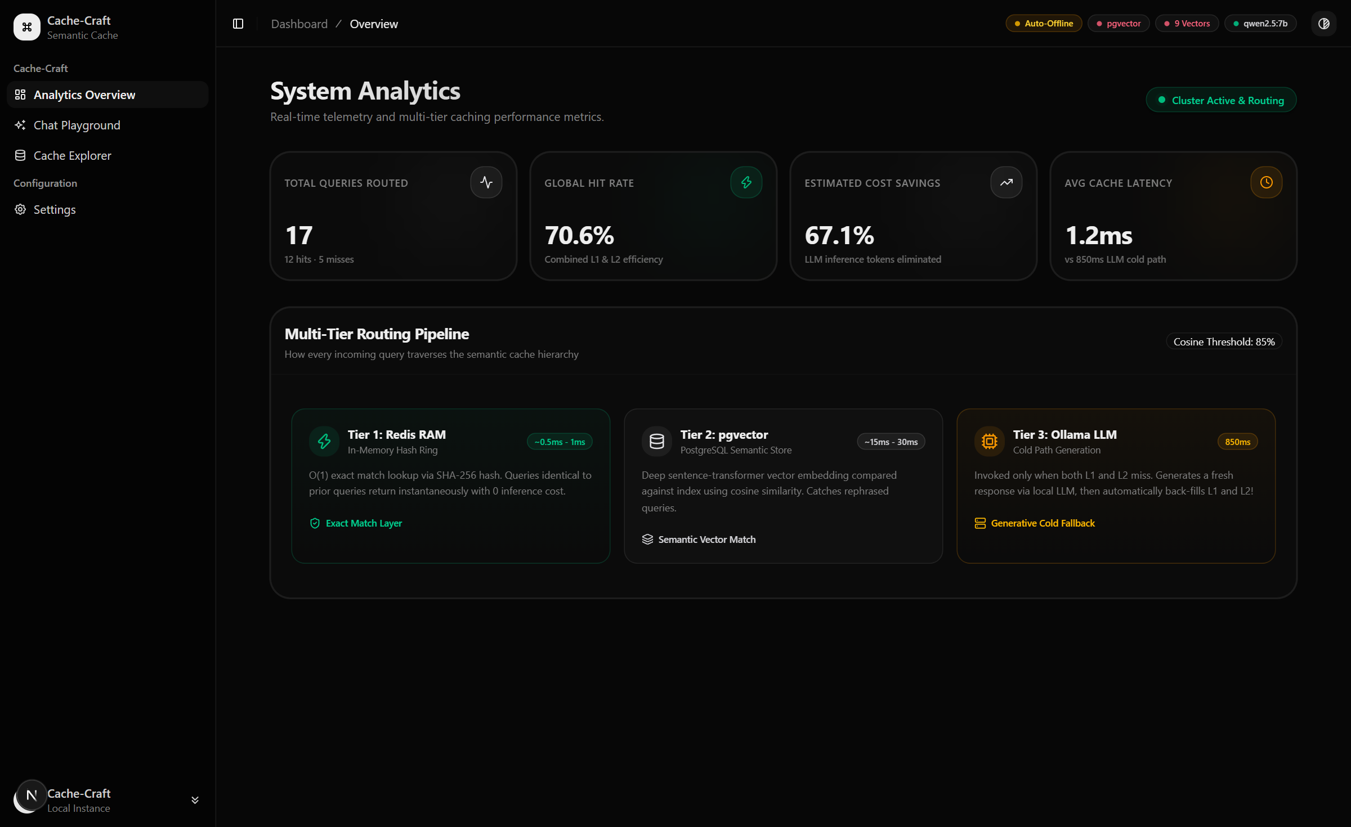
Live Dashboard — System Analytics
Real-time telemetry: hit rates, routing pipeline, and per-tier latency
70.6%
Global Hit Rate
67.1%
Cost Savings
1.2 ms
Avg Cache Latency
3-Tier Pipeline
Visualised

Slide 6
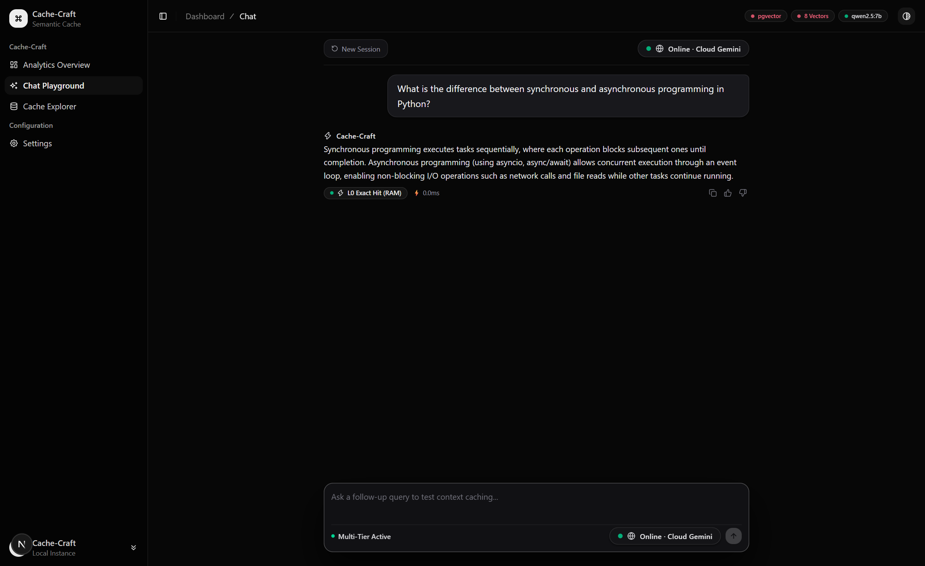
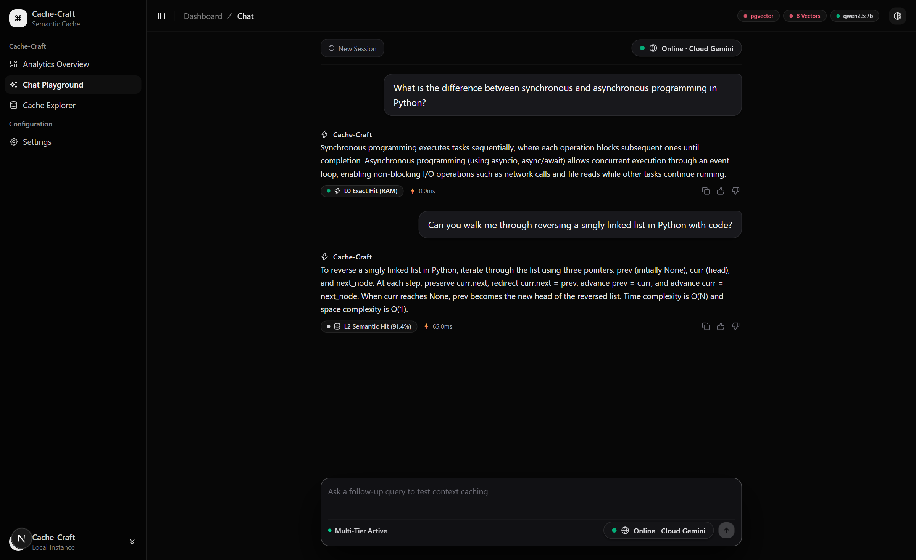
Chat Playground — Tier Routing in Action
⚡ L0 Exact Hit (0.0 ms)
🔍 L2 Semantic Hit (91.4% · 65 ms)
Left: Identical repeat query → L0 RAM hit, ~0 ms | Right: Paraphrased query → L2 semantic match at 91.4% similarity, 65 ms

Slide 7
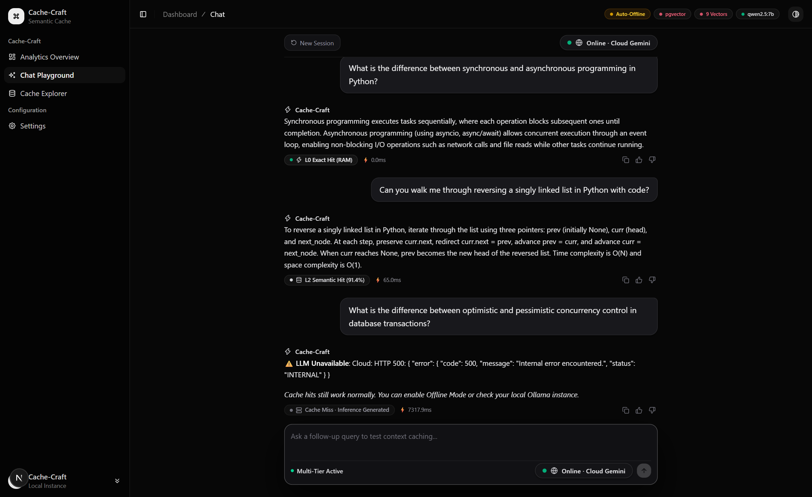
L3 Fallback — Cache Miss & Auto Back-Fill
When all cache tiers miss → LLM generates a fresh answer, then auto-populates L1 & L2
1 Query Arrives
Not in RAM, Redis, or pgvector
2 Embed Query
Sentence-transformer ~15 ms CPU
3 Vector ANN Search
HNSW index scan — no match found
4 LLM Call
Gemini Cloud / local Ollama fallback
5 Auto Back-Fill
Response written to L1 Redis + L2 pgvector
After back-fill, the next similar query hits L0 or L2 instantly.

Slide 8
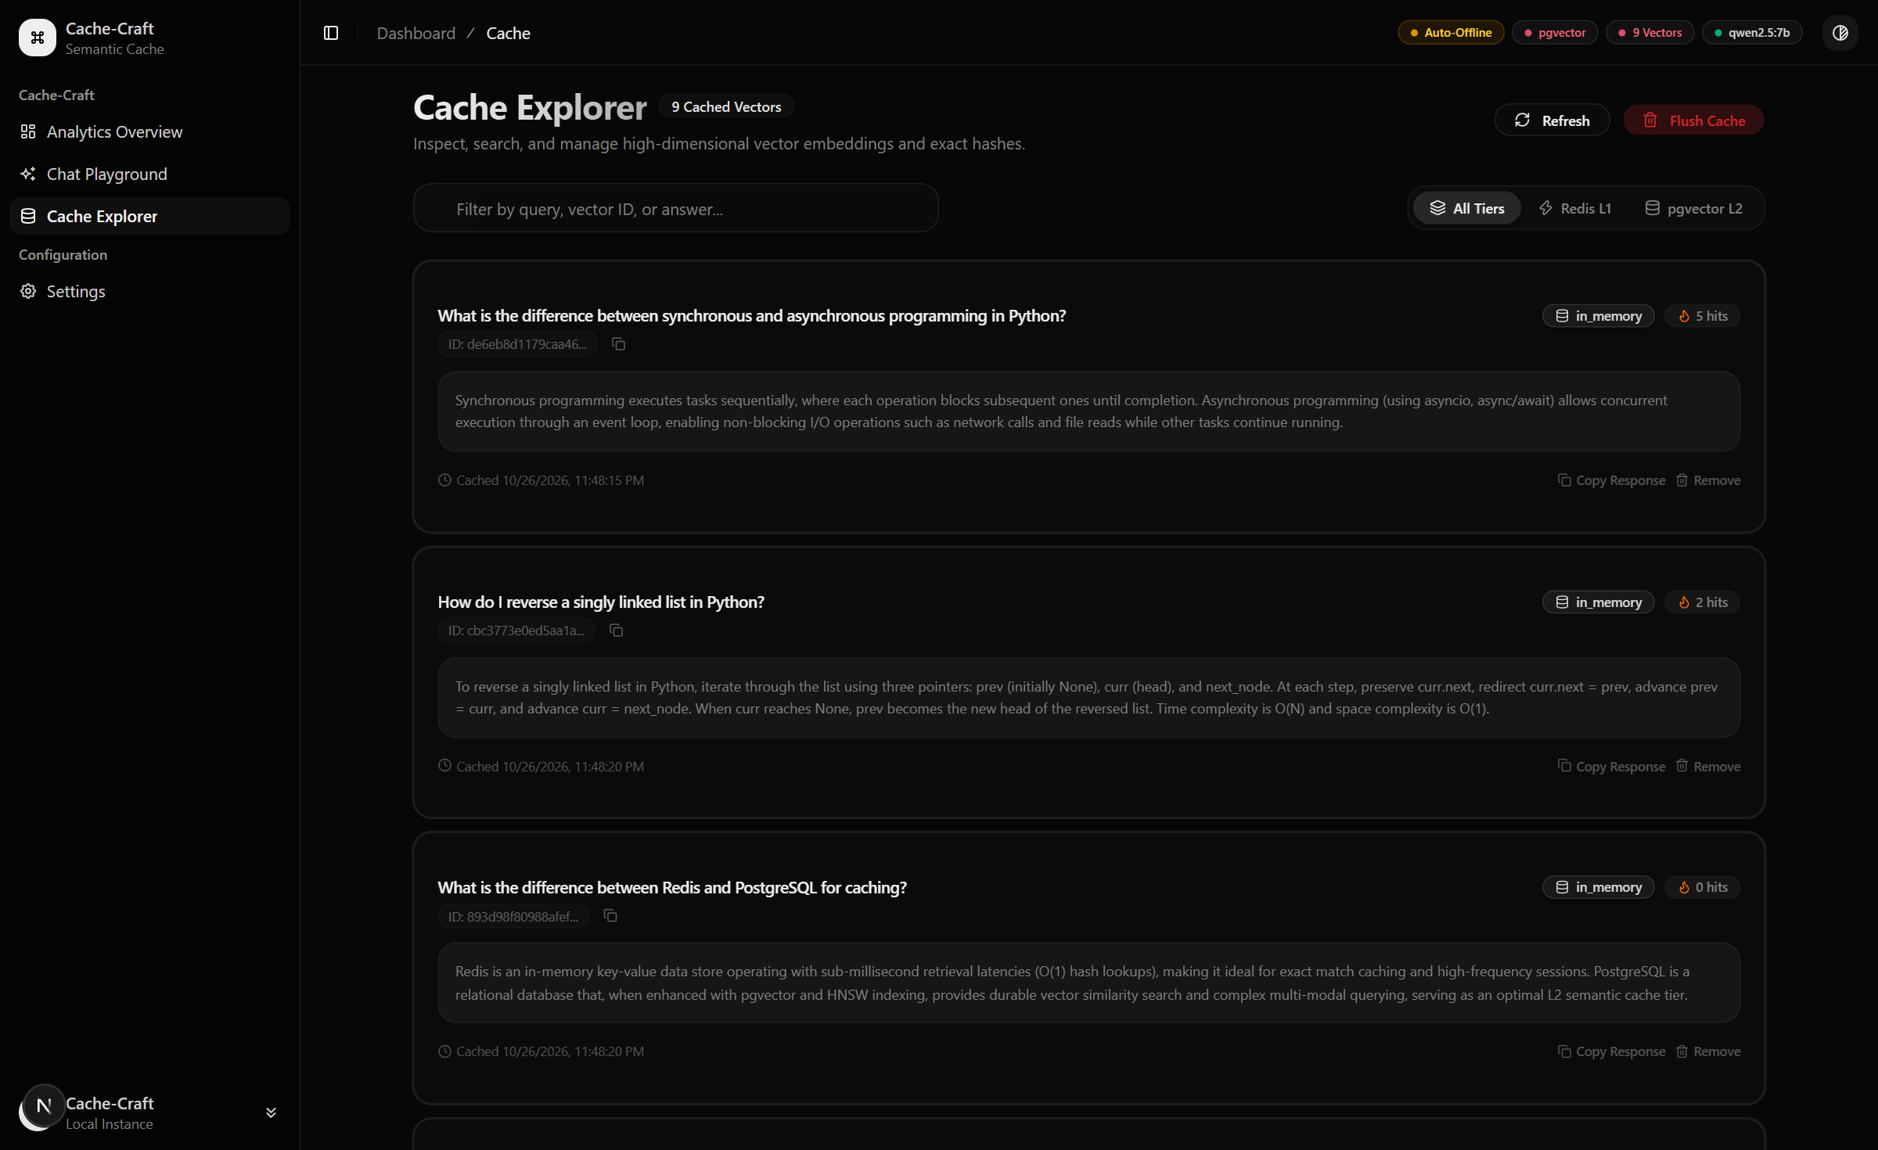
Cache Explorer — Inspect Stored Vectors
Browse, search, and manage every cached query-answer pair and its embedding metadata
🔍 Semantic Search
Filter by query text, vector ID, or cached answer
🏷 Tier Badges
Each entry shows storage tier: in_memory / Redis / pgvector
🔥 Hit Counter
Per-entry reuse count — identify your hottest cached topics
🗑 Remove / Flush
Remove individual entries or purge entire cache in one click
📅 Timestamps
Cached datetime + TTL visibility for lifecycle management

Slide 9
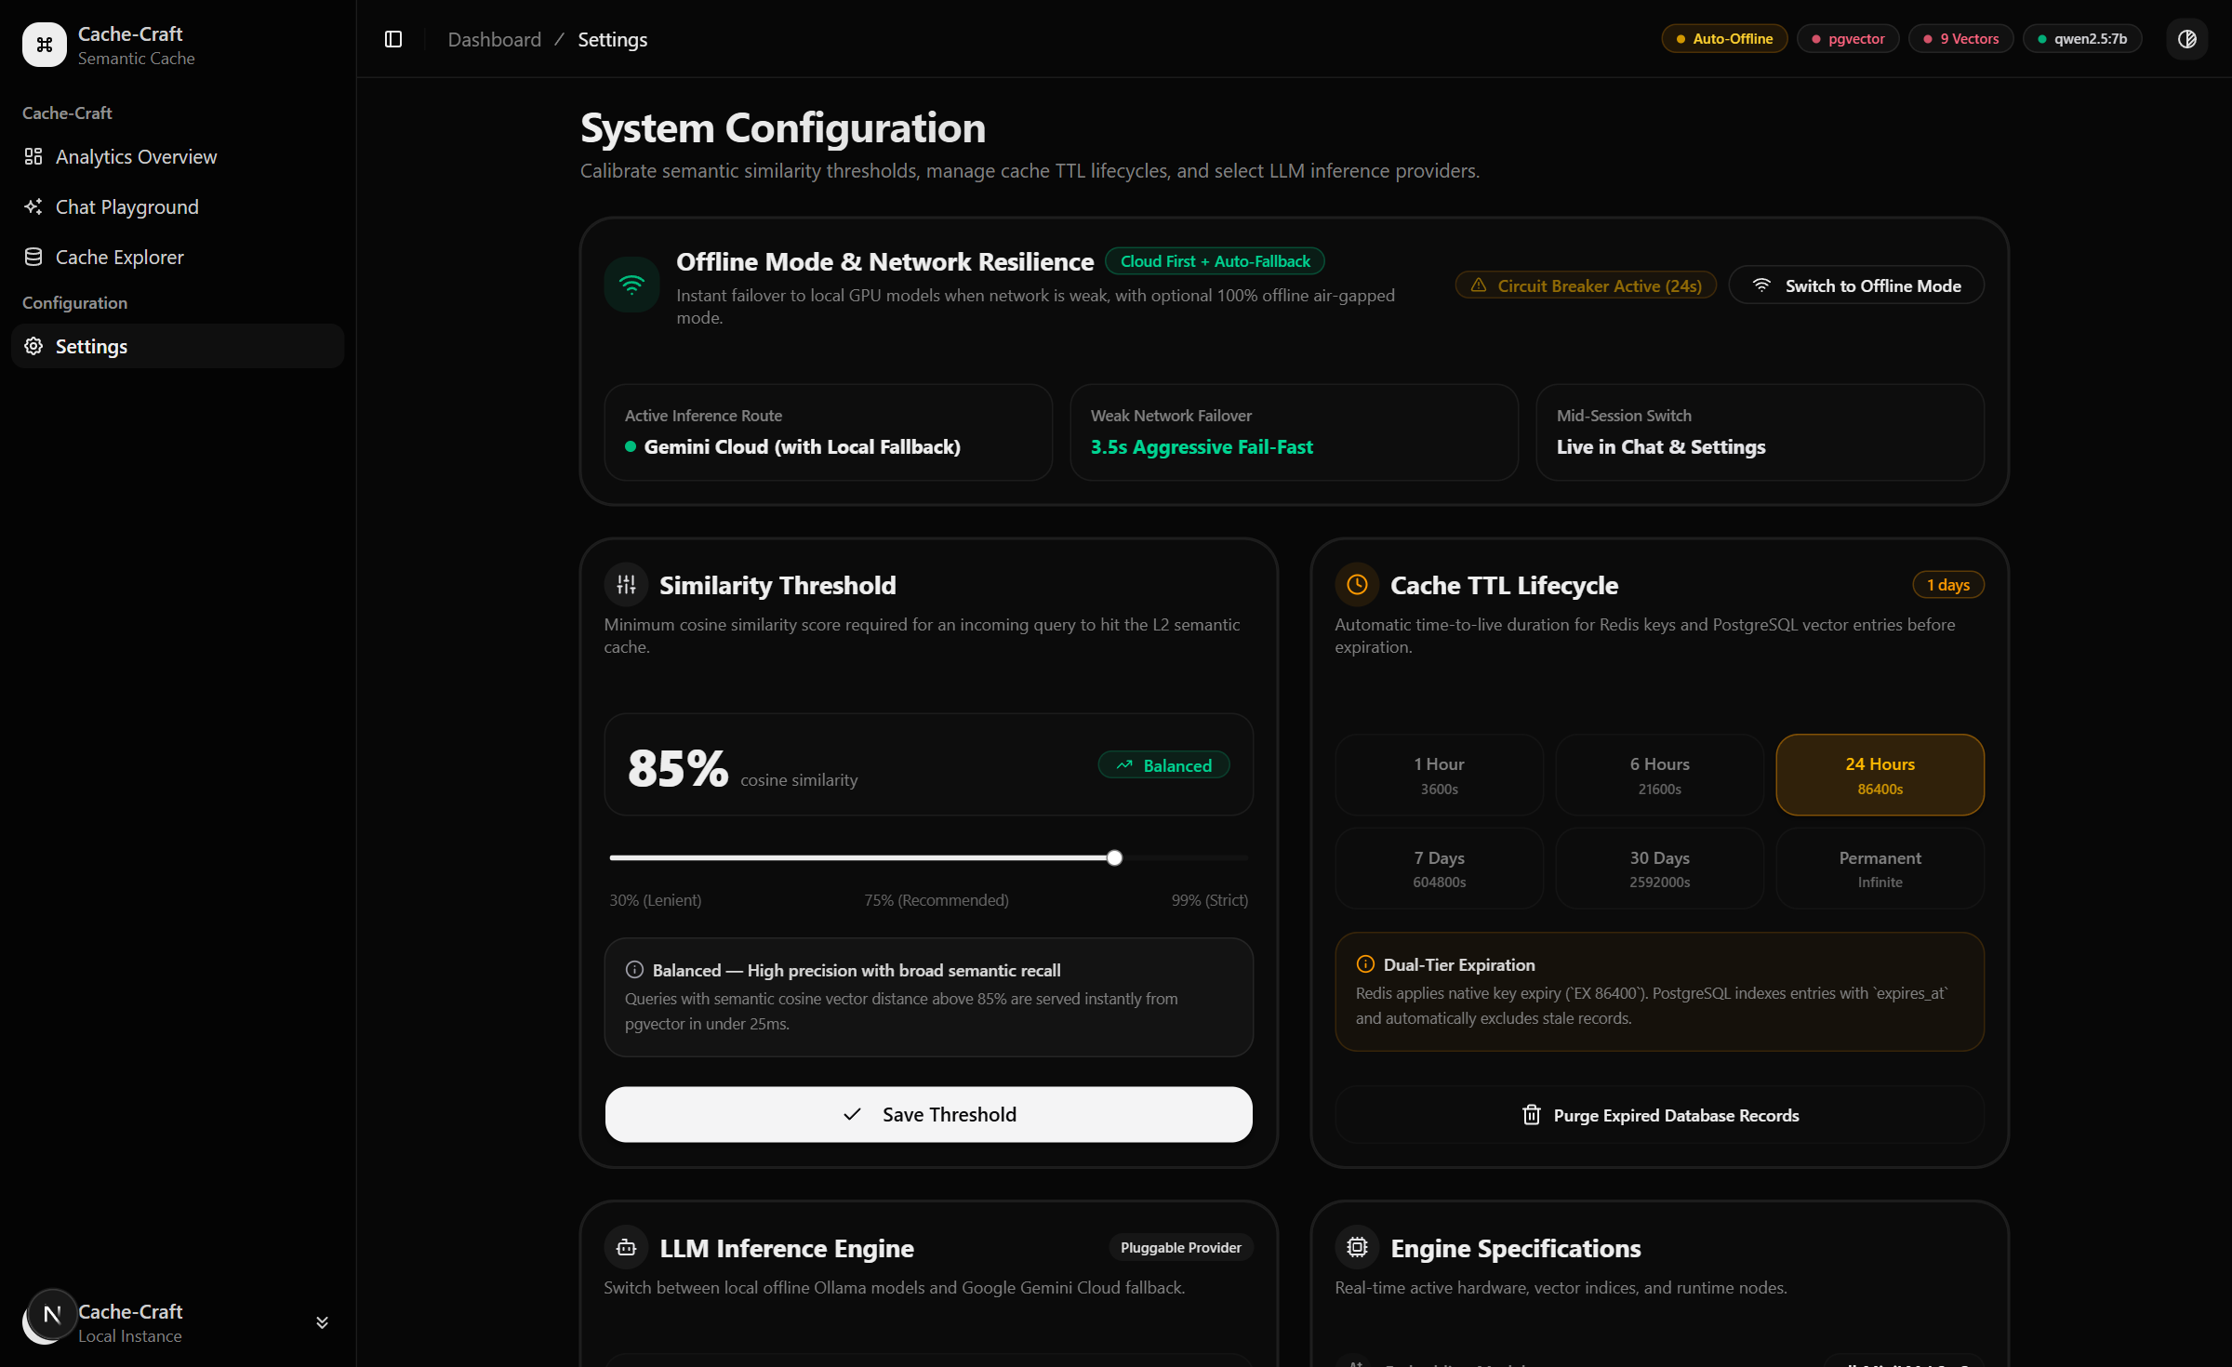
System Configuration — Live Controls
Operators can tune threshold, TTL, and LLM provider without restarting the service
Similarity Threshold τ
Slider 30%→99%. Default 85% = balanced precision-recall. Shown as percentage in UI.
Cache TTL Lifecycle
Per-tier expiry: 1h / 6h / 24h / 7d / 30d / Permanent. Dual-tier: Redis EX + pgvector expires_at.
LLM Inference Engine
Switch between Gemini Cloud and local Ollama without service restart.
Network Resilience
3.5 s circuit breaker auto-switches to offline LLM when cloud is unreachable.

Slide 10
Evaluation Results
Benchmark: 1,200 queries (500 paraphrases · 200 negatives · 500 seeds) — in-memory semantic engine
96.8%
81.2%
88.4%
~3×
Precision @ τ=0.85
Recall @ τ=0.85
F1 Score @ τ=0.85
Speedup vs Cold LLM
Threshold Sweep
Latency Benchmarks
τ
Precision
Recall
F1
L0 RAM hit
~0 ms
0.70
85.7%
96.2%
90.6%
0.75
91.4%
93.0%
92.2%
L1 Redis hit
~1.8 ms
0.80
94.3%
88.2%
91.1%
L2 pgvector hit
~25 ms
0.85
96.8%
81.2%
88.4%
0.90
98.6%
60.4%
74.9%
L3 LLM cold call
~2,400 ms
Embedding (CPU)
~15 ms

Slide 11
Technology Stack
Backend
Frontend
DevOps
▸ FastAPI
▸ Next.js 14
▸ Docker Compose
Async Python REST + SSE endpoints
App Router, TypeScript, SSR
Multi-service orchestration
▸ Python 3.11
▸ TailwindCSS
▸ PostgreSQL 16
Core language & async runtime
Utility-first styling system
Primary data store
▸ Sentence-Transformers
▸ ShadCN/UI
▸ HNSW Index
all-MiniLM-L6-v2 embeddings, 384-dim
Component library
Efficient ANN for pgvector
▸ pgvector
▸ SSE Streaming
▸ Railway / Fly.io
PostgreSQL ANN extension (HNSW)
Real-time telemetry updates from backend
Cloud deployment targets
▸ Redis
Exact-match hash ring + TTL

Slide 12
Conclusion & Future Work
What We Achieved
Future Directions
• Built a working 3-tier semantic cache router from scratch
• Multi-tenant isolation: per-user cache namespaces
• Achieved 88.4% F1 at τ = 0.85 on a 1,200-query benchmark
• Adaptive threshold: auto-tune τ from live feedback
• Measured ~3× latency speedup over cold LLM calls
• Cross-session context continuity and session stitching
• Full-stack implementation: FastAPI + Next.js + PostgreSQL
• Distributed cache sharding for horizontal scalability
• Live dashboard with real-time telemetry and cache explorer
• Fine-tuned domain-specific embedding models
• Configurable threshold, TTL, and LLM provider at runtime
• Cost analytics dashboard with API-spend integration
Cache-Craft demonstrates that a lightweight semantic caching layer can significantly reduce LLM inference costs and latency — making AI assistants faster, cheaper, and more scalable.

