Slide 1

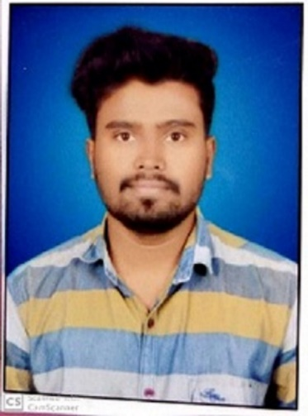


Akash Namdev Kamble
Education and certificates
Bachelor of Technology in
Information Technology : 2017-2020
Analyst/Software Engineer
Base Location: MUMBAI
Akash.Namdev-kamble@capgemini.com
Java | Basics, OOPS, Exception Handling, Collections & Generics, Java 8 Features
Spring Framework | Spring MVC. Spring JDBC, , Spring Boot
React | Components, Hooks, Virtual DOM, Routing, Forms & Validation
RDBMS | MySQL,Oracle
UI Technology | HTML 5, CSS, JavaScript,ReactJS
Tools | Git ,GitHub, Postman, Eclipse, Visual Studio code
Add On Skills | Communication , Team management , Problem solving, Adaptability
Email ID:
Skills
Mobile No: +919689007218
Grade: A4
EMP ID-46205956
Strengths
Full Stack Developer
Good Knowledge of java programming.
Achievement
ONLINE EXAM PORTAL :
Case study of Online Exam Portal along with Spring Boot, HTML5, CSS and ReactJS used as User Interface.
ONLINE RAILWAY RESERVATION SYSTEM:
Case study of Online Railway Reservation System along with Spring Boot ,Spring security, HTML5, CSS and ReactJS used as User Interface.
•Good with Spring Framework
•Good in developing web pages using HTML, CSS.
•Currently learning on iTransform: Full Stack With ReactJS, Spring Boot MS & MongoDB
Full Stack developer with React and Full Stack Java Developer
Hands on experience in developing web pages
using HTML5, CSS3, REACTJS. Good understanding of Document Object Model (DOM) and DOM Functions.
Four layered architecture which includes a Presentation Layer, Business Layer, Persistence Layer and Database Layer. Exception Layer handled the exceptions.
Proficient in creating Single page Web Application in
REACTJS with routing.
Check out my work on GitHub
Presentation Title | Author | Date © Capgemini 2017. All rights reserved | 1

