Slide 1
GNR 607 PRINCIPLES OF SATELLITE IMAGE PROCESSING
Farheen Bano, 193310022
Aakash Khanderao, 193310020
Mohit Kumar, 193310019

Slide 2
Detect Edges in image by Applying SOBEL EDGE DETECTor and Gaussian Smoothing Filter

Slide 3
IMAGE PROCESSING TECHNIQUES USED
EDGE ENHANCEMENT METHODS
NEIGHBOURHOOD OPERATIONS

Slide 4
EDGE IN AN IMAGE
Edges are significant local changes of intensity in an image.
Edges typically occur on the boundary between two different regions in an image.

Slide 5
WHY SOBEL EDGE DETECTOR?
Since the introduction of the average factor, it has some smoothing effect to the random noise of the image.
Because it is the differential of two rows or two columns, so the elements of the edge on both sides has been enhanced, so that the edge seems thick and bright.

Slide 6
SOBEL EDGE DETECTION EXPLAINATION
A convolution mask is used is usually much smaller than the actual image.
The center of the mask is placed over the pixel you are manipulating in the image.
The mask is slid over an area of the input image, changes that pixel's value and then shifts one pixel to the right and continues to the right until it reaches the end of a row.
It then starts at the beginning of the next row.

Slide 7

SOBEL EDGE MASK (FOR 3X3)
The sobel filter uses two 3 x 3 kernels.
One for changes in the horizontal direction, and one for changes in the vertical direction.
The two kernels are convolved with the original image to calculate the approximations of the derivatives.
If we define Gx and Gy as two images that contain the horizontal and vertical derivative approximations respectively, the computations are:
where A is the original source image.
The x coordinate is defined as increasing in the right-direction and the y coordinate is defined as increasing in the down-direction.

Slide 8


Sobel Filter
At each pixel in the image, the gradient approximations given by Gx and Gy are combined to give the gradient magnitude, using:
The gradient’s direction is calculated using:
A value of would indicate a vertical edge that is darker on the left side.

Slide 9
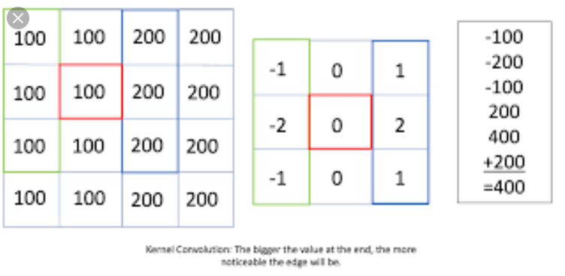
Convolution with Sobel

Slide 10
WHY AVERAGING BEFORE SOBEL OPERATION?
Removes Noise so that it doesn’t appear as edges.
Visually Pleasing image.

Slide 11
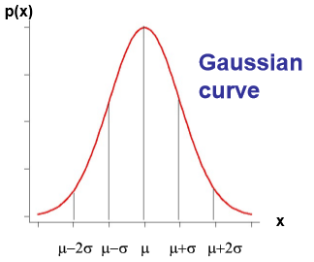

AVERAGING WITH GAUSSIAN FILTER
To give option of adjusting smoothening based on user preference.
Higher values of sigma signify high variance and high kurtosis thus comparable values at origin and neighboring, thus higher smoothening.
Lower values of sigma signify low variance and low kurtosis thus steep increase in Gaussian distribution.
The formula to find Gaussian smoothening on the image:

Slide 12

THRESHOLDING
To give user with options to keep a percentage of max change in DN values as threshold for edge detection.
Change above threshold to be considered as edges and vice versa.
A trivial form of enhancement of the input image is to map all values below a threshold gray level to a constant value, and those gray levels from the threshold value and above to another constant value. This can be expressed as

Slide 13
Framework and Technologies Used
Front End- HTML, javaScript, CSS and BootStrap
Back End- Flask framework(Python)

Slide 14
Algorithm
(Python)
Main method:
Sobel Edge Detection
Gaussian Average Smoothing Filter then Sobel Edge Detection
Threshold
Sobel Edge Detection:
edgeDetect()
Read the image file
Convert the image to grayscale
Specify the Sobel kernel
[[-1,0,1], and [[-1,-2,-1],
[-2,0,2], [0,0,0],
[-1,0,1]] [1,2,1]]
d) Perform convolution with both the kernel
separately
Find the magnitude of gradiant by using both the convolution values of the image. Magnitude formula:img_out=np.sqrt(np.power(img_x,2)+np.power(img_y,2))
Output the filtered image
Convolution_np()
Find height and width of Sobel kernel to get matrix size
Iterate and calculate sum+=(w*a)
for every pixel where w is the Sobel kernal and a is the image matrix
Replace the image pixel with the calculated values
Return the altered image
2. Gaussian Average Smoothening Filter
Gaussian_blur()
Input the window size and sigma values
Find Gaussian kernal by the following formula:
1 / (np.sqrt(2 * np.pi) * sd) * np.e ** (-np.power((x - mu) / sd, 2) / 2)
Perform Convolution on the entire image by the calculated kernal
Output the filtered image
Convolution()
Create a kernel of window size
Perform convolution on image by the following formula: output[row, col] = np.sum(kernel * padded_image[row:row + kernel_row, col:col + kernel_col])
c) Return the output
Thresholding
thresholdOp()
Input the threshold percentage
Perform thresholding on the image
Output the filtered image

Slide 15
STEPS To be Followed
Upload the image.
After image is uploaded successfully, apply Sobel Edge Detector on the original image. Keep window size and sigma values as 0.
In the next screen, set window size and sigma values accordingly to smoothen the image.
Now the edges are detected on the smoothened image.
Compare both the images.
Alter the window size and sigma values repeatedly to display the change in the output.

Slide 16

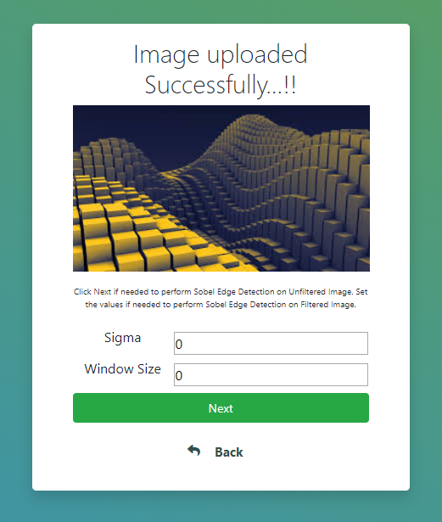

Slide 17
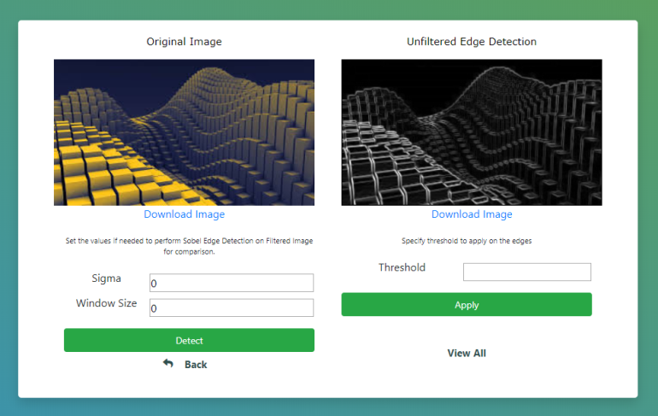
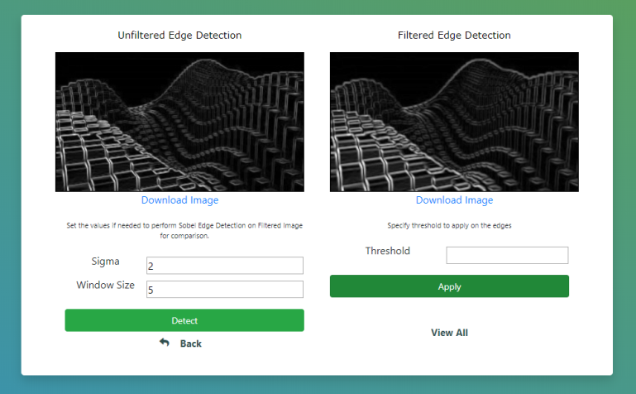

Slide 18
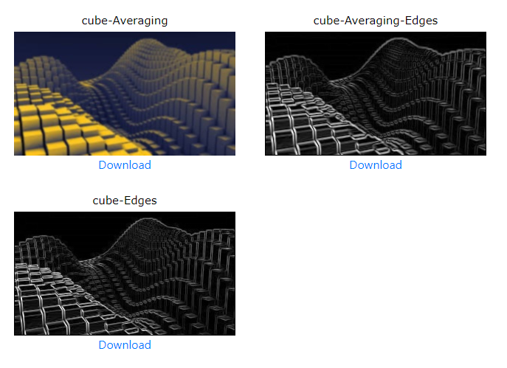
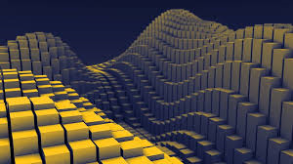
COMPARISON
Original Image

Slide 19
THANK YOU

