Slide 1

PHOTOMOSAICS: BASED ON PYTHON
UNDER THE GUIDELINES OF:-
MR. LALIT MALIK
DEPT. OF C.S
SUBMITTED BY :- AAKASH KUMAR (16BCA009)
RAHUL RANA (16BCA021)

Slide 2
INTRODUCTION TO DIP
Digital Image Processing (DIP) deals with processing of images which are digital in nature.
There are two types of methods used for image processing namely, analogue and digital image processing. Analogue image processing is applicable for hard copies like printouts and photographs. A digital image is a representation of a two-dimensional image as a finite set of digital values, called picture elements or pixels.

Slide 3
OBJECTIVE
In this digital world, transferring sensitive data electronically has become inevitable. The objective of this work is to hide and retrieve confidential information in image mosaics. The photomosaic approach has been used for the creation of the mosaic and the least significant bit (LSB) technique has been adopted for the embedding of the hidden information. The construction of the photomosaic is done by selecting an image, splitting it into smaller images (tiles) of sizes 8×8, 16×16 and 32×32.

Slide 4
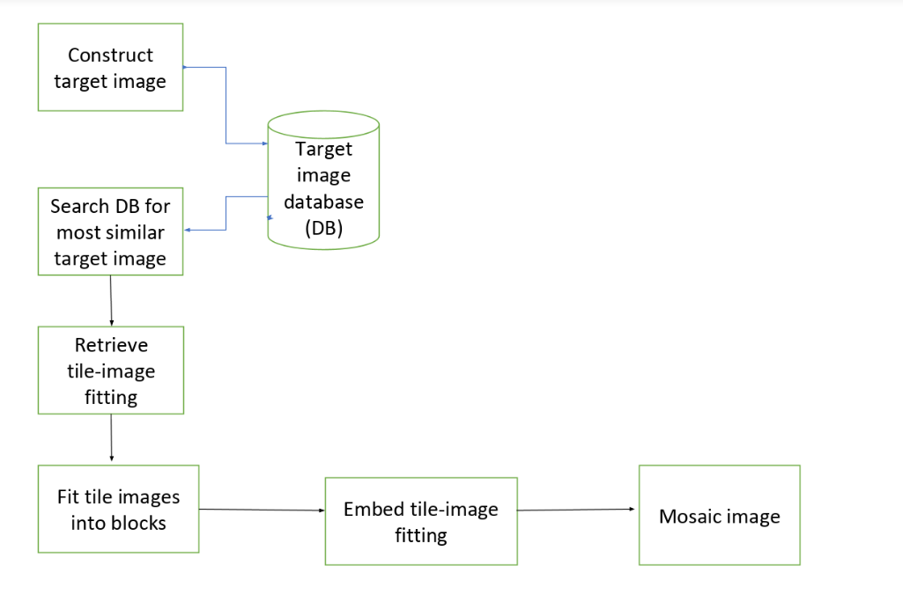
FLOW CHART OF PHOTOMOSAIC

Slide 5
HOW TO CREATE MOSAIC ?
1. Read the tile images, which will replace the tiles in the original image.
2. Read the target image and split it into an MxN grid of tiles.
3. For each tile, find the best match from the input images.
4. Create the final mosaic by arranging the selected input images in an MxN grid.

Slide 6
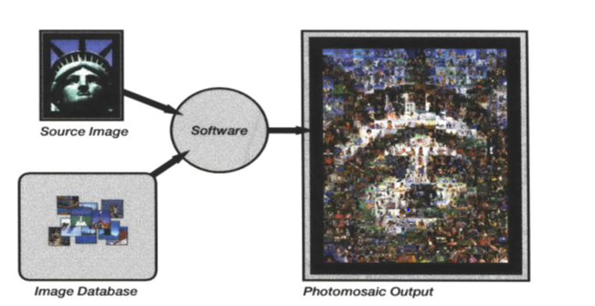
GENERATING THE IMAGE

Slide 7
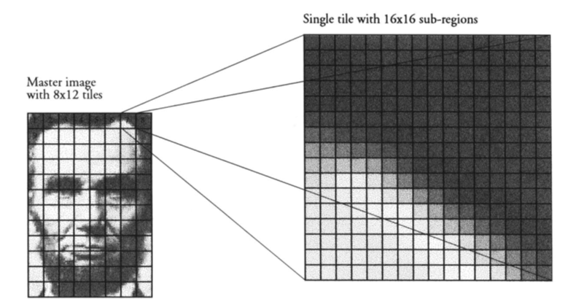
……
GRID AND TILES

Slide 8
FUTURE SCOPE
Speed and Quality Enhancements
I have made a recognizable Lincoln using 8 x 12 photographs, which is better than possible with solid pixels. This has led me to set a new goal of making a recognizable Lincoln from 4 x 6 photographs. There are two ways to go about this: either consider millions of images during the selection process, or improve the criteria used for selection. I propose to use both options. Larger and more Sophisticated Databases
The Photomosaic system should be integrated with a relational data base that provides for advanced queries on numerous parameters. Images could then be stored in the database along with these other parameters as binary large objects (blobs), or simply as pointers to the real image file. An example query would be "find me an image that contains any animal or bird and is visually similar to this blob."

Slide 9
Thank You

