Slide 1

CHAT APPLICATION: BASED ON PYTHON
UNDER THE GUIDELINES OF:-
MR. LALIT MALIK
DEPT. OF C.S
SUBMITTED BY :- AAKASH KUMAR (16BCA009)
RAHUL RANA (16BCA021)

Slide 2
What is Chatting ?
On the Internet, chatting is talking to other people who are using the Internet at the same time you are.
In some cases, a private chat can be arranged between two parties who meet initially in a group chat.

Slide 3
What is Chat Application ?
Chat application is primarily based on group chat to refer to direct one – on – one chat or text. DVS(Delivering Value Services) Technologies provide both type of chat application. DVS Technologies chat application facilitates real–time communication , with its superior feature set and unprecedented reliability. DVS Technologies chat application increase the efficiency of chat application.

Slide 4
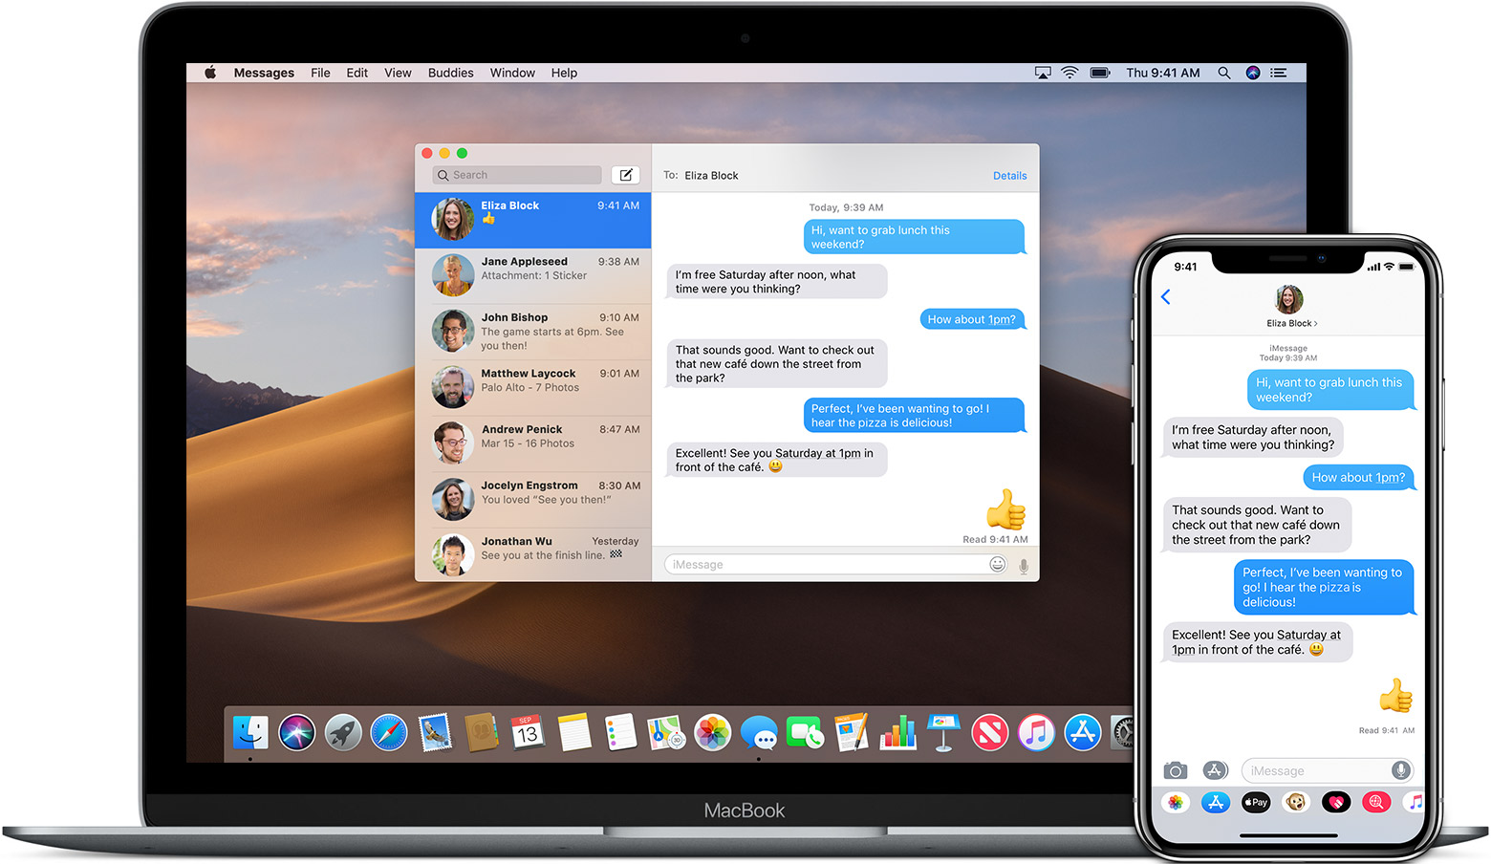
How Chat Application looks like

Slide 5
SOCKETS AND JAVA SOCKET CLASSES
A socket is a end point of two way of communication link between two programs running on the network.
A socket is bound to a port number on that the TCP layer can identify the application that data destined to be sent.
Java’s.net package provides two classes:
Socket – for implementing a client
Server Socket – for implementing a server
There are four fundamental operations a socket performs. These are:
Connect to a remote machine
Send data
Receive data
Close the connection

Slide 6
……
…..
Socket provide an interface for programming networks at the transport layer.
A socket is reliable connection for the transmission of data between two hosts.
A server (program) runs on a specific computer and has a socket that is bound to a specific port.

Slide 7
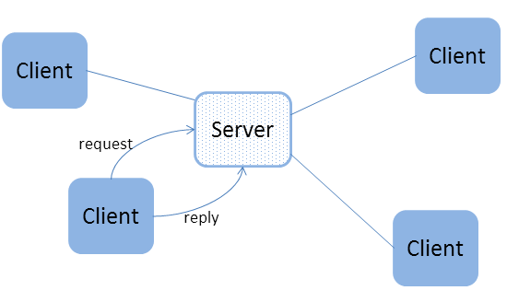
CLIENT SERVER PROGRAMMING
Client/Server describe the relationship between two computer programs in which one program , the client , makes a service request from a another program, the server which fulfill the request.
Clients and servers are connected by sockets.

Slide 8
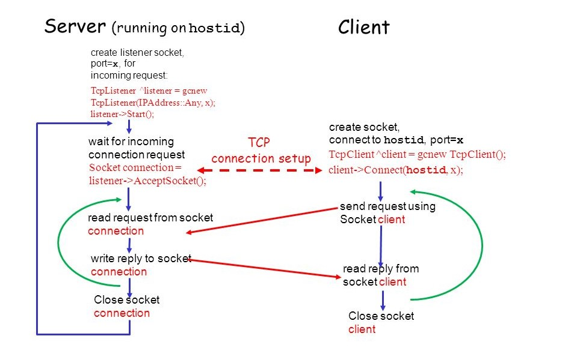
Client/Server Socket Interaction : TCP

Slide 9
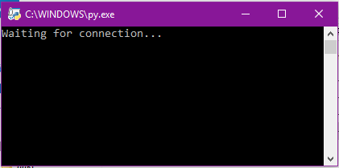
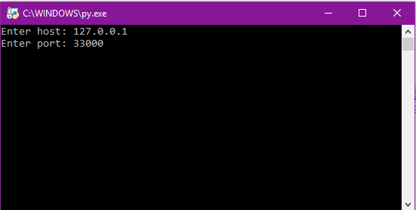
CHAT APPLICATION OUTPUT
SERVER
CLIENT

Slide 10
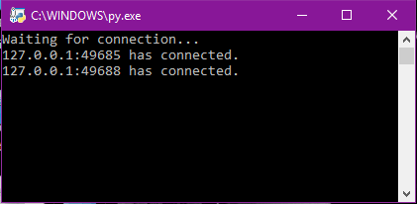
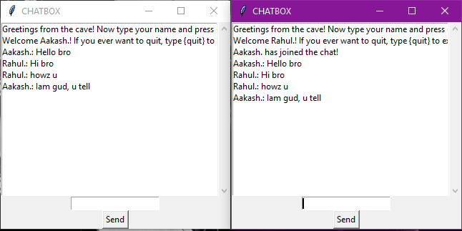
……
After connection of two clients
Chatting process on both clients

Slide 11
APPLICATION
This also includes listing usernames of the clients that are currently logged in to facilitate communication.
A “Chat Server ” is a form of real time Internet text messaging (text) or synchronous conferencing.
It is mainly designed for group communication in discussion forums , called channels , but also allows one – to – one communication via private message as well as, chat data transfer s via Direct Client – to – Client.

Slide 12
FUTURE SCOPE
Login session information: We can include a feature in this application that will keep a record of a user’s login session.
Offline messages: User can send a messages to friends even when they are offline.
File transferring and sharing : User can transfer one or more files to other users. A file can also be shared between two or more users.
Profile Database: The profile information of every can be stored at the server.
Login Timeout: This feature allows to the user to be logged in only for a specific time. After this time span ends, the user is automatically logged out.

Slide 13
Thank You

