Slide 1

Introduction
to ReactJS
Department :-
PHP Team
Date :-
29/09/2018

Slide 2
Today we discuss
1). What is React.js?
2). How to install?
3). Folder Structure
4). How does it works?
5). Component
6). Props
7). State
8). JSX
9). Virtual DOM

Slide 3
Introduction
Developed by Facebook
React is a view layer library, not a framework like Backbone, Angular etc.

Slide 4
How to install ?
1. Download NPM, Node,Yarn, VSCode and install it.
2. Install React App (creat-react-app <app_name>)
3. Open source code in VS code IDE or sublime.
4. cd <app_name>.
5. Run npm install --global cross-env
6. Run npm start.
7. App will Open on port http://localhost:3000/

Slide 5
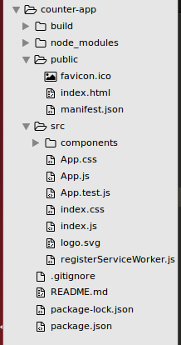
Folder Structure

Slide 6
How does it works?
React Js used npm and node to run the app.
Runs on port 3000

Slide 7
Component
Components are self-contained reusable building blocks of web application.
React components are basically just idempotent functions (same input produces same output).
They describe your UI at any point in time, just like a server-rendered app.

Slide 8
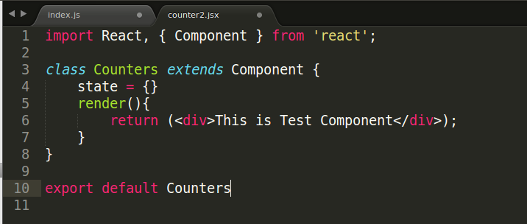

Slide 9
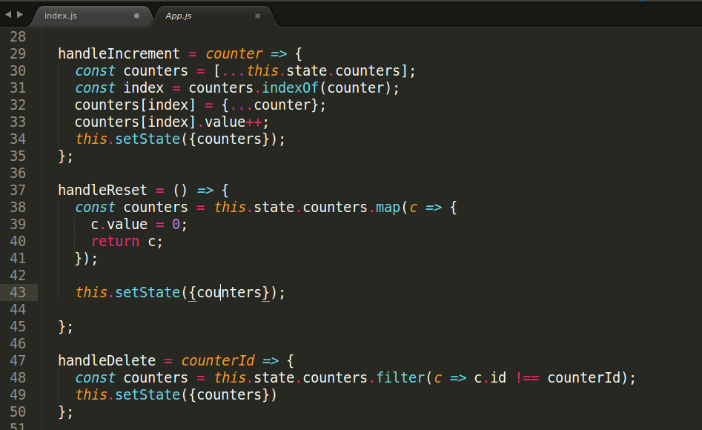
Props
Passed down to component from parent component and represents data for the component
Accessed via this.props

Slide 10
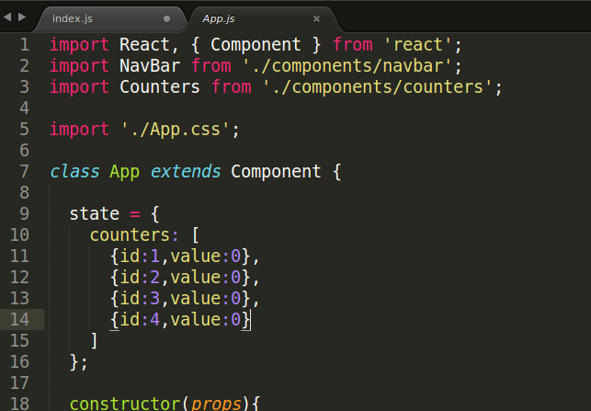
State
Represents internal state of the component
Accessed via this.state
When a component's state data changes, the rendered markup will be updated by re-invoking render() method

Slide 11
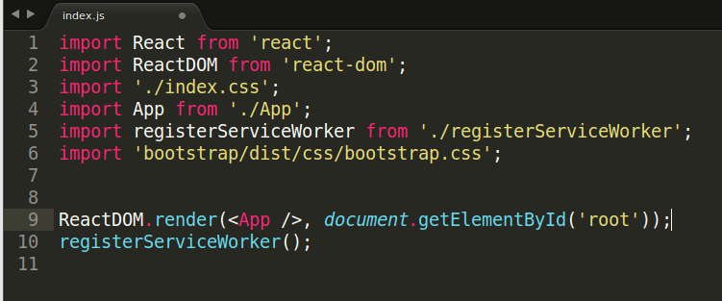
JSX
Arguably, one of the coolest things in React
XML-like syntax for generating component's HTML
Easier to read and understand large DOM trees
Translates to plain JavaScript using react-tools

Slide 12
Virtual DOM
The virtual DOM is used for efficient re-rendering of the DOM
React aims to re-render the virtual tree only when the state changes
Uses 2 virtual trees (new and previous) to find differences and batch update real DOM
Observes data changes (setState) and does dirty-checking to know when to re-render component
Whenever possible, does not update entire component in real DOM - only computes a patch operation that updates part of the DOM

Slide 13
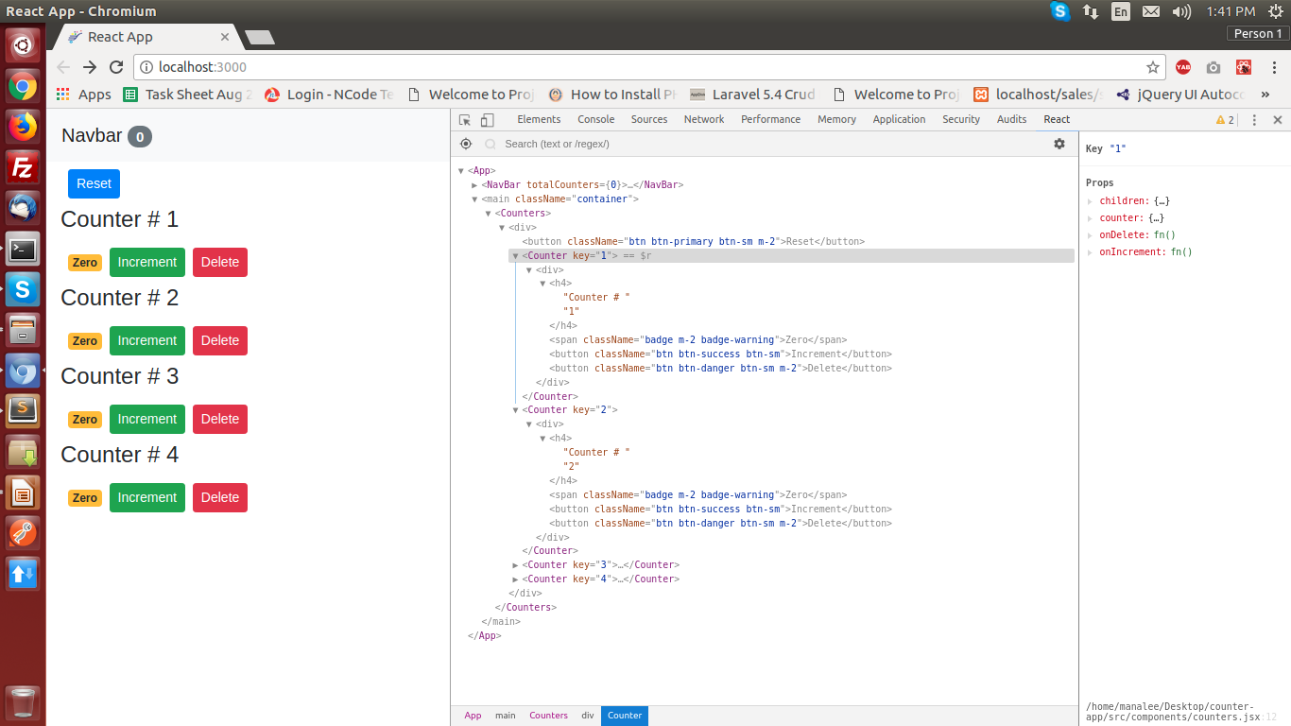

Slide 14
Demo
http://10.16.16.72:3000/

Slide 15
Thank you
Presented By: Manalee Shanishchara

