Slide 1
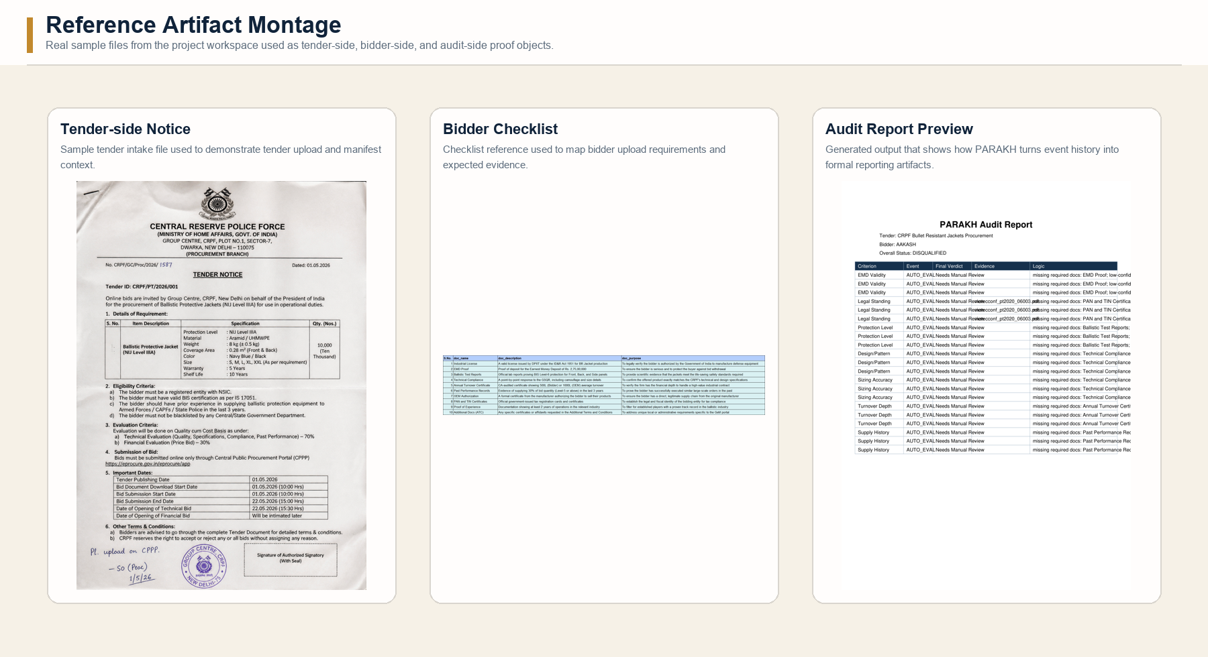
PARAKH
Procurement Audit-Ready Assessment & Knowledge Harnessing
AI-Based Tender Evaluation and Eligibility Analysis for Government Procurement by CRPF
An officer-first procurement evaluation platform
that makes tender decisions transparent,
consistent, and defensible.
Team
Team Zenith
Abhishek Neema (Leader)
Ramadhar
Aakash Kumar
Prahlad Bhatt
Hackathon presentation for judges, mentors, and operational reviewers
PARAKH | AI for Bharat Hackathon
01

Slide 2
PROBLEM
The real procurement challenge is not just reading files. It is defending a decision later.
CRPF-style procurement forces officers to act quickly while still satisfying audit, vigilance, and public-information scrutiny.
01
Heavy documentation
02
Mixed input quality
Government tender evaluation is
document-heavy, time-sensitive, and
vulnerable to inconsistent
interpretation.
Bid packs contain mixed formats such
as digital PDFs, scans, photos,
handwritten notes, annexures, and
corrigenda.
03
Officer liability
04
Black-box AI risk
Officers face personal
accountability under RTI, vigilance
review, audit, and legal challenge
if a decision cannot be defended.
Generic black-box AI is risky
because OCR uncertainty, ambiguous
clauses, and subjective criteria can
cause silent errors.
Why this matters
If the platform cannot show evidence, logic, and chronology, it increases risk instead of reducing it. PARAKH is designed specifically to close that explanation gap.
PARAKH
02

Slide 3
GAP
Manual review breaks down exactly where public accountability becomes most important.
Officers often assemble evidence, interpret criteria, record notes, and defend outcomes across disconnected tools.
01
Read every file
02
Interpret clauses
03
Compare evidence
04
Record the verdict
05
Defend the outcome
Tender packs, annexures, scans,
photos, and corrigenda all have to
be assembled manually.
Hard thresholds and subjective
requirements are mixed together in
real tender sets.
Turnover, tax identity, ballistic
reports, and experience proofs are
validated by hand.
Notes can be fragmented across
spreadsheets, PDFs, and personal
judgement.
Auditors ask for logic, evidence,
and chronology after the decision
already happened.
The explanation gap
Two officers can look at the same evidence and reach different outcomes because the workflow is not structured around explicit criteria, linked evidence, and an immutable audit trail.
PARAKH
03

Slide 4
SOLUTION
PARAKH uses AI for extraction and structure, but keeps authority with the officer.
That balance is exactly why the solution fits the hackathon theme and the procurement reality.
TUE
Tender Understanding Engine
Why this fits the problem
Creates a versioned criteria manifest from
tender-side rules, staged into administrative,
technical, and capacity checks.
PARAKH matches the theme by applying AI only where it
adds traceable operational value: document
understanding, structured extraction, and decision...
BDI
Bidder Document Intelligence
Accepts bidder uploads, extracts text and fields,
and turns heterogeneous documents into structured
evidence.
Deterministic rules handle objective criteria, while
uncertain or subjective cases are escalated to
officers instead of being auto-rejected.
The solution is tailored to procurement realities such
as tender-side versioning, bidder-side evidence
capture, and audit-ready export.
EARE
Evaluation and Ambiguity-Resolution Engine
Maps evidence to criteria and produces
deterministic three-state verdicts: Eligible, Not
Eligible, or Needs Manual Review.
The platform directly addresses the explanation gap by
preserving evidence, reasoning, overrides, and
tamper-evident event history.
HLWAS
Human-in-the-Loop Workbench and Audit System
Lets officers review criterion-level logic, record
overrides with reason codes, inspect audit
history, and export reports.
AI is bounded, auditable, and explicitly subordinate to officer judgement.
PARAKH
04

Slide 5
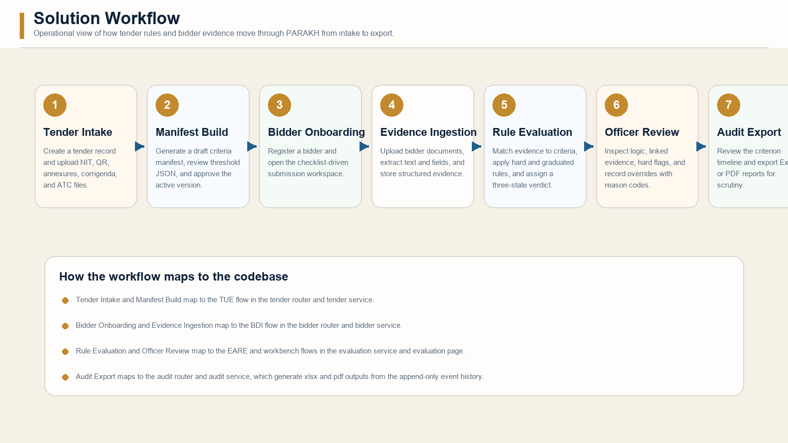
WORKFLOW
The platform connects tender rules, bidder evidence, deterministic evaluation, officer review, and export in one chain.
This is the core demo story: every stage leaves behind structured data that the next stage can reuse and audit.
PARAKH
05

Slide 6
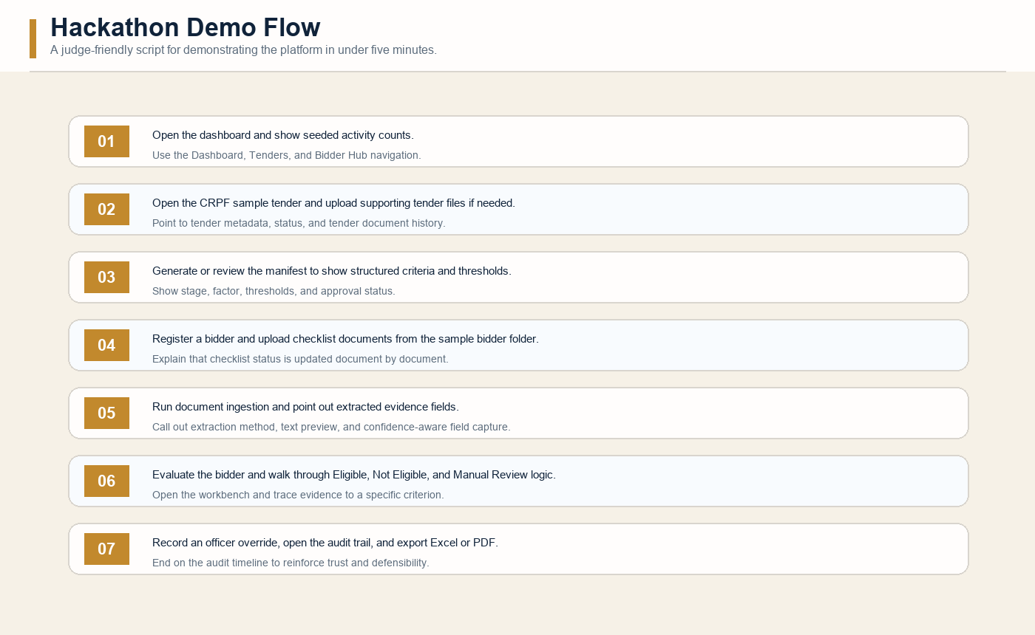
DEMO
A judge can understand the product in under five minutes because the workflow is linear, visible, and evidence-led.
What the judge should see
Seeded tender and seeded
users remove setup
friction.
Checklist-driven upload
makes the platform easy to
narrate.
Evaluation links every
verdict back to evidence.
Audit export makes the
value visible immediately.
7
10
Criteria
Docs
Seeded manifest factors
Checklist uploads
PARAKH
06

Slide 7
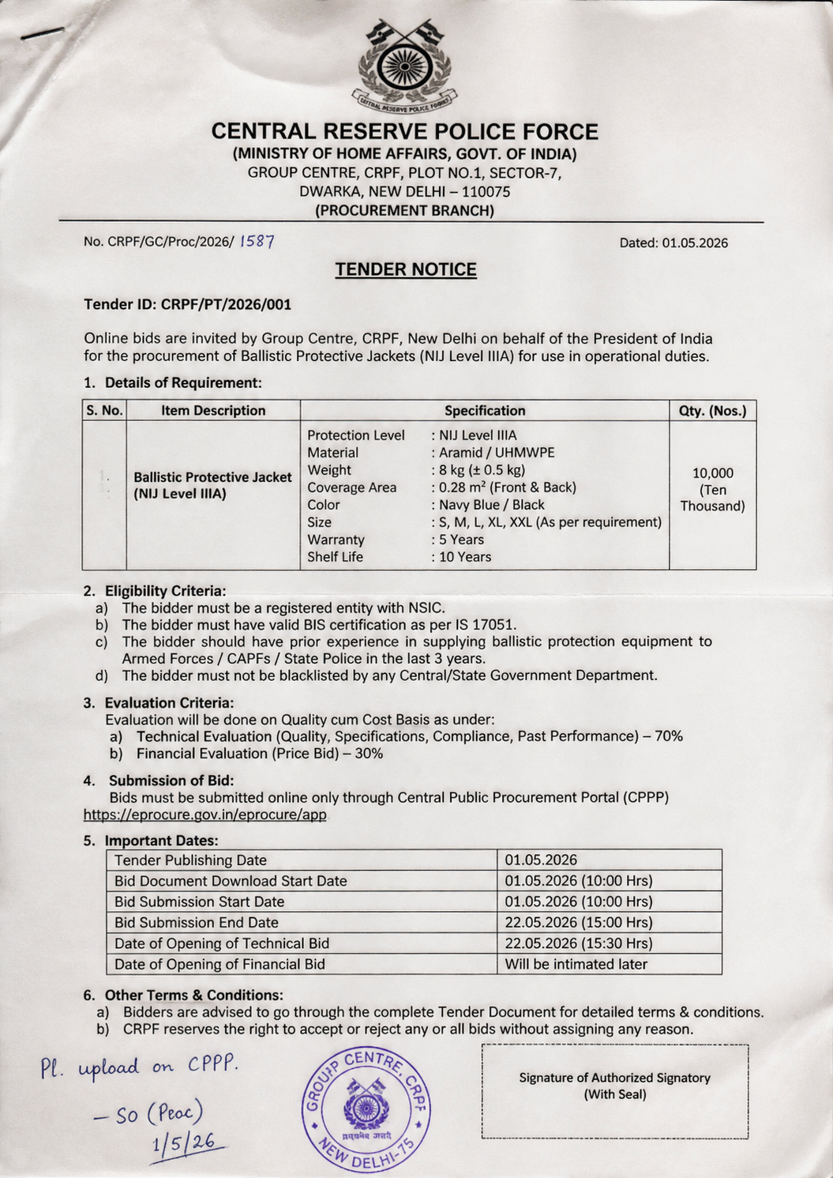
TUE
Tender-side files become a versioned criteria manifest instead of a pile of disconnected PDFs.
What happens in this stage
Tender metadata is captured through the Tender
Console.
Tender-side files are stored with document id, type,
path, and timestamp.
Generate Draft creates a structured manifest from
seeded evaluation criteria.
Officers can review descriptions, threshold JSON, and
guidance notes before approval.
7
Versioned
Tender trace
Seeded criteria
Manifest lifecycle
Every source document is stored and referenced
Admin, Tech, Capacity
DRAFT, APPROVED, SUPERSEDED
Ready for later audit
PARAKH
07

Slide 8
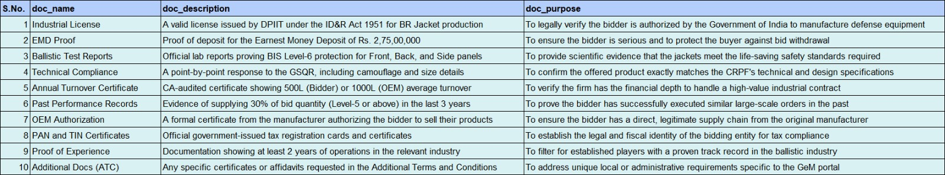
BDI
The bidder workflow is checklist-driven, which makes the platform practical for real submission review.
Document intake and extraction
Each bidder is initialized with a 10-document checklist
from fixture data.
Uploaded files are stored per tender and bidder, then
passed to extraction routines.
The prototype supports digital PDFs, images, HTML, and
fallback handling.
Structured fields include PAN, GSTIN, EMD details,
ballistic levels, turnover averages, size mix, OEM
authorization, and experience years.
10
4
Confidence-aware
Checklist docs
Input types
Extraction policy
Mapped to evidence templates
pdf, image, html, fallback
Low-confidence fields route to manual review
PARAKH
08

Slide 9
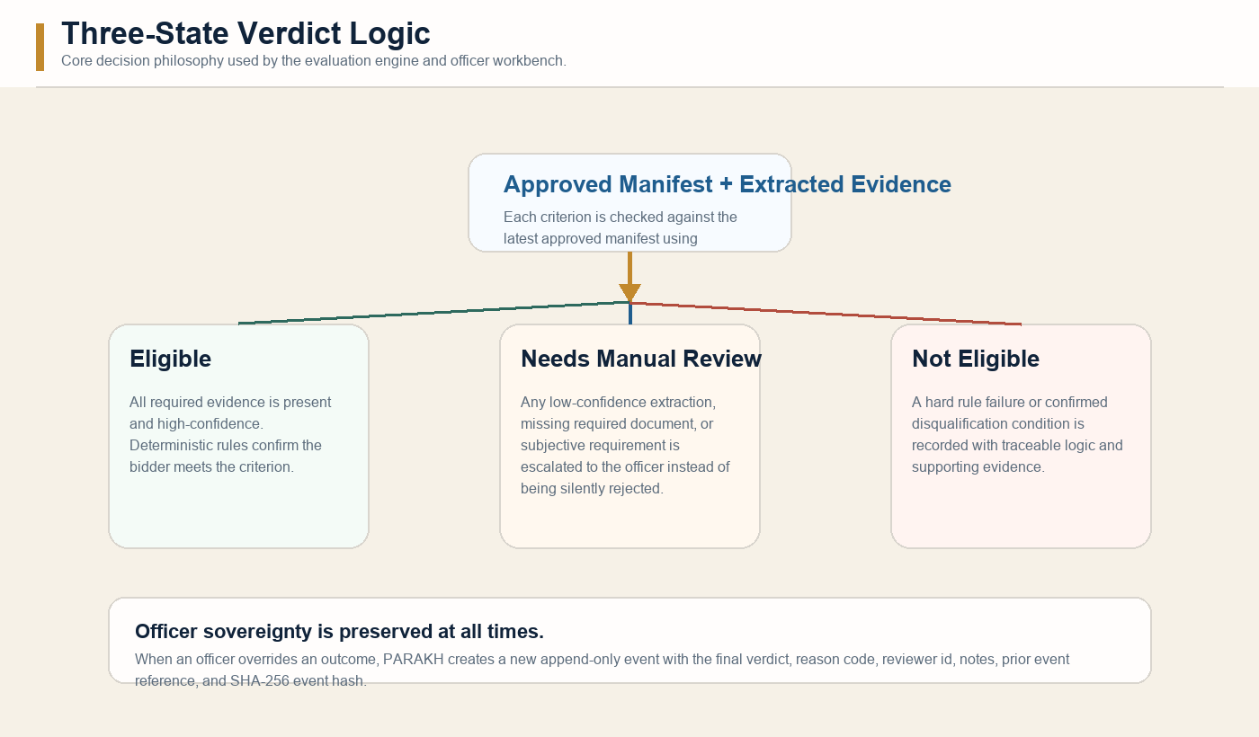
EARE
PARAKH is strongest where many AI demos are weakest: it refuses false certainty.
Decision mechanics
Objective hard rules can
auto-resolve when evidence
is complete and...
Missing or weak evidence
automatically becomes Needs
Manual Review.
Subjective checks remain
officer-reviewable even when
extraction hints exist.
3
6
SHA-256
Verdicts
Reason codes
Audit chain
Eligible / Not Eligible / Review
Structured override capture
Tamper-evident events
PARAKH
09

Slide 10
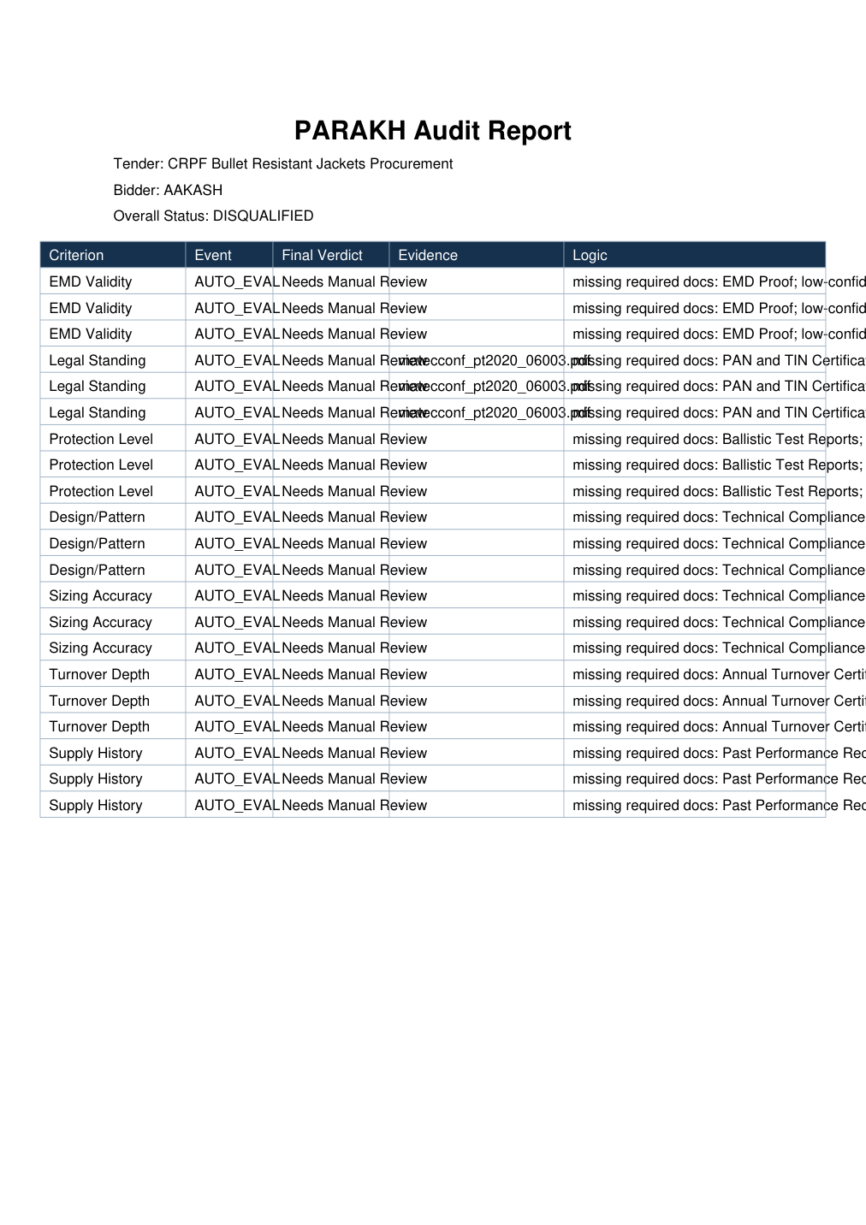
AUDIT
The platform ends where trust begins: a human-readable, machine-traceable record of why the decision happened.
Audit-ready behaviors
Every evaluation and override is stored as a new
append-only event.
Each event carries evidence references, extracted
values, match logic, reviewer data, and prior event
linkage.
The audit page groups events by criterion so judges and
officers can trace the full chronology.
Exports are available in both Excel and PDF formats for
downstream review.
Why this matters
PDF
XLSX
It turns the result from AI says so into evidence, logic, and audit trail.
Export format
Export format
Narrative report
Structured workbook
PARAKH
10

Slide 11
FEATURES
The prototype already covers the full procurement-assistance loop instead of stopping at extraction alone.
Tender creation
Manifest approval
Checklist uploads
Authority-side record creation
with metadata and document
history.
Versioned criteria blueprint
with editable threshold JSON.
Bidder workspace driven by
document requirements.
Evidence extraction
Three-state verdicting
Audit export
Field-level capture with text
preview and confidence scores.
Eligible, Not Eligible, or Needs
Manual Review.
Excel and PDF generation from
append-only event history.
4
7
10
6
2
Officer-first
Subsystems
Core criteria
Checklist docs
Reason codes
Export modes
Operating stance
11
PARAKH
TUE, BDI, EARE, HLWAS
Seeded procurement checks
Bidder evidence categories
Override control surface
PDF and Excel
Authority stays human

Slide 12
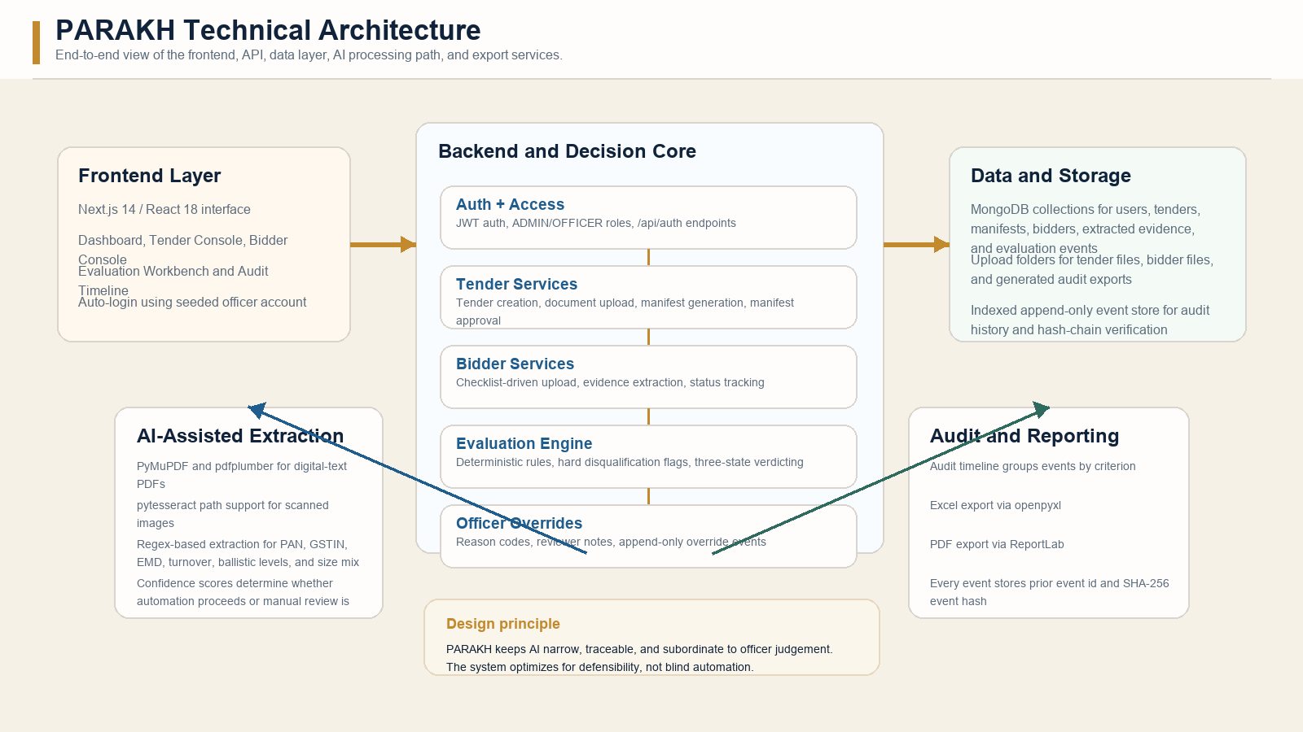
ARCHITECTURE
The stack is straightforward enough for a hackathon prototype and strong enough to communicate production intent.
Frontend: Next.js + React | Backend: FastAPI | Database: MongoDB | Exports: openpyxl + ReportLab | Infra: Docker Compose + Redis stub
PARAKH
12

Slide 13
WHY PARAKH IS DIFFERENT
This is not another AI-on-PDFs demo. Its differentiation comes from governance discipline.
Manual review only
Generic black-box AI
PARAKH
Speed
Slow and person-dependent
Fast, but often opaque
Fast where evidence is
clear; reviewable where it
is not
Consistency
Varies by reviewer
Can be brittle or
hallucination-prone
Rules, manifests, and
structured evidence create
repeatability
Auditability
Often fragmented
Weak unless custom logging
is added
Built-in append-only event
store with hashes
Officer control
High, but inefficient
Low when the model acts
like a judge
High, because overrides
and reason codes are
first-class
PARAKH
13

Slide 14
SCOPE AND ROADMAP
The prototype is honest about what is working now and what should come next.
Working in the prototype
Next-step roadmap
Tender creation, document upload, manifest
generation, and manifest approval
Automated clause extraction from full
tender packs and corrigenda chains
Bidder registration, checklist-driven
upload, and evidence ingestion
Bilingual and handwritten document
robustness for field-heavy Indian
procurement files
Deterministic rule-based evaluation with
three-state verdicting
Committee mode, clarification request
tracking, and deeper collaboration
workflows
Officer override flow with reason codes and
reviewer notes
Advanced analytics across tenders,
bidders, overrides, and recurring risk
patterns
Deployment hardening for government cloud
environments and production security
controls
Audit timeline plus PDF and Excel export
PARAKH
14

Slide 15
PARAKH
From black-box automation to audit-ready assistance
PARAKH shows that the best use of AI in public procurement
is not replacing the officer. It is making the officer
faster, safer, and more defensible.
4
7
2
Subsystems
Criteria
Exports
Connected end-to-end
Seeded manifest checks
PDF + XLSX
Theme fit: AI-assisted tender evaluation for
government procurement
Closing message
Demo fit: complete flow from tender intake to
export
A procurement officer does not need a system that says trust me. They need a system that says here is the evidence, here is the logic, and here is the record.
Differentiator: deterministic logic plus human
accountability
Team Zenith | Abhishek Neema (Leader) | Ramadhar | Aakash Kumar | Prahlad Bhatt
Thank you
15

