Slide 1

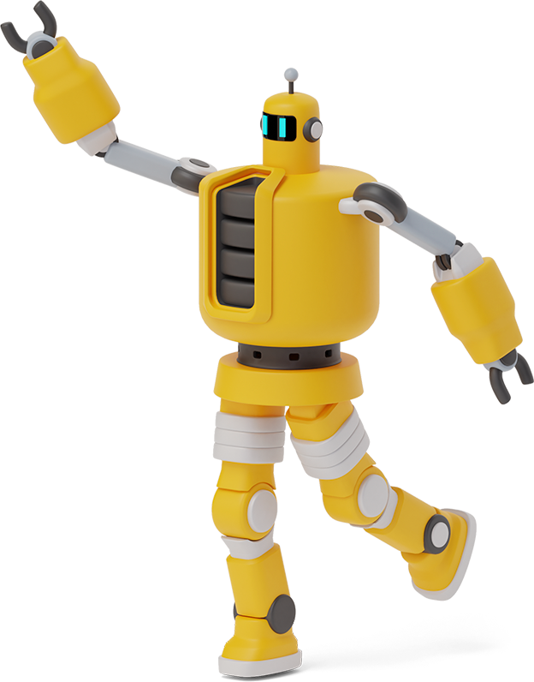
cyberpunk

Slide 2

DESIGNERS
PANDIRAJA.P
RAKESH.A
NAGA SAPTA AAKASH.B
GOWRI SUBRAMANIAN.A
BALAKRISHNAN.P

Slide 3


ULTRON

Slide 4

environment
1
Greenfoot

Slide 5



About greenfoot..
The Greenfoot project was initiated by Michael Kölling in 2003, and a first prototype was built by Poul Henriksen (masters student) and Michael Kölling in 2003/2004.
From 2005 development was continued involving the other members of the BlueJ Group.
In March 2009, Greenfoot project became free and open source software, and licensed under GNU GPL with Classpath exception.

Slide 6

concept
A Space war between Ironman and Ultrons .
He has to shoot obstacles , escape from some trapes and protect the planet.

Slide 7
controls
Level - 1,2
Up arrow – move up
Down arrow –move down
Left arrow –move left
Right arrow –move right
Space – To Shoot
Level - 3
Up arrow – move up
Down arrow –move down
Space – To Shoot

Slide 8
Classes used
World class
StartScreen
MyWorld
MyWorld2
Level2
Level3
StateWorld
HighScore
Actor class
Asteroids
Drones
Explode
Laser
Move
Score
Ironman
IronBeam
Ironmanbb
Ultronbb
UltronBeam

Slide 9

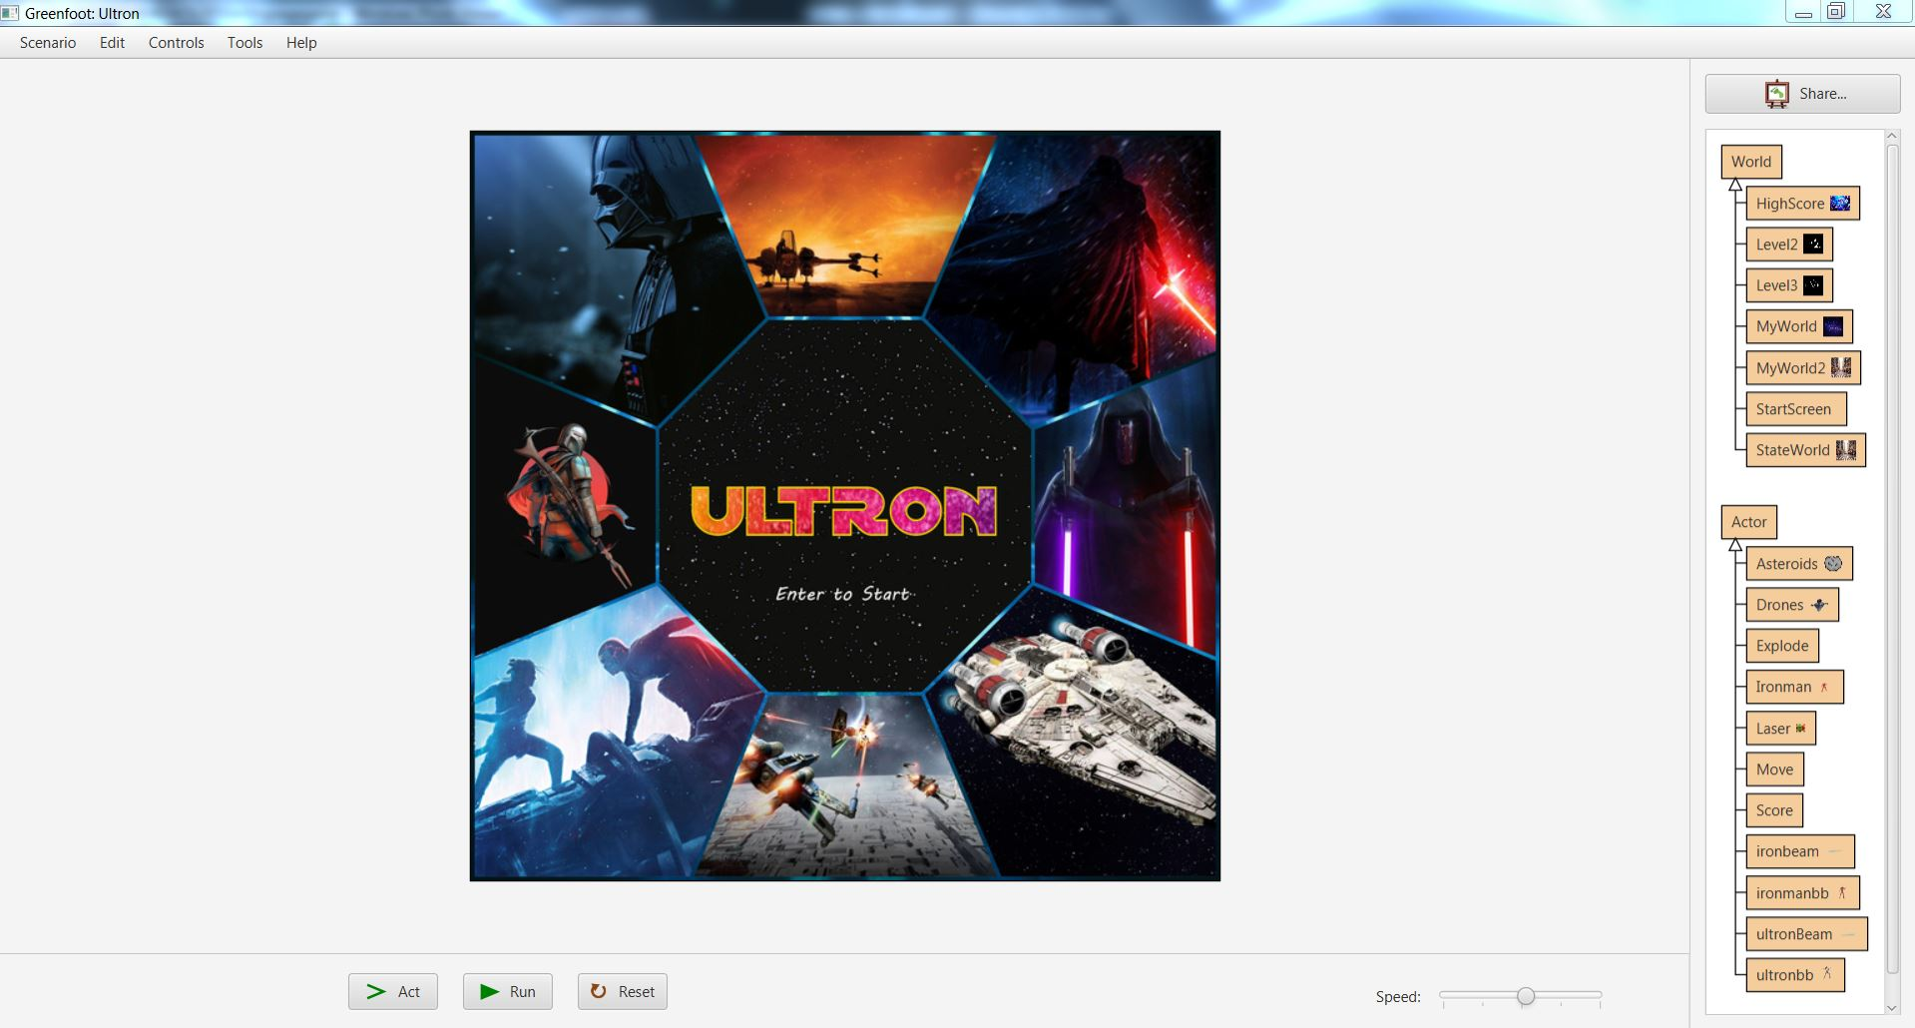
Want big impact?
Use big image.
Front Screen

Slide 10
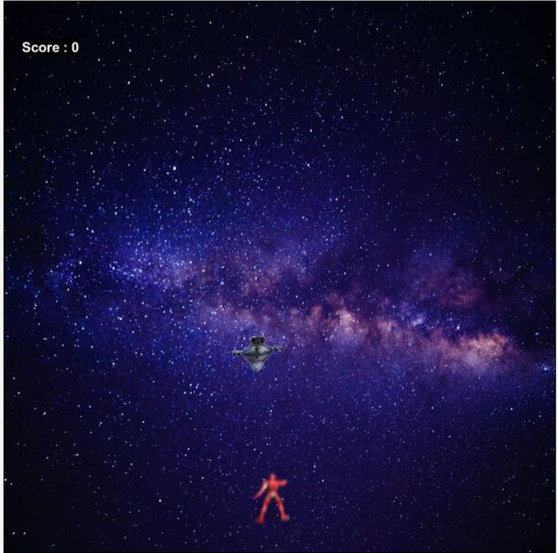

Slide 11

After Reach the Score : 150

Slide 12
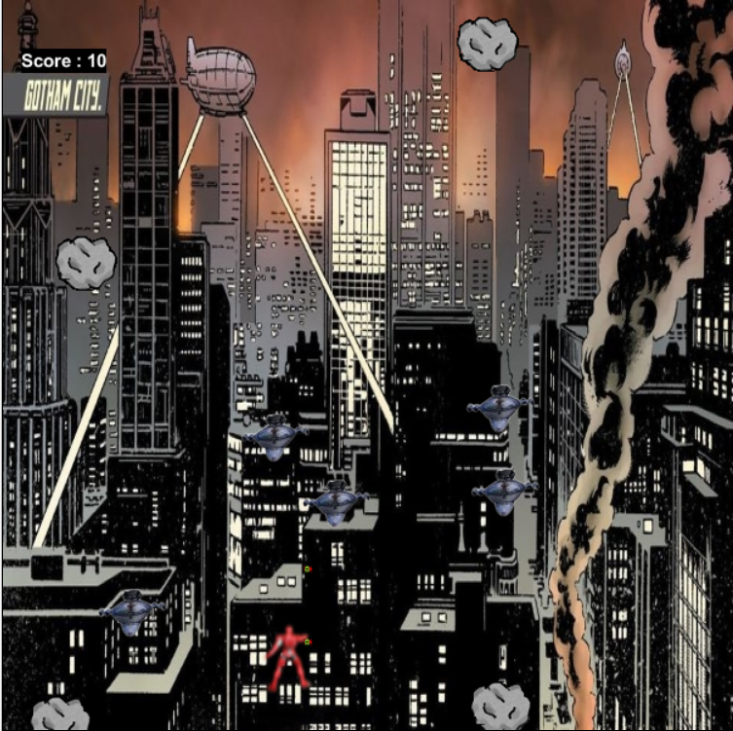
Level 2

Slide 13

After reach the score 250

Slide 14

Boss Battle

Slide 15
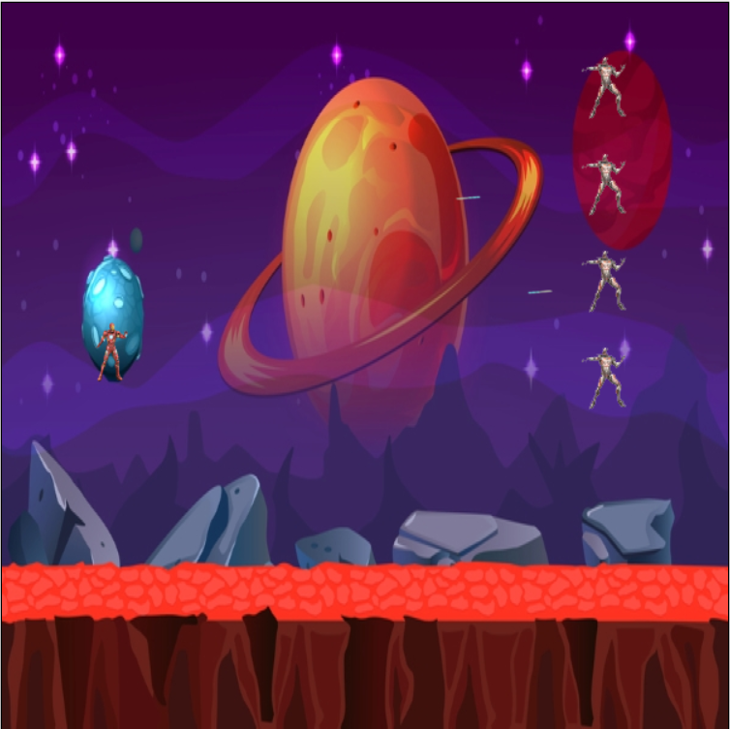

Slide 16

ENJOY THE GAME

Slide 17
Thank You all

