Slide 1

Prediction of Employability for Graduates
SRM INSTITUTE OF SCIENCE AND TECHNOLOGY
SCHOOL OF COMPUTING
DEPARTMENT OF COMPUTING TECHNOLOGIES
18CSP107L / 18CSP108L - MINOR PROJECT / INTERNSHIP
Batch ID:
Student 1 Reg. No:RA19110030101252
Student 1 Name:Aakash Pandey
Student 2 Reg. No:RA1911003010225
Student 2 Name:Sriharsha Itha
Guide name: Abhirami G
Designation: Department: CTECH

Slide 2
Abstract
Nowadays, Graduates' employability is a major concern for the universities, and predicting their employability can help take timely actions to increase the institutional placement ratio
We predict the placement status of a student based on various student attributes using Logistic regression algorithm.
Knowing weaknesses before appearing can help students work in areas that they need to improve to best match the company's skillset.

Slide 3
This system predicts if a student would be placed or not based on the student’s qualifications, historical data, and experience. This predictor uses a machine-learning algorithm to give the result.
The algorithm used is logistic regression. Logistic regression is basically a supervised classification algorithm. In a classification problem, the target variable(or output), y, can take only discrete values for given set of features(or inputs), X. Talking about the dataset, it contains the secondary school percentage, higher secondary school percentage, degree percentage, degree, and work experience of students. After predicting the result its efficiency is also calculated based on the dataset.

Slide 4
Introduction
Annual Employability Survey 2019 report by Aspiring Minds reveals that 80% of Indian engineers are not fit for any job in the economy.
Due to rampant unemployment graduates who are not finding job are doing blue collar Jobs.
Employability of graduates becomes one of the performance indicators for higher educational institutions

Slide 5
The graduates in every institution reflect the skills developed and competencies acquired by the students through the education offered by the institution that is suitable in the companies.
Therefore, in this study, we aim to predict graduate employability based on there skills, academic background, resume, internships etc.

Slide 6
Literature Review:
Existing system ‘s prediction relies on identifying the most predictive features impacting the hiring opportunity of graduates.
In the existing system they are only using internship as only a metric to predict a job outcome.
However, internships do not guarantee employability, especially when a graduate’s internship performance is not satisfactory, and the internship requirements are not met.

Slide 7
Comparison of Existing methods with merits and demerits
Merits:
It often provides predictive accuracy which no other algorithm can triumph.
Lots of flexibity it provides several hyper parameter tuning and optimizes on different loss function.
Often works well with categorical numerical values.
Handling of missing data-imputation not required.

Slide 8
Demerits:
Gradient Boosting Models will continue improving to minimize all errors. This can overemphasize outliers and cause overfitting.
Computationally expensive - often require many trees (>1000) which can be time and memory exhaustive.
Less interpretative in nature, although this is easily addressed with various tools.
The high flexibility results in many parameters that interact and influence heavily the behavior of the approach .This requires a large grid search during tuning.

Slide 9
Challenges:
Very limited research has been carried out to examine the impact of internship programs on the labor market opportunities. Due to which finding a dataset matching our requirements was difficult.
Measuring emotional competence metric which is one of the major criteria in our proposed model and quantifying it into measurable data .
Adding new metrics into existing system to achieve our goals.
Performing model training and obtaining an expected outcome with high accuracy also with our current dataset.

Slide 10
Problem Statement and Objectives:
Prediction of Employability for graduates using ensemble learning.
In our problem statement we are trying to predict employability for young graduates using various factors.
Identifying the significant factors affecting employability, as well as the requirements of the new job market
Employment, or rather the lack of it, that is to say, unemployment, is without doubt one of the most negative economic phenomena due to its potential consequences on the cohesion and stability of societies.

Slide 11
Objective:
Identify their weaknesses and strengths, students might better plan their career.
Reducing number of unemployed students after finishing their graduations.
Improving schools and universities curriculum to build new competencies, both for educating, training and reskilling current and future graduates.

Slide 12
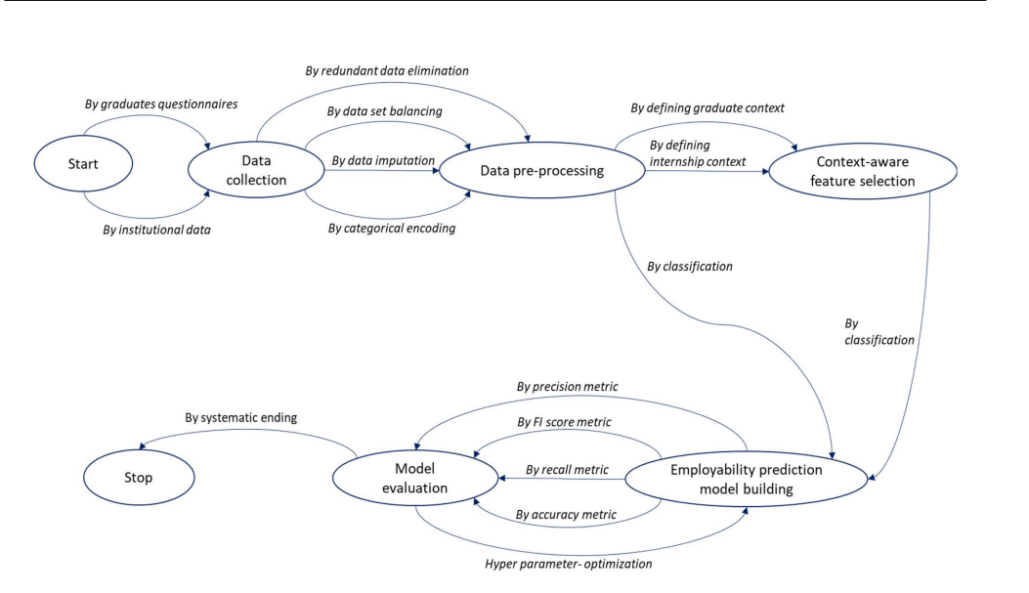
Architecture Diagram

Slide 13
Strategy
Our system predicts if a student would be placed or not based on the student’s qualifications, historical data, and experience. This predictor uses a machine-learning algorithm to give the result.
Talking about the dataset, it contains the secondary school percentage, higher secondary school percentage, degree percentage, degree, and work experience of students. After predicting the result its efficiency is also calculated based on the dataset. The dataset used here is in .csv format

Slide 14
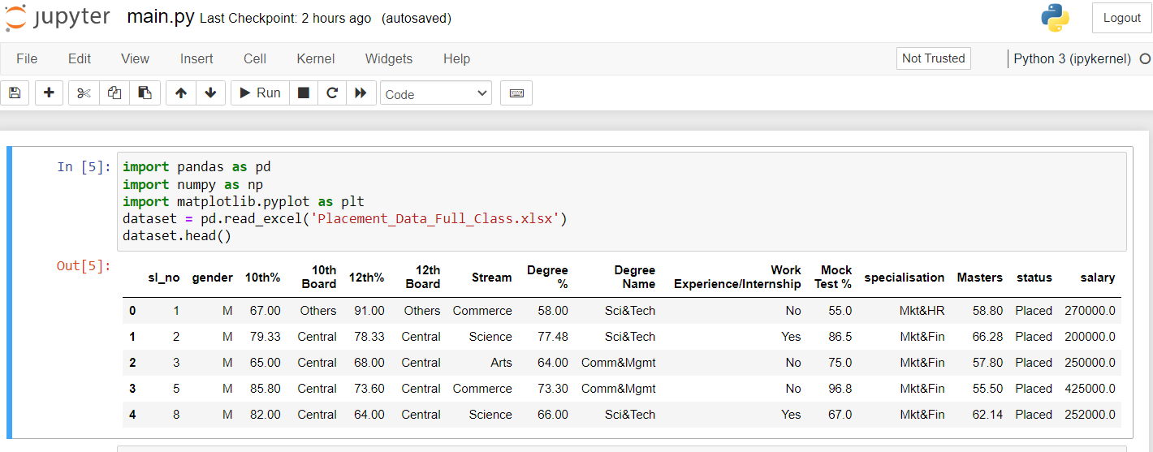
Dataset preparation and pre-processing
Step 1: Import the required modules.
Step 2: Using pd.read_csv to read the dataset

Slide 15
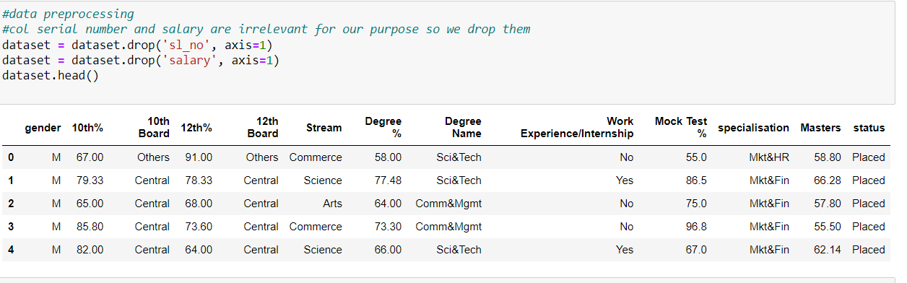
Step 3: Now we will drop the columns that are not needed.

Slide 16
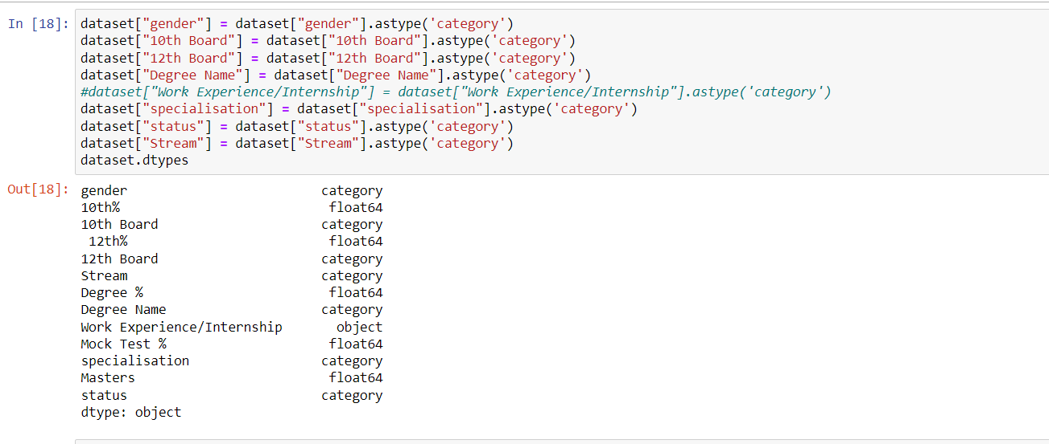
Step 4: Now before moving forward we need to pre-process and transform our data. For that, we will use astype() method on some columns and change the datatype to category.

Slide 17
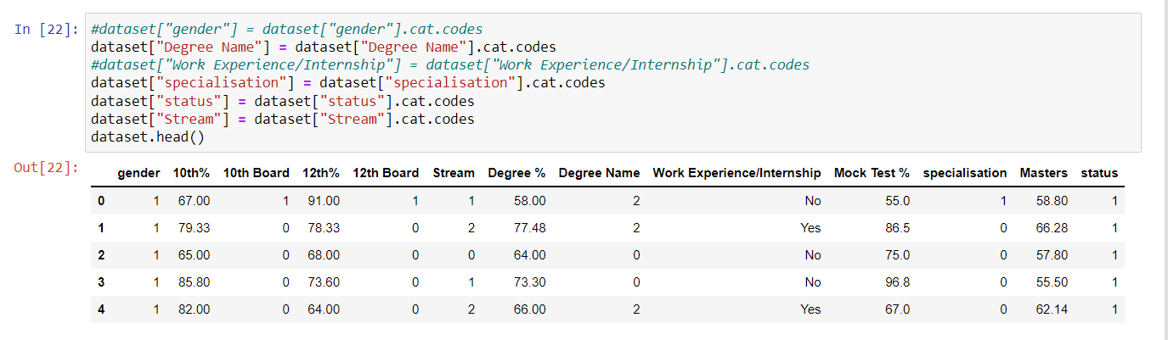
Step 5: Now we will apply codes on some of these columns to convert their text values to numerical values.

Slide 18
Discussion
So the first step in our project was to find a suitable database and make some adjustments in preprocessing stage. We imported the dataset then dropped the data that had no use in our model. For example, one column that was dropped was Salary. While it can be an important column for other projects we do not care about how much the students are making when they are employed we are care about whether they are employed or not.

Slide 19
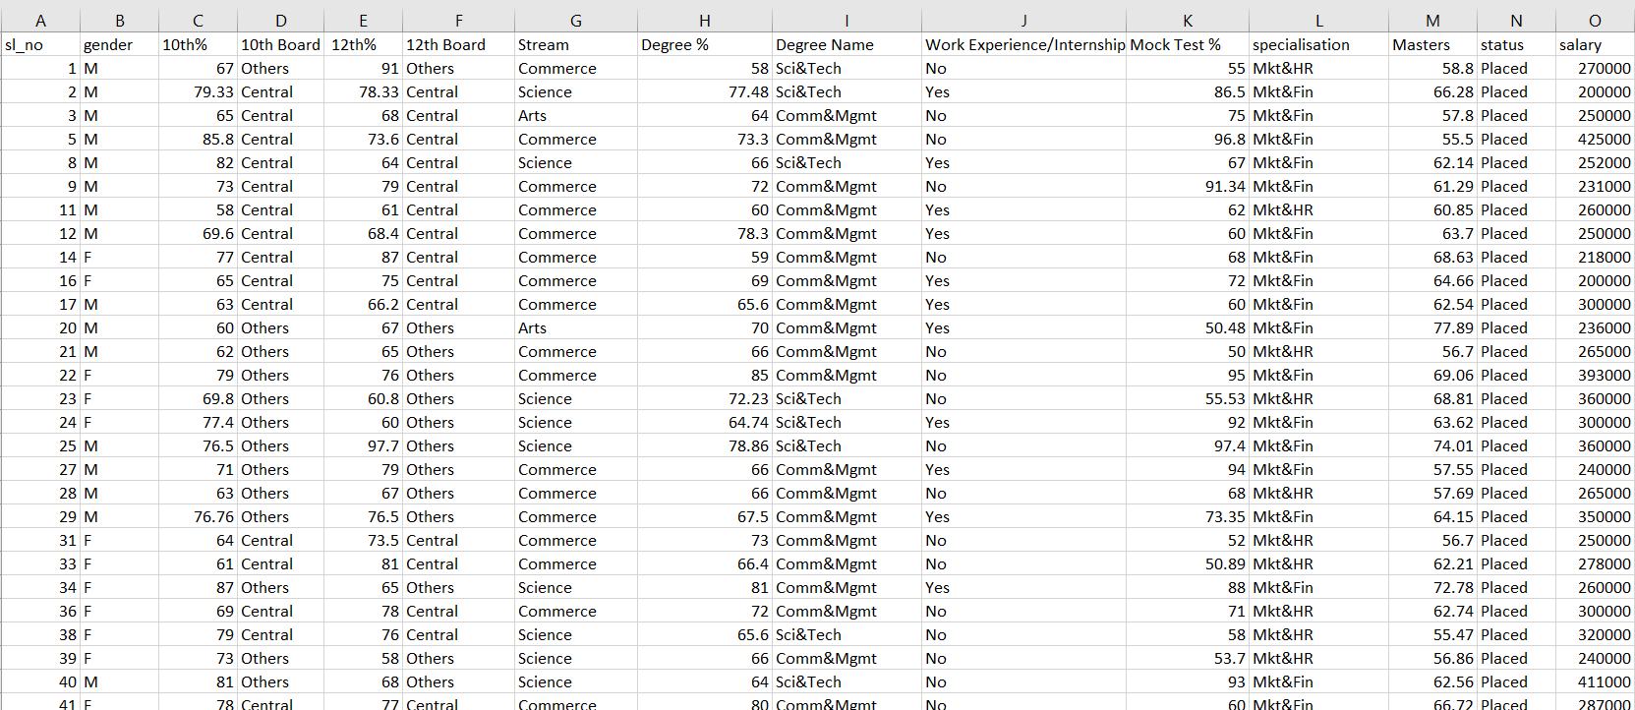
Screenshots

Slide 20
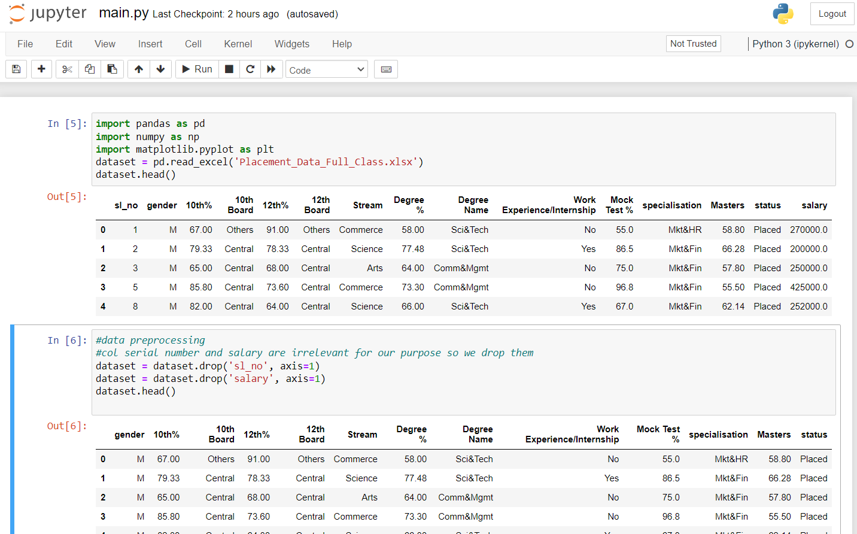

Slide 21
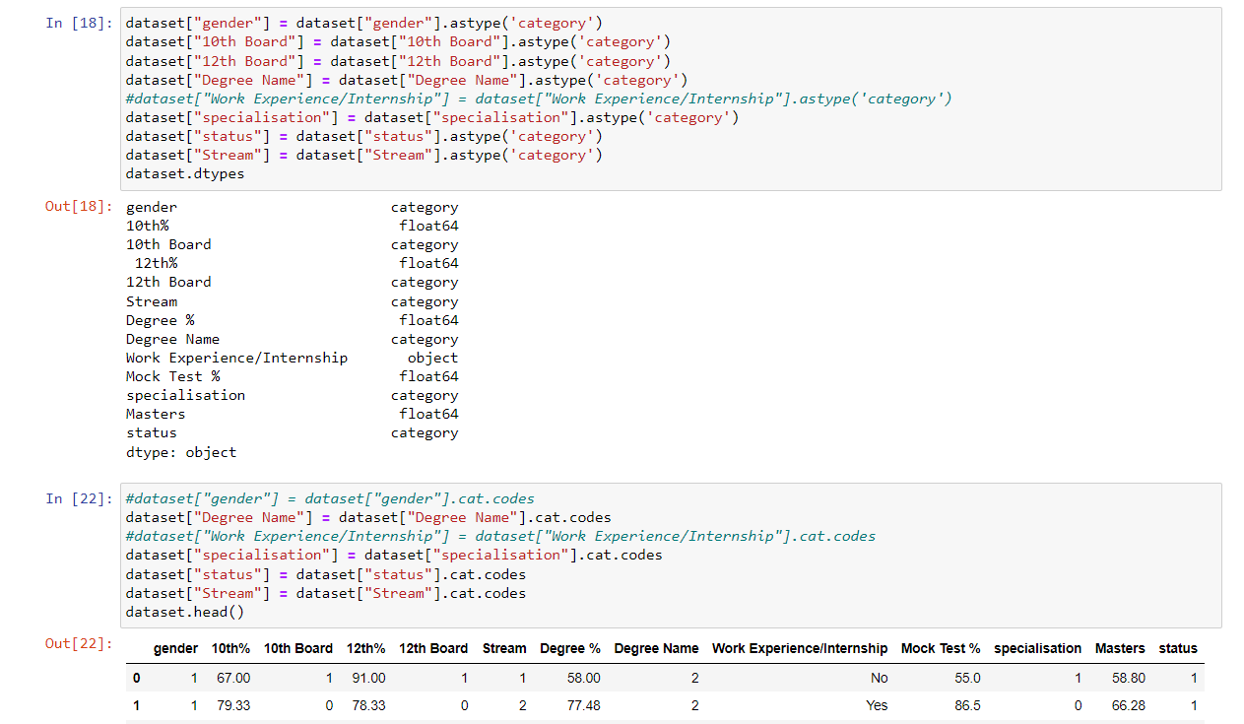

Slide 22
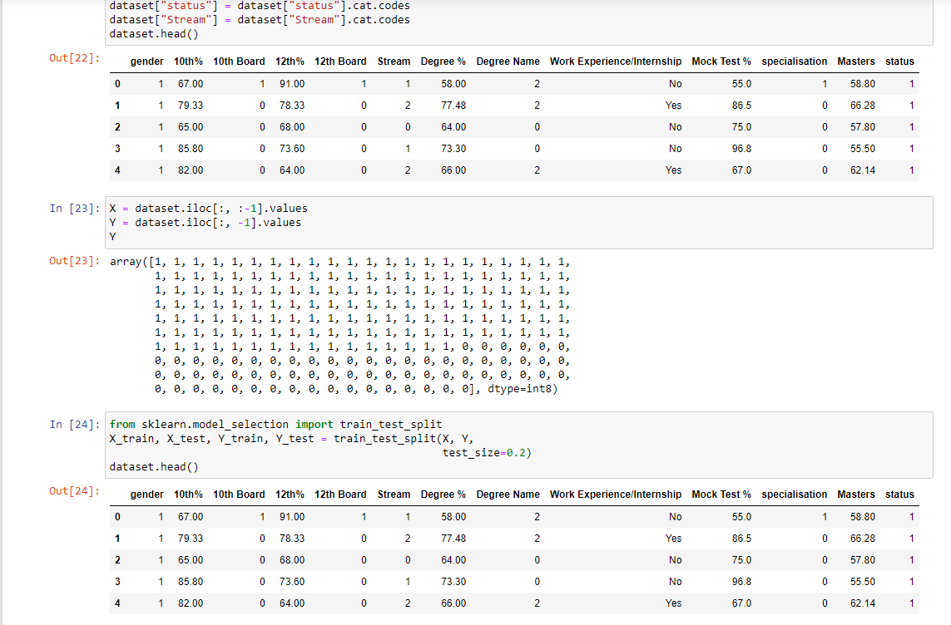

Slide 23
THANK YOU

