Slide 1
Novel Contribution
The inspiration driving this wander is to play out an examination of atmosphere data. Here, examination portrays point by point examination of fundamental atmosphere data parameters for performing atmosphere foreseeing.
Preliminary data will be assembled from CityPulse an online store that offers different semantically cleared up datasets accumulated from associates of the CityPulse EU FP7 broaden and relevant resources for splendid city data.
Let us talk about the hypothesis of this survey:
The hypothesis of the survey is delivered as H1: Today a ton of imperative data and sensor information remain unused or are limited to specific application spaces due to incalculable progressions and setups (atmosphere takes note). In this manner, a get-together of basic information from various sources is done physically and as a general rule, it is out-dated.
A t-test with the expectation of complimentary examples is used to address the hypothesis. The discussion of the survey researched extraordinary information on atmosphere database.

Slide 2
Novel Contribution (Cont…)
The eventual outcome of the survey is a productive and reasonable representation of atmosphere information database.
Traverse region points of confinement to engage honestly to goodness gagging and atmosphere forewarning reports that reinforce the coordination and examination of heterogeneous data and information sources and empowers the progression of innovative consistent smart city applications.
About City Under Consideration:
Arhus is Denmark's second-greatest city and the cash related concentration of the Central Denmark Region.
The city has a catchment zone of 1.2 million people inside a one-hour travel go and is especially connected with Copenhagen and Hamburg.
The tenants of Aarhus live inside walking division of parks and recreational reaches, and inside a 15-minute bike ride of an immaculate coastline, and they advantage from close-by provisions of clean drinking water.

Slide 3
Novel Contribution (Cont…)
In a nearby organized exertion with the business assemble and the city's various data foundations, the City of Aarhus will reduce the city's CO2 transmissions and make keen game plans and green advancement.
Creative demonstrating wanders ensure exchange offers of home-created environment courses of action abroad, attract overall theory and fulfill the goal of being CO2-fair by 2030.
This presentation proposes a review of how atmosphere data examination and representation attempt can help in building framework for sharp urban ranges to stimulate the introduction of splendid city applications for atmosphere envisioning and takes note.

Slide 4
About Data
The weather data for the city of Aarhus in Denmark is public for analyses purpose, available at Weather Data . The dataset is a collection of weather observations from the city of Aarhus.
Measurements are recorded from February 2014 – June 2014 and August 2014 – September 2014.
Weather data values will be analyzed on the basis of components like - Dew Point, Humidity, Pressure, Temperature, Wind Direction and Wind Speed.
Data provided in online repository is in .Json file format. And in this project we will consider processing of only .Csv file format. So, we will perform transformation of. Json to .Csv file format.
For data analyses and exploration we will use Apache Zeppelin environment more specifically Spark Module.

Slide 5
About DataVariables
Predictors: - Humidity, Air Pressure, Temperature, Wind Direction, Dew point.
Humidity: - Humidity is the measure of water vapor noticeable all around. Water vapor is the vaporous condition of water and is imperceptible. Humidity shows the probability of precipitation, dew, or haze. Higher dampness diminishes the viability of sweating in cooling the body by decreasing the rate of dissipation of dampness from the skin. There are three primary estimations of humidity: total, relative and particular.
Air Pressure: - Atmospheric pressure, here and there additionally called barometric weight is the weight applied by the heaviness of air in the environment of Earth (or that of another planet). Much of the time climatic weight is nearly approximated by the hydrostatic weight created by the heaviness of air over the estimation point.
Temperature: - Temperature is a level of hotness or coldness the can be measured utilizing a thermometer. It's likewise a measure of how quick the particles and atoms of a substance are moving. Temperature is measured in degrees on the Fahrenheit, Celsius, and Kelvin scales.

Slide 6
Wind Direction: - - Wind direction is represented by the course from which it starts. For example, a northerly wind blows from the north toward the south. The wind bearing will vitally affect the ordinary atmosphere. You can frequently be given a twist course and you will have a completely brilliant considered how the atmosphere will change and what atmosphere can be typical with that wind heading.
Dew Point: - Dew point is the temperature at which airborne water vapor will accumulate to shape liquid dew. A higher dew point suggests there will be more soddenness observable all around. Dew point is now and again called ice minute that the temperature is underneath chilly. The measurement of dew point is related to humidity.
Response Variable: - Wind speed. So, we will build our model to predict wind speed using above predictors.
Wind Speed: - Wind speed, or wind stream speed, is a basic climatic amount. Wind speed is brought on via air moving from high weight to low weight, more often than not because of changes in temperature. Wind speed influences climate determining, airplane and oceanic operations, development undertakings, development and digestion system rate of many plant species, and endless different ramifications.

Slide 7
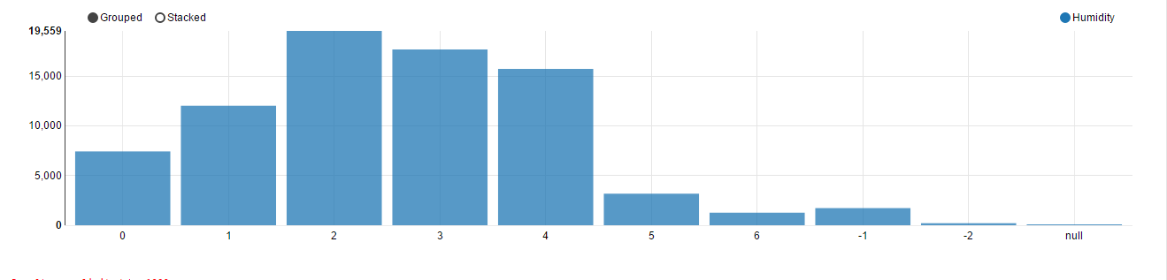
Glimpse Of Data
Humidity VS Dew point
HUMIDITY
DEW POINT

Slide 8
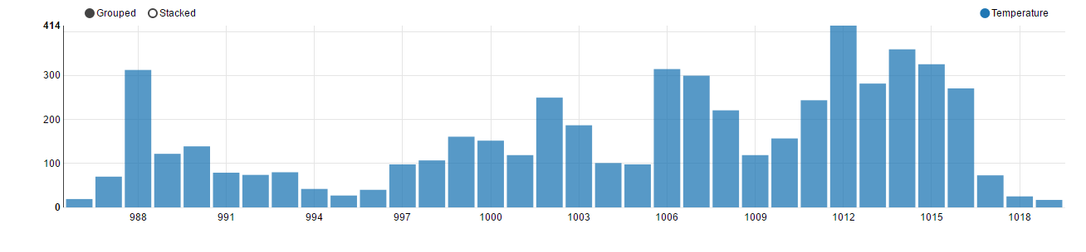
Glimpse Of Data (Cont…)
Temperature VS Air Pressure
TEMPERATURE
AIR PRESSURE

Slide 9
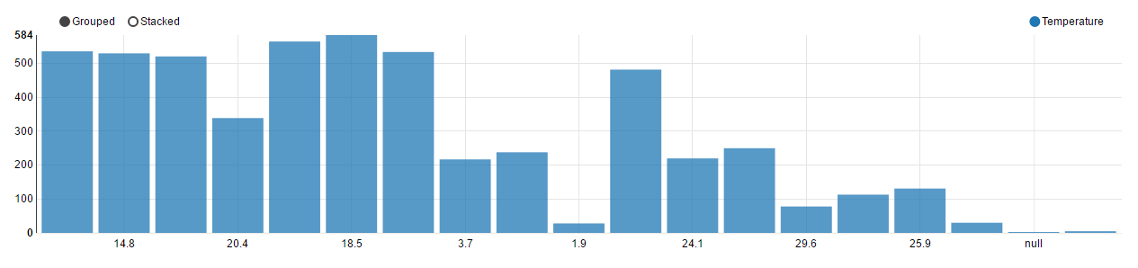
Glimpse Of Data (Cont…)
Temperature VS WindSpeed
TEMPERATURE
Wind Speed

Slide 10
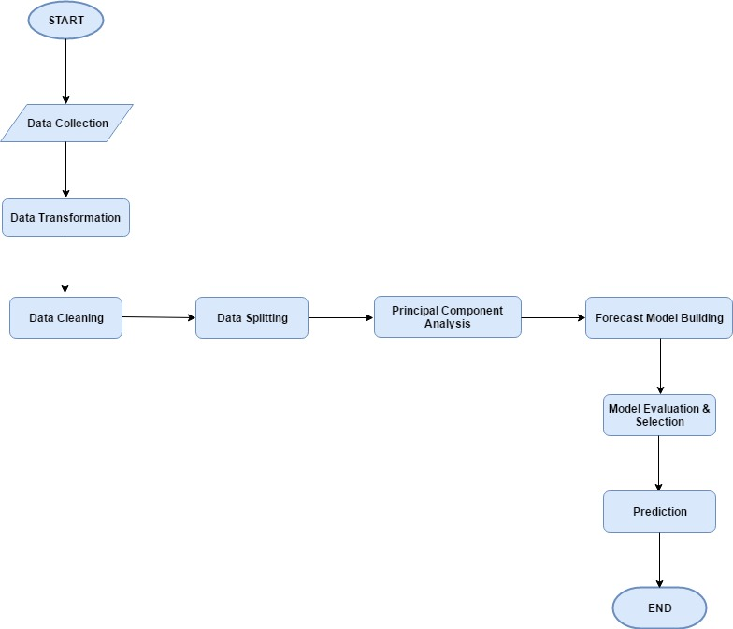
Algorithm Flowchart

Slide 11
Algorithm Explanation
Data Collection: - Data collection is the route toward get-together and measuring data on elements of energy, in a set up efficient form that engages one to answer communicated inquire about inquiries, test hypotheses, and survey comes about.
Data Transformation: - Data provided in online repository is in .Json file format. And in this project we will consider processing of only .Csv file format. So, we will perform transformation of. Json to .Csv file format.
Data transformation is the path toward changing over data from one association (e.g. a database record, XML file, or Excel sheet) to another.
Since data often lives in different territories and designs over the attempt, data transformation is essential to ensure data from one application or database is conceivable to various applications and databases, a fundamental part for applications blend.

Slide 12
Algorithm Cont…
Data Cleaning: - Data cleaning is the route toward recognizing and helping (or clearing) decline or mistaken records from a record set, table, or database and implies perceiving divided, misguided, off base or unessential parts of the data and after that supplanting, changing, or deleting the muddled or coarse data.
Data Splitting: - The slightest troublesome course for us to comprehend the limit of a judicious model to perform on future data is to endeavor to copy this certainty. Notwithstanding the way that we can't genuinely get to the future before it happens we can hold some of our starting at now available data and view it just as was data from what's to come.
For assuring the certainty of model we routinely separate the available data into discrete sections self-assertively, developing our models on one of these portions and using the other for farsighted model examination and possibly exhibit refinement.
In our case Aarhus city data set will be divided in 60-40 ratio. In which 60% will be training part and 40% of data will go in testing bucket.

Slide 13
Algorithm Cont…
Principal Component Analysis: - Principal components analysis is a procedure for identifying a smaller number of uncorrelated variables, called "principal components", from a large set of data.
The goal of principal components analysis is to explain the maximum amount of variance with the fewest number of principal components and reduce the number of variables and avoid multi co linearity.
Model Building: - Model Building–choosing predictors–is one of those skills in statistics that is difficult to teach. It’s hard to lay out the steps, because at each step, you have to evaluate the situation and make decisions on the next step.
All the variables in Aarhus city dataset are of type continuous. We will build linear models for prediction of response variable. Below are some linear models that we will build on our dataset.
Simple Linear Regression, Multiple Linear Regression, Additive Model.

Slide 14
Implementation
For implementation of proposed algorithm, we will use Python programming language. Below given are tools and particular libraries .
Tool: - Apache Zeppelin.
Programming Language: - Python.
Data Transformation & Analysis: Pandas, Numpy, Scipy, Matplotlib etc.
Data Cleaning: replace (), drop_duplicates (), cut (), merge (), format () etc.
Data Splitting: partition (), rpartition (), rsplit () etc.
Principal Component Analysis: Matplotlib, mlabpca ().
Model Building & Evaluation: scipy, sklearn etc.

Slide 15
Work by Competitor
Article: - Average Daily Air Temperature’s Long-Range Forecast Using Inductive Modeling and Satellite Dataset.
About author : - Dr. Dmytro Zubov is the author of competitor article into consideration.
In this paper, long-range forecasting average daily air temperature using inductive method was proposed.
Principle of high-impact weather events substantiates the different places’ interaction by atmosphere, hydrosphere, landmass, biosphere, etc.
Nowadays, several meteorological factors (e.g., air temperature, precipitation, wind, pressure, visibility, snow depth) are analyzed.
This paper emphasizes importance of the average daily air temperature’s long-range forecast. Further, daily values may be used as very good basis for week, month, and season forecasts.

Slide 16
About Data
In this research article Air Temperature & Sea Level Air Pressure bi-monthly data for different countries is taken into consideration.
Data Sources: - www7.ncdc.noaa.gov
Darwing and Tahiti sea level pressures, southern oscillation index (SOI), equatorial SOI, sea surface temperature
ftp://ftp.cpc.ncep.noaa.gov/wd52dg/data/indices/tahiti.his
Multivariate ENSO index data took part in the correlation analysis.
www.esrl.noaa.gov/psd/enso/mei/table.html
Aburatsu, Japan sea level pressure http://ilikai.soest.hawaii.edu/woce/wocesta.html

Slide 17
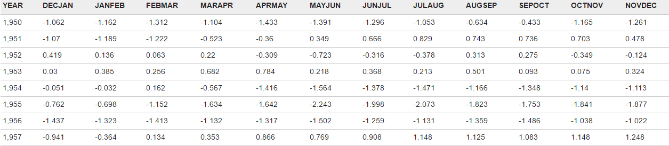
Glimpse Of Data
Ensol Index Data Set

Slide 18
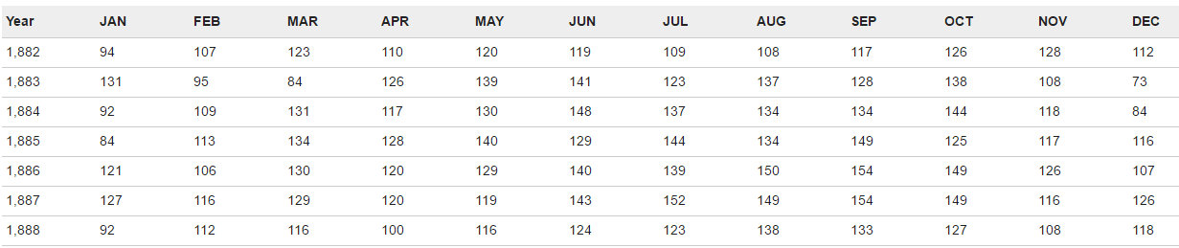
Glimpse Of Data (Cont…)
Air Pressure Data Set

Slide 19
About Forecasting Model
Proposed average daily air temperature’s long-range forecasting model has next linear structure.
More specifically the model used is Linear Regression.
In terms of weather forecasting linear regression model is a kind of NWP (Numerical Weather Prediction) process.
Numerical Weather Prediction was first proposed by Lewis Fry Richardson in 1920.
Richardson knew that the amount of data that would need to be processed would be enormous, to create forecasts with accuracy and practical value.
Today, computers are used to handle all of the information needed.

Slide 20
NWP Model Flowchart
Gather
Relevant Data
Data
Assimilation
Numerical
Weather
Predictions
(Linear Regression in our case)
Forecast
Postprocessing
Issue forecasts,
Evaluate

Slide 21


Equation of Linear Regression Model
Equation 1:
Equation 2: Inductive Method

