Slide 1

Novel Contribution
Competitor Article: - Average Daily Air Temperature’s Long-Range Forecast Using Inductive Modeling and Satellite Dataset.
This paper emphasizes importance of the average daily air temperature’s long-range forecast. Further, daily values may be used as very good basis for week, month, and season forecasts.
The air temperature has great influence on power service’s load (Robinson, Peter J., 1997), and one’s direct application is for estimating future fuel needs.
For air temperature’s long range forecasting 66 datasets of different countries were acquired from NOAA satellite and information service from 1 January 1973 to 20 April 2013 .
XF[i], XR[i] – prediction and true air temperature in the forecasted point; i – data position’s number in time series, i = 1,2,3, ..., 14521 (19 July 1973 – 20 April 2013);
l = 14045 – training sequence’s length; k0, k1, k2, k3 – weighting Coefficients.
Xj1*[I – d1] , Xj2*[I – d2] , Xj3*[I – d3] - biased by lead-times d1, d2, d3 and three days averaged true air temperature time series for the appropriate places j1, j2, j3 = 0,1,2, ..., 66 (number of the place from the above list; plus additional parameters optionally; 0 means the same place in the right and left sides).

Slide 2
Novel Contribution Cont…
Contribution to process improvement
Focus of competitor process was only on time series analyses of air temperature and then predict the same. But in order to make an accurate prediction, consideration of one environment variable is not enough.
To make the weather analyses process reliable, independent variables like Dew point, Humidity & Air Pressure are also considered in the new proposed method.
Contribution to reliability improvement
For reliability improvement, in proposed algorithm short range forecasting method is used that generally forecasts to go out to 72 hours or less. That has error less than 10% in the mean.
Model improvement
a). Temperature - K0 + K1 * Dew Point + K2 * Humidity + K3 * Pressure.
The new model has linear structure. Where K0, K1, k2, K3 are weighting coefficients of independent variable and Temperature is dependent variable.
b). For short range time series analyses, dataset is partitioned on monthly basis. And then forecasting is performed. We will see this process in next slides.

Slide 3
Novel Contribution Cont…
The weather data for the city of Aarhus in Denmark is public for analyses purpose, available at Weather Data . The dataset is a collection of weather observations from the city of Aarhus. Measurements are recorded from February 2014 – June 2014 and August 2014 – September 2014.
Data Variables:
Date Time: - Date and time of weather observation. Data structure: YYYY/MM/DD HH:MM:SS
Temperature (In Degree Celsius): - Temperature is a level of hotness or coldness the can be measured utilizing a thermometer.
Dew Point (In Degree Celsius): - Dew point is the temperature at which airborne water vapor will accumulate to shape liquid dew.
Humidity (In Percentage): - Humidity is the measure of water vapor noticeable all around. Humidity shows the probability of precipitation, dew, or haze.
Pressure (In mBar): - Atmospheric pressure, here and there additionally called barometric weight is the weight applied by the heaviness of air in the environment of Earth.
Wind Direction (In Degrees): - Wind direction is represented by the course from which it starts. For example, a northerly wind blows from the north toward the south.
Wind Speed (In Kmph): - Wind speed, or wind stream speed, is a basic climatic amount. Wind speed is brought on via air moving from high weight to low weight, more often than not because of changes in temperature.

Slide 4
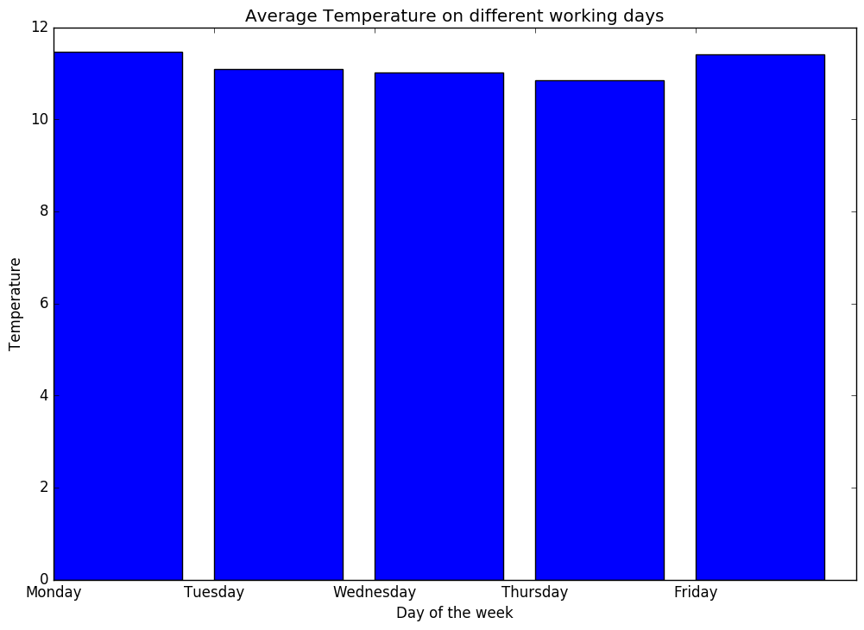
Novel Contribution Cont…
Monday & Friday are week days with highest temperature.

Slide 5
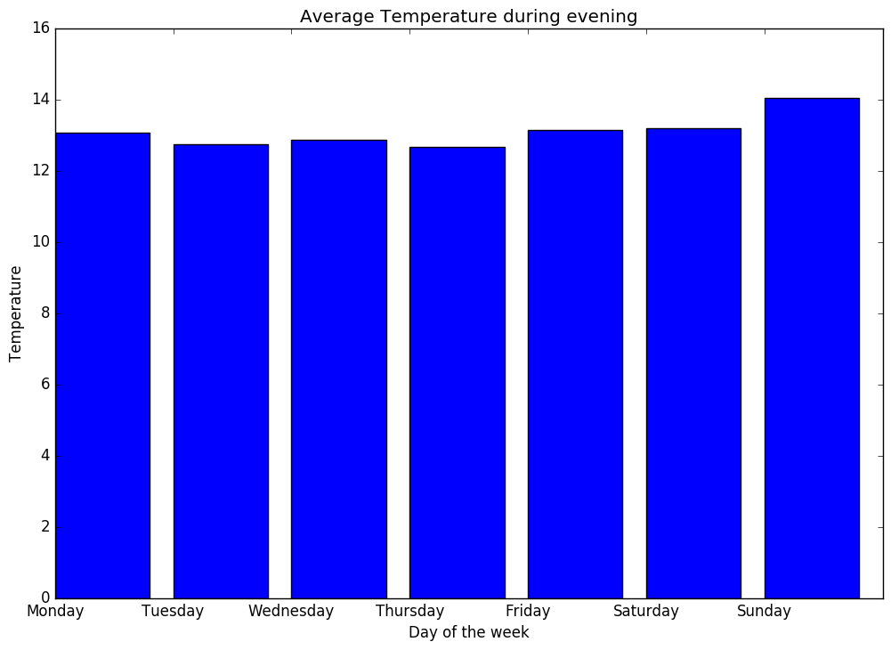
Novel Contribution Cont…
Sunday is the day when evening temperature is at the peak.

Slide 6
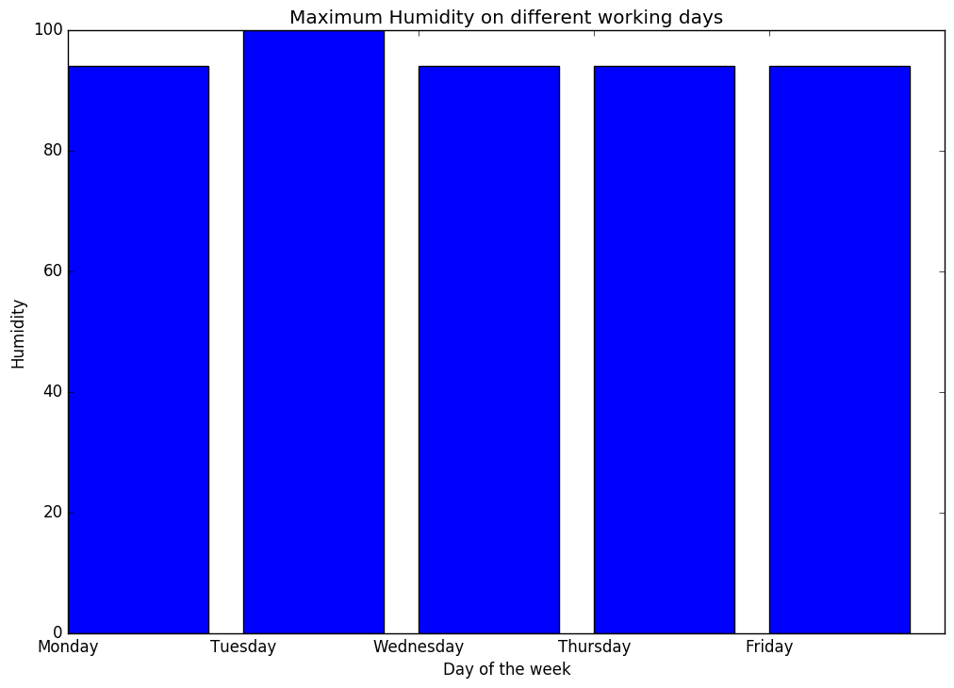
Novel Contribution Cont…
Tuesday is the week day with maximum humidity.

Slide 7
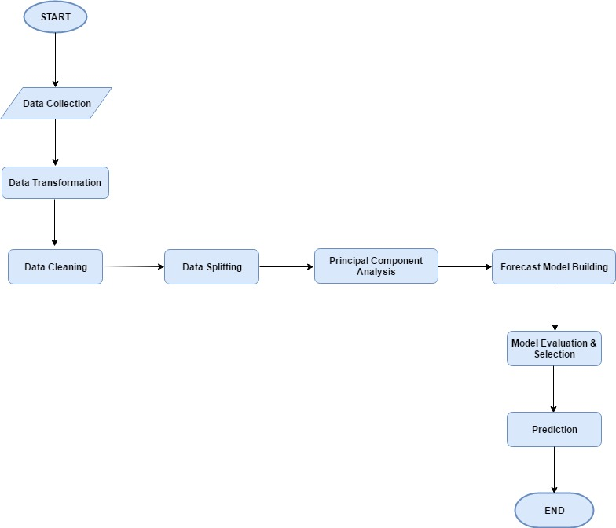
Novel Contribution Cont…
Algorithm designed for weather analyses and prediction.

Slide 8
Novel Contribution Cont…
Let’s take a look at some important steps performed while designing statistical model for prediction of air temperature.
Linear Model:
a). Perform “Kstest” to check whether environmental variables are normally distributed or not. If not then normalize the variables first.
b). Visualize the linear relationships in the dataset.
c). Perform “Pearson correlation” to get an idea of relationship between dependent and independent variable and it also informs about weighting coefficient of independent variables.
d). Finally, design the linear model with appropriate variables.
Time Series Forecast:
a). First convert “datetime” variable into index column.
b). Check stationarity of time series i.e. constant mean, constant variance & auto covariance that does not depend on time.
c). Eliminate trend and seasonality.
d). Forecasting a time series.

Slide 9
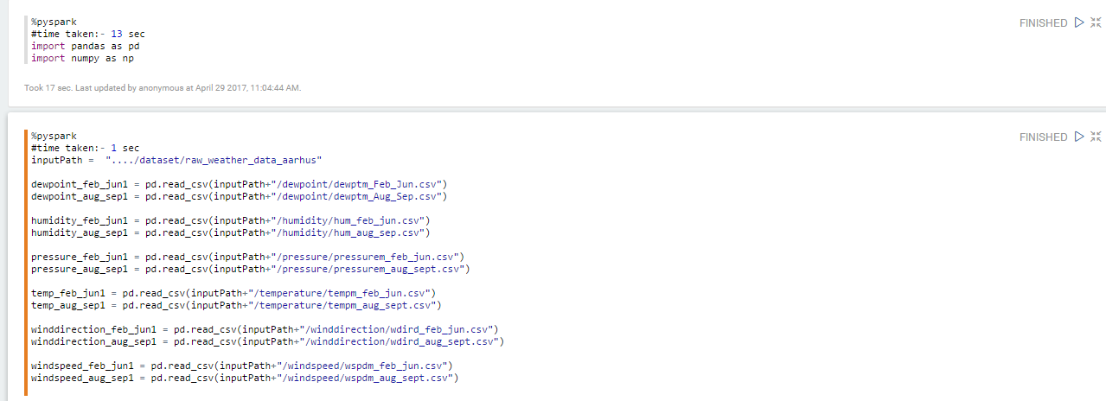
Demonstration in Zeppelin…
Data Loading:

Slide 10
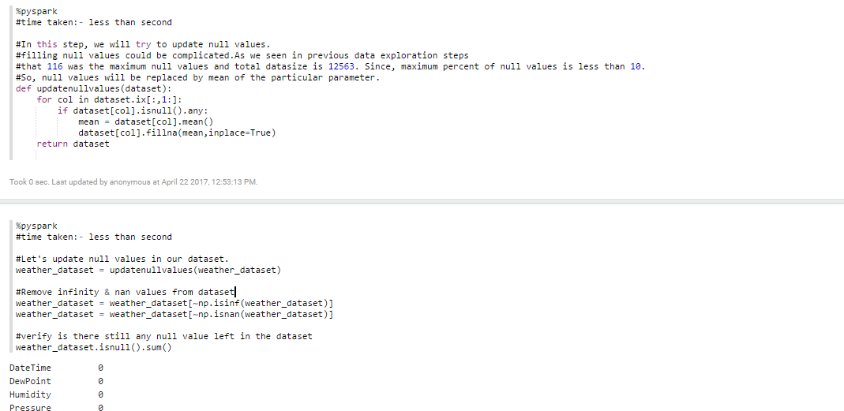
Demonstration in Zeppelin Cont…
Data Cleaning:

Slide 11
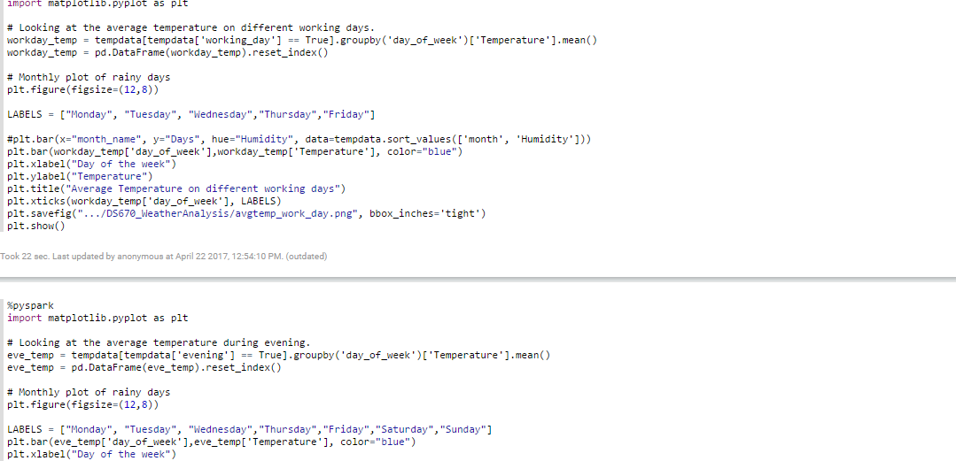
Demonstration in Zeppelin Cont…
Data Visualization:

Slide 12
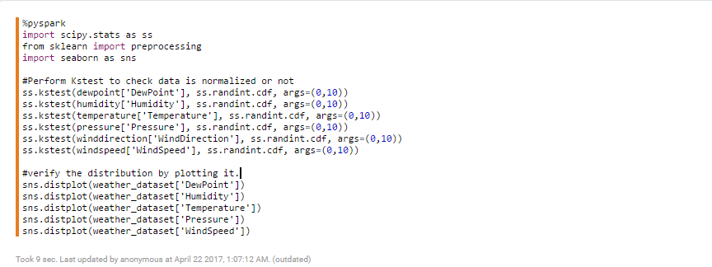
Demonstration in Zeppelin Cont…
KSTest: Performed Kstest to check the distribution of weather parameters.

Slide 13
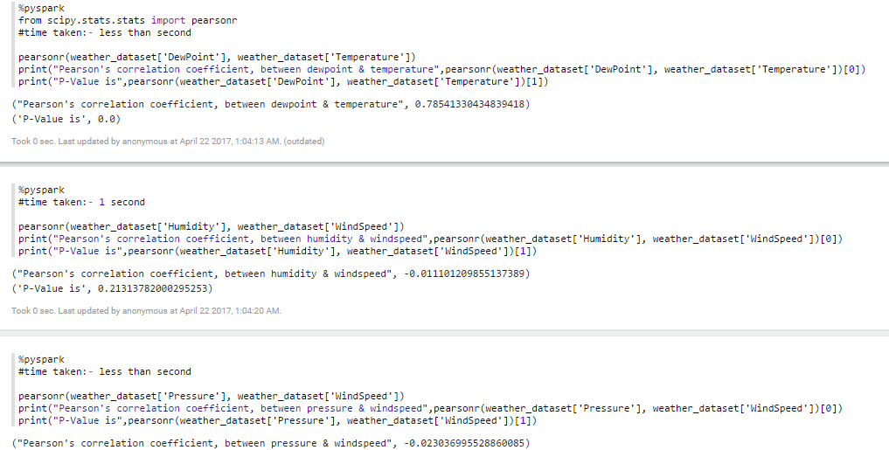
Demonstration in Zeppelin Cont…
Pearson Correlation: Performed pearson correlation to get an idea of relationship (Positive or Negative)between weather parameters.

Slide 14
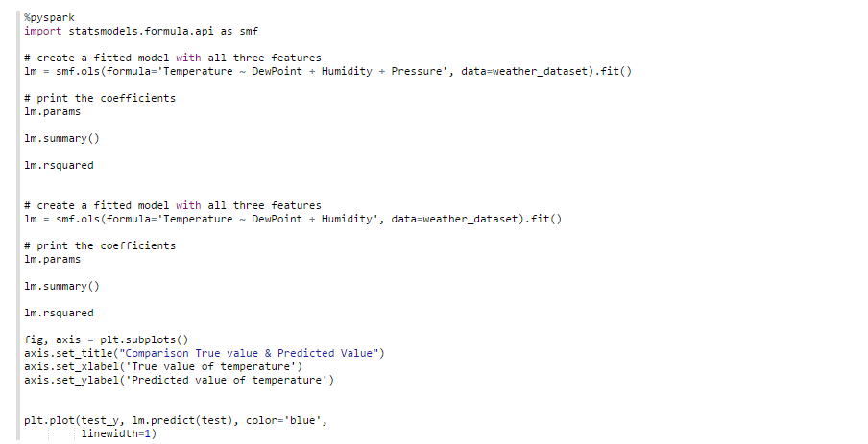
Demonstration in Zeppelin Cont…
Build Linear Model

Slide 15
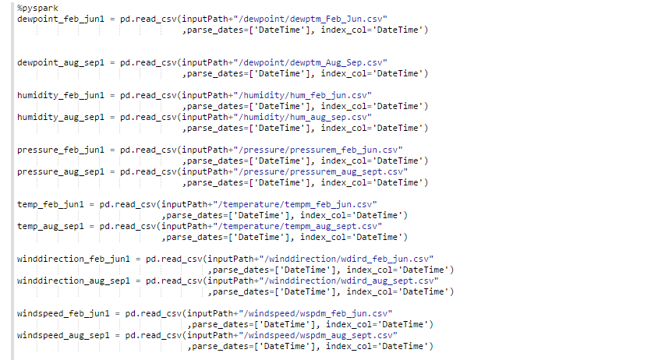
Demonstration in Zeppelin Cont…
Convert ‘DateTime’ parameter to index of dataset for time series analyses

Slide 16
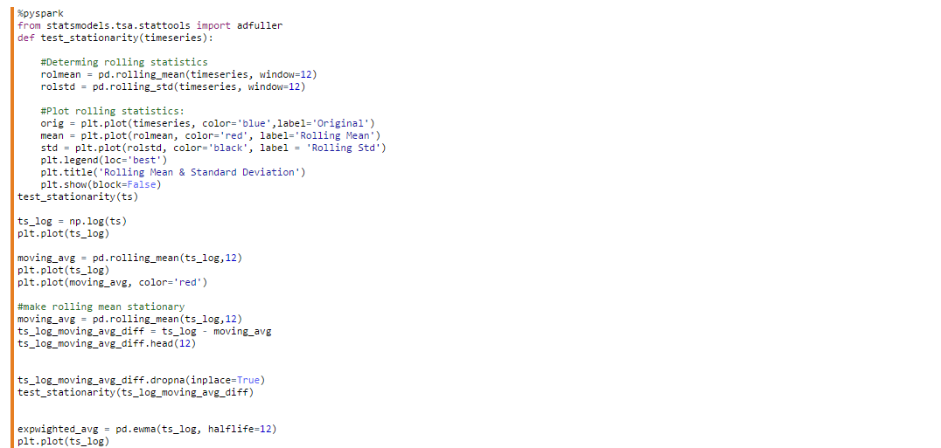
Demonstration in Zeppelin Cont…
Check data is stationary, if not then make it stationary.

Slide 17
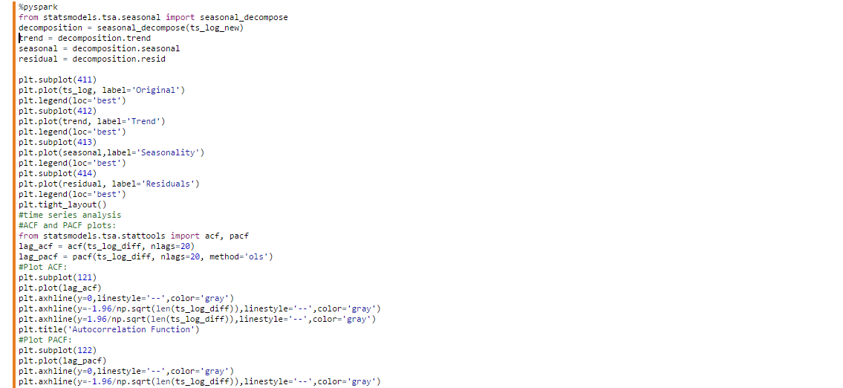
Demonstration in Zeppelin Cont…
Seasonality verification and ACF, PACF check.

Slide 18
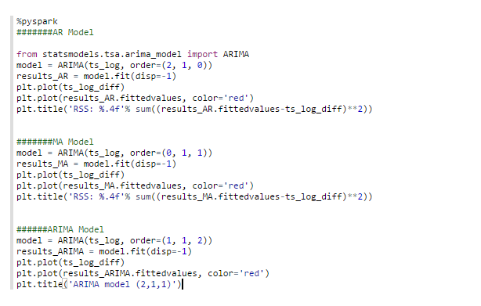
Demonstration in Zeppelin Cont…
Model building for time series analysis.

Slide 19
Results Summary in Tables and Charts
KSTest Results: Kstest is performed for parameters that are considered for statistical model building. Pvalue of all the variables is 0. Variables are normalized.
Weather Parameter | Test Results
Dew Point | KstestResult(statistic=0.3729231258446617, pvalue=0.0).
Humidity | KstestResult(statistic=1.0, pvalue=0.0).
Temperature | KstestResult(statistic=0.651, pvalue=0.0).
Pressure | KstestResult(statistic=1.0, pvalue=0.0).

Slide 20
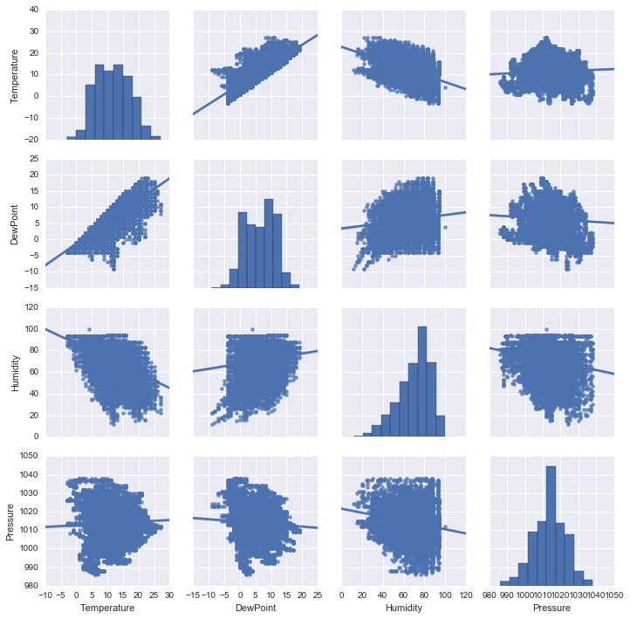
Results Summary in Tables and Charts Cont..
Pearson Correlation: Positive relation of temperature with dewpoint & pressure. Negative relation with humidity in the atmosphere.
Weather Parameter | Correlation with Temperature
Dew Point | PearsonResult(coefficient= 0.78541330434839418).
Humidity | PearsonResult(coefficient= -0.47275732315191615).
Pressure | PearsonResult(coefficient= 0.058368756214757185).

Slide 21
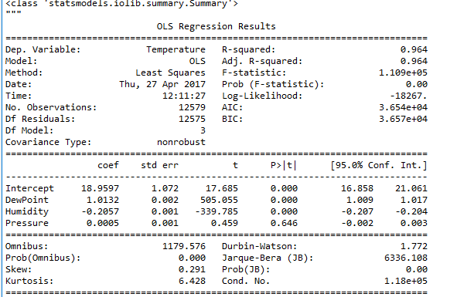
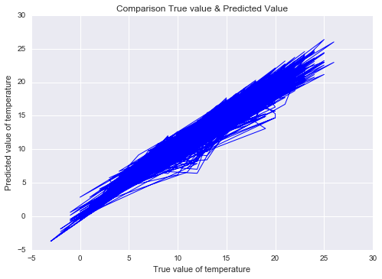
Results Summary in Tables and Charts Cont..
OLS Regression Results

Slide 22
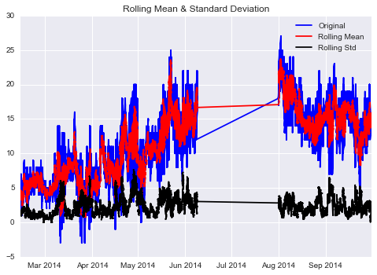
Results Summary in Tables and Charts Cont..
Stationarity test: From stationary test graph we can observe that standard deviation is stationary but mean is not stationary.

Slide 23
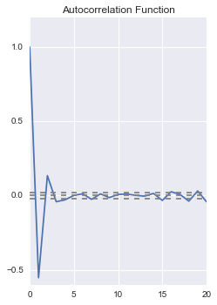
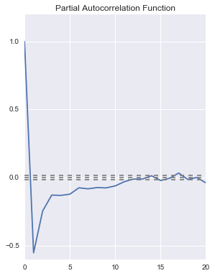
Results Summary in Tables and Charts Cont..
ACF Plot , we can notice value of q = 2.
PACF Plot , we can notice value of p = 1.

Slide 24
Results Summary in Tables and Charts Cont..
Results ARIMA Model: Prediction of time series model used by competitor is not that good as we can see that RMSE value is too high than the Linear Model designed in previous slide.
ARIMA Model | Scores
ARIMA(2,1,1) | RMSE (Root Mean Square Error): 20.01
ARIMA(2,1,1) | MAE (Mean Absolute Error): 8 degree Celsius.

Slide 25
Results Summary in Tables and Charts Cont..
SUMMARY
Performance of linear model is much better than time series forecasting method proposed by competitor. For now dewpoint, humidity & pressure are considered as independent variables. The long range forecasting method has significant errors at long-range period (more than 20% in the mean). Short range forecasting method is much reliable. That has error less than 5% in the mean. You can’t consider just temperature, or relative humidity, or wind direction alone when trying to make a forecast. You have to understand each measurement and what it could mean to the larger weather picture. Only then can you put them together to make an accurate forecast. Use of generated variables could be the future enhancement for this project.

