Slide 1
Room Occupancy Detection
DS 630 Machine Learning
Instructor :
Professor Wang
Submitted by:
Aakash Parwani
Amit Pandey
Sumit Sameriya

Slide 2
Overview
The purpose of this project is to predict the occupancy in an office room using data from light, temperature, humidity and CO2 sensors has been assessed with different statistical classification models using the open source program R.
This analysis will help in predicting energy consumptions as well as deployment of new technologies like Wi-Fi, AC etc. in buildings.

Slide 3
Data Set Description
Data Set Characteristics: | Multivariate, Time-Series | Number of Instances: | 20560
Attribute Characteristics: | Real | Number of Attributes: | 7
Associated Tasks: | Classification | Missing Values: | 0

Slide 4
Attribute Information
Date time year-month-day (hour: minute: second)
Temperature, in Celsius
Relative Humidity, %
Light, in Lux
CO2, in ppm
Humidity Ratio, Derived quantity from temperature and relative humidity, in kgwater-vapor/kg-air
Weekend Status(Weekday or Weekend)
Occupancy( 0 or 1)
(a) 0 for not occupied (b) 1 for occupied status

Slide 5
Highlights:
Data set is divided into two sets: Training Data (40%) and Testing Data (60%).
High accuracies were found when using LDA and RF model.
Light and CO2 predictors have high importance among other predictors.
Two predictor’s combinations are good enough for high accuracies.
Using all the predictor’s may decrease the accuracy of the prediction.

Slide 6
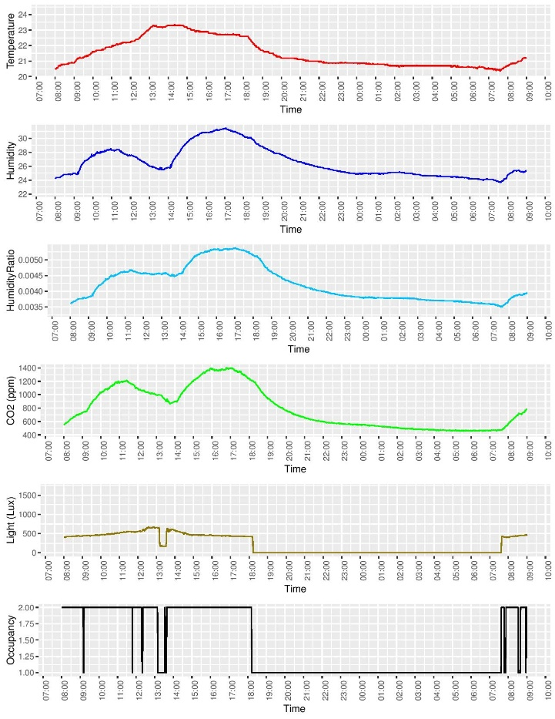
Below figure defines the variation of predictors with time. As we can see Humidity, Temperature & CO2 are varying almost equally and they are high between 2:00 PM – 5:00 PM.
Analysis of Variables with Time

Slide 7
Methodologies
Random Forest
Linear Discriminant Analysis(LDA)

Slide 8
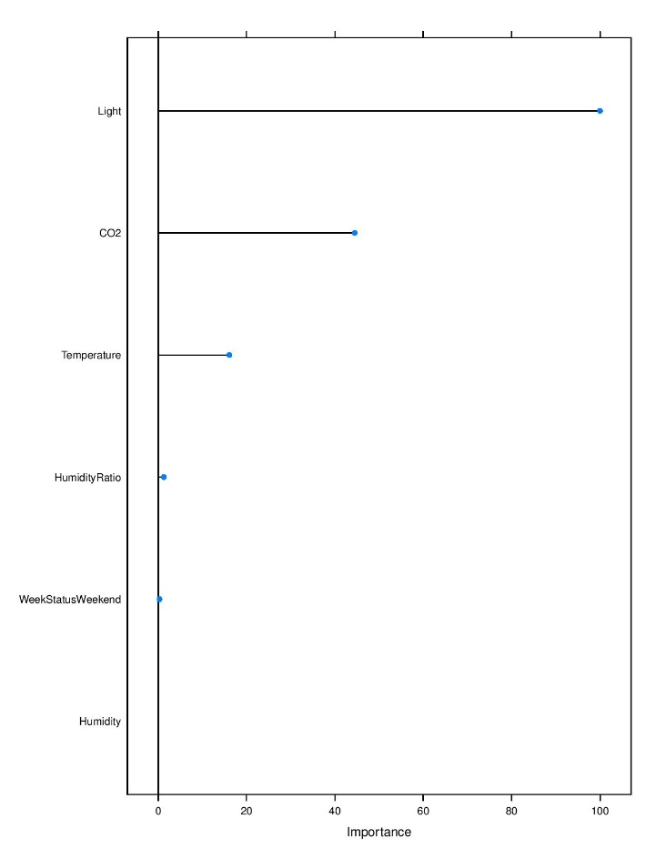
Random Forest Methodology
Importance of variables
> varImp(ModelRF_ALL_b)
RF variable importance
Overall
Light 100.0000
CO2 44.4871
Temperature 16.1103
HumidityRatio 1.2959
WeekStatusWeekend 0.3078
Humidity 0.0000

Slide 9
Misclassification Error Rate
Misclassification error rate of testing data with all predictors: ModelRF_ALL_b
Misclassification error rate of testing data without CO2 & Light: ModelRF_ALL_b
 | NO | YES
NO | 7514 | 189
YES | 12 | 2037
 | NO | YES
NO | 5166 | 2537
YES | 573 | 1476
Misclassification error rate = 0.0194
Misclassification error rate = 0.32
Note:- From above figures we can depict that misclassification rate is increased with omitting variables CO2 & Light.

Slide 10
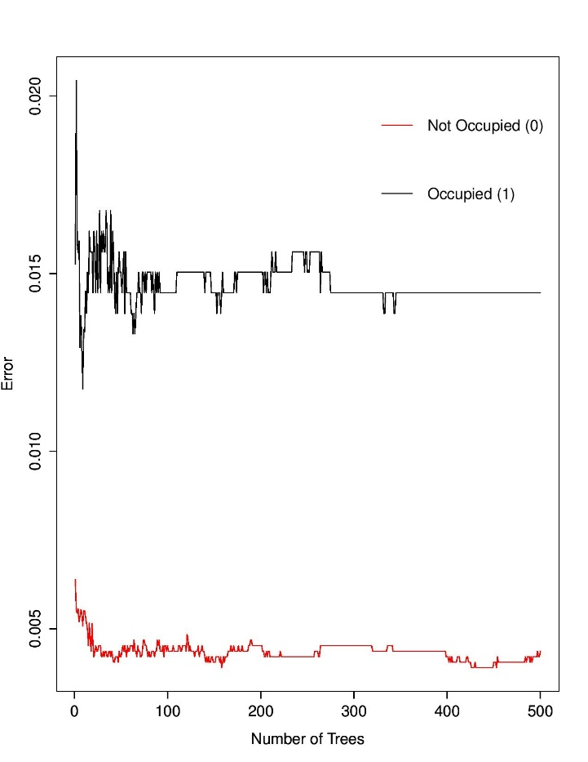
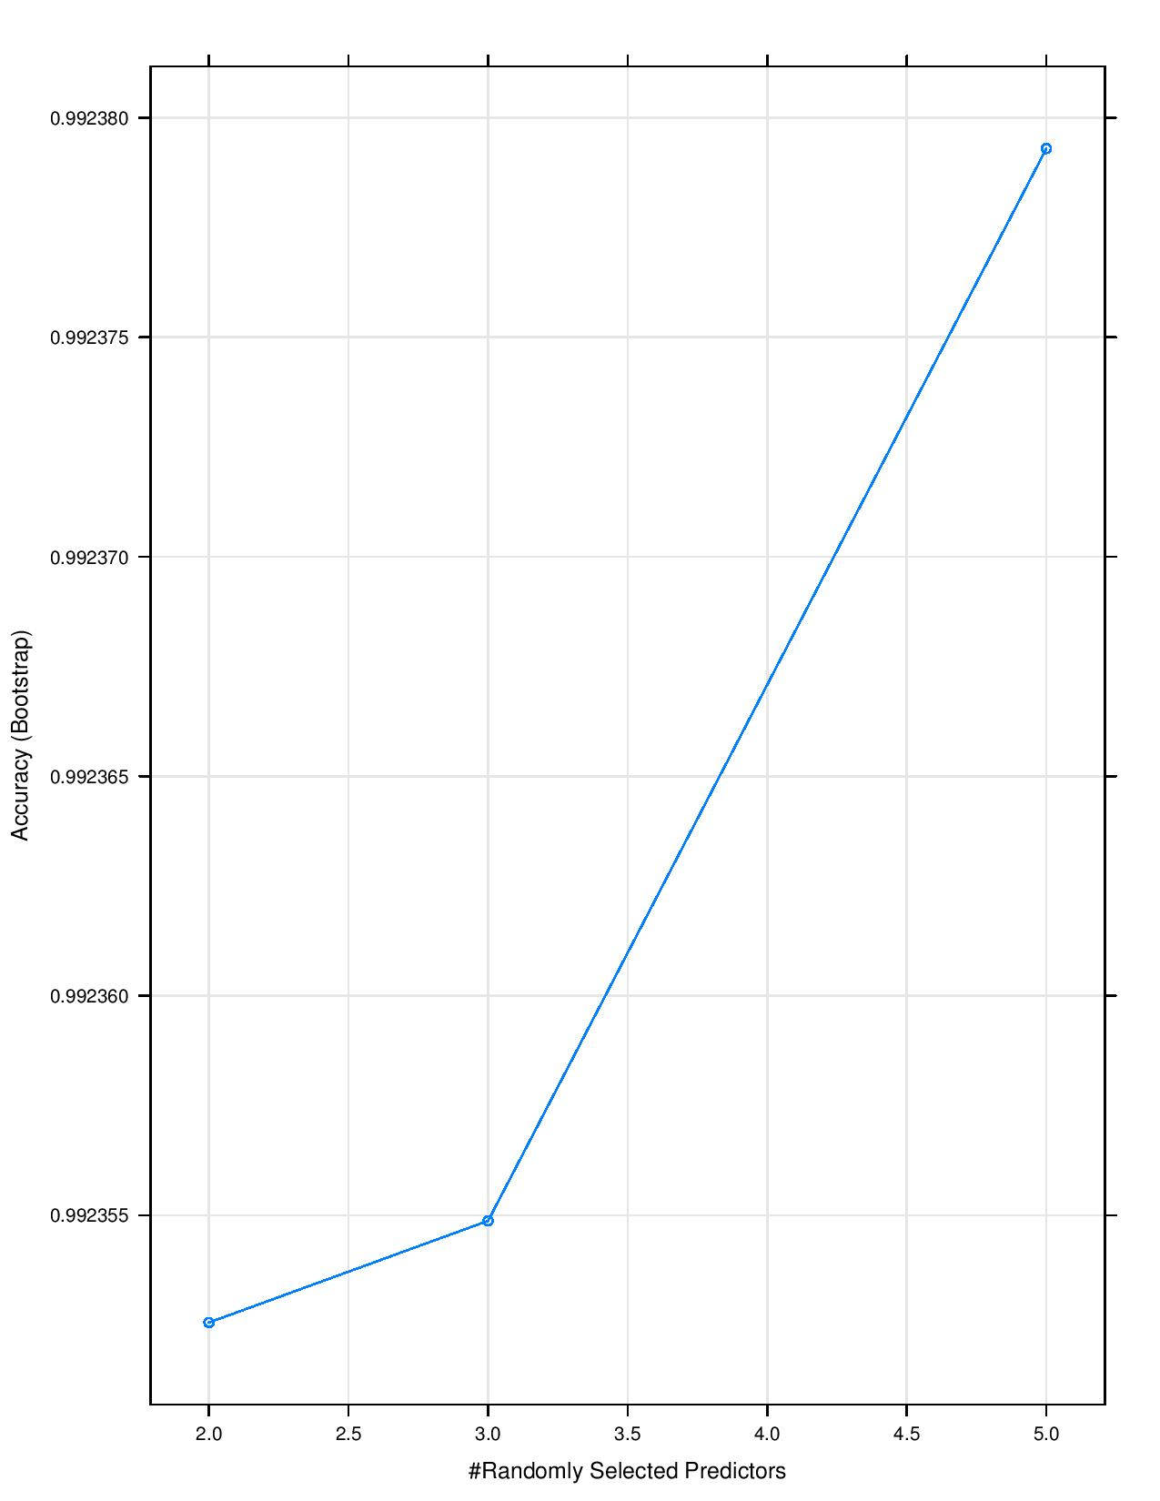
Model Accuracy & Error Rate
ModelRF_ALL_b_no_CO2noLight <- train(Occupancy~.-date-CO2-Light,method="rf",data=datatraining_b)
> ModelRF_ALL_b_no_CO2noLight
Random Forest

Slide 11
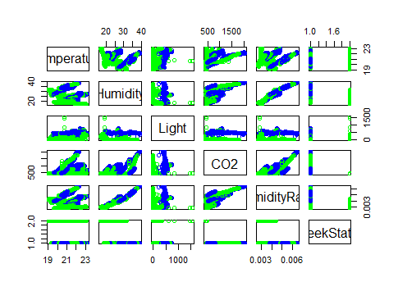
LDA Methodology
Importance of variables
varImp(ModelLDA_ALL_b)
ROC curve variable importance Importance
Light 100.00
CO2 96.24
Temperature 83.99
HumidityRatio 56.66
Humidity 44.16
WeekStatus 41.09

Slide 12
Misclassification Error Rate
Misclassification error rate of testing data with all predictors: ModelRF_ALL_b
Misclassification error rate of testing data without Co2 & Light: ModelLDA_noCO2NoLight_b
 | NO | YES
NO | 7645 | 58
YES | 8 | 2041
 | NO | YES
NO | 6573 | 1130
YES | 230 | 1819
Misclassification error rate = 0.006
Misclassification error rate = 0.162
Note:- From above figures we can depict that misclassification rate is increased with omitting variables CO2 & Light

Slide 13
Conclusion
CO2 and Light are important variables for predicting room occupancy.
LDA (Linear Discriminant Analysis) performs better than Random Forest.
Models misclassification rate increases with removal of CO2 & Light variables.
Humidity & CO2 level shows increment between 3:00 PM – 5:00 PM.
In future in we can try CART method also.

