Slide 1
Linux
Introduction by Aakash Rajput & Cheapovend

Slide 2
Introduction to Linux
UNDERSTANDING OS

Slide 3
TABLE OF CONTENTS
01
03
INTRODUCTION
COMPILATION
02
04
PREPROCESSING
ASSEMBLY & LINKING

Slide 4

General Intro
An operating system is system software that manages computer hardware, software resources, and provides common services for computer programs.

Slide 5
01
Linux

Slide 6
Linux
Linux® is an open source operating system (OS). An operating system is the software that directly manages a system's hardware and resources, like CPU, memory, and storage. The OS sits between applications and hardware and makes the connections between all of your software and the physical resources that do the work.

Slide 7
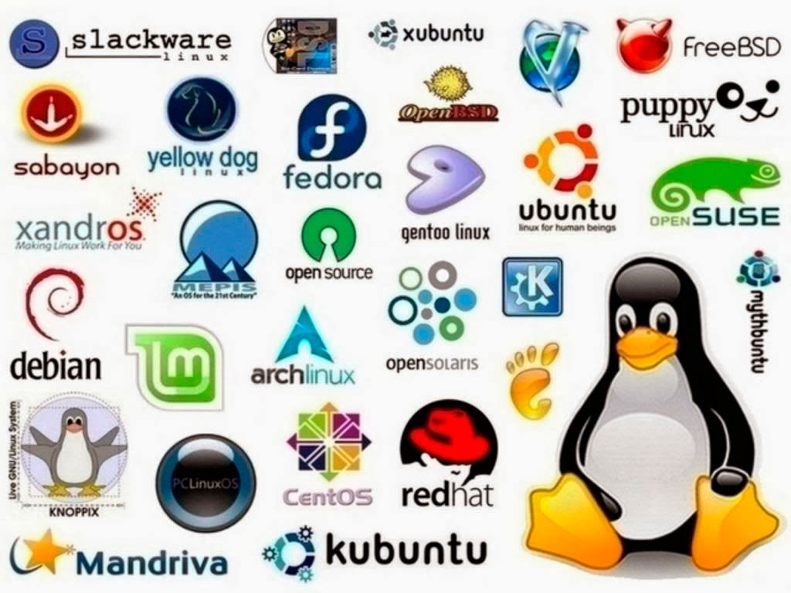
Linux Flavors

Slide 8
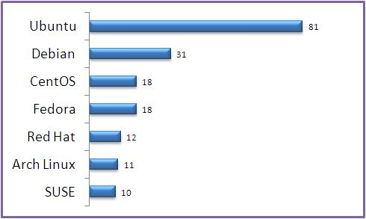
Most Used Linux Distribution

Slide 9
02
Linux Uses!

Slide 10
Smart Devices
Linux distributions present a myriad of options by increasing the capabilities of essential devices. Whether it is a smartphone or a tablet, Linux has facilitated a broader software scope and increased multimedia functionality. As a result, you have access to countless applications at your fingertips.

Slide 11
Servers and Mainframes
Every company faces a daily need to keep its information safe from third parties with malicious intentions. Thus, there is a need to utilize servers that guarantee maximum information security. Linux systems display the least vulnerability to external attacks and allow the implementation of reliable data security measures that increase a company’s immunity to hacking attempts

Slide 12
TeleCommunication
Every network realizes that to remain relevant and competitive today, it has to evolve with technology. The embedded devices in the telecommunication industry provide an excellent response to the question of what is Linux used for. Due to how easy Linux can be customized, the majority of the hardware used by networks is installed with Linux. Linux platforms improve access and distribution of network transmissions by subscribers. By installing Linux in firewalls, a network shields its information from unknown systems.

Slide 13
TeleCommunication
Every network realizes that to remain relevant and competitive today, it has to evolve with technology. The embedded devices in the telecommunication industry provide an excellent response to the question of what is Linux used for. Due to how easy Linux can be customized, the majority of the hardware used by networks is installed with Linux. Linux platforms improve access and distribution of network transmissions by subscribers. By installing Linux in firewalls, a network shields its information from unknown systems.

Slide 14
Made Mind to Use Linux?

Slide 15
03
Installing Linux

Slide 16
Selecting The Distribution!
Selecting a Distribution is tough Choice but you can Google your Linux Distribution according to your need. Still Some Suggestion from my Side :)
Beginner / Learn to use Linux :- Ubuntu, Arch Linux, Puppy Linux
Penestartion / Cybersecurity :- Kali Linux, BlackArch Linux, BackBox
Networking:- Ubuntu, CenstOS

Slide 17
Methods to Install Linux

Slide 18
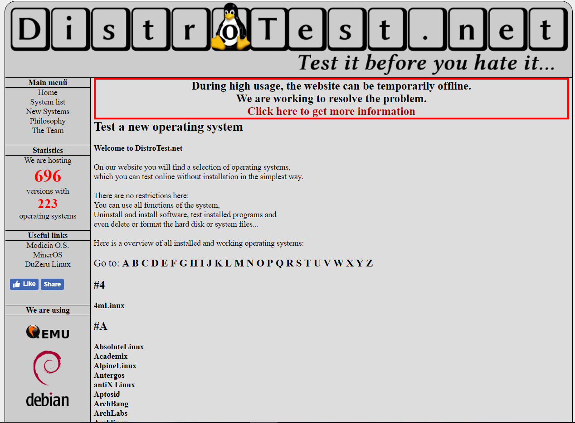
DistroTest
There are many Linux distribution available to use but finding perfect distribution is very difficult. You have to download almost 2GB of the file for each distribution and during testing, you don’t find anything good. What if you could test a Linux distribution without actually downloading it and setting up a VMware or wasting a lot of time in installing it as a primary Operating system?

Slide 19
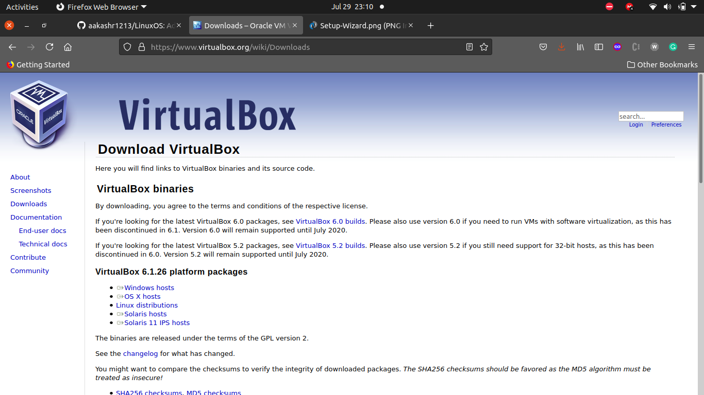
Virtual Box
You can download the latest version of VirtualBox from the Virtual Box website:https://www.virtualbox.org/wiki/Downloads

Slide 20
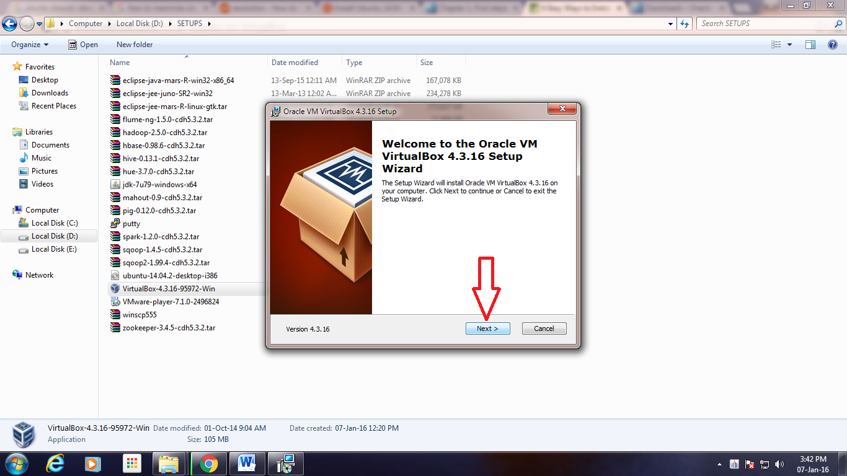
Virtual Box
Click On Next till the End of the Prompt

Slide 21
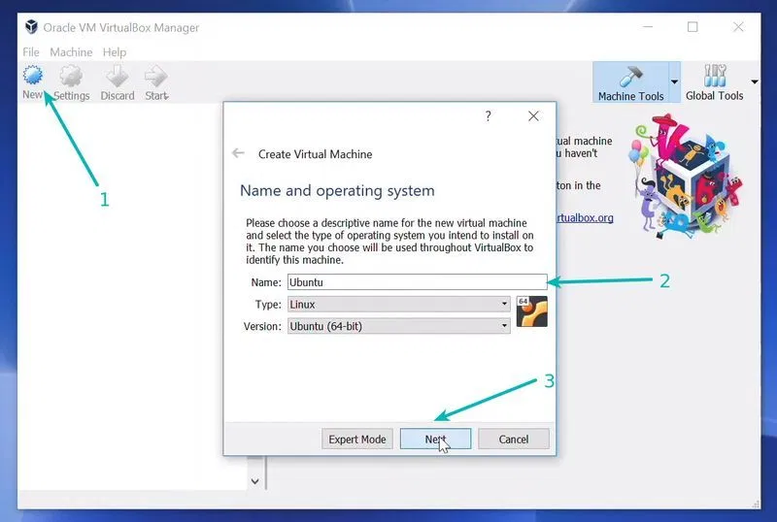
Virtual Box
Download the Linux ISO
Start VirtualBox, and click on the New symbol. Give the virtual OS a relevant name.
Allocate RAM to the virtual OS. Example: 8GB of RAM and I decided to allocate 2GB of it. You can use more RAM if your system has enough extra.
Create a virtual disk. This serves as the hard disk of the virtual Linux system. It is where the virtual system will store its files.
recommend using the VDI file type here.

Slide 22
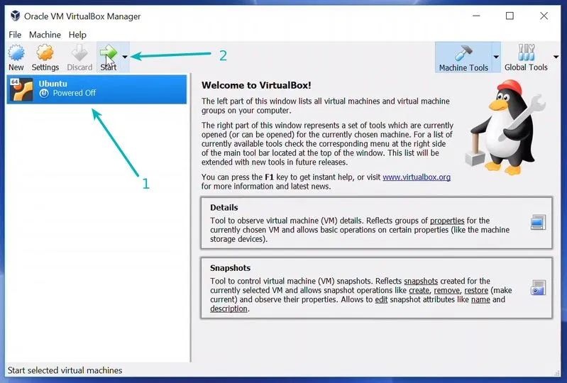
Virtual Box
You can choose either the “Dynamically allocated” or the “Fixed size” option for creating the virtual hard disk.
The recommended size is 10 GB. However, I suggest giving it more space if possible. 15-20 GB is preferable.
Once everything is in place, it’s time to boot that ISO and install Linux as a virtual operating system.

Slide 23
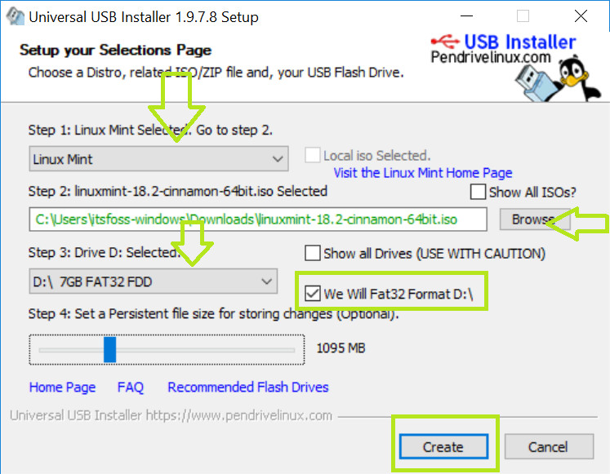
Dual Boot
Go to Your Linux Dist. website and download ISO file. This ISO file is the disk image that you can burn to a USB or DVD.
I recommend using a free tool called Universal USB Installer in Windows:

Slide 24
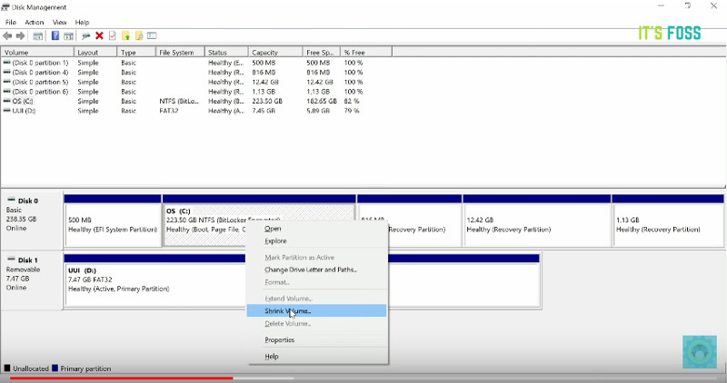
Dual Boot
go to start menu and type ‘partition’. This will bring up Disk Management utility. Now carefully select the disk in which you’ll make some free space by shrinking the volume.

Slide 25
Dual Boot
Plug the live USB or disk into the computer and restart the computer. While booting the computer press F10 or F12 function key (defers from computer to computer) to go to the boot menu. Now, choose the option to boot from USB or Removable Media.
It takes some time to boot from the live USB or disk. Have some patience

Slide 26
04
Conclusion

Slide 27
After all this steps you’re ready to start with your Linux Distro.
Although you can check my GitHub Profile for the Book on Linux Networking,

Slide 28
Thank you!
GitHub Profile: aakashr1213

