Slide 1


Slide 2
Agenda
What is Data Binding?
Types of Data Binding
Interpolation
Property Binding
Attribute binding
Class binding
Style binding
Event Binding
Two way Data Binding
Overview

Slide 3
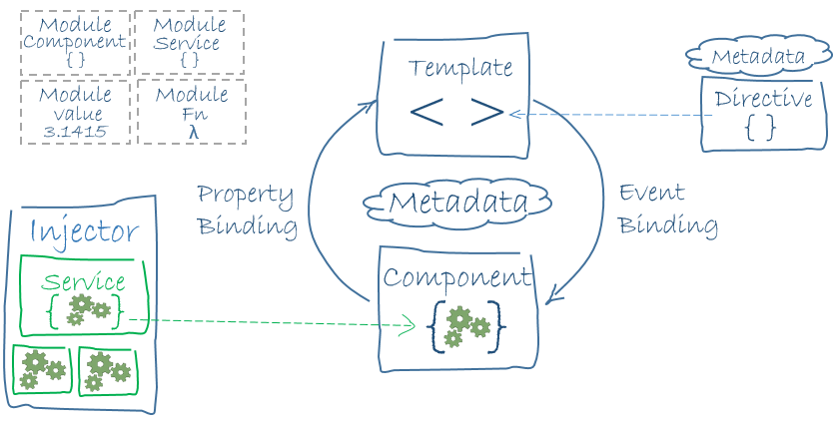
Angular Architecture

Slide 4
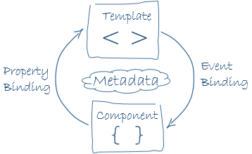
Data Binding in Angular

Slide 5
Data Binding in Angular
Data binding deals with how to bind your data from component (TS File) to HTML DOM elements (Templates).
Connections can be made in two different ways:
one way binding, and
two-way binding.

Slide 6
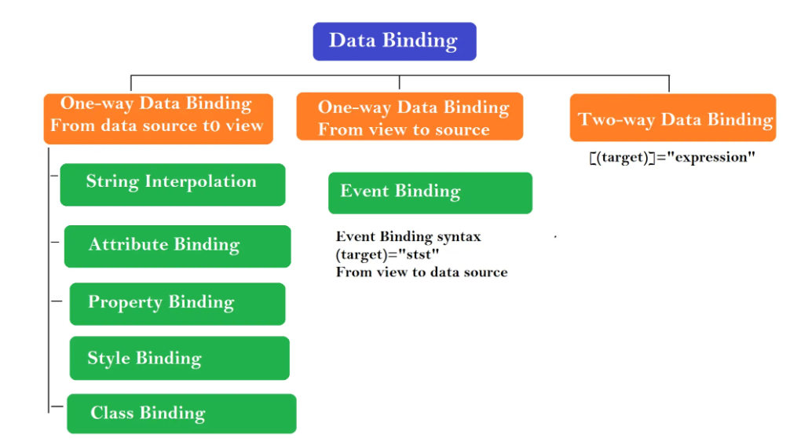

Slide 7
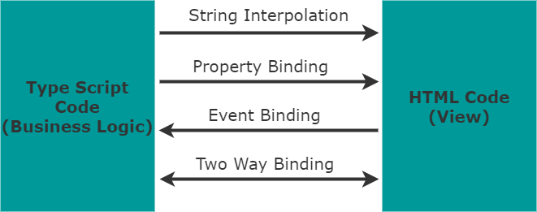
Types of Bindings in Angular

Slide 8

String Interpolation
Interpolation is a technique that allows to bind a value to a UI element
Interpolation binds the data one-way
Use interpolation to display the value of a variable in the corresponding component template

Slide 9

Property Binding
Property Binding is a one-way binding mechanism that lets you set property of a view element
Property binding uses [] syntax for data binding

Slide 10
Style Binding

Slide 11
Class Binding

Slide 12
Attribute Binding

Slide 13

Event Binding
This data binding type is when information flows from the view to the component when an event is triggered
The event is generally occured due to user interaction (ex: mouse click, key press)

Slide 14

Two-way binding
In two- way data binding, data flows from component to the view and back
The component and view are always in sync and consistency is maintained
This is typically used in forms where any changes need to be reflected in both component and the view

Slide 15
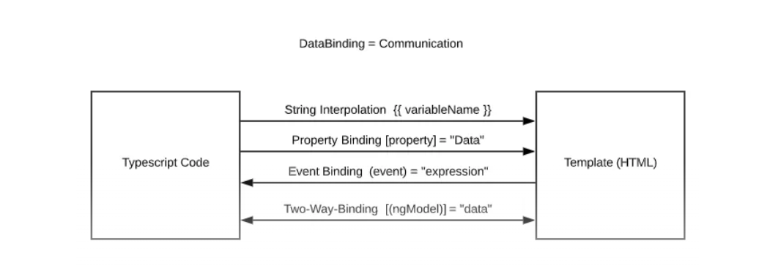
Overview

