Slide 1
Setup Commands
npm install -g @angular/cli
Setup Angular application
ng new my-first-project
cd my-first-project
ng serve

Slide 2
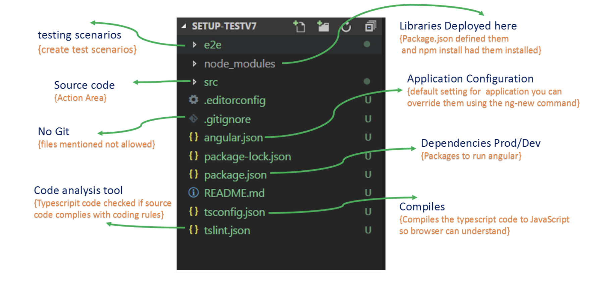
Folder Structure

Slide 3
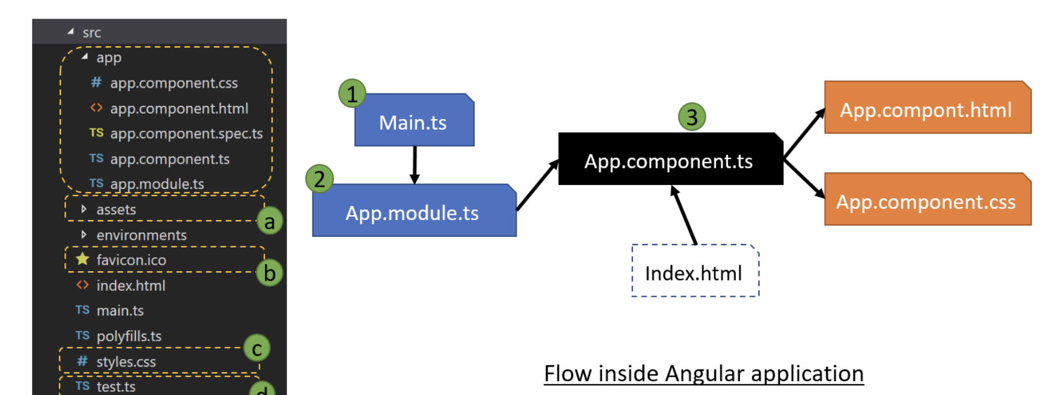
1) Main.ts the entry point from which 2) app.Module.ts gets called which in turns call a particular 3) App.component.ts file. Under /src/ folder we have other files and folders as shown in the above image. a) assets : Store’s all the static files like Images and icons etc. used within your application b) favicon.ico : The icon for your App c) style.css : Global CSS and stylesheet which can be used by all your pages and components d) test.ts : Configuration used for setting the testing environment

Slide 4
Create Component
Run, ng generate component <component-name>
Command creates the following:
A directory named after the component
A component file, <component-name>.component.ts
A template file, <component-name>.component.html
A CSS file, <component-name>.component.css
A testing specification file, <component-name>.component.spec.ts

Slide 5
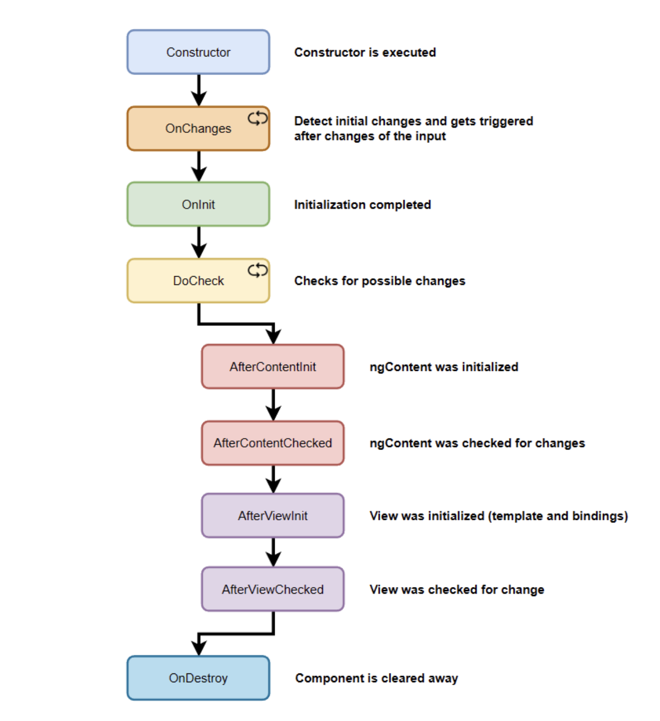
Component Lifecycle

Slide 6
QUESTIONS ???

Slide 7
THANK YOU!

