Slide 1
Enhancing DARPA-NET Scores Dataset
Professor:
Jordan Suchow
Team 3:
Aakash Rami
Hariom Mehta
Nitin Hazarani
Manvi Sharma

Slide 2
Agenda
Project Objective
Findings and Enhancements
Data Set
Libraries & Extraction
Issues faced
Advantages
Sample Output
Conclusion & Future Enhancement

Slide 3
Project Objective
The Goal is to enhance columns in the dataset provided by DARPA-NET Scores claims dataset which could help to improve credibility and claims provided in dataset about Articles of different Authors.

Slide 4
Findings for Enhancement
h-index is an author-level metric that attempts to measure both the productivity and citation impact of the publications of an author.
h-index is based on the set of the author’s most cited papers and the number of citations that they have received in other publications.
h index of 20 is good, 40 is outstanding, and 60 is truly exceptional.

Slide 5
Findings for Enhancement
i10-index is the newest in the line of journal metrics and was introduced by Google Scholar in 2011. It is a simple and straightforward indexing measure found by tallying a journal’s total number of published papers with at least 10 citations.
Citation is a simple way for authors to keep track of citations to their articles.

Slide 6
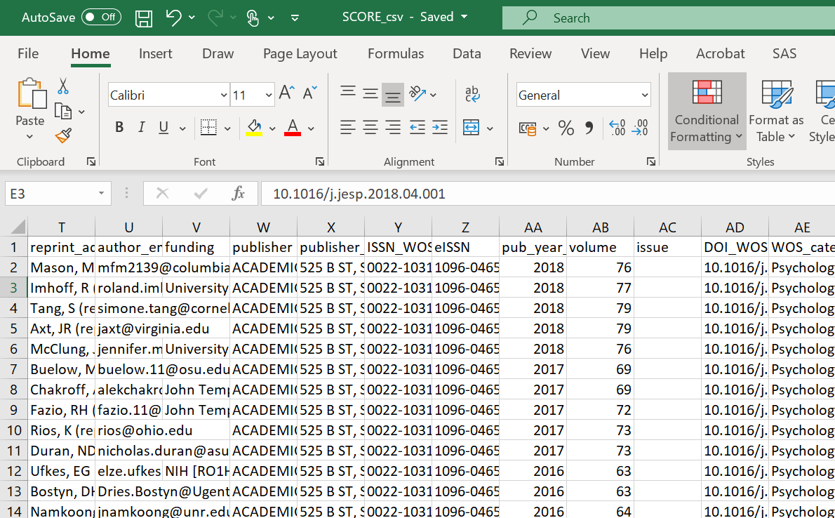
Data Set
https://osf.io/um7kc/?view_only=1c79efb782e54b05acd3b1aa2dd375fd
Dataset has around 2600 rows that contain information regarding claims provided for articles to enhance its credibility.

Slide 7
Libraries & Extraction
Beautifulsoup:- It is an Python library for pulling data out of HTML and XML files. It allows you to interact with HTML in a similar way to how you would interact with a web page using developer tools and scrape information from a page.
Web Crawler:- A crawler is a computer program that automatically searches documents on the Web. Crawlers are primarily programmed for repetitive actions so that browsing is automated. Search engines use crawlers most frequently to browse the internet and build an index

Slide 8
Issues Faced
Blocked by website after visiting in shorter span of time
Finding the only important html tags from the source code of webpage
Optimizing the code and output
Data was not 100 % accurate
Unable to Find some authors profile while crawling
Unable to fetch data from Google scholar API
Some data was behind osi login, it was hard to get in everytime

Slide 9
Advantages
h-index is an index that attempts to measure both productivity and impact of published work of an author or scholar.
Adds Veracity to author’s articles and claims provided in the dataset.
i10-index and citations will assist in estimating productivity of authors and popularity of their articles.

Slide 10
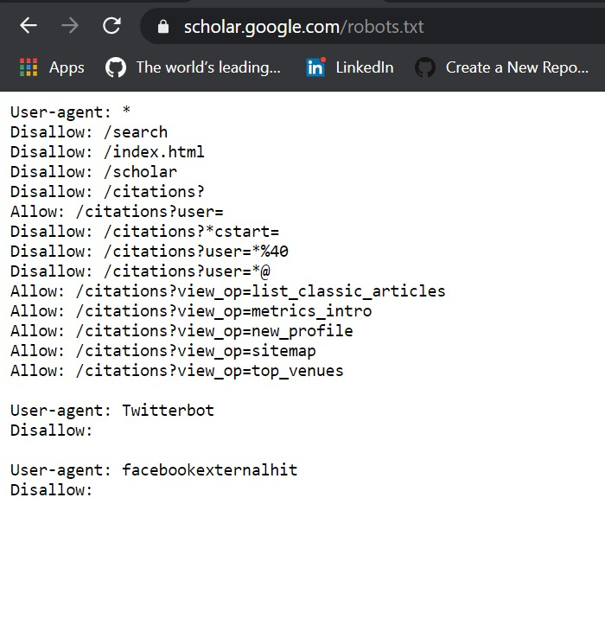
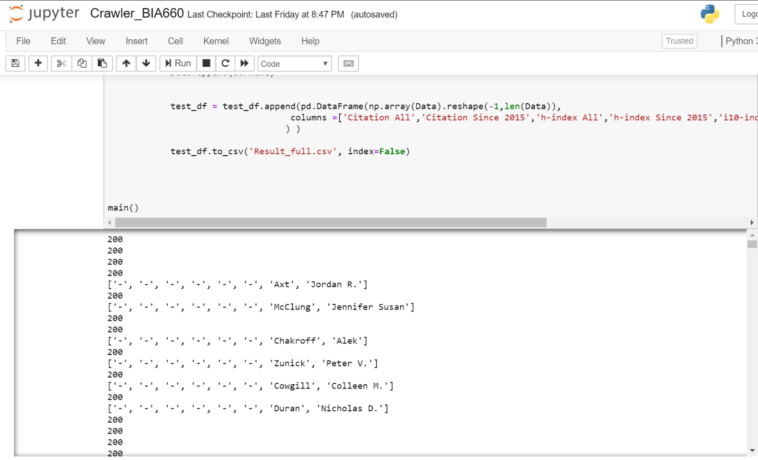
Sample Output

Slide 11
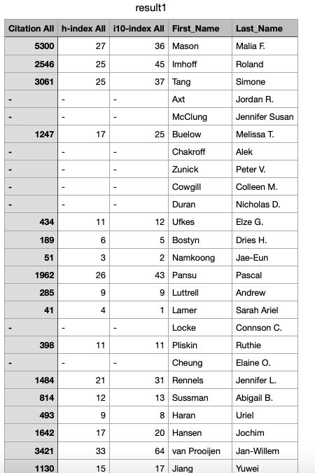
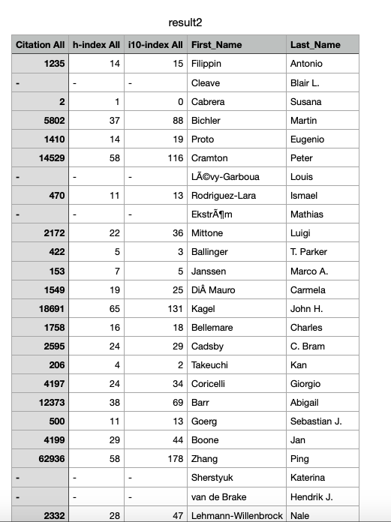
Sample Output

Slide 12
Conclusion & Future Enhancement
Verifying email Id affiliated with google scholar for missing rows
Preparing an predictive algorithm that measures category of authors by their area of expertise
Weighing authenticity of author’s via social media handles like twitter, LinkedIN.
Currently results are fetched from google scholar site and contains some missing values. In future by crawling other websites those values can be filled.
Using tools like Scrapy - fast and non blocking mechanism, more accurate output

Slide 13
Thank you for Listening!

