Slide 1
Merchandise Categorization and Inventory
Mongo
DB
XML
Integrating MongoDB and Neo4j through XML
Neo4j
Big Data Lab case study · modelled on Nykaa, illustrative data
Notes:
Introduce yourself and the project in one sentence: a small system that answers 'what is this product, where does it sit, and do we have stock?' for an online beauty retailer. Modelled on Nykaa, but the prices, stock and warehouses are made up. The picture is the whole idea: two databases, one XML document.

Slide 2



The use case
An online beauty retailer needs one answer from several systems
What is this product?
Name, brand, price, flexible attributes
Where does it sit?
Brands and products are real. Prices, stock and warehouses are made up.
Category path and related products
Do we have stock?
Quantity and status per warehouse
Notes:
The retailer sells thousands of products. A customer-service person or a merchandiser asks three questions: what is this product, where does it sit in the catalog, and do we have it in stock. The answers live in different places and have different shapes, which is the problem this project solves. Green = MongoDB answers, blue = Neo4j answers; I use the same colours throughout the deck and in the app.

Slide 3
Why two databases
MongoDB
MongoDB
Neo4j
Product catalog
Stock levels
Category graph
Name, brand, price, tags
Attributes differ per product
Quantity per SKU per warehouse
Reorder level gives OK, LOW, OUT
Category tree
BOUGHT_TOGETHER and SIMILAR_TO links
WHY
WHY
WHY
Documents fit uneven data: a lipstick has a shade, a sunscreen has SPF.
A validator blocks negative stock; one row per SKU and warehouse.
“Everything under Makeup” is one graph walk, not many joins.
Notes:
Each kind of data goes where it fits best. The catalog is document-shaped and every product type has different attributes, so MongoDB. Stock is many small rows per product, with rules (no negative quantity, one row per SKU and warehouse) that MongoDB's validator and unique index enforce. Categories and 'bought together' links are relationships, so Neo4j; asking for everything under Makeup is one walk down the tree instead of repeated joins. This split is the whole point of the project: polyglot persistence.

Slide 4
Architecture
MongoDB
catalog and stock
FastAPI mediator
Browser
one HTML page
asks both databases, builds XML, validates it
Neo4j
categories and links
What the mediator does with the answers
XML pieces
Merge by SKU
Validate (XSD)
JSON + trace
The browser never talks to a database. Only the mediator does.
Notes:
One request flows through four stages. The browser sends one search to the FastAPI mediator. The mediator queries MongoDB and Neo4j, turns each answer into an XML piece, merges the pieces by SKU into one document, validates that document against the XSD, and returns it with a trace of every database call. The browser never talks to a database directly. Next slide: the demo.

Slide 5
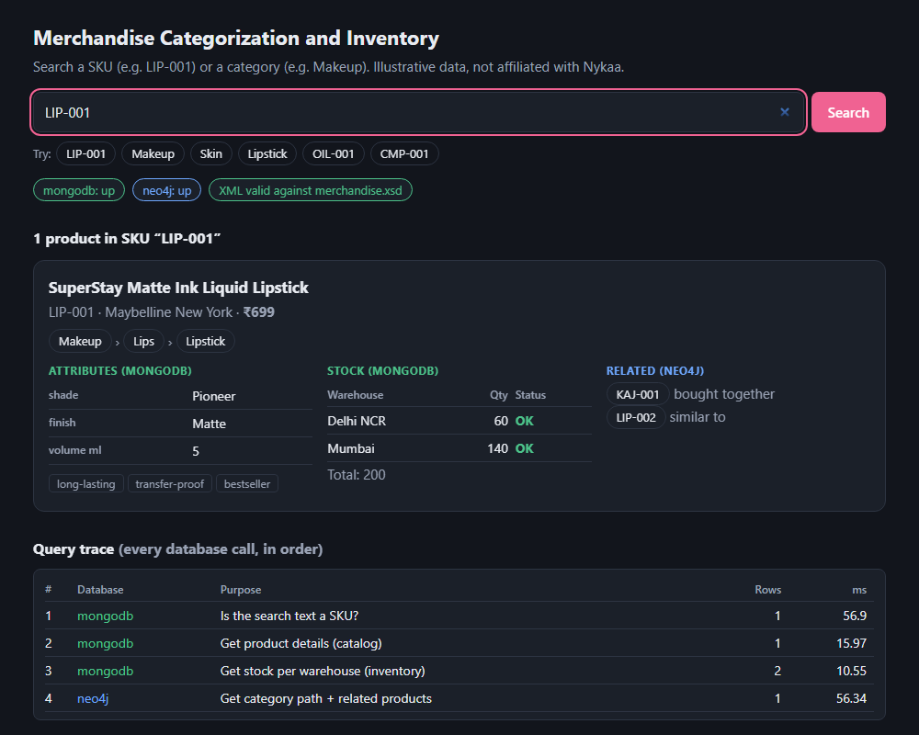
Live demo
Demo script
LIP-001: both databases, one card
Makeup: 8 products from the graph
OIL-001: no stock, still valid
CMP-001: OUT. FND-001: LOW
xyz: nothing found
Stop Neo4j, search again
http://127.0.0.1:8000/
Notes:
Switch to the live page at http://127.0.0.1:8000/. 1) Search LIP-001: show MongoDB attributes and stock, the Neo4j category path and related products, then the query trace (three MongoDB calls, one Neo4j call) and the XML tabs. 2) Makeup: 8 products from Lips, Face and Eyes; this is the graph walk. 3) OIL-001: stock is missing on purpose and the page says 'No stock records'. 4) CMP-001 is OUT, FND-001 is LOW. 5) xyz: nothing found, only two trace steps. 6) Run 'docker compose stop neo4j' beforehand, search LIP-001: expect about 5 seconds, then a banner and MongoDB data only. Start Neo4j again with 'docker compose start neo4j'. Rehearse step 6 first.

Slide 6
One search, four steps
Is the text a SKU?
Trace for LIP-001
1
MongoDB · case-insensitive match
# | Database | Purpose | Rows
1 | mongodb | Is it a SKU? | 1
2 | mongodb | Product details | 1
3 | mongodb | Stock per warehouse | 2
4 | neo4j | Path + related | 1
2
If not, is it a category?
Neo4j · walks down the tree
3
Get catalog and stock
MongoDB · products + inventory
Result mode
4
Get category path and related
sku
category
none
Neo4j · one graph query
LIP-001 gives sku. Makeup gives category.
xyz gives none.
Notes:
This is the sequence the mediator runs for every search, and the page shows it as the query trace. Step 1 asks MongoDB whether the text is a SKU (case does not matter). If not, step 2 asks Neo4j whether it is a category, walking down the tree so subcategories count. Then it fetches the catalog and stock from MongoDB and the category path and related products from Neo4j. The mode (sku, category or none) ends up on the merged XML. The page also shows the milliseconds for each call, as in the screenshot on the previous slide.

Slide 7
Neo4j: the category graph
Makeup
Cypher
(c)<-[:SUBCATEGORY_OF*0..]-
(sub)<-[:IN_CATEGORY]-(p)
Lips
Eyes
Face
*0.. means zero or more levels, so subcategories count too.
Lipstick
Kajal
Foundation
Searching “Makeup” returns 8 products from Lips, Face and Eyes.
LIP-001
KAJ-001
FND-001
BOUGHT_TOGETHER
Blue = categories (SUBCATEGORY_OF). Outlined = products (IN_CATEGORY).
Notes:
The graph holds only SKUs and categories; product details stay in MongoDB. Products point to their lowest category with IN_CATEGORY, and categories point to their parent with SUBCATEGORY_OF. 'Everything under Makeup' is the Cypher on the right: start at Makeup and walk down zero or more levels. The star-zero-dots part is why a search for Makeup finds products in Lips, Face and Eyes without us listing the subcategories. The dashed link is a BOUGHT_TOGETHER relationship between two products; SIMILAR_TO works the same way.

Slide 8
Three XML documents
MongoDB piece
Merged by SKU
<product sku="LIP-001">
<name>SuperStay Matte Ink …</name>
<price currency="INR">699</price>
<attributes>
<attribute name="shade">Pioneer</attribute>
</attributes>
<stock total="200"> … </stock>
</product>
<merchandise query="LIP-001" mode="sku" …>
<product sku="LIP-001">
<name>SuperStay Matte Ink …</name>
<price currency="INR">699</price>
<attributes> … </attributes>
<stock total="200"> … </stock>
<category_path> … </category_path>
<related> … </related>
</product>
</merchandise>
Neo4j piece
<product sku="LIP-001">
<category_path>
<category>Makeup</category>
<category> … </category>
</category_path>
<related> … </related>
</product>
Green parts came from MongoDB, blue from Neo4j.
The sku attribute is the join key.
MongoDB parts first, then Neo4j: the order the XSD requires.
Notes:
Neither database knows the other exists. Each answers in its own XML piece, and XML is the common language between them. The mediator merges the pieces by the sku attribute: for every SKU it copies the MongoDB parts first and then the Neo4j parts into one product element, wrapped in a merchandise root that records the query, the mode and the count. If a SKU only appears in one piece (say Neo4j was down), it is kept with the parts we have. The code is in xml_builder.py: mongo_to_xml, neo4j_to_xml and merge_xml.

Slide 9
The XML Schema
Root element
Restricted values
Typed numbers
mode="sku|category|none"
[A-Z]{3}-[0-9]{3}
xs:nonNegativeInteger
merchandise holds query, mode and count.
SKU pattern. Status is OK, LOW or OUT.
Quantities are whole numbers, prices never negative.
Flexible attributes
Optional parts
Unique SKUs
<attribute name="spf">
minOccurs="0"
xs:unique @sku
The name is data, so one schema fits every product.
Only sku is required, so partial data stays valid.
Two products with one SKU are rejected.
Notes:
merchandise.xsd is the rulebook every merged document must pass. The root carries the query, a mode limited to sku, category or none, and a count. Simple types restrict values: a SKU must match three capital letters, a dash and three digits; status can only be OK, LOW or OUT; relation can only be BOUGHT_TOGETHER or SIMILAR_TO; quantities are non-negative whole numbers and a price is a non-negative decimal with a currency attribute. Product attributes differ per product, so their name is data (attribute name=...), which lets one schema cover lipsticks, sunscreens and shampoos. A product is an ordered sequence of name, brand, price, tags, attributes, stock, category_path and related, but every part is optional; only the sku is required. That is what keeps a document valid when one database fails. Finally xs:unique rejects two products with the same SKU.

Slide 10
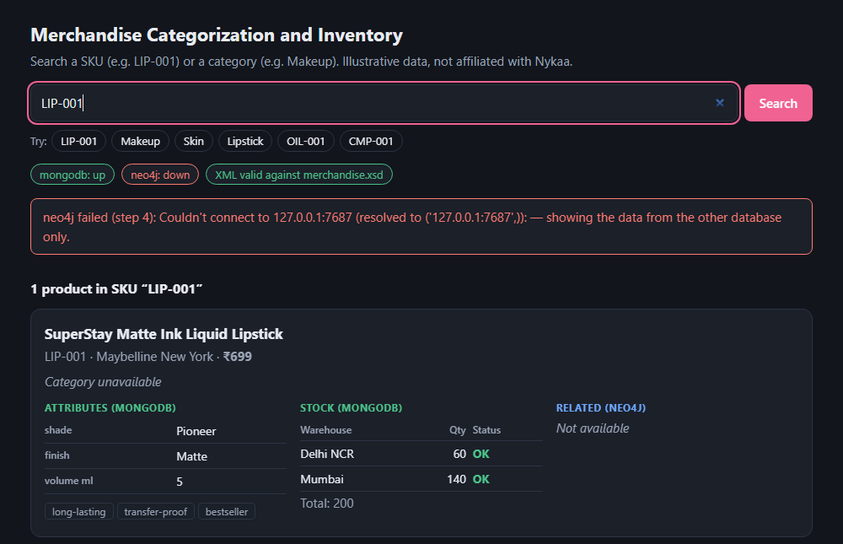
When a database fails
Partial, not broken. MongoDB data still shows; category parts are missing.
Still valid. Every part except sku is optional in the XSD.
Visible. A banner and the trace show the Neo4j error at step 4.
Tested. The self-test shows the XSD rejects a bad status, a bad SKU and a duplicate SKU.
Neo4j stopped: the search waits about 5 s, then answers.
Notes:
Because every part except the SKU is optional in the schema, one database failing degrades the answer instead of breaking it. Here Neo4j is stopped: the card says 'Category unavailable', the MongoDB catalog and stock are still there, the trace records the Neo4j error at step 4, and the merged XML is still valid. The wait of about five seconds is the Neo4j driver retrying before it gives up; say so out loud if you demo this live. Mention the self-test: python xml_builder.py --check proves the schema rejects an invalid status, a malformed SKU and a duplicate SKU.

Slide 11
Takeaways
01
02
03
Right store for each shape
XML as the common language
The XSD as the contract
Documents for uneven catalog data, a graph for hierarchy and links.
Each database answers in its own XML piece; the mediator joins them on SKU.
One schema validates every merged document, even when a database is down.
Limits: sample data, no caching, no login.
Questions?
Notes:
Three things to remember. One: use the right store for each shape of data. Two: XML is the common language, and the SKU is the join key. Three: the XSD is the contract that every merged document must satisfy, which is also what makes partial results safe. Honest limits: the data is sample data, there is no caching and no login. Then open for questions. Likely ones: why XML and not JSON (the brief asks for XML, and XSD gives strong validation); why not one database (each shape fits one store much better); what if SKUs do not match (the merge keeps whatever parts exist, and the XSD allows that); where is the join (merge_xml, on the sku attribute).

