Slide 1

MINI PROJECT ON PRODUCT WEBSITE
Presented By: Aakash & Nosan

Slide 2
INTRODUCTION
E-SHOE WEBSITE
Shoe Hive is the buying and selling of shoes over the Internet.
It is conducted over computers, tablets, smartphones, and other smart devices.
Almost any type of shoe can be purchased through Shoe Hive today; for this reason, Shoe Hive is often highly competitive.
Shoe Hive operates in several market segments including business-to-business, business-to-consumer, consumer-to-consumer, and consumer-to-business.
There are some pretty major examples of shoe ecommerce businesses that have made it big, including Amazon, Flipkart, eBay, and Myntra. Shoe Hive aims to join this list of top shoe ecommerce platforms.

Slide 3






Save Money
24/7 Support
Online Order
Happy Sell
Free Shipping
Promotions

Slide 4



Software Requirements
HTML ( Hypertext Markup Language )
CSS ( Cascading Style Sheets )
JS (JavaScript)

Slide 5
Modules
1
INDEX
2
ITEMS
3
ABOUT US
E-SHOE
WEBSITE
4
CONTACT
5
PAYMENT
6
PLACE ORDER

Slide 6
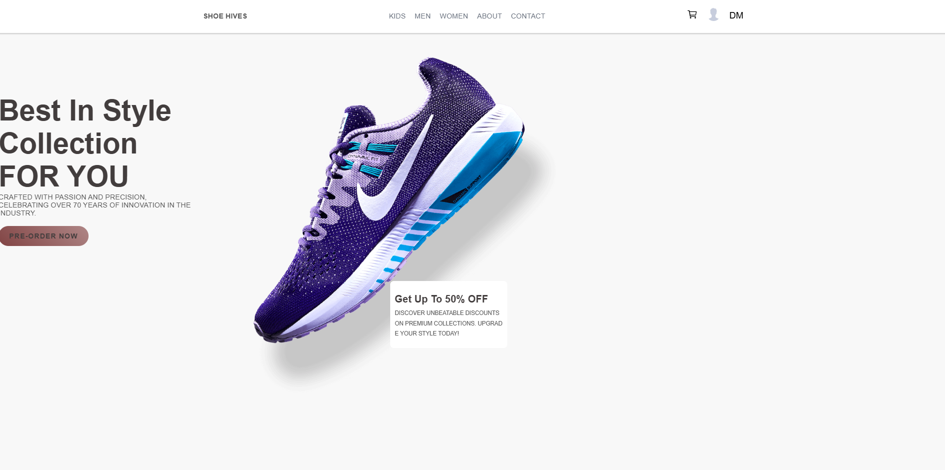
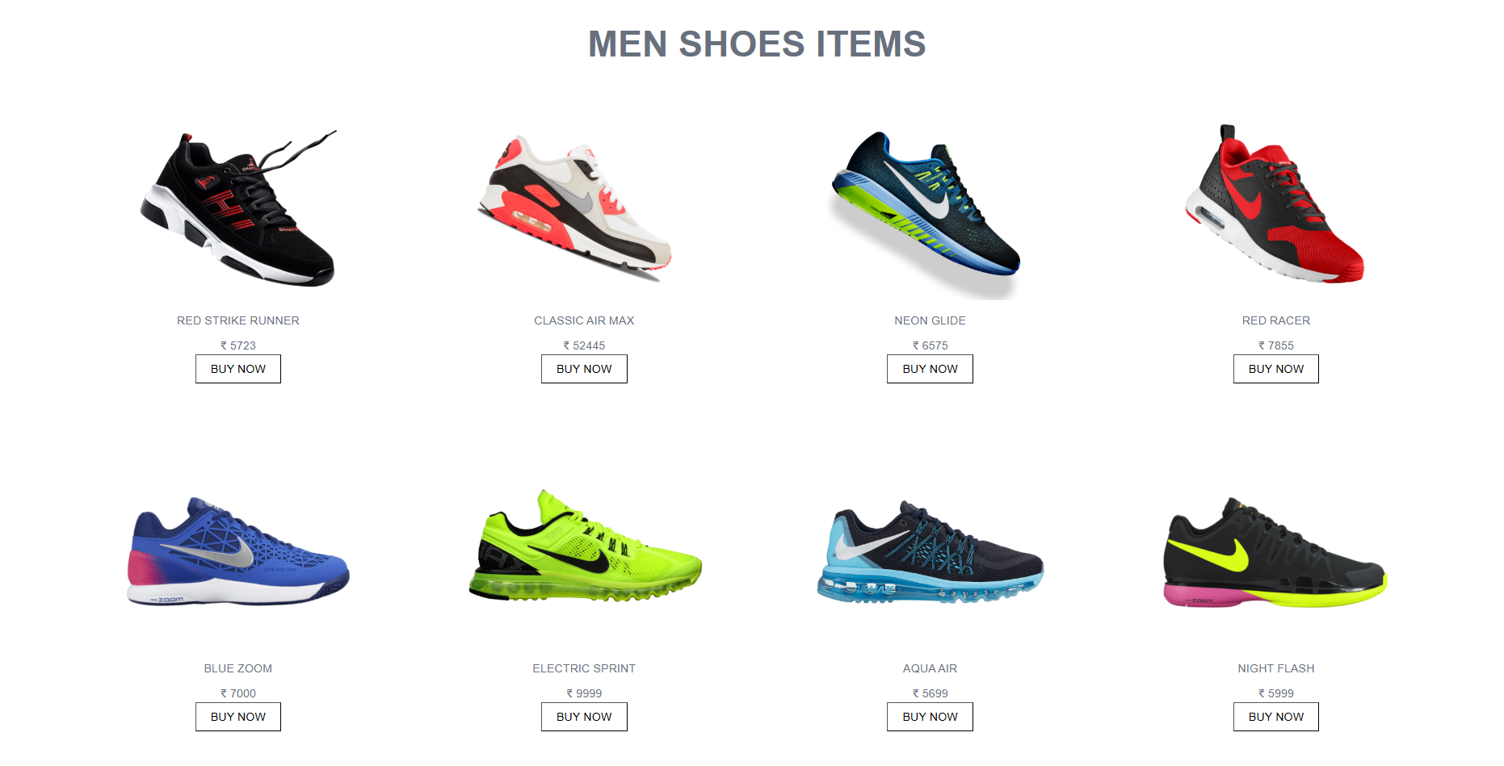
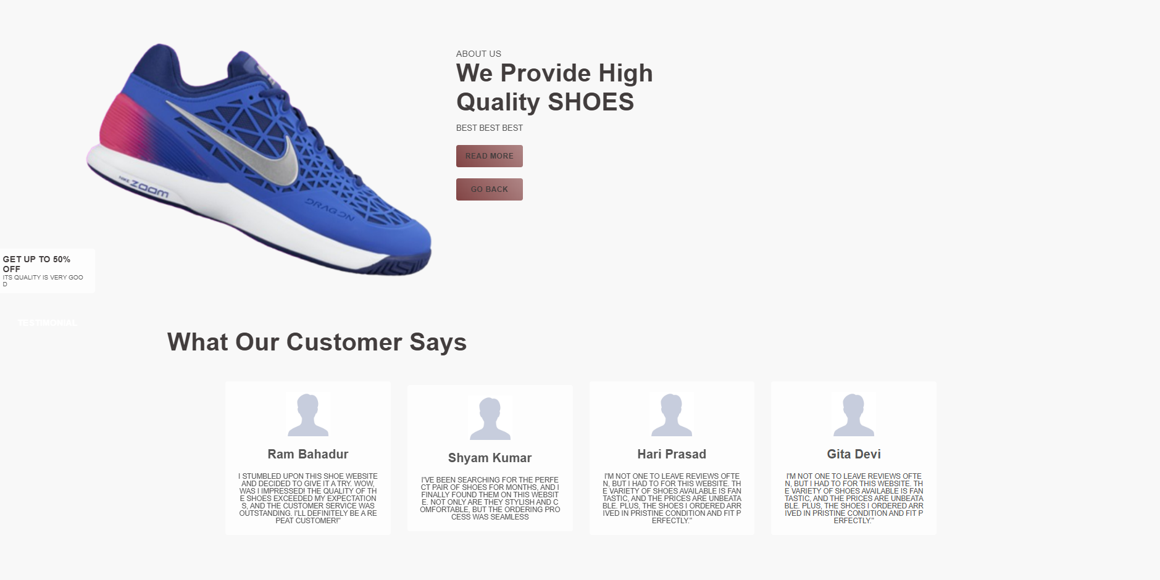
1
INDEX
2
ITEMS
3
ABOUT US

Slide 7

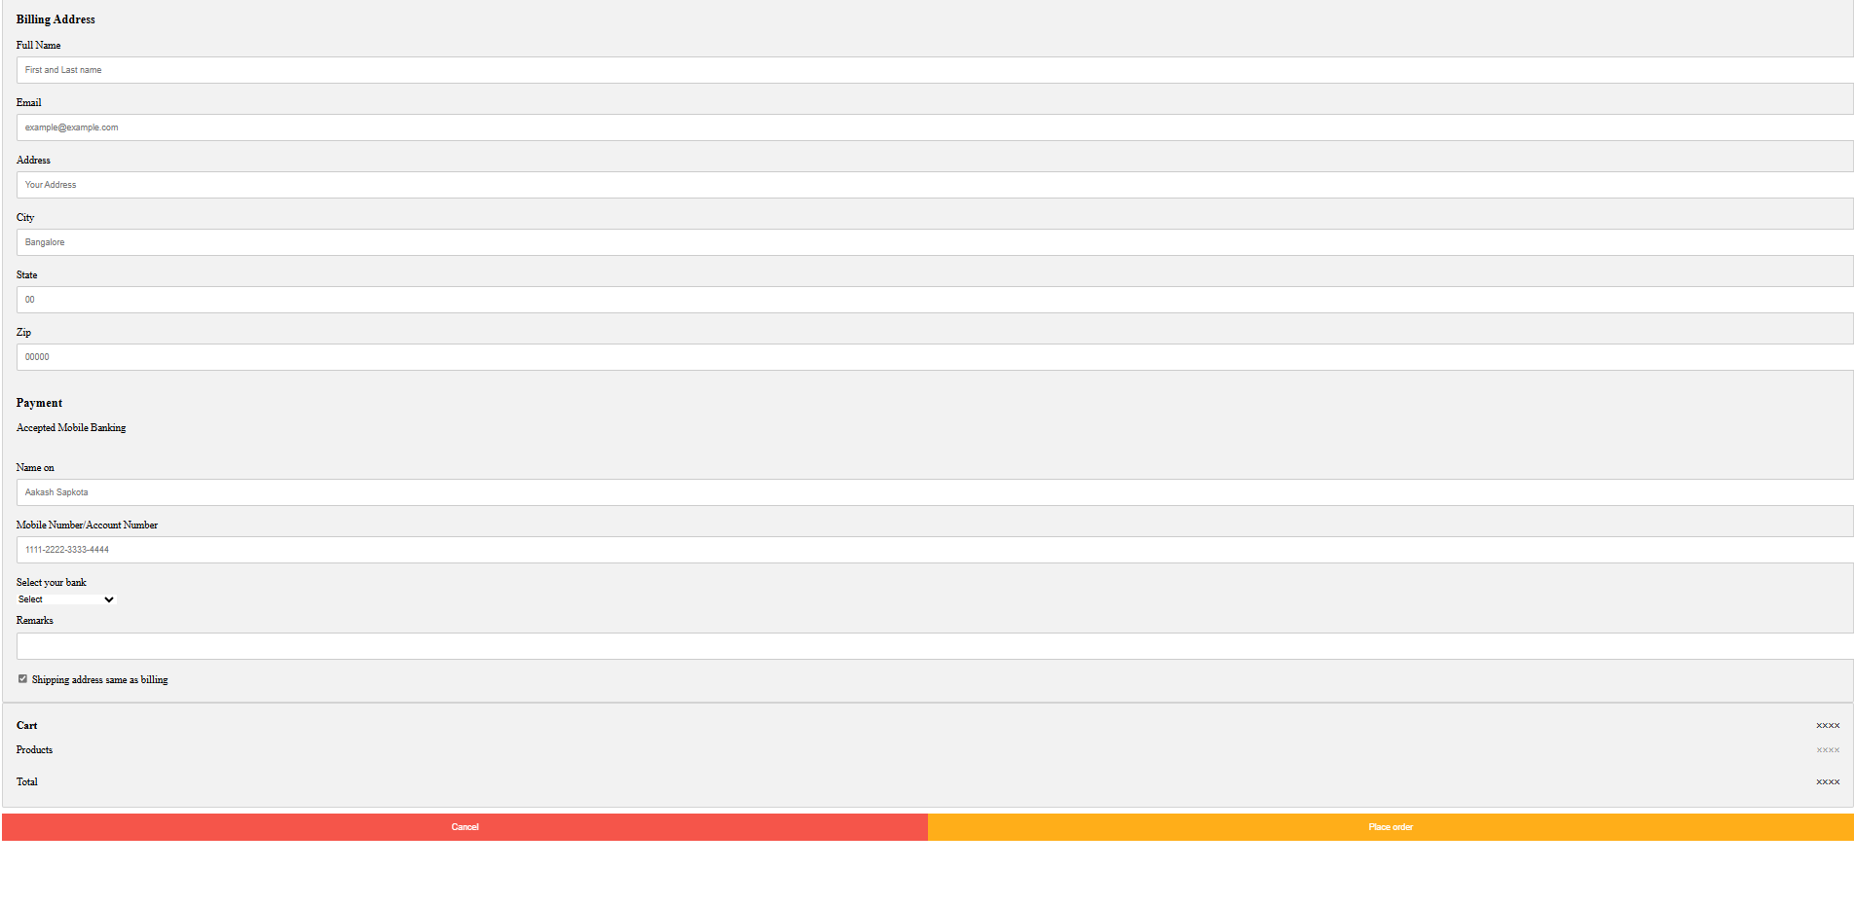
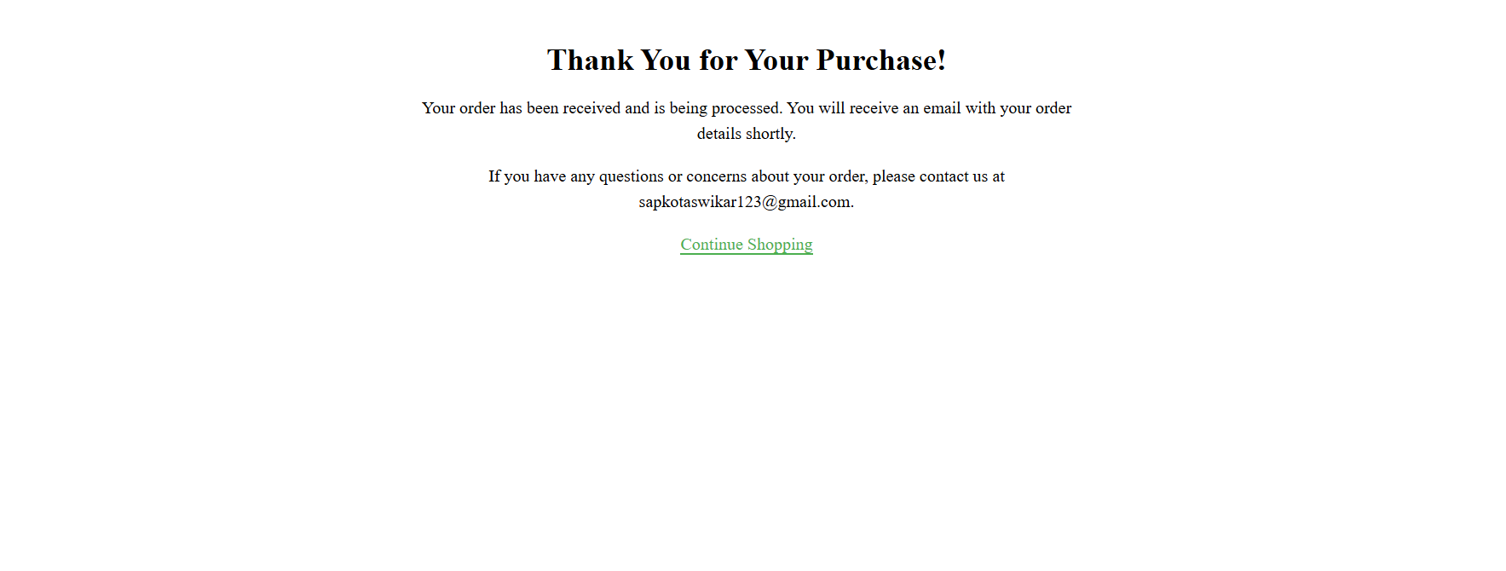
4
CONTACT
5
PAYMENT
6
PLACE ORDER

Slide 8
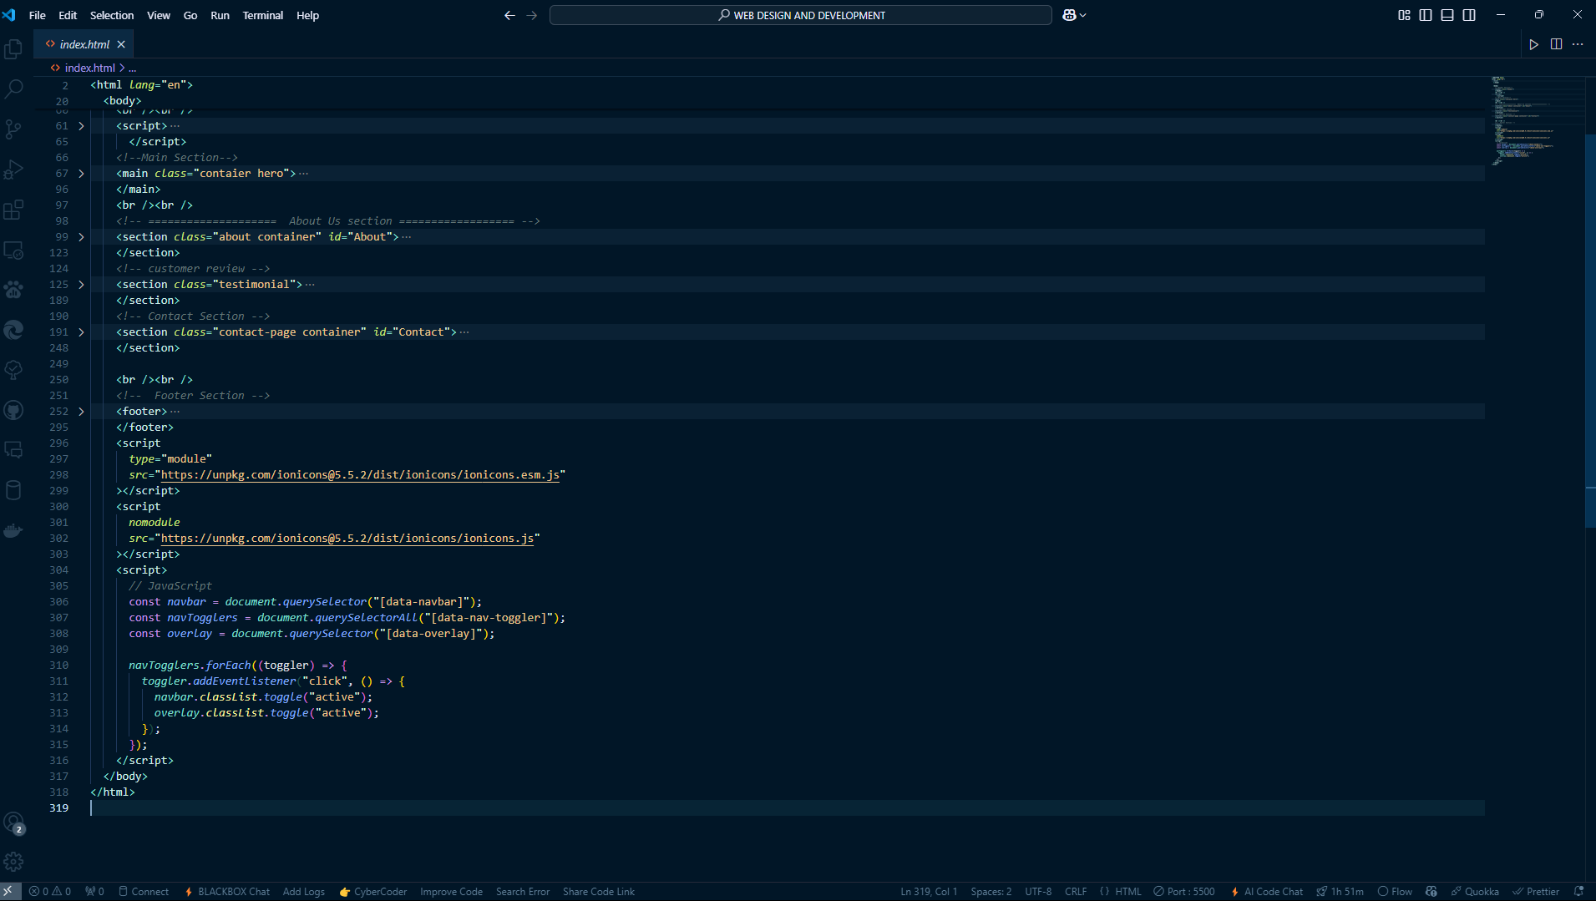
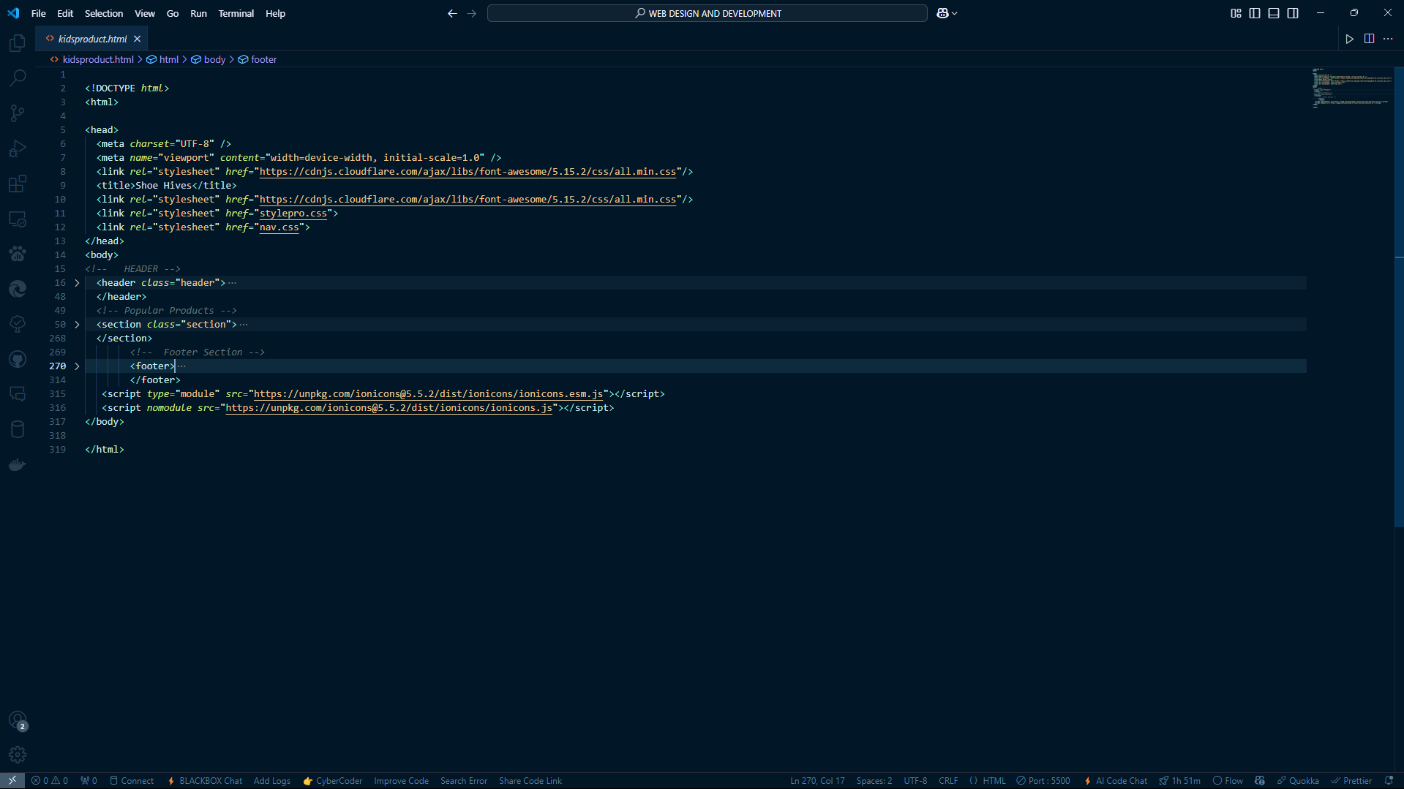
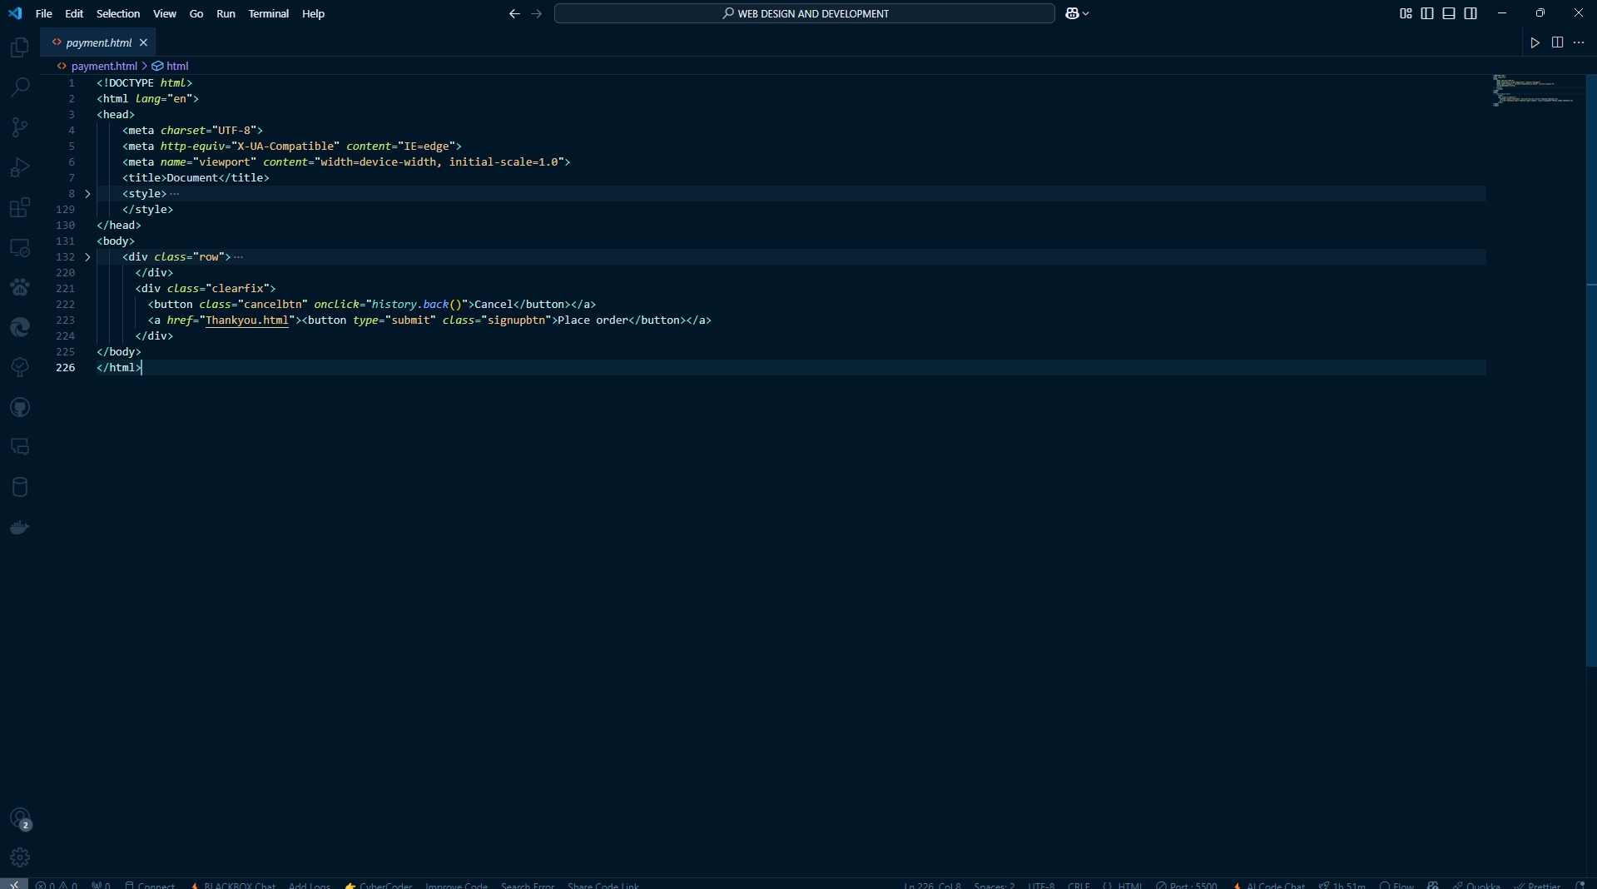
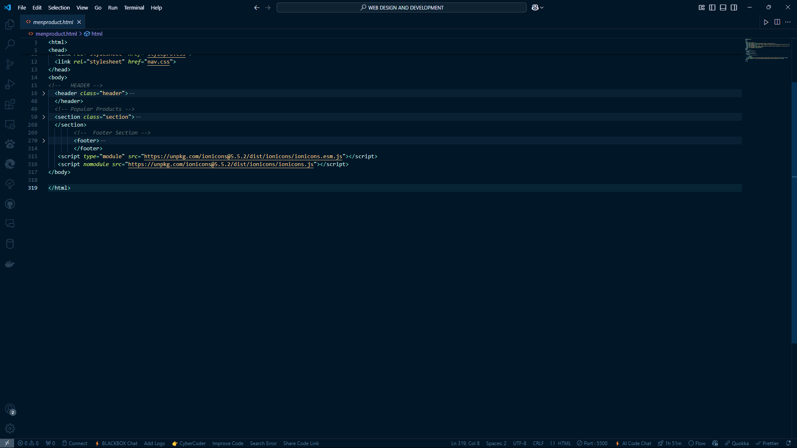
CODING

Slide 9
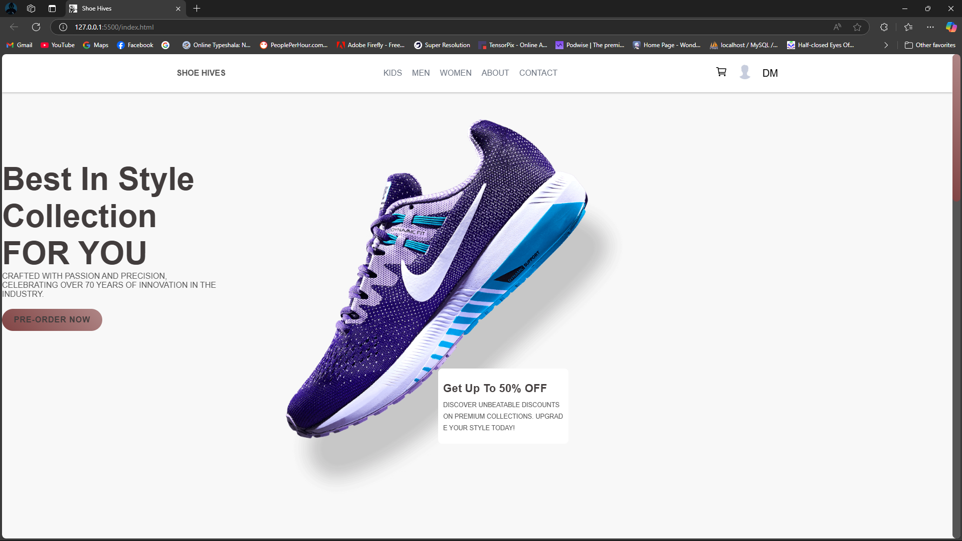
SCREENSHOT OF E-SHOE WEBSITE

Slide 10
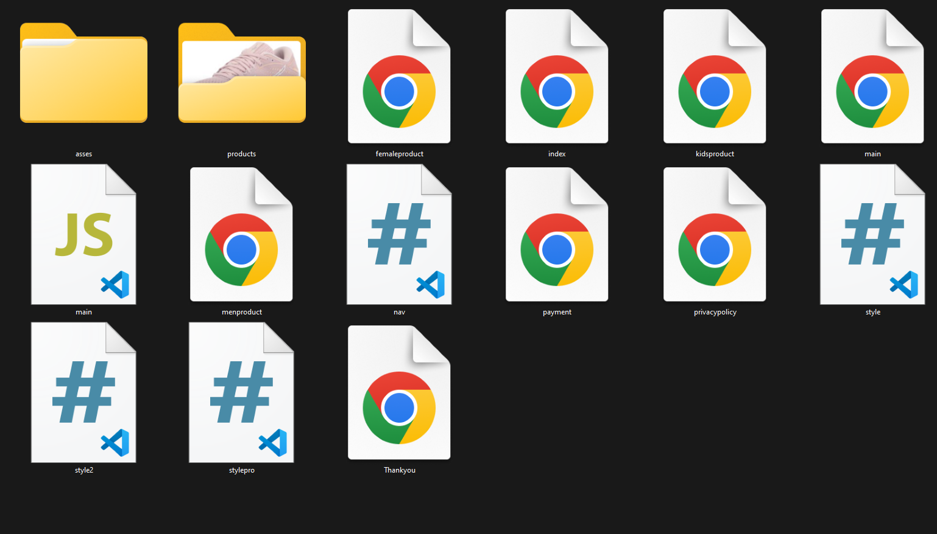
SCREENSHOT OF MY FILES LOCATION

Slide 11


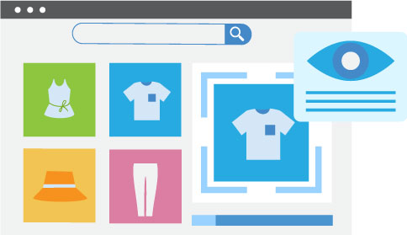

FUTURE SCOPE
Mobile-friendliness
Customer experience
Image recognition turned product recognition
Add multiple things like game, payment ,music etc

Slide 12
CONCLUSION
Shoe Hive still represents one of the business methods that can thrive if done the right way. Even if the stock market and commodities face downturns, Shoe Hive remains resilient and continues to receive high transaction volumes. Additionally, Shoe Hive introduces new techniques and styles in shoe transactions. Utilizing extensive e-commerce capabilities in the online world significantly benefits both individuals and the community.
"C:\Users\aakas\Documents\WEB DESIGN AND DEVELOPMENT\index.html"

