Slide 1


Subject Name:
Database Management systems
Subject Code:
10CS54
Prepared By:
Sindhuja K
Department:
CSE
Date

Slide 2
Unit –VI
DATABASE DEGIGN- 1

Slide 3
Topics
1 Informal Design Guidelines for Relational Databases
2 Functional Dependencies (FDs)
3 Normal Forms Based on Primary Keys
4 General Normal Form Definitions (For Multiple Keys)
5 BCNF (Boyce-Codd Normal Form)

Slide 4
Introduction
Database design methods
  Bottom – up approach
  Top – down approach(forms, invoce)
Two levels of relation schemas
  The logical "user view" level
  The storage "base relation" level
What are the criteria for "good" base relations?
Objective : Goodness/quality of DB
  Functional dependency
  Normal Forms

Slide 5
1 Informal Design Guidelines for Relational Databases
1.1Semantics of the Relation Attributes
1.2 Redundant Information in Tuples and Update Anomalies
1.3 Null Values in Tuples
1.4 Spurious Tuples

Slide 6
1.1 Semantics of the Relation Attributes
Informally, each tuple in a relation should represent one entity or relationship instance. (Applies to individual relations and their attributes).
Attributes of different entities (EMPLOYEEs, DEPARTMENTs, PROJECTs) should not be mixed in the same relation
Only foreign keys should be used to refer to other entities
Entity and relationship attributes should be kept apart as much as possible.

Slide 7
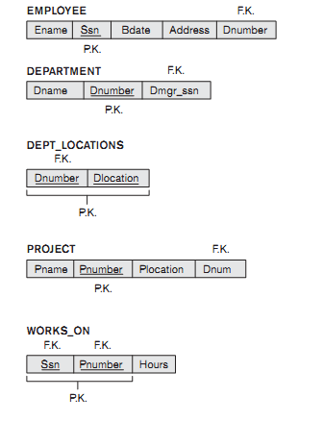

Slide 8
1.2 Redundant Information in Tuples and Update Anomalies
Mixing attributes of multiple entities may cause problems
Information is stored redundantly wasting storage
Problems with update anomalies
  Insertion anomalies
  Deletion anomalies
  Modification anomalies

Slide 9
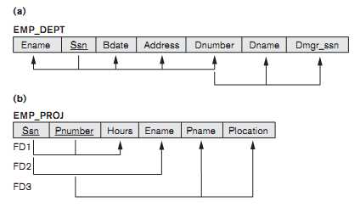
Update Anomaly: Changing the name of project number P1 from “ProductX” to “Product Y” may cause this update to be made for all employees working on project P1.

Slide 10
Insert Anomaly: Cannot insert a project unless an employee is assigned to .
Inversely - Cannot insert an employee unless an he/she is assigned to a project.
Delete Anomaly: When a project is deleted, it will result in deleting all the employees who work on that project. Alternately, if an employee is the sole employee on a project, deleting that employee would result in deleting the corresponding project.

Slide 11
1.3 Null Values in Tuples
Attributes that are NULL frequently could be placed in separate relations (with the primary key)
Reasons for nulls:
  attribute not applicable or invalid
  attribute value unknown (may exist)
  value known to exist, but unavailable

Slide 12
1.4 Spurious Tuples
Bad designs for a relational database may result in erroneous results for certain JOIN operations
The "lossless join" property is used to guarantee meaningful results for join operations
There are two important properties of decompositions:
non-additive or losslessness of the corresponding join
preservation of the functional dependencies.

Slide 13
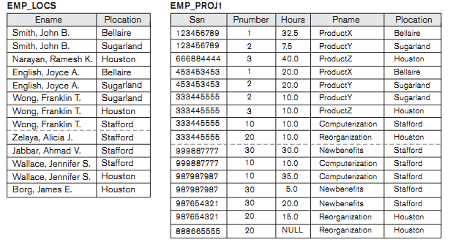

Slide 14
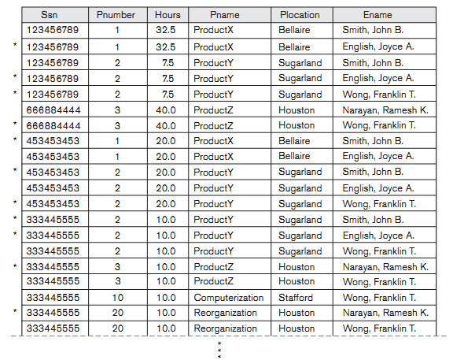

Slide 15
Guidelines - summary
GUIDELINE 1: Design a schema that can be explained easily relation by relation. The semantics of attributes should be easy to interpret.
GUIDELINE 2: Design a schema that does not suffer from the insertion, deletion and update anomalies. If there are any present, then note them so that applications can be made to take them into account
GUIDELINE 3: Relations should be designed such that their tuples will have as few NULL values as possible
GUIDELINE 4: The relations should be designed to satisfy the lossless join condition. No spurious tuples should be generated by doing a natural-join of any relations.

Slide 16
2.1 Functional Dependencies
2.1 Definition of FD
2.2 Inference Rules for FDs
2.3 Equivalence of Sets of FDs
2.4 Minimal Sets of FDs
Functional dependencies (FDs) are used to specify formal measures of the "goodness" of relational designs
FDs and keys are used to define normal forms for relations
FDs are constraints that are derived from the meaning and interrelationships of the data attributes
A set of attributes X functionally determines a set of attributes Y if the value of X determines a unique value for Y

Slide 17
Definition
  X -> Y holds if whenever two tuples have the same value for X, they must have the same value for Y
  For any two tuples t1 and t2 in any relation instance r(R): If t1[X]=t2[X], then t1[Y]=t2[Y]
  X -> Y in R specifies a constraint on all relation instances r(R)
  Written as X -> Y; can be displayed graphically on a relation schema as in Figures. ( denoted by the arrow: ).
  FDs are derived from the real-world constraints on the attributes

Slide 18
Examples of FD
  social security number determines employee name
  SSN -> ENAME
  project number determines project name and location
  PNUMBER -> {PNAME, PLOCATION}
  employee ssn and project number determines the hours per week that the employee works on the project
  {SSN, PNUMBER} -> HOURS
  An FD is a property of the attributes in the schema R
  The constraint must hold on every relation instance r(R)
  If K is a key of R, then K functionally determines all attributes in R (since we never have two distinct tuples with t1[K]=t2[K])

Slide 19
2.2 Inference Rules for FDs
Given a set of FDs F, we can infer additional FDs that hold whenever the FDs in F hold
Armstrong's inference rules:
IR1. (Reflexive) If Y subset-of X, then X -> Y
IR2. (Augmentation) If X -> Y, then XZ -> YZ
(Notation: XZ stands for X U Z)
IR3. (Transitive) If X -> Y and Y -> Z, then X -> Z
IR1, IR2, IR3 form a sound and complete set of inference rules
Some additional inference rules that are useful:
(Decomposition) If X -> YZ, then X -> Y and X -> Z
(Union) If X -> Y and X -> Z, then X -> YZ
(Psuedotransitivity) If X -> Y and WY -> Z, then WX -> Z
The last three inference rules, as well as any other inference rules, can be deduced from IR1, IR2, and IR3 (completeness property)

Slide 20
Closure of a set F of FDs is the set F⁺ of all FDs that can be inferred from F
Closure of a set of attributes X with respect to F is the set X ⁺ of all attributes that are functionally determined by X
X ⁺ can be calculated by repeatedly applying IR1, IR2, IR3 using the FDs in F

Slide 21
2.3 Equivalence of Sets of FDs
Two sets of FDs F and G are equivalent if:
- every FD in F can be inferred from G, and
- every FD in G can be inferred from F
Hence, F and G are equivalent if F ⁺ =G ⁺
Definition: F covers G if every FD in G can be inferred from F (i.e., if G ⁺ subset-of F ⁺)
F and G are equivalent if F covers G and G covers F
There is an algorithm for checking equivalence of sets of FDs

Slide 22
2.4 Minimal Sets of FDs
A set of FDs is minimal if it satisfies the following conditions:
Every dependency in F has a single attribute for its RHS.
We cannot remove any dependency from F and have a set of dependencies that is equivalent to F.
We cannot replace any dependency X -> A in F with a dependency Y -> A, where Y proper-subset-of X ( Y subset-of X) and still have a set of dependencies that is equivalent to F.

Slide 23
Minimal Sets of FDs
Every set of FDs has an equivalent minimal set
There can be several equivalent minimal sets
There is no simple algorithm for computing a minimal set of FDs that is equivalent to a set F of FDs
To synthesize a set of relations, we assume that we start with a set of dependencies that is a minimal set (e.g., see algorithms 11.2 and 11.4)

Slide 24
3 Normal Forms Based on Primary Keys
3.1 Normalization of Relations
3.2 Practical Use of Normal Forms
3.3 Definitions of Keys and Attributes Participating in Keys
3.4 First Normal Form
3.5 Second Normal Form
3.6 Third Normal Form

Slide 25
3.1 Normalization of Relations
Normalization: The process of decomposing unsatisfactory "bad" relations by breaking up their attributes into smaller relations
Normal form: Condition using keys and FDs of a relation to certify whether a relation schema is in a particular normal form
2NF, 3NF, BCNF based on keys and FDs of a relation schema
4NF based on keys, multi-valued dependencies : MVDs; 5NF based on keys, join dependencies : JDs (Chapter 11)

Slide 26
3.2 Practical Use of Normal Forms
Normalization is carried out in practice so that the resulting designs are of high quality and meet the desirable properties
The practical utility of these normal forms becomes questionable when the constraints on which they are based are hard to understand or to detect
The database designers need not normalize to the highest possible normal form. (usually up to 3NF, BCNF or 4NF)
Denormalization: the process of storing the join of higher normal form relations as a base relation—which is in a lower normal form

Slide 27
3.3 Definitions of Keys and Attributes Participating in Keys
A superkey of a relation schema R = {A₁, A₂, ...., A_{n}} is a set of attributes S subset-of R with the property that no two tuples t₁ and t₂ in any legal relation state r of R will have t₁[S] = t₂[S]
A key K is a superkey with the additional property that removal of any attribute from K will cause K not to be a superkey any more.
If a relation schema has more than one key, each is called a candidate key. One of the candidate keys is arbitrarily designated to be the primary key, and the others are called secondary keys.
A Prime attribute must be a member of some candidate key
A Nonprime attribute is not a prime attribute—that is, it is not a member of any candidate key.

Slide 28
First Normal Form
Disallows composite attributes, multivalued attributes, and nested relations; attributes whose values for an individual tuple are non-atomic
Considered to be part of the definition of relation

Slide 29
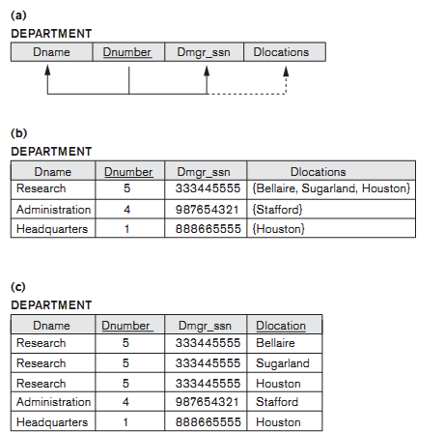
Example

Slide 30

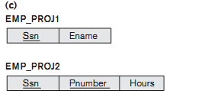
Example

Slide 31
Second Normal Form
Uses the concepts of FDs, primary key
Definitions:
Prime attribute - attribute that is member of the primary key K
Full functional dependency - a FD Y -> Z where removal of any attribute from Y means the FD does not hold any more
Examples: - {SSN, PNUMBER} -> HOURS is a full FD since neither SSN -> HOURS nor PNUMBER -> HOURS hold
- {SSN, PNUMBER} -> ENAME is not a full FD (it is called a partial dependency ) since SSN -> ENAME also holds
A relation schema R is in second normal form (2NF) if every non-prime attribute A in R is fully functionally dependent on the primary key
R can be decomposed into 2NF relations via the process of 2NF normalization

Slide 32
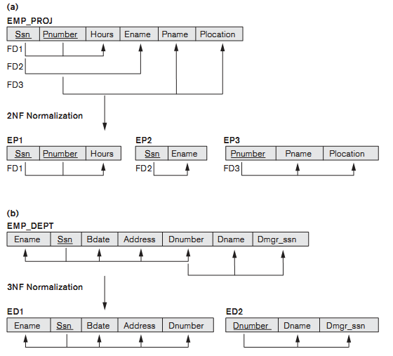
Example

Slide 33
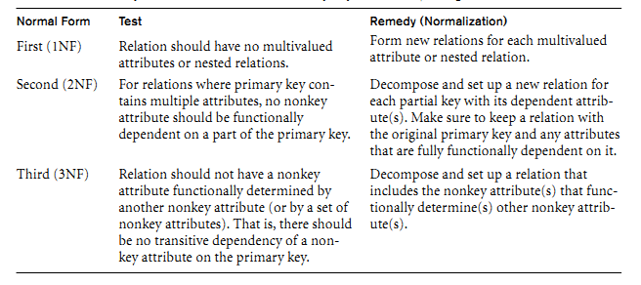

Slide 34
Third Normal Form
Definition:
Transitive functional dependency - a FD X -> Z that can be derived from two FDs X -> Y and Y -> Z
Examples:
- SSN -> DMGRSSN is a transitive FD since
SSN -> DNUMBER and DNUMBER -> DMGRSSN hold
- SSN -> ENAME is non-transitive since there is no set of attributes X where SSN -> X and X -> ENAME
A relation schema R is in third normal form (3NF) if it is in 2NF and no non-prime attribute A in R is transitively dependent on the primary key
R can be decomposed into 3NF relations via the process of 3NF normalization
NOTE:
In X -> Y and Y -> Z, with X as the primary key, we consider this a problem only if Y is not a candidate key. When Y is a candidate key, there is no problem with the transitive dependency .
E.g., Consider EMP (SSN, Emp#, Salary ).
Here, SSN -> Emp# -> Salary and Emp# is a candidate key.

Slide 35
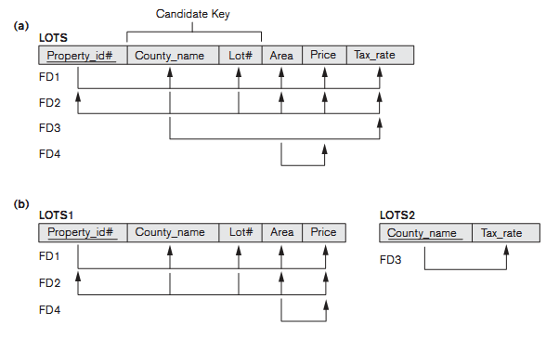
Example

Slide 36
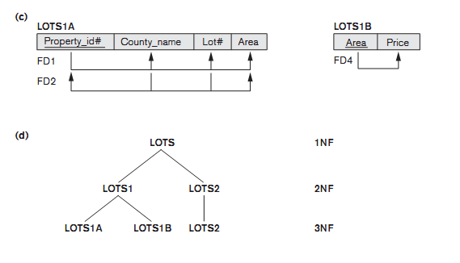
Example

Slide 37
4 . General Normal Form Definitions (For Multiple Keys)
The above definitions consider the primary key only
The following more general definitions take into account relations with multiple candidate keys
A relation schema R is in second normal form (2NF) if every non-prime attribute A in R is fully functionally dependent on every key of R
Definition:
Superkey of relation schema R - a set of attributes S of R that contains a key of R
A relation schema R is in third normal form (3NF) if whenever a FD X -> A holds in R, then either:
(a) X is a superkey of R, or
(b) A is a prime attribute of R
NOTE: Boyce-Codd normal form disallows condition (b) above

Slide 38
5.BCNF (Boyce-Codd Normal Form)
A relation schema R is in Boyce-Codd Normal Form (BCNF) if whenever an FD X -> A holds in R, then X is a superkey of R
Each normal form is strictly stronger than the previous one
  Every 2NF relation is in 1NF
  Every 3NF relation is in 2NF
  Every BCNF relation is in 3NF
There exist relations that are in 3NF but not in BCNF
The goal is to have each relation in BCNF (or 3NF)

Slide 39
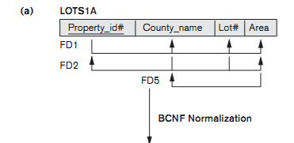
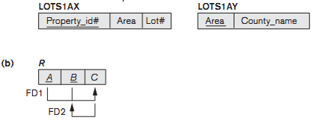
Example

Slide 40

Example
Two FDs exist in the relation TEACH:
fd1: { student, course} -> instructor
fd2: instructor -> course
{student, course} is a candidate key for this relation and that the dependencies shown follow the pattern in Figure 10.12 (b). So this relation is in 3NF but not in BCNF
A relation NOT in BCNF should be decomposed so as to meet this property, while possibly forgoing the preservation of all functional dependencies in the decomposed relations. (See Algorithm 11.3)

Slide 41
Three possible decompositions for relation TEACH
  {student, instructor} and {student, course}
  {course, instructor } and {course, student}
  {instructor, course } and {instructor, student}
All three decompositions will lose fd1. We have to settle for sacrificing the functional dependency preservation. But we cannot sacrifice the non-additivity property after decomposition.
Out of the above three, only the 3rd decomposition will not generate spurious tuples after join.(and hence has the non-additivity property).

