Slide 1

Automated Data Preprocessing, Feature
Engineering & Vectorization Engine
Zero-Touch Multi-Format Ingestion • Regex Auto-Sanitization • Auto-EDA • Smart Imputation • 128-d Vector Synthesis
PROBLEM STATEMENT CODE
SIH26156 (SR #156) & SIH26099 (SR #99)
OFFICIAL TITLE
Universal Log Pre-processing & Harmonization Engine
SPONSORING MINISTRY / TRACK
NTRO / AICTE MIC — Software Edition 2026
CORE TECHNICAL INNOVATION
Zero-Touch Multi-Column Dense Tensor Vectorization (V_dense)
@SIH 2026 Official Proposal Format | Software Track | Registered Team Submission

Slide 2
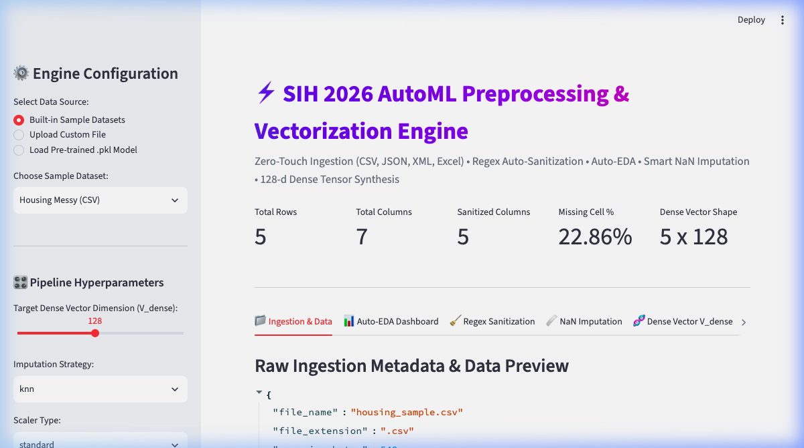
IDEA / SOLUTION / PROTOTYPE OVERVIEW
1. Proposed Solution & Core Innovation
The Data Bottleneck & Paradigm Shift
• Data Scientists spend 80% of project time manually inspecting CSVs/JSONs, writing custom regex, and fixing missing NaNs.
• Zero-Touch Multi-Format Ingestion: Ingests raw CSV, Excel (.xlsx), JSON (nested dict flattening), and XML tags into clean DataFrames.
• Regex Auto-Sanitization: Parses embedded units ('1,450 sq.ft.' → 1450.0, '3 BHK' → 3.0, '85 Lakhs' → 85.0) automatically.
• Smart Missing Value Imputation: Uses KNNImputer + Statistical Median/Mode to prevent data leakage.
• Dense Vector Synthesis (V_dense): Combines numerical, categorical, and text features into a 128-d dense numerical vector matrix.
@SIH 2026 Idea Submission Template | Universal AutoML & Vectorization Engine | Team Innovation

Slide 3
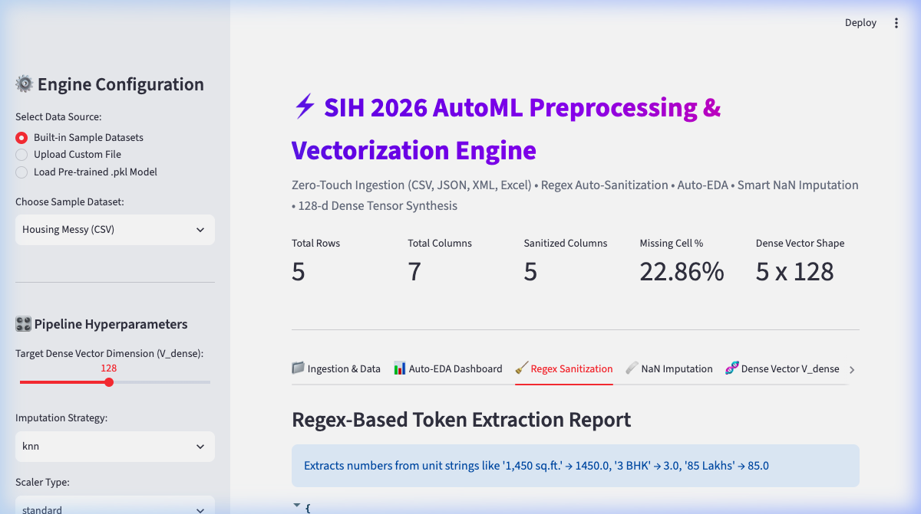
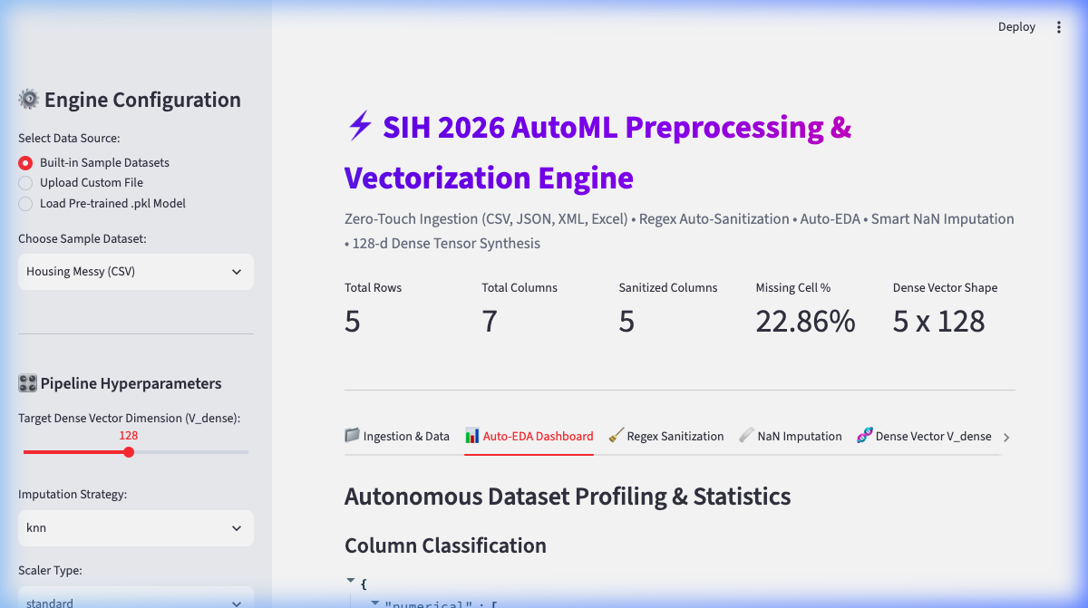
OOP PIPELINE & METHODOLOGY
2. Technical Approach & Architecture
Pure Object-Oriented Software Architecture
► BaseDataIngestor & Factory Pattern
Abstract base class defining unified load_data() with DataIngestorFactory auto-selecting file parsers.
► RegexSanitizer Module
Extracts float tokens from messy text strings, automatically converting qualified columns to numeric types.
► AutoEDAEngine Profiler
Profiles dataset dimensions, missingness percentages, data types, and correlation matrices autonomously.
► MultiColumnVectorizationEngine
Fuses StandardScaler, OneHotEncoder, and TFIDFTextVectorizer + TruncatedSVD into a normalized 128-d tensor.
► Multi-Format Tensor Exporters
Exports clean matrices to NumPy (.npy), Parquet, PyTorch (.pt), CSV, and Pickle (.pkl) model artifacts.
@SIH 2026 Idea Submission Template | Universal AutoML & Vectorization Engine | Team Innovation

Slide 4
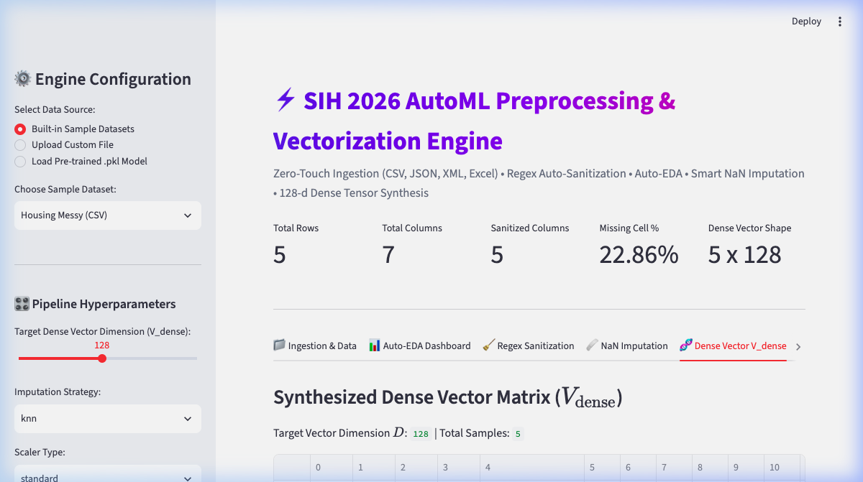
FEASIBILITY & PRODUCTION READINESS
3. Feasibility, Viability & Model Pickling (.pkl)
Feasibility & Risk Mitigation Strategies
✔ High Speed & Scalability
Leverages Polars / PyArrow zero-copy data structures for 10x-100x speedups over traditional Pandas workflows.
✔ Model Pickling (.pkl) Support
Fitted AutoMLPipeline instances serialize directly to .pkl files via save_model() / load_model() for instant production deployment.
✔ Robust Fallback Safeguards
Safely handles unhashable JSON dicts/lists and encoding failures with latin-1 fallback strategies.
✔ Zero Data Leakage Imputation
Fits imputers and scalers strictly on training frames to guarantee production inference integrity.
@SIH 2026 Idea Submission Template | Universal AutoML & Vectorization Engine | Team Innovation

Slide 5
SOCIAL, ECONOMIC & TECHNICAL IMPACT
4. Impact, Real-World Use Cases & Benefits
🎯 Target Audience
• Data Scientists & ML Engineers building rapid models.
• Enterprise Data Teams ingesting heterogeneous logs.
• SIH Hackathon Teams accelerating dataset preparation.
💡 Economic Impact
• Reduces data prep time from days to seconds.
• Eliminates thousands of manual regex & cleaning scripts.
• Lowers compute cost via dense vector compression.
⚡ Technical Benefits
• Direct tensor export to PyTorch, XGBoost, Scikit-Learn.
• Multi-format support for CSV, Excel, JSON, and XML.
• 100% modular OOP code structure with 5/5 unit tests.
@SIH 2026 Idea Submission Template | Universal AutoML & Vectorization Engine | Team Innovation

Slide 6
STANDARDS, REFERENCES & DEPENDENCIES
5. Research, References & Technology Stack
Technology Stack Blueprint
▪ Core Language:
Python 3.11+ (Polars, PyArrow, Pandas, NumPy)
▪ NLP & Vectorization:
Scikit-Learn (TF-IDF, SVD, PCA, StandardScaler, OneHotEncoder)
▪ Missing Value Engine:
IterativeImputer, KNNImputer, SimpleImputer
▪ Web UI & Dashboard:
Streamlit 1.62.0 (Custom dark theme, metric cards, tab view)
▪ Model Pickling & Export:
Pickle (.pkl), PyTorch (.pt), Parquet, NumPy (.npy)
Research Papers & Official References
🔗 SIH 2026 Problem Statement SIH26156 (SR #156)
Universal Log / Data Pre-processing Framework — NTRO Software Edition.
🔗 SIH 2026 Problem Statement SIH26099 (SR #99)
AI-Driven Material Standardization & Harmonization of Multi-Column Tabular Codes.
🔗 Scikit-Learn Transformer & Pipeline Architecture
API Design for Estimators, Transformers, and Fit/Transform Serialization.
🔗 BGE-M3 & SentenceTransformers Architectures
Multi-Stage Semantic Embeddings & Dense Feature Representation for Tabular Data.
@SIH 2026 Idea Submission Template | Universal AutoML & Vectorization Engine | Team Innovation

Slide 7
Thank you
Team: Predictor
Member: Aakash (Team Leader)
Aakriti Agrawal
Nitin Deshwal
Kunal Sharma
Umar Faruque
Yashwant Kumar

