Slide 1
VIT CHENNAI · SCHOOL OF COMPUTER SCIENCE AND ENGINEERING
AI-Powered Secure Code Analysis and
Vulnerability Detection using Retrieval-
Augmented Generation (RAG)
BCSE497J — Project I | Review 2 (Panel Review) | 19 August 2026
Presented by:
Aakash Sivakumar — 23BCE5119
Udhay Anand Pandiyan — 23BCE1793
Guide: Jenila Livingston L M
Programme: B.Tech. Computer Science and Engineering

Slide 2
OVERVIEW
What We'll Cover
01
Problem, Domain & Motivation
02
Literature Review
Why current tools fall short
20 recent papers (2024–2026) across 4 themes
03
Objectives & Scope
04
Proposed Methodology
What Project I will deliver
The 10-stage RAG pipeline
05
System Architecture & Modules
06
Feasibility, Risks & Work Plan
How the pieces fit together
Ethics, risk mitigation, review timeline
BCSE497J · Project I · Review 2
2

Slide 3
1 · DOMAIN & PROBLEM
Why This Matters
As software applications grow more complex, ensuring code security has become a critical challenge.
Traditional static analysis tools generate high volumes of false positives with limited, template-based explanations. Purely LLM-based reviewers hallucinate or rely on superficial patterns when ungrounded.
We need a system that detects vulnerabilities, explains them against recognised standards (OWASP Top 10, CWE), scores severity defensibly, and recommends verifiable fixes.
76–90%+
false-positive rate on a production SAST tool at industry scale
8.2 days
median CVSS severity-scoring delay in 2023 (up from 2.7 days in 2019)
0.06–0.14
pair accuracy of an ungrounded LLM distinguishing vulnerable vs. patched code
Sources: Tencent industry FP study (arXiv:2601.18844); AutoCVSS (EMNLP 2025 Industry); Vul-RAG (arXiv:2406.11147)
BCSE497J · Project I · Review 2
3

Slide 4



1 · DOMAIN & PROBLEM
Three Ways to Review Code — and Why We Combine Two of Them
Static Analysis
Alone
LLM Alone
(Ungrounded)
RAG-Grounded LLM
(Proposed)
Rule/signature based
76–90%+ false positives
No contextual explanation
Rich contextual reasoning
Hallucinates root cause
0.06–0.14 pair accuracy
Retrieves repo + OWASP/CWE context
Explainable, standards-referenced
Rule-based severity, not LLM-only
BCSE497J · Project I · Review 2
4

Slide 5
3 · OBJECTIVES & SCOPE
What Project I Will Deliver
Objectives
In Scope (Project I)
Ingest a GitHub repo & chunk code at function/class level
Generate embeddings and store in a vector database
Build an OWASP Top 10 + CWE knowledge base
Run dual-context RAG retrieval (repo + standards)
Score severity with a transparent, CVSS-inspired rule layer
Generate remediation suggestions with before/after diffs
Present findings on an interactive, filterable dashboard
Requirement analysis · literature study · architecture & module design · tech-stack selection · KB & severity-rubric design · Python/JS prototype scope · preliminary work plan
Deferred to Project II
Multi-language production support · CI/CD & IDE integration · PR-level scanning · historical trend & compliance reporting
BCSE497J · Project I · Review 2
5

Slide 6




2 · LITERATURE REVIEW
The Research Landscape
Detection via RAG
227
Grounding LLM judgment in retrieved knowledge instead of raw pattern-matching (Vul-RAG, RepoAudit, VulnGym)
False-Positive Reduction
studies reviewed in a 2025 systematic literature review on LLM-based vulnerability detection (Jan 2020 – Jun 2025)
Combining LLMs with static-analyzer output to cut alert fatigue (ZeroFalse, Tencent study, benchmark comparisons)
Severity / CVSS Scoring
46.7%
Predicting defensible severity from CVE text or code context (AutoCVSS, ML-based CVSS prioritisation)
of all studies published in 2024 alone — the field is moving fast
Automated Repair
Generating and validating secure-code fixes, not just flags (patch-validation feedback, code-LM repair)
BCSE497J · Project I · Review 2
6

Slide 7
2 · LITERATURE REVIEW
Key Papers (8 of 20 Reviewed)
Paper | Technique | Key Result
Vul-RAG (ACM TOSEM 2025) | Knowledge-level RAG over CVE cause/fix pairs | +16–24% pair accuracy; found real 0-day-class bugs
ZeroFalse (2025) | LLM adjudication over CodeQL/SARIF + CWE rubrics | F1 up to 0.955 on real-world data
Tencent Industry Study (2026) | Hybrid LLM + static analysis (LLM4PFA) | 94–98% false positives eliminated, <$0.12/alarm
LLM vs. SAST Benchmark (2025) | Head-to-head: GPT-4.1/Mistral/DeepSeek vs. SonarQube/CodeQL/Snyk | LLM F1 0.75–0.80 vs. static tools 0.26–0.55
AutoCVSS (EMNLP 2025) | LLM CVSS-metric prediction, few-shot RAG | Beats baselines by up to 33pp in low-resource settings
SLR on LLM Vuln. Detection (2025) | Meta-analysis of 227 studies | 7 recurring gaps: interpretability, deployment, eval standardisation
RepoAudit (2025) | Multi-agent, inter-procedural data-flow analysis | 100+ confirmed bugs found in open-source projects
LLM Repair Case Study (ACM AIware 2024) | Reasoning + patch-validation feedback | Iterative feedback improves patch correctness
BCSE497J · Project I · Review 2
7

Slide 8
2 · LITERATURE REVIEW
The Gap We Target
No reviewed system combines all four of the following — this is the specific gap the proposed system addresses:
A
B
C
D
Repository-scale ingestion & chunking
RAG grounded in external standards
Transparent, rule-based severity
Explainable dashboard with verifiable fixes
not just isolated function snippets
OWASP Top 10 + CWE — not only historical CVE pairs or raw analyzer output
CVSS-inspired scoring, not LLM judgment alone
standards-referenced findings, developer-reviewed remediation
BCSE497J · Project I · Review 2
8

Slide 9
4 · PROPOSED METHODOLOGY
The RAG-Based Detection Pipeline
1
2
3
4
5
Ingest & Chunk
Embed & Index
Dual-Context Retrieval
LLM Analysis
Score & Remediate
Clone repo, parse with tree-sitter, split into function/class-level chunks
→
Embed code chunks + OWASP/CWE docs into two vector collections
→
Retrieve related repo code AND relevant security-standard entries
→
CWE-aware structured prompt → verdict, mapped CWE-ID, explanation
→
Rule-based CVSS-inspired severity + before/after fix suggestion
Steps 6–10 (severity detail, dashboard) are elaborated in the supporting report, Chapter 3.
BCSE497J · Project I · Review 2
9

Slide 10
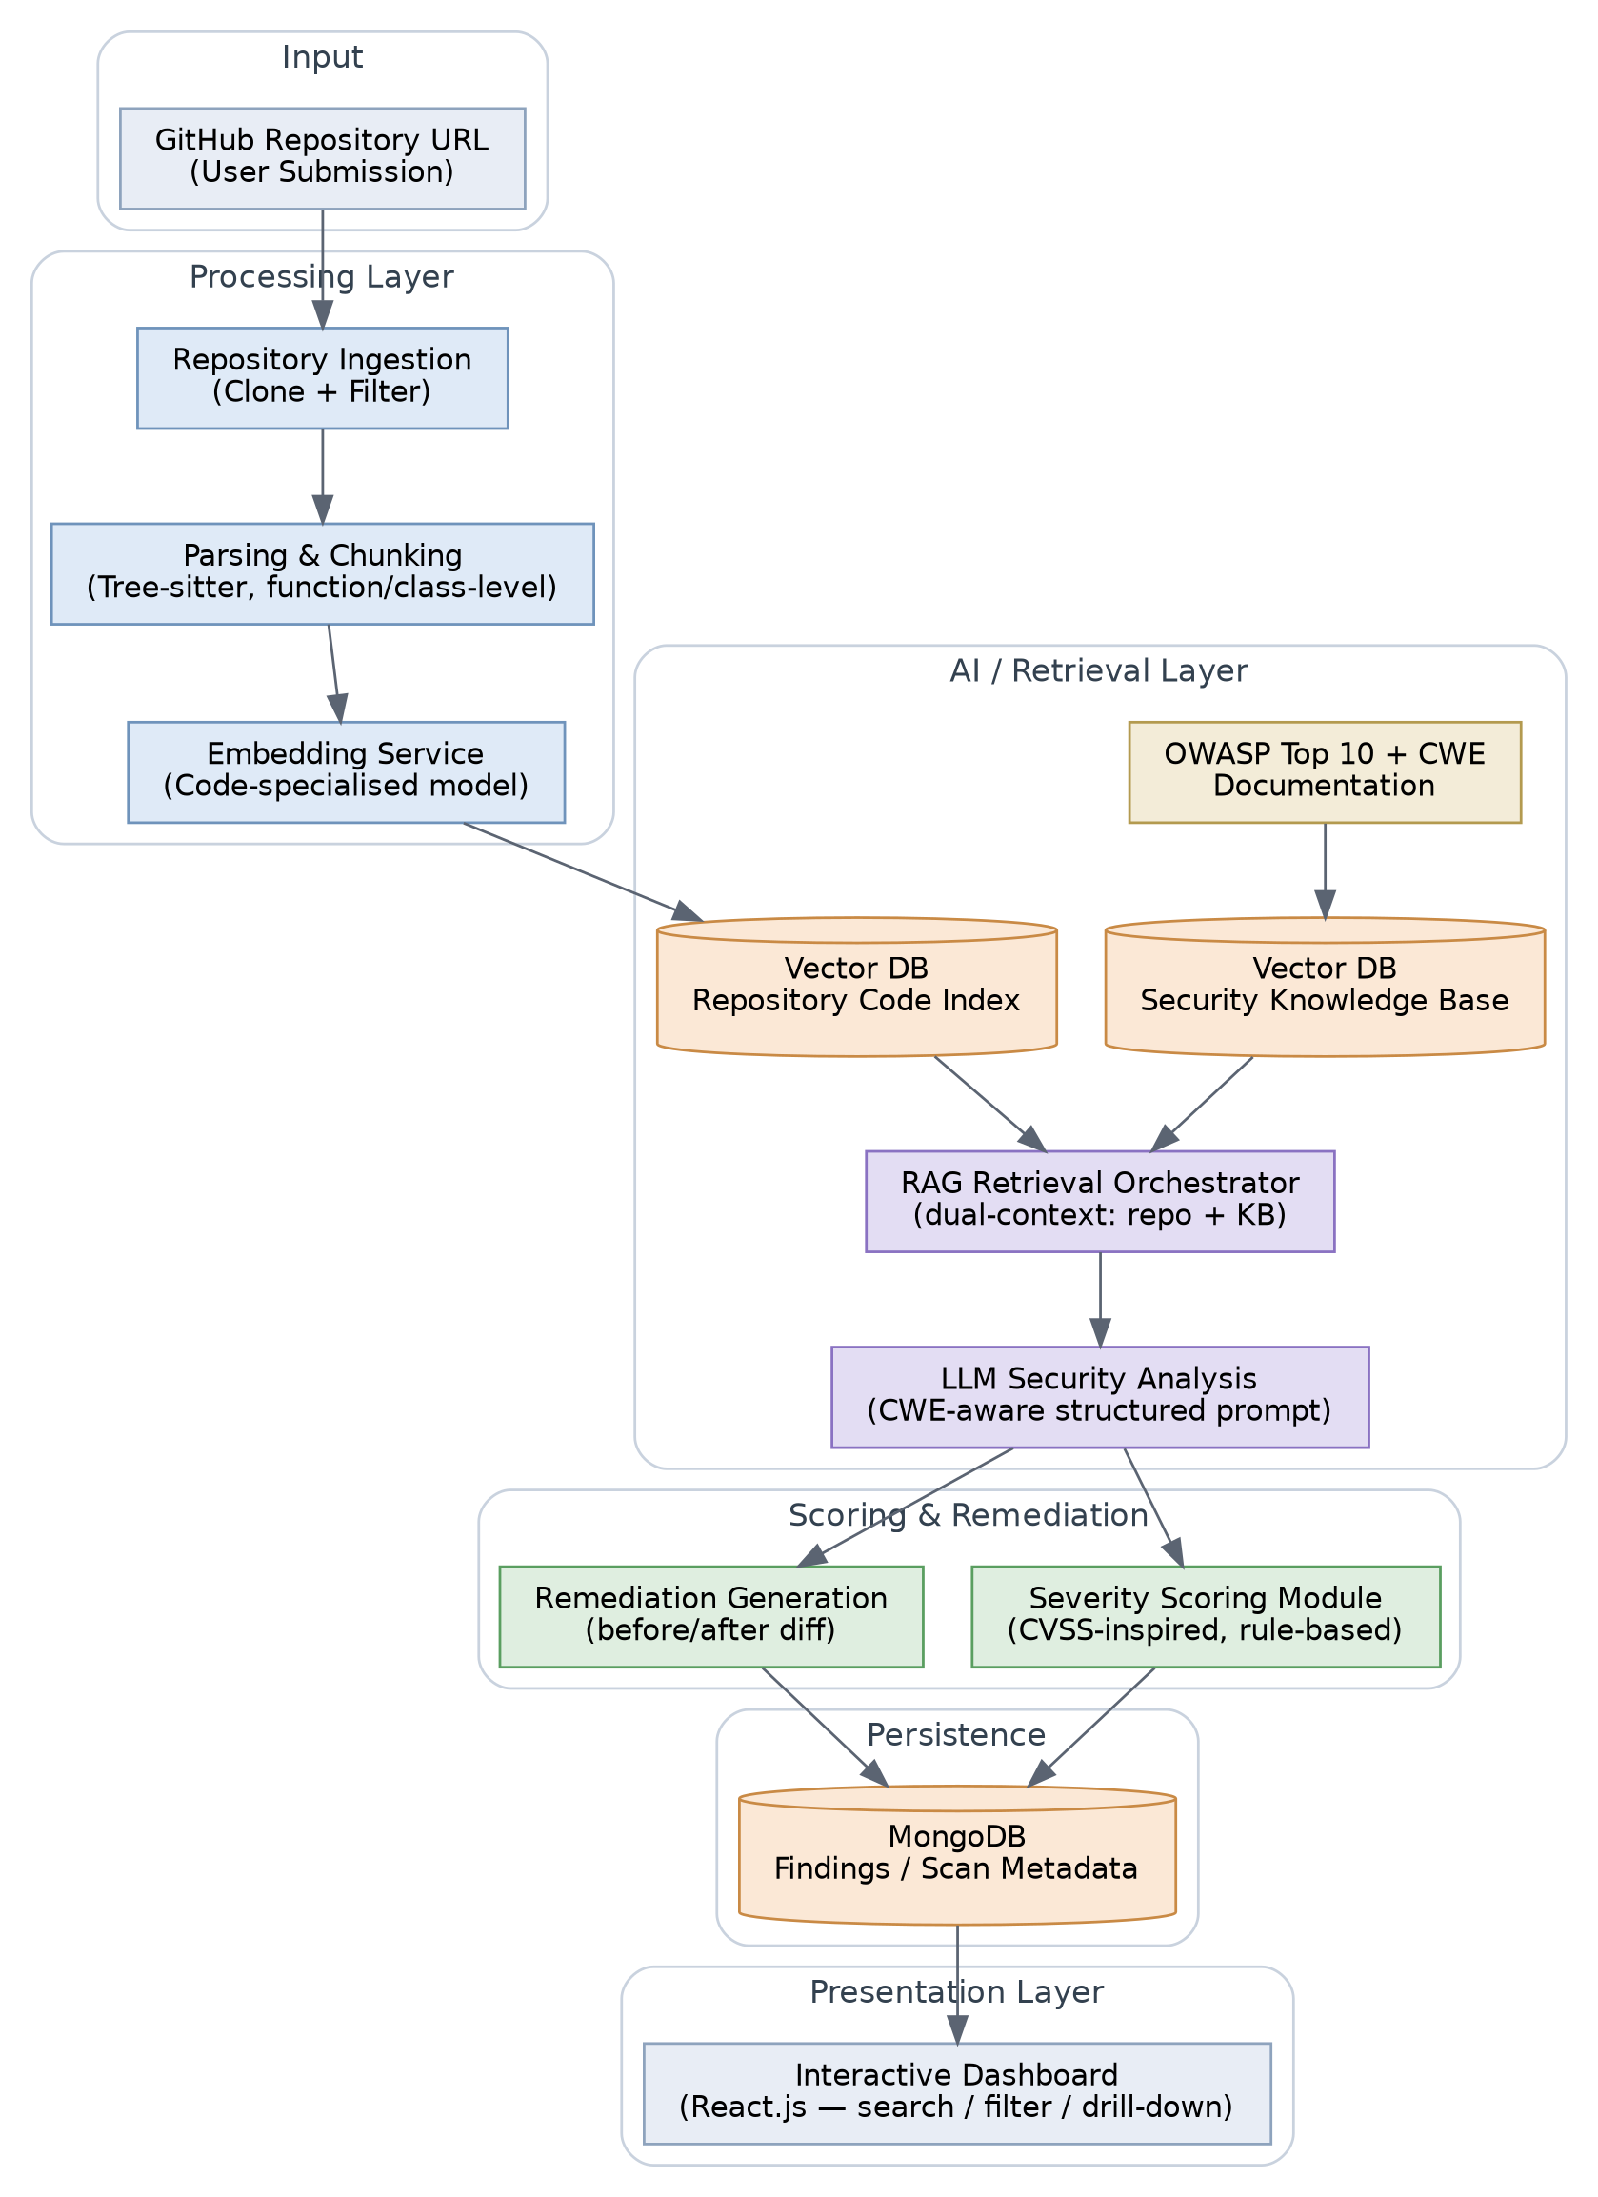
5 · SYSTEM ARCHITECTURE
End-to-End Architecture
BCSE497J · Project I · Review 2
10

Slide 11
5 · MODULE DESIGN
Module Responsibilities
Module | Responsibility | Key Design Choice
Repository Ingestion | Clone & pre-filter GitHub repo | Shallow clone; exclude vendored/binary paths
Parsing & Chunking | Split source into logical units | Tree-sitter, function/class-level (not fixed windows)
Embedding Service | Vectorise code & KB text | Code-specialised model; separate repo vs. KB collections
Security Knowledge Base | Store OWASP/CWE as retrievable knowledge | Built once, versioned, chunked by weakness category
RAG Retrieval Orchestrator | Fetch dual context per chunk | Top-k from both repo index and KB, merged into one prompt
LLM Security Analysis | Classify, map to CWE, explain | CWE-specific structured prompt/rubric
Severity Scoring | Assign a defensible severity band | Rule-based, CVSS-inspired — not LLM-only
Remediation Generation | Suggest fix + before/after diff | Developer-reviewed, never auto-applied
Dashboard | Visualise & triage findings | Search, filter by severity/CWE/file, drill-down
BCSE497J · Project I · Review 2
11

Slide 12



5 · IMPLEMENTATION
Technology Stack
Frontend
Backend
Database
React.js, HTML, CSS, JavaScript
Node.js, Express.js
MongoDB (scans, findings, users)
Vector Store
AI Components
Security Standards
FAISS · ChromaDB · Pinecone
LLM · code-specialised embeddings · RAG orchestration
OWASP Top 10 · CWE · CVSS-inspired scoring
BCSE497J · Project I · Review 2
12

Slide 13

DISTINGUISHING FACTOR
Innovation
Two independent knowledge sources, one transparent scorer.
RAG grounded simultaneously in the target repository's own code (context) and an external, standards-based security corpus — OWASP Top 10 + CWE (grounding) — paired with a rule-based, CVSS-inspired severity layer that does not depend solely on LLM judgment.
Motivated directly by two literature findings: Vul-RAG shows knowledge-level RAG substantially outperforms ungrounded LLM judgment; AutoCVSS shows pure-LLM severity scoring is not consistently reliable versus rule-assisted approaches.
BCSE497J · Project I · Review 2
13

Slide 14
6 · FEASIBILITY & RISK
Feasibility, Risks & Ethics
Risk | Impact | Mitigation
LLM hallucinated/superficial findings | False findings undermine trust | Mandatory RAG grounding in OWASP/CWE KB; confidence shown
Residual false positives | Alert fatigue | CWE-specific structured prompting; severity module deprioritises low-confidence findings
Large repos exceed time/cost budget | Poor UX, high LLM cost | Chunk-level batching, embedding cache, configurable filters
Auto-generated fixes applied blindly | Could introduce new bugs | Fixes always shown as a diff for manual developer review
Analysing code without consent | Ethical/legal concern | Public-repo scope only; explicit user submission required
Feasibility: every core technique (chunking, embedding retrieval, LLM classification) is individually validated at scale in the reviewed literature — the main risk is integration, not novelty.
BCSE497J · Project I · Review 2
14

Slide 15
6 · WORK PLANNING
Work Plan Aligned to the Review Schedule
Review 2
Draft Report / Review 4
19 Aug 2026
12–16 Oct 2026
Domain, literature, architecture & module design
RAG + LLM analysis + severity scoring integrated end-to-end; initial dashboard
Review 3
Review 5 (Final)
16 Sep 2026
21 Oct 2026
Ingestion + chunking + embedding pipeline; KB built; ~50% modules working
Remediation generation, dashboard polish, testing, final report & demo
BCSE497J · Project I · Review 2
15

Slide 16

Thank You
Questions & Discussion
AI-Powered Secure Code Analysis and Vulnerability Detection using RAG · BCSE497J Project I · VIT Chennai

