Slide 1
VIT CHENNAI · SCHOOL OF COMPUTER SCIENCE AND ENGINEERING
AI-Powered Secure Code Analysis and
Vulnerability Detection using Retrieval-
Augmented Generation (RAG)
BCSE497J — Project I | Review 3 (Panel Review) | 16 September 2026
5 / 10 modules implemented · running end-to-end
Presented by:
Aakash Sivakumar — 23BCE5119
Udhay Anand Pandiyan — 23BCE1793
Guide: Jenila Livingston L M
Programme: B.Tech. Computer Science and Engineering

Slide 2
OVERVIEW
What We'll Cover
01
Recap: System & Architecture
02
Review 3 Scope
What was designed at Review 2
What "~50% implementation" means, module by module
03
Implementation Walkthrough
04
A Real Technical Decision
Ingestion → chunking → embedding → KB → retrieval
The embedding-model constraint, and how we resolved it
05
Results Obtained So Far
06
Limitations & Plan for Review 4
Real-repo run, labeled benchmark, automated tests
What's next, and why
BCSE497J · Project I · Review 3
2

Slide 3
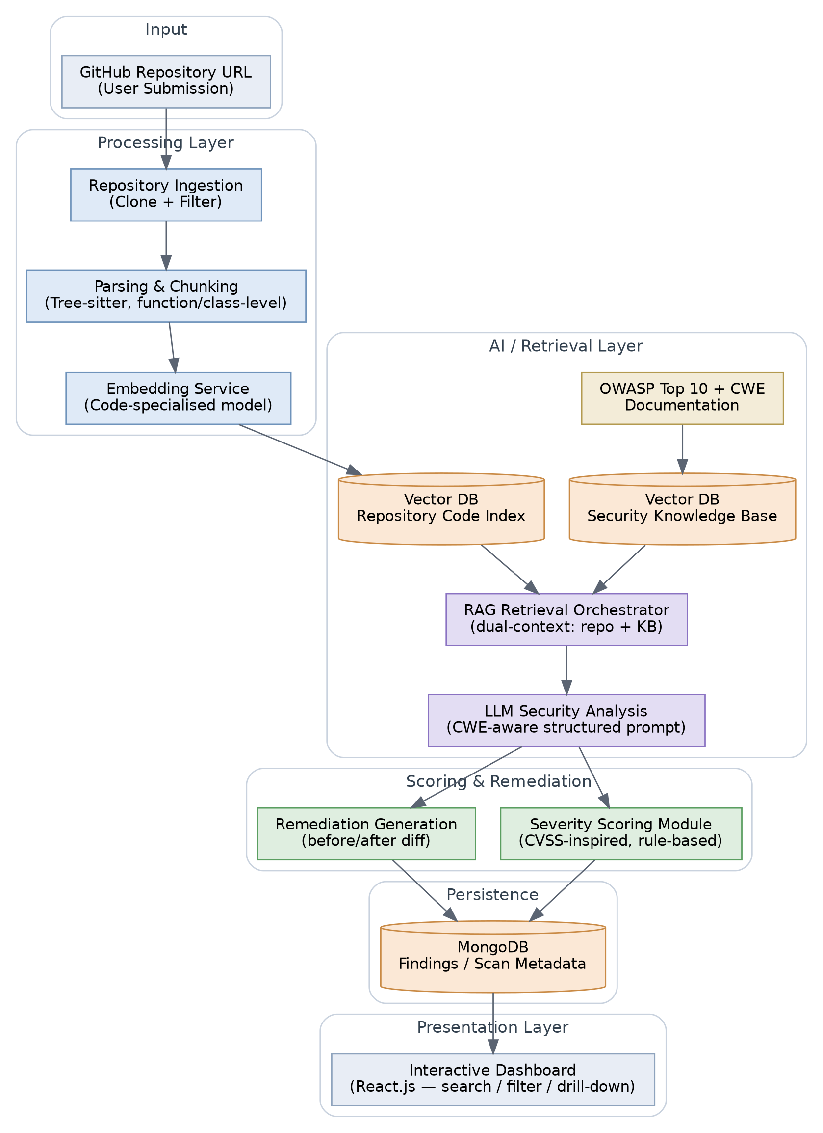
1 · RECAP
The Designed System (Review 2)
Ten modules across five layers:
Input → Processing (ingest, chunk, embed) → AI/Retrieval (dual-context RAG + LLM analysis) → Scoring & Remediation → Persistence & Dashboard.
Review 3 asked for roughly half of this working end-to-end against real code.
BCSE497J · Project I · Review 3
3

Slide 4
2 · REVIEW 3 SCOPE
5 of 10 Modules — Implemented and Running
Module | Status | Evidence
Repository Ingestion | ✓ Done | Cloned & filtered a real public repo (§4.3)
Parsing & Chunking | ✓ Done | Tree-sitter, function/class-level, tested
Embedding Service | ✓ Done | Documented model substitution + measured fix (§4.2)
Security Knowledge Base | ✓ Done | 35 entries: OWASP Top 10:2025 + CWE Top 25:2025
RAG Retrieval Orchestrator | ✓ Done | Dual-context retrieval demoed & benchmarked (§4.4)
LLM Security Analysis | Review 4 | Requires LLM API provisioning — planned next
Severity Scoring | Review 4 | Rule-based module — designed, not yet coded
Remediation Generation | Review 5 | Depends on LLM analysis stage
Findings Store (MongoDB) | Review 4 | Persistence layer for findings
Dashboard | Review 5 | React.js UI — final-review scope
BCSE497J · Project I · Review 3
4

Slide 5





3 · IMPLEMENTATION
The Implemented Pipeline, Step by Step
1
2
3
4
5
Ingest
Chunk
Embed
Index KB
Retrieve
Shallow git clone; filter vendored/binary/oversize/unsupported-language files
→
tree-sitter AST parse → function/class-level chunks (Python, JS, TS)
→
IDF-weighted GloVe averaging, camelCase/snake_case-aware tokenizer
→
OWASP Top 10:2025 + CWE Top 25:2025 → 35-entry FAISS knowledge base
→
Dual-context: nearest repo code + nearest security-KB entries, per chunk
All five stages run against real code, not synthetic examples — see Results (slides 9–11).
BCSE497J · Project I · Review 3
5

Slide 6


4 · TECHNICAL ACCURACY
A Real Constraint, and How We Resolved It
Constraint: our build environment's network policy blocks Hugging Face Hub and Stanford NLP's file host — confirmed by direct connection tests — which is where the "code-specialised embedding model" named in our proposal is normally downloaded from.
Resolution: GitHub-hosted distribution was reachable, so we substituted IDF-weighted averaged GloVe word vectors (glove-wiki-gigaword-100, via gensim's GitHub-hosted gensim-data) — a genuine pretrained embedding, documented everywhere it matters, confined to one module.
A failure we found, measured, and fixed — not just claimed to fix:
Before (plain averaging)
After (IDF-weighted) — 54.5% → 63.6% top-1 accuracy
Plain averaging retrieved CWE-22 (Path Traversal) above the correct CWE-89 (SQL Injection) on a classic SQLi snippet
Generic shared tokens ("select", "user") diluted the average
Added IDF weighting over the KB corpus + camelCase/snake_case identifier splitting
Re-ran the full 22-snippet benchmark to measure the actual effect, not assume it
BCSE497J · Project I · Review 3
6

Slide 7


3 · IMPLEMENTATION
The Security Knowledge Base
Real, current standards
35
Fetched directly from top10.owasp.org/2025 and cwe.mitre.org/top25/archive/2025 — not paraphrased from memory
Structured entries
standards-based entries indexed and retrievable
Each entry: rank, CWE-ID, name, mapped OWASP category, description, example vulnerable pattern
Verified retrieval
10 + 25
Sanity-checked on 4 classic weakness types (SQLi, command injection, path traversal, deserialization) — all correct at rank 1
OWASP Top 10:2025 categories + CWE Top 25:2025 weaknesses
Honest scope note
The CWE→OWASP mapping is this project's own best-fit judgment, documented as such — not claimed as an official crosswalk
BCSE497J · Project I · Review 3
7

Slide 8
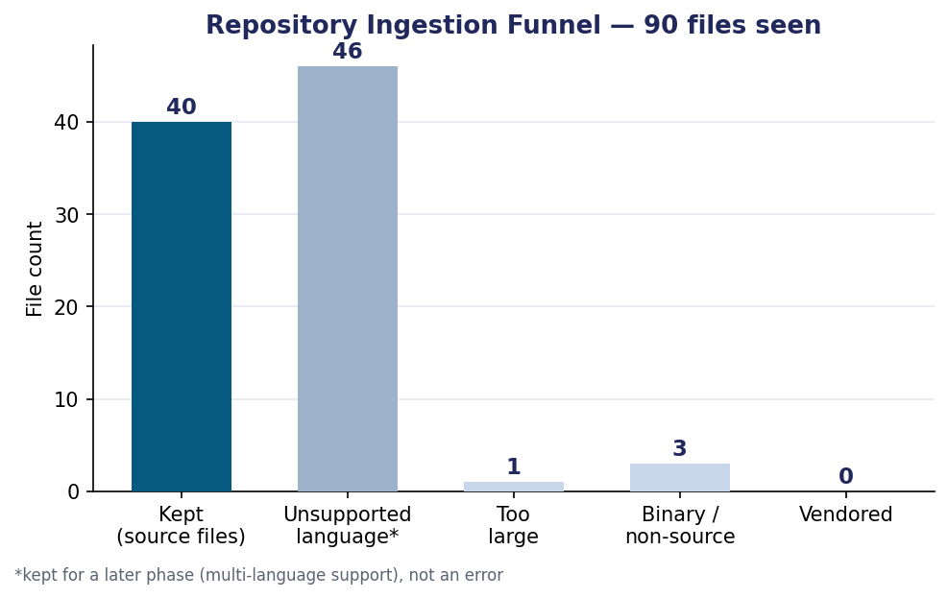
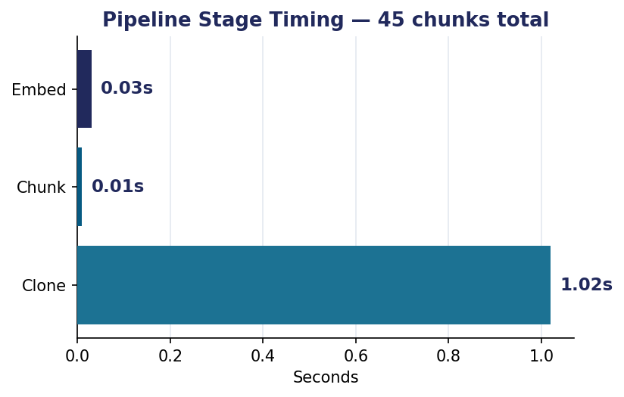
5 · RESULTS SO FAR
Real-Repository Run: OWASP/NodeGoat
A public, intentionally-vulnerable Node.js reference application — small enough to inspect by hand, well known enough for an external sanity check.
BCSE497J · Project I · Review 3
8

Slide 9
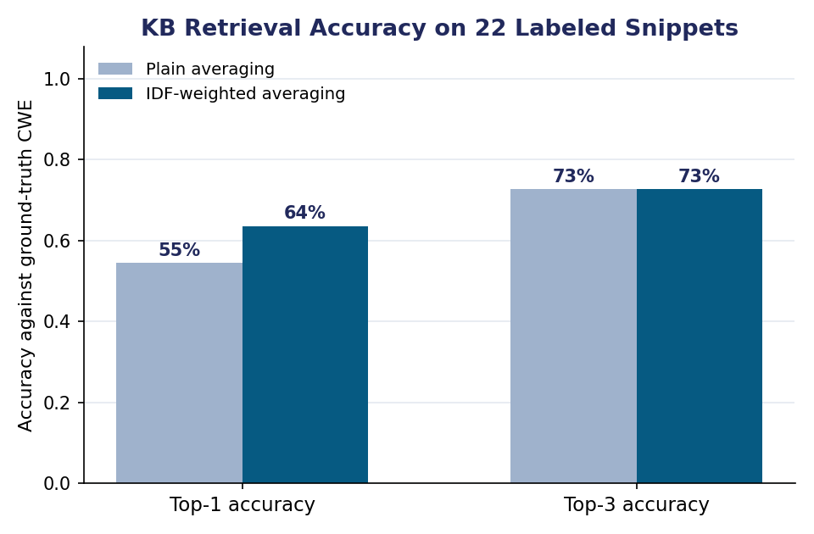
5 · RESULTS SO FAR
Retrieval-Accuracy Benchmark (22 Labeled Snippets)
63.6% / 72.7%
Top-1 / Top-3 retrieval accuracy against ground-truth CWE labels, using the IDF-weighted embedding actually shipped in the pipeline
Where it still struggles
Closely related access-control weaknesses (Missing/Incorrect Authorization, IDOR, Broken Access Control) — these differ on facts a word-frequency model can't see (is a check present at all, or present but wrong?). This is the specific, motivated target for the Review 4 LLM reasoning step.
BCSE497J · Project I · Review 3
9

Slide 10
5 · RESULTS SO FAR
Automated Testing
Python & JavaScript chunkers correctly identify function/class boundaries and names
Identifier tokenizer correctly splits camelCase and snake_case
Embeddings are unit-normalised (L2 norm = 1)
FAISS vector store save/load round-trip preserves vectors and metadata
Knowledge base loads all 35 entries correctly
SQL-injection sanity check retrieves CWE-89 at rank 1
7 / 7
automated tests passing
pytest · src/tests/test_pipeline.py
BCSE497J · Project I · Review 3
10

Slide 11
6 · LOOKING AHEAD
Limitations, Openly Stated — and the Plan for Review 4
Limitation (today) | Planned Review 4 Action
GloVe embedding is a documented substitute for a code-specialised transformer | Swap in once model hosting/API access is available; re-run the same benchmark to measure the gain
module.exports = function(){...} wrapper chunks as one large unit | Split on inner method definitions for older CommonJS-style code
Access-control CWE family (Authorization/IDOR/Access-Control) is hard to separate by retrieval alone | Add the LLM reasoning step specifically for this weakness family
Only Python/JS/TS processed; other languages retained, not analysed | Extend chunking/embedding to further languages per §3.8 future scope
Review 4 (12–16 Oct 2026): integrate LLM security analysis + rule-based severity scoring end-to-end; initial dashboard.
BCSE497J · Project I · Review 3
11

Slide 12

Thank You
Questions & Discussion
5 of 10 modules implemented · 63.6% / 72.7% retrieval accuracy · 7 / 7 tests passing
AI-Powered Secure Code Analysis and Vulnerability Detection using RAG · BCSE497J Project I · VIT Chennai

