Slide 1

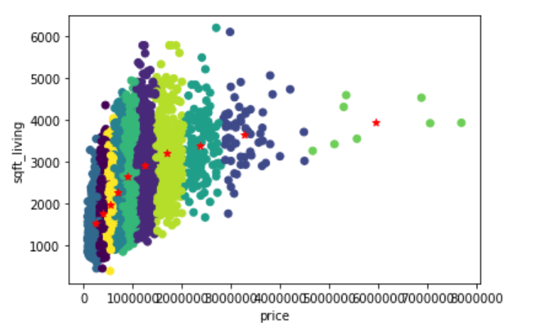
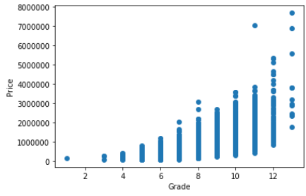

Predicting the Prices Of The House
School of Computer Science and Information Systems, Northwest Missouri State University
Aakash Valluru
Introduction
Results
Conclusions
The Dataset which I am going to work is to predict the Prices of the houses based on the features available in the dataset and clustered the houses based on the price and sqft living.
Based on the clustering, I would pick the values which is close to the centroid, because if we invest on those values, the price is little high and in turn there is more profit.
Evaluating the prices of the houses based on the other factors like grade, Year build, and number of bedrooms present.
The data in my dataset is continuous so I used linear regression to predict the final Price with an accuracy of 90 percent.
I have classified the condition of the house into 4 groups and performed decision tree classifier to determine the condition where the house belongs to.
I have performed clustering to determine the factors so that we can get the houses whose prices are high.
Materials/Methods
Features:
Year built
Number of Bedrooms
Grade
Performed linear regression to train the model.
Used Decision Tree Classifier to perform feature selection.
Evaluate
From this scatter plot diagram I have concluded that for most of the houses the price value increases if the grade increases . But for some cases even if the grade is low the prices are high because they are dependent on square feet.
Additional Resources
Acknowledgements
Poster Repository
https://www.kaggle.com/harifoxem/housesalesprediction/kernels
Mentor: Dr. Charles Hoot
https://github.com/aakashvalluru/Mlposterpresentation

