Slide 1

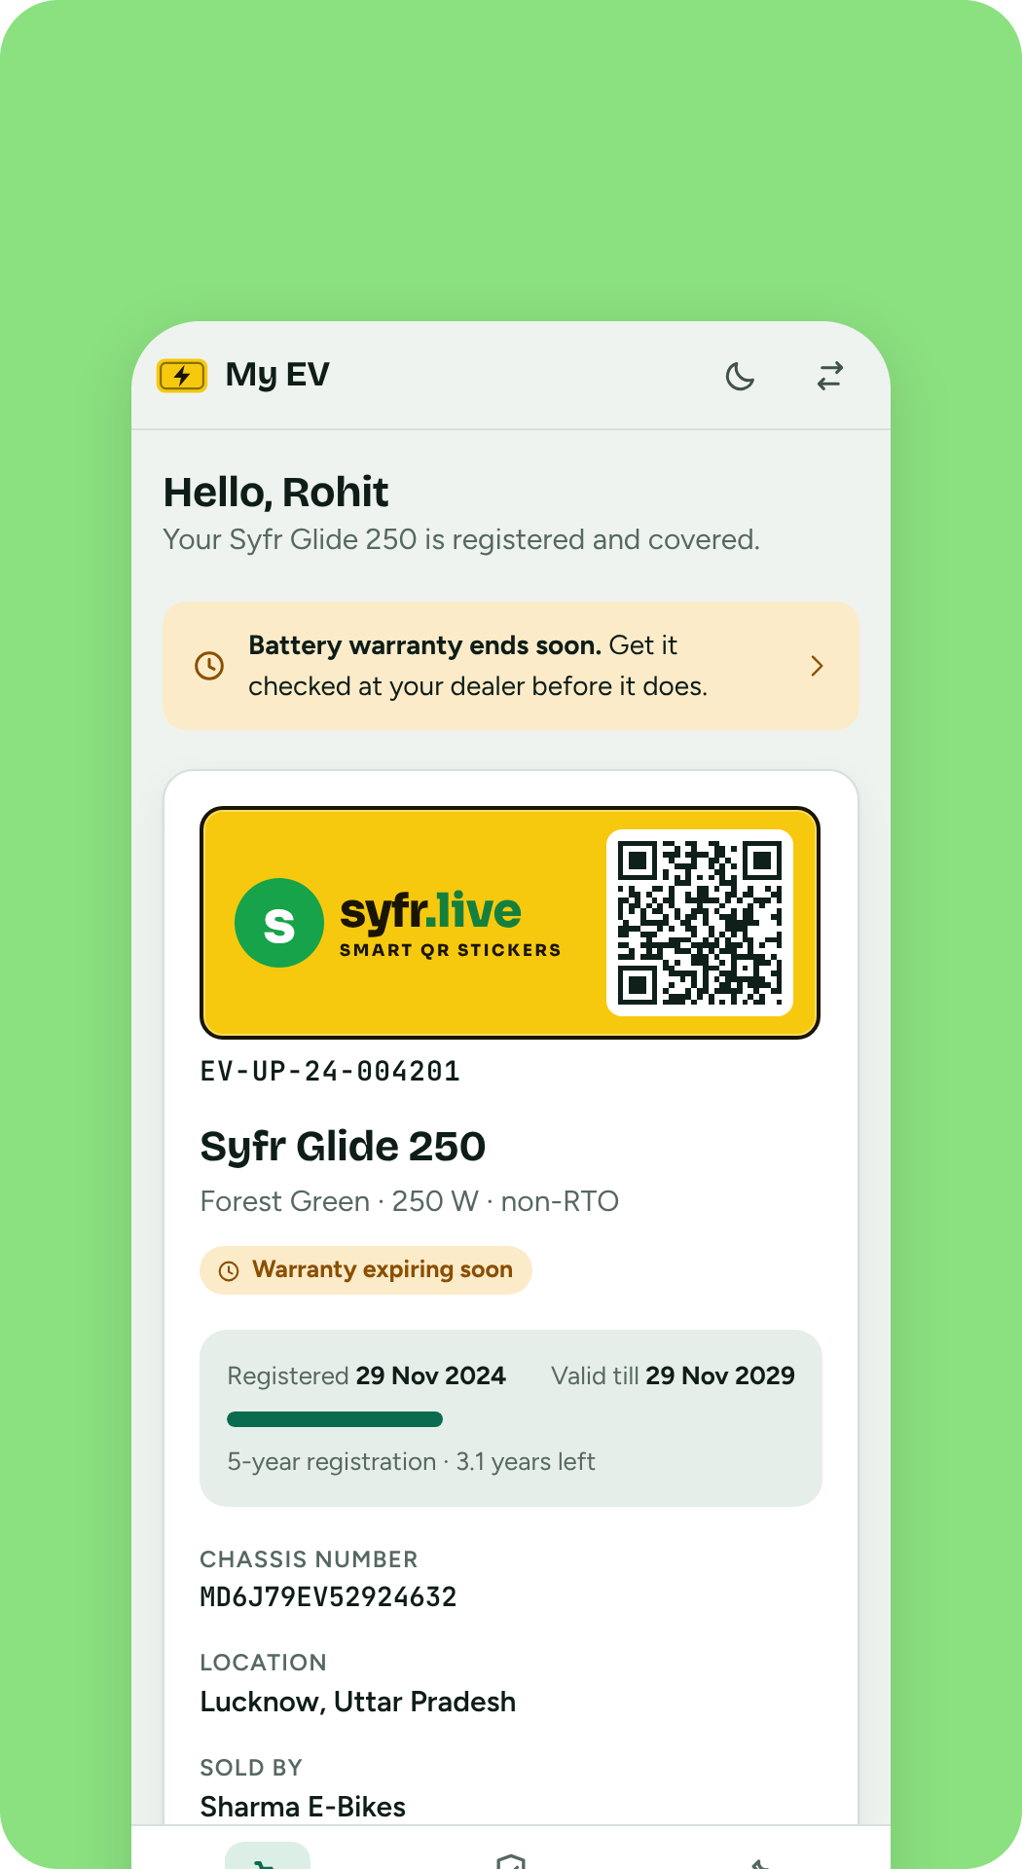
One registry for every non-RTO e-bike
syfr.live
Registration, warranty and parts history, from the factory to the dealer to the owner.
PRODUCT
DATA
Registry for small e-bikes
Sample data only
Notes:
syfr.live is a web portal that keeps the records of small, non-RTO electric bikes: who owns which bike, where it was sold, what warranty each part carries, and which parts have been replaced. Everything in this deck is shown with sample data.

Slide 2




Non-RTO e-bikes leave no record behind
THE GAP
Paper warranty
A claim depends on a bill the owner may have lost
No central record
Unseen part swaps
Nobody can say how many bikes are on the road, who owns them or where they were sold.
Dealers rely on their memory of the sale
A new motor, controller or battery is fitted and what was replaced, and when, is lost.
Nobody can check which part carries which warranty
syfr.live gives each bike a QR plate and one record that company, dealer and owner can all read.
Notes:
The gap: low-speed e-bikes do not go through the RTO, so there is no government registry to lean on. The portal fills that gap for the manufacturer and its dealer network.

Slide 3
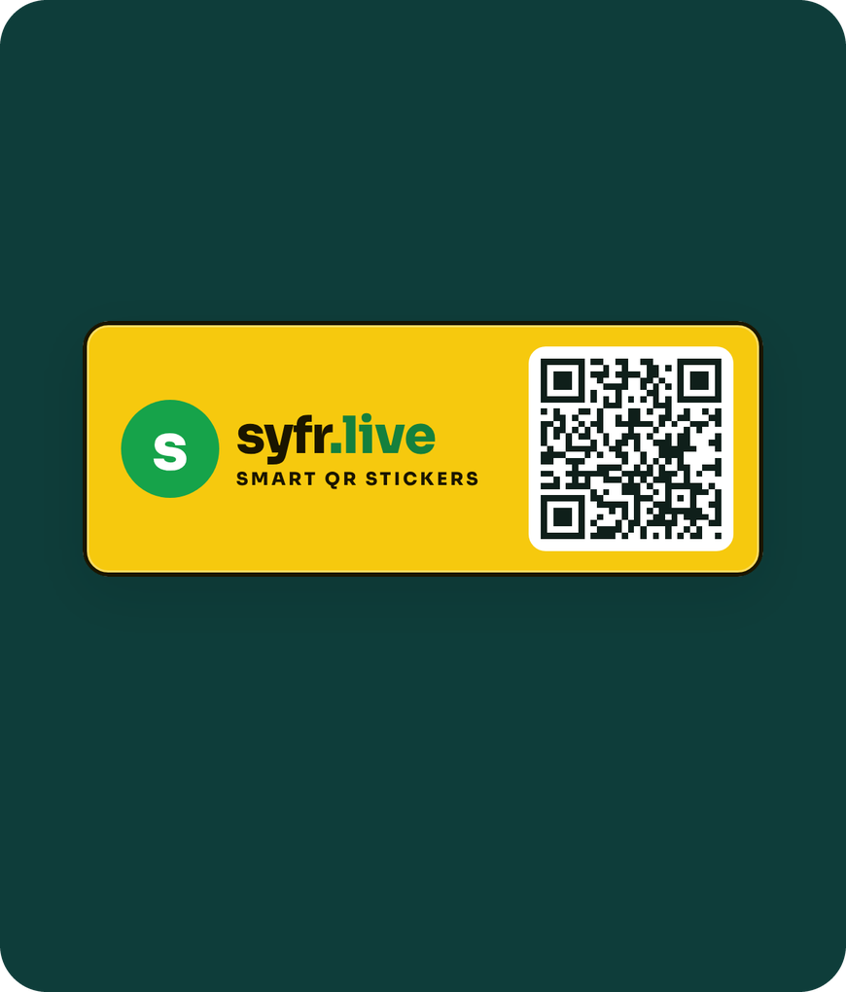
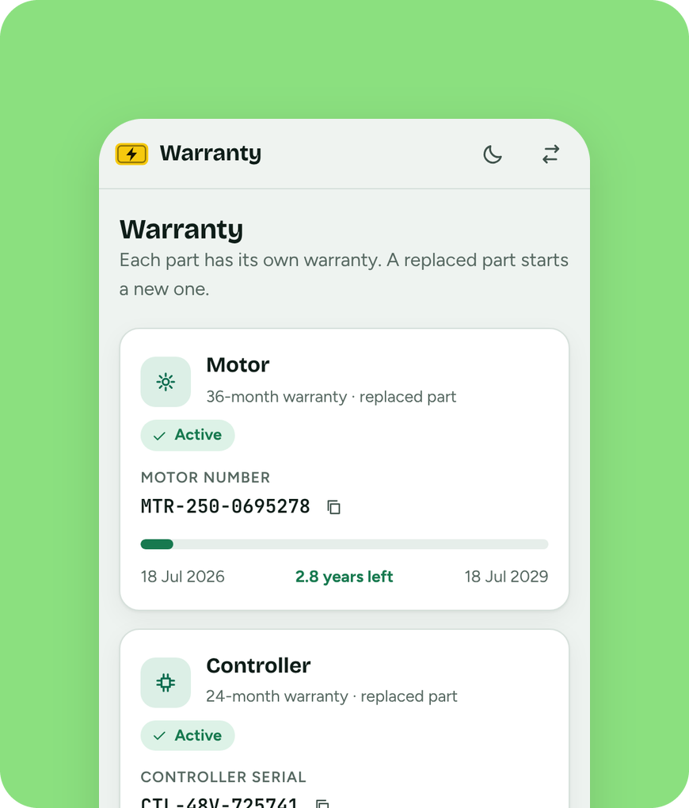

One QR plate. One record for everyone
THE SOLUTION
The dealer registers the bike before it is sold
The plate carries the company logo and a QR code
Owner, dealer and company read the same record
Scan the plate, see the whole bike
Notes:
The plate is the link between the physical bike and its record. Scanning it opens registration, warranty per part and the parts history.

Slide 4



Three users, one registry
WHO IT'S FOR
Company
Dealer
Vehicle owner
Live map, area report and every warranty on record. Desktop first.
Register before selling, scan the plate, log part swaps. Phone and tablet.
Registration period, warranty per part and parts history. On the phone.
Built for the control room, the shop counter and the owner's pocket
Notes:
Each role gets its own view of the same data.

Slide 5
Registrations by state, as they happen
COMPANY
Every state and union territory, with its districts underneath. Totals move as dealers register bikes.
Top five states in the demo
REGISTERED IN THE DEMO
1,48,000+
SAMPLE DATA
Notes:
Sample data. The five largest states in the demo registry; the full table lists every state and union territory with its districts.

Slide 6

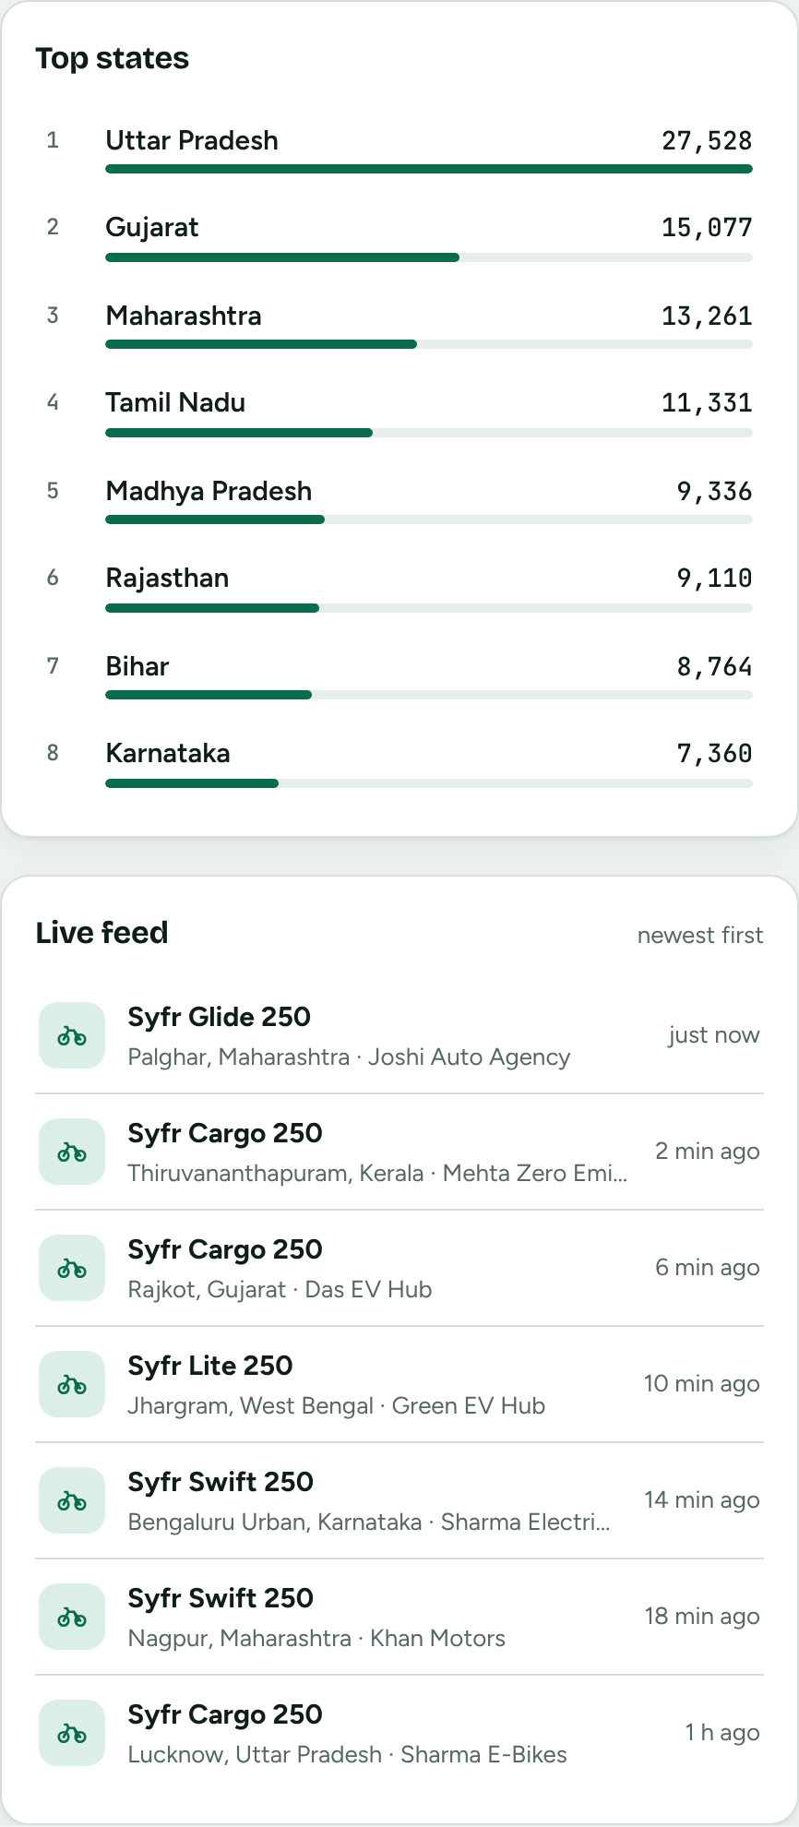
Every district on one live map
COMPANY
One circle per district. A deeper shade means more registrations. Click a state to zoom in, and watch new bikes pulse onto the map.
36
726
states and union territories
districts, one circle each
Notes:
The map uses real district boundaries. The numbers are made up. The live feed adds a registration every few seconds so the real-time behaviour is visible in a demo.

Slide 7
Warranty status across every vehicle
WARRANTY
The register lists each bike with motor, controller and battery status. Filter by active, expiring soon or expired, or search by serial number.
Active
485
Expiring soon
38
VEHICLES IN THE SAMPLE REGISTER
Expired
540
17
Notes:
Sample data: counts from the demo register. 'Expiring soon' means a part's warranty ends within 60 days.

Slide 8
Three parts, each with its own warranty
PARTS
CONTROLLER
MOTOR
BATTERY
24 months
24-36 months
18-30 months
Tracked by controller serial
Tracked by motor number
Tracked by battery serial
CTL-48V-725741
MTR-250-8695278
BAT-48V20-7257410
A replacement starts a new warranty
A replacement starts a new warranty
A replacement starts a new warranty
Terms vary by model. Shown from the demo's model list.
Notes:
Warranty months come from the demo's four models: motors carry 24 or 36 months, controllers 24, batteries 18 to 30. Serial numbers shown are examples.

Slide 9
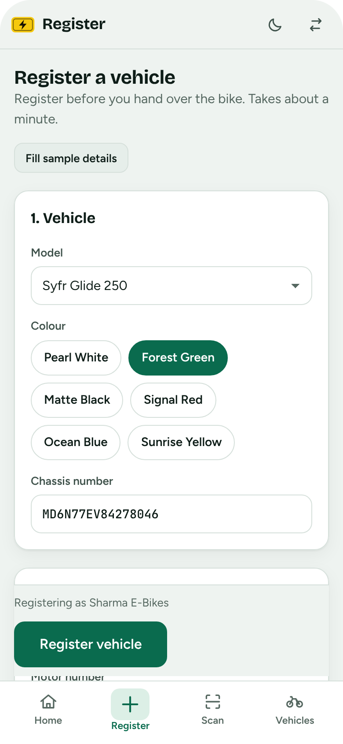

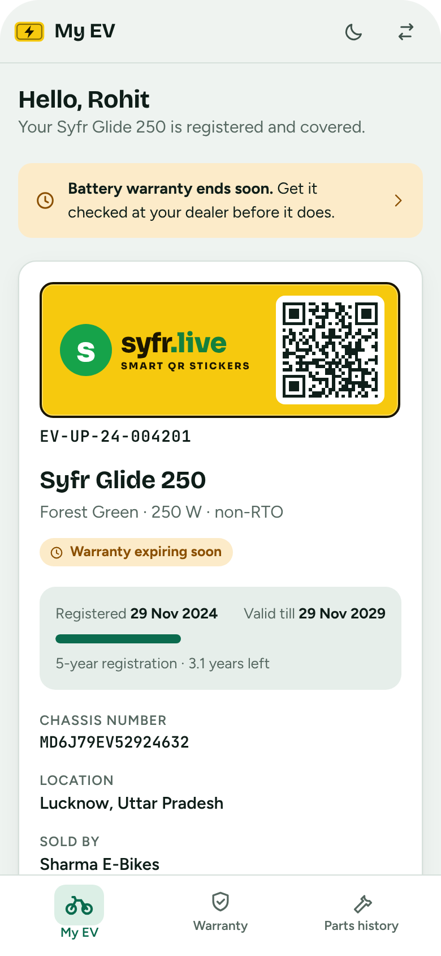

Built for the shop counter and the owner's pocket
ON THE PHONE
Dealers
Vehicle owners
Register in one form
Scan the plate QR
Registration and QR
Warranty per part
Notes:
Dealers register a bike and scan plates; owners see their registration, QR and warranty per part. The dealer app also logs part replacements.

Slide 10
From scattered paper to one registry
BEFORE AND AFTER
What changes for a small e-bike once it has a plate that opens a record.
Feature | Paper and memory | syfr.live
Central record of every bike | No | Yes
Warranty visible to the owner | No | Yes
Part replacement history | No | Yes
Live area-wise numbers | No | Yes
Plate that opens the record | No | Yes
One record that company, dealer and owner can all read.
Notes:
A qualitative comparison, not a measured one: it describes what the portal adds, not how any particular dealer works today.

Slide 11

What is built, and what comes next
ROADMAP
BUILT
BUILT
PROPOSED
PROPOSED
PROPOSED
PROPOSED
3
4
5
6
Demo UI
QR plate and scan
Backend
Sign-in
Dealer rollout
Reminders and claims
Three role views with sample data
Logo and QR on the plate, camera or photo scan
Real database and API behind the screens
Role login, with OTP for owners
Onboarding and bulk QR plate printing
SMS or WhatsApp alerts, claim workflow
Notes:
The first two steps exist in the demo. The rest are proposals, not commitments; the backend unlocks the others.

Slide 12
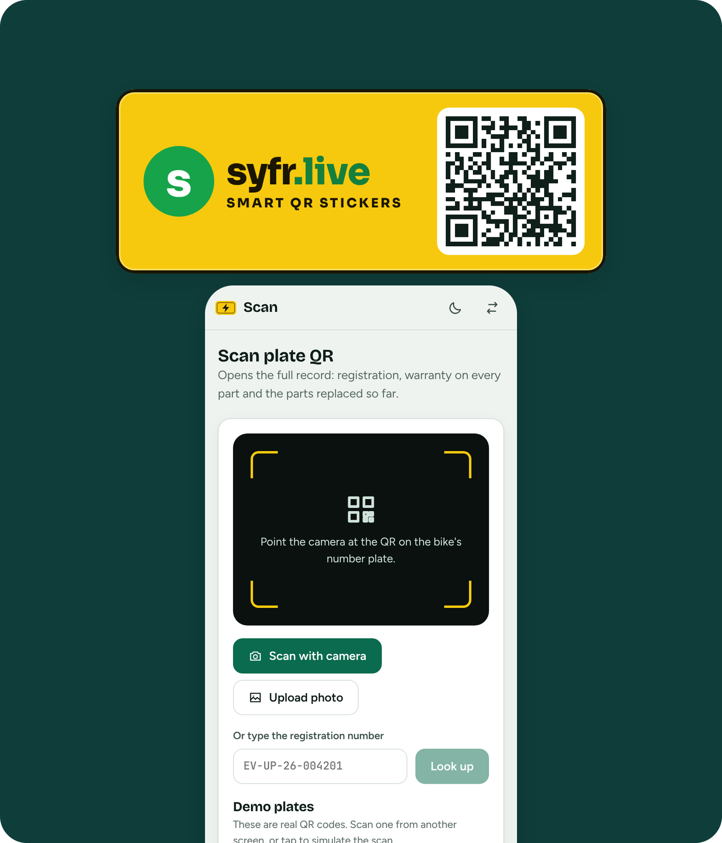



One QR plate.
One registry.
syfr.live.
TRY IT
Live demo: claude.ai/artifact/76eZmTT9gninNENMKdFitt
Code: ev-registry/ in the fans-app repo
All data shown is sample data
Notes:
The demo link is a private page; share it from its Share menu before sending it to others.

