Slide 1
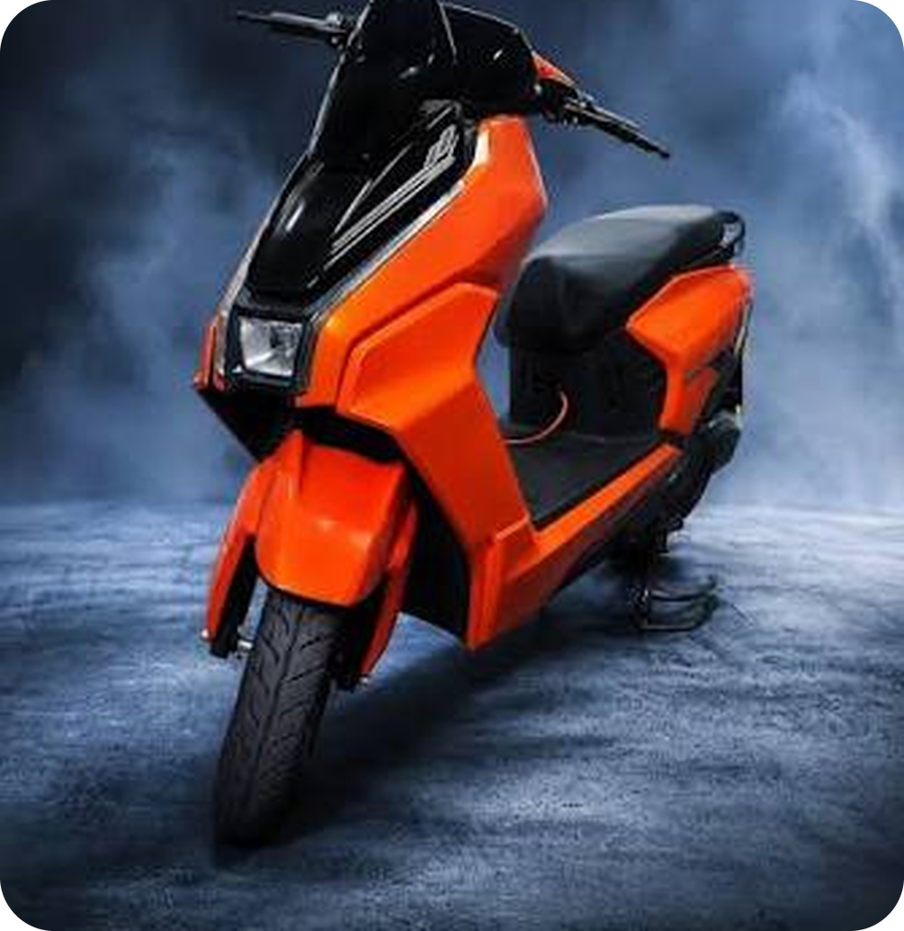

Top 5
Reasons To Buy
Photo is a stand-in. Swap in an Ereganto product shot.
Notes:
Poster-style deck: five reasons to buy an Ereganto scooter, each tied to what the registry portal gives the owner. The scooter photo is a stand-in and should be replaced with an Ereganto product shot. No specifications or prices are claimed.

Slide 2
Five reasons, at a glance
01
02
03
04
05
Registered first
QR plate
Visible warranty
Part history
Dealer-ready
Your dealer registers the scooter before the sale.
Scan it to open the whole record.
Motor, controller and battery, each with time left.
Every swap logged with old and new serial.
Any dealer can scan and see the history.
Notes:
The five reasons are about the registration and warranty record, because those are what the portal provides.

Slide 3
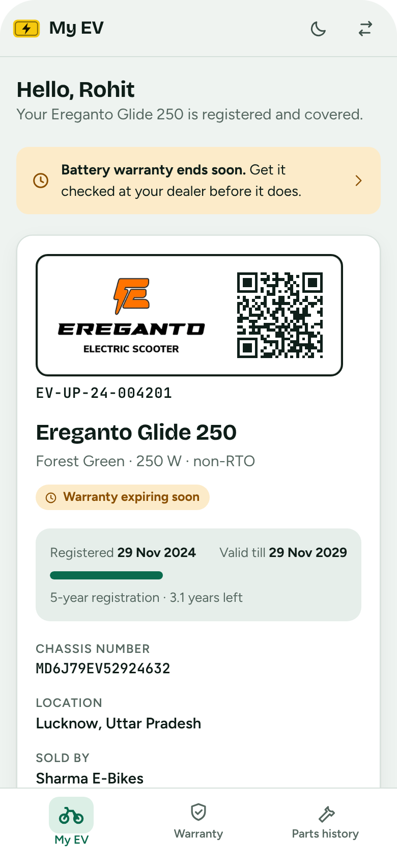

Registered before you ride away
REASON 1 OF 5
01
Your dealer registers the scooter on the portal before the sale, so its record exists from day one.
Valid for five years in the demo
Model, chassis and owner on record
Registered and valid-till dates shown
Notes:
Reason 1: Registered before you ride away. Screens use sample data.

Slide 4
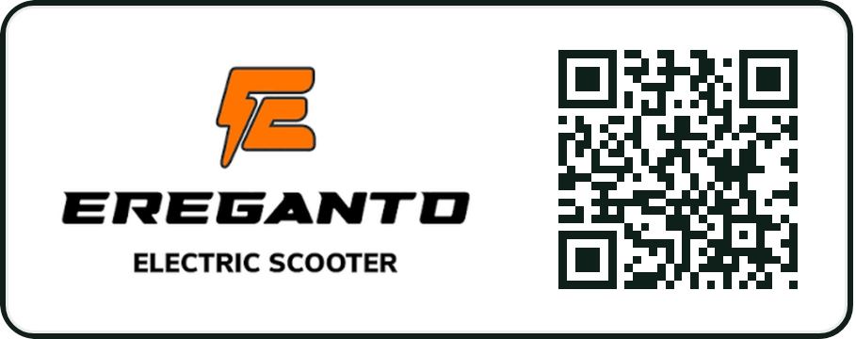
A QR plate that opens its record
REASON 2 OF 5
02
The plate carries the Ereganto logo and a QR code. Scan it to see registration, warranty and history.
EV-UP-24-004201
Logo on the left, QR on the right
Registration number printed below
Works with any phone camera
Notes:
Reason 2: A QR plate that opens its record. Screens use sample data.

Slide 5

Warranty you can see
REASON 3 OF 5
03
Motor, controller and battery each carry their own warranty, with the time left shown on your phone.
Active, expiring soon or expired
A warning before a warranty ends
Motor number and serials listed
Notes:
Reason 3: Warranty you can see. Screens use sample data.

Slide 6
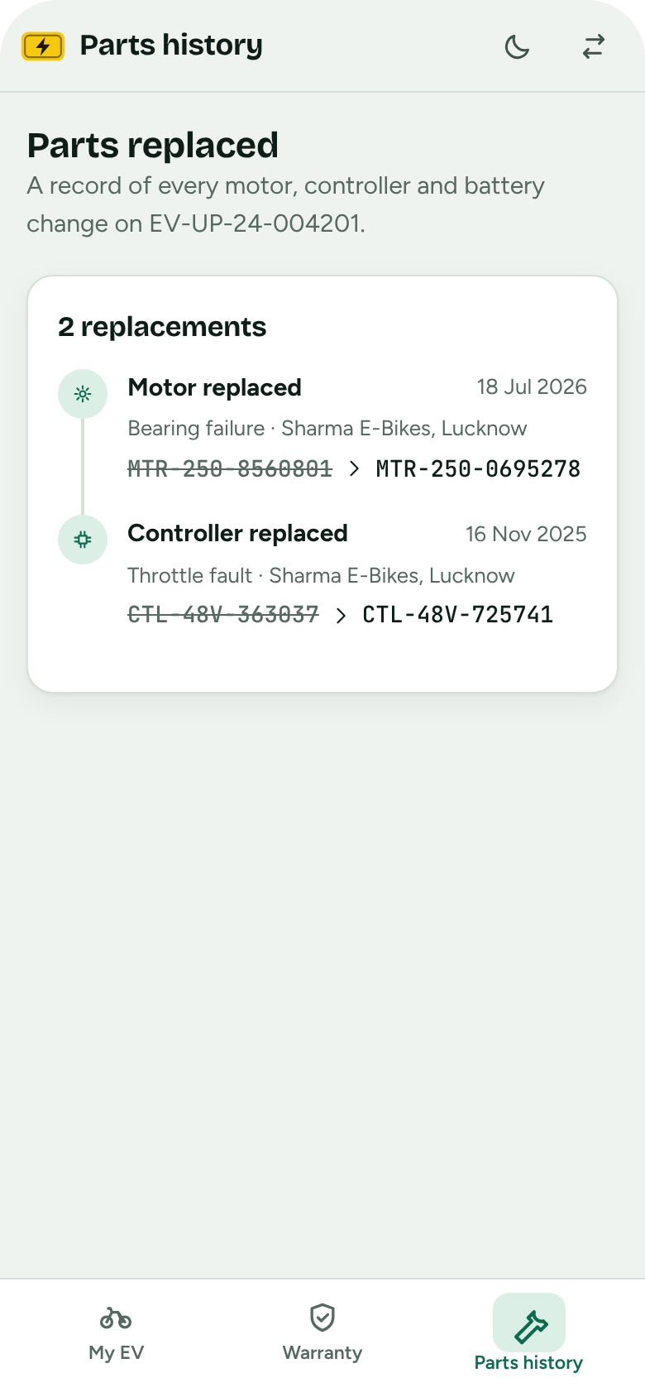
Every part swap on record
REASON 4 OF 5
04
Each replaced motor, controller or battery is logged with its old and new serial number.
Old and new serial side by side
The reason for each replacement
A new part starts a new warranty
Notes:
Reason 4: Every part swap on record. Screens use sample data.

Slide 7

Any dealer can pick up where you left off
REASON 5 OF 5
05
Dealers scan the plate and see the whole history before they touch the scooter.
Scan with the camera or a photo
Warranty and parts on one screen
Log a replacement on the spot
Notes:
Reason 5: Any dealer can pick up where you left off. Screens use sample data.

Slide 8
Registered.
Covered.
On record.
See the live demo
All screens use sample data
Notes:
The demo link is a private page; share it from its Share menu before sending it to others.

