Slide 1
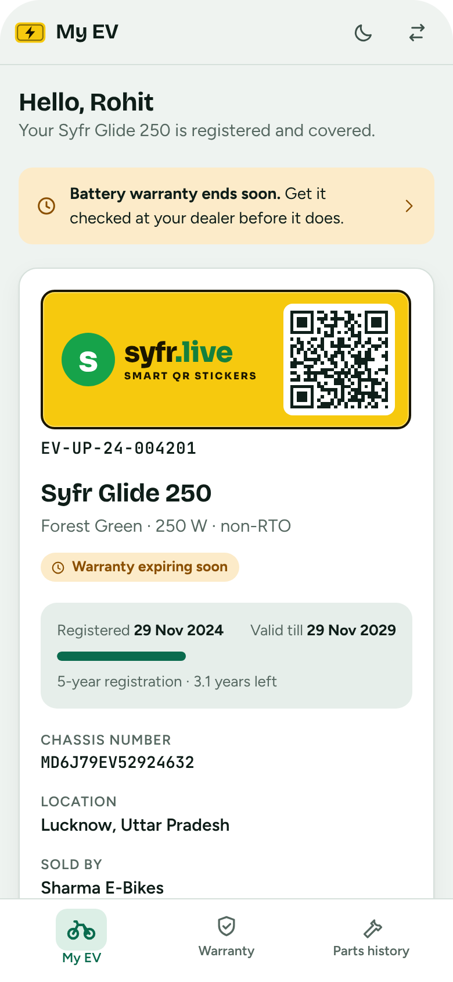
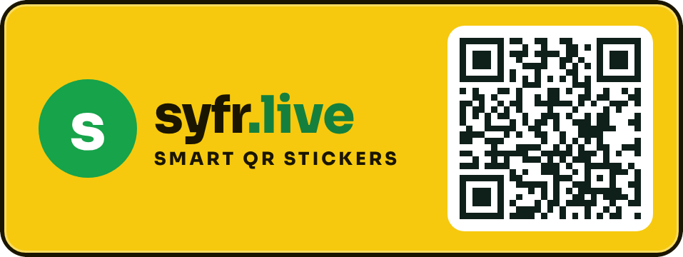
EV Pehchaan
SYFR.LIVE | DEMO WITH SAMPLE DATA
One registry for every non-RTO e-bike: registration, warranty and parts history.
Notes:
EV Pehchaan is a web portal that keeps the records of small, non-RTO electric bikes: who owns which bike, where it was sold, what warranty each part carries, and which parts have been replaced. Everything in this deck is shown with sample data.

Slide 2

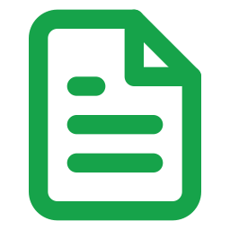

Non-RTO e-bikes leave no record behind
THE GAP
No central record
Paper warranty
Unseen part swaps
Nobody can say how many bikes are on the road, who owns them or which district they were sold in.
A claim depends on a bill and a card the owner may have lost, and on a dealer's memory of the sale.
A new motor, controller or battery is fitted and the history of what was replaced, when, is gone.
EV Pehchaan gives each bike a registration number, a QR plate and one record that company, dealer and owner can all read.
Notes:
The gap: low-speed e-bikes do not go through the RTO, so there is no government registry to lean on. The portal fills that gap for the manufacturer and its dealer network.

Slide 3



Three users, one registry
WHO IT'S FOR
Company
Dealer
Owner
Desktop first
Built for phone and tablet
Built for the phone
Live registrations on an India map, district by district
Area-wise report that updates in real time
Warranty registration details for every vehicle
Register each bike on the portal before selling it
Scan the QR on the number plate
Check warranty and the history of parts replaced
Registration date and validity period
Warranty on motor, controller and battery
Every part that was changed, with serial numbers
Notes:
Each role gets its own view of the same data. Company is optimised for a large screen; dealer and owner are optimised for phones and tablets.

Slide 4
From the showroom to the owner's phone
HOW IT WORKS
1
2
3
4
5
Dealer registers
QR goes on the plate
Owner sees the record
Parts get replaced
Company sees it live
Model, chassis, motor number, controller and battery serials, owner and district.
The plate carries the company logo and a QR code that opens the bike's record.
Registration period, warranty per part and the dealer's contact, on any phone.
The dealer scans the plate and logs the swap. A new part starts a new warranty.
The district circle on the India map darkens and the area report moves.
Notes:
The order matters: a bike is registered before it is sold, so warranty starts on day one and the owner never has to claim it.

Slide 5

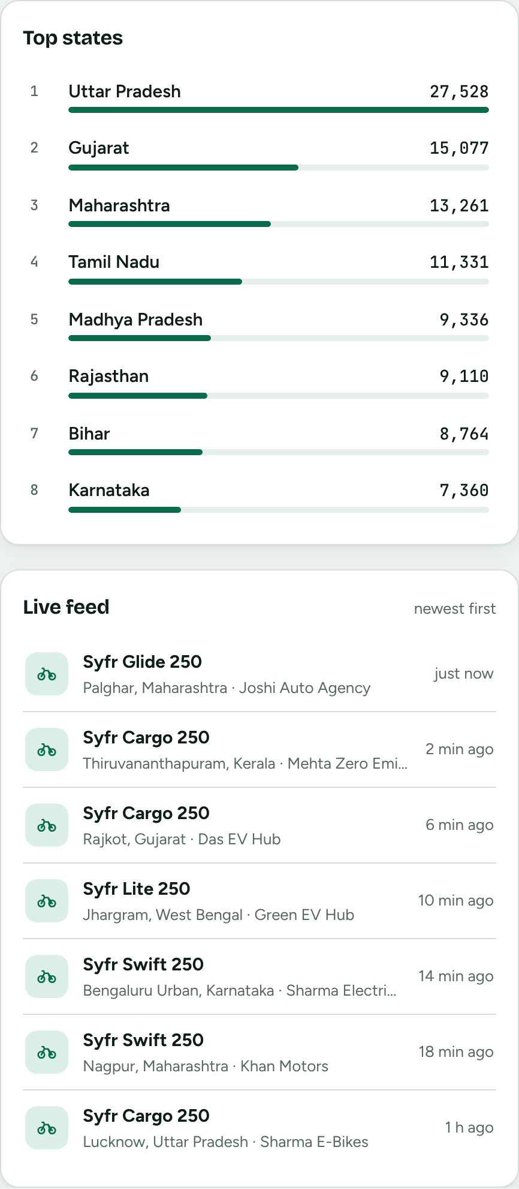
Every district on one live map
COMPANY
Circles by district
A deeper shade means more registrations. Switch between all-time and today.
Zoom into a state
Click a state to see its districts and a ranked list of the busiest ones.
Moves as bikes sell
New registrations pulse on the map and appear in the live feed.
Notes:
The map uses real district boundaries. The numbers are made up. The live feed adds a registration every few seconds so the real-time behaviour is visible in a demo.

Slide 6
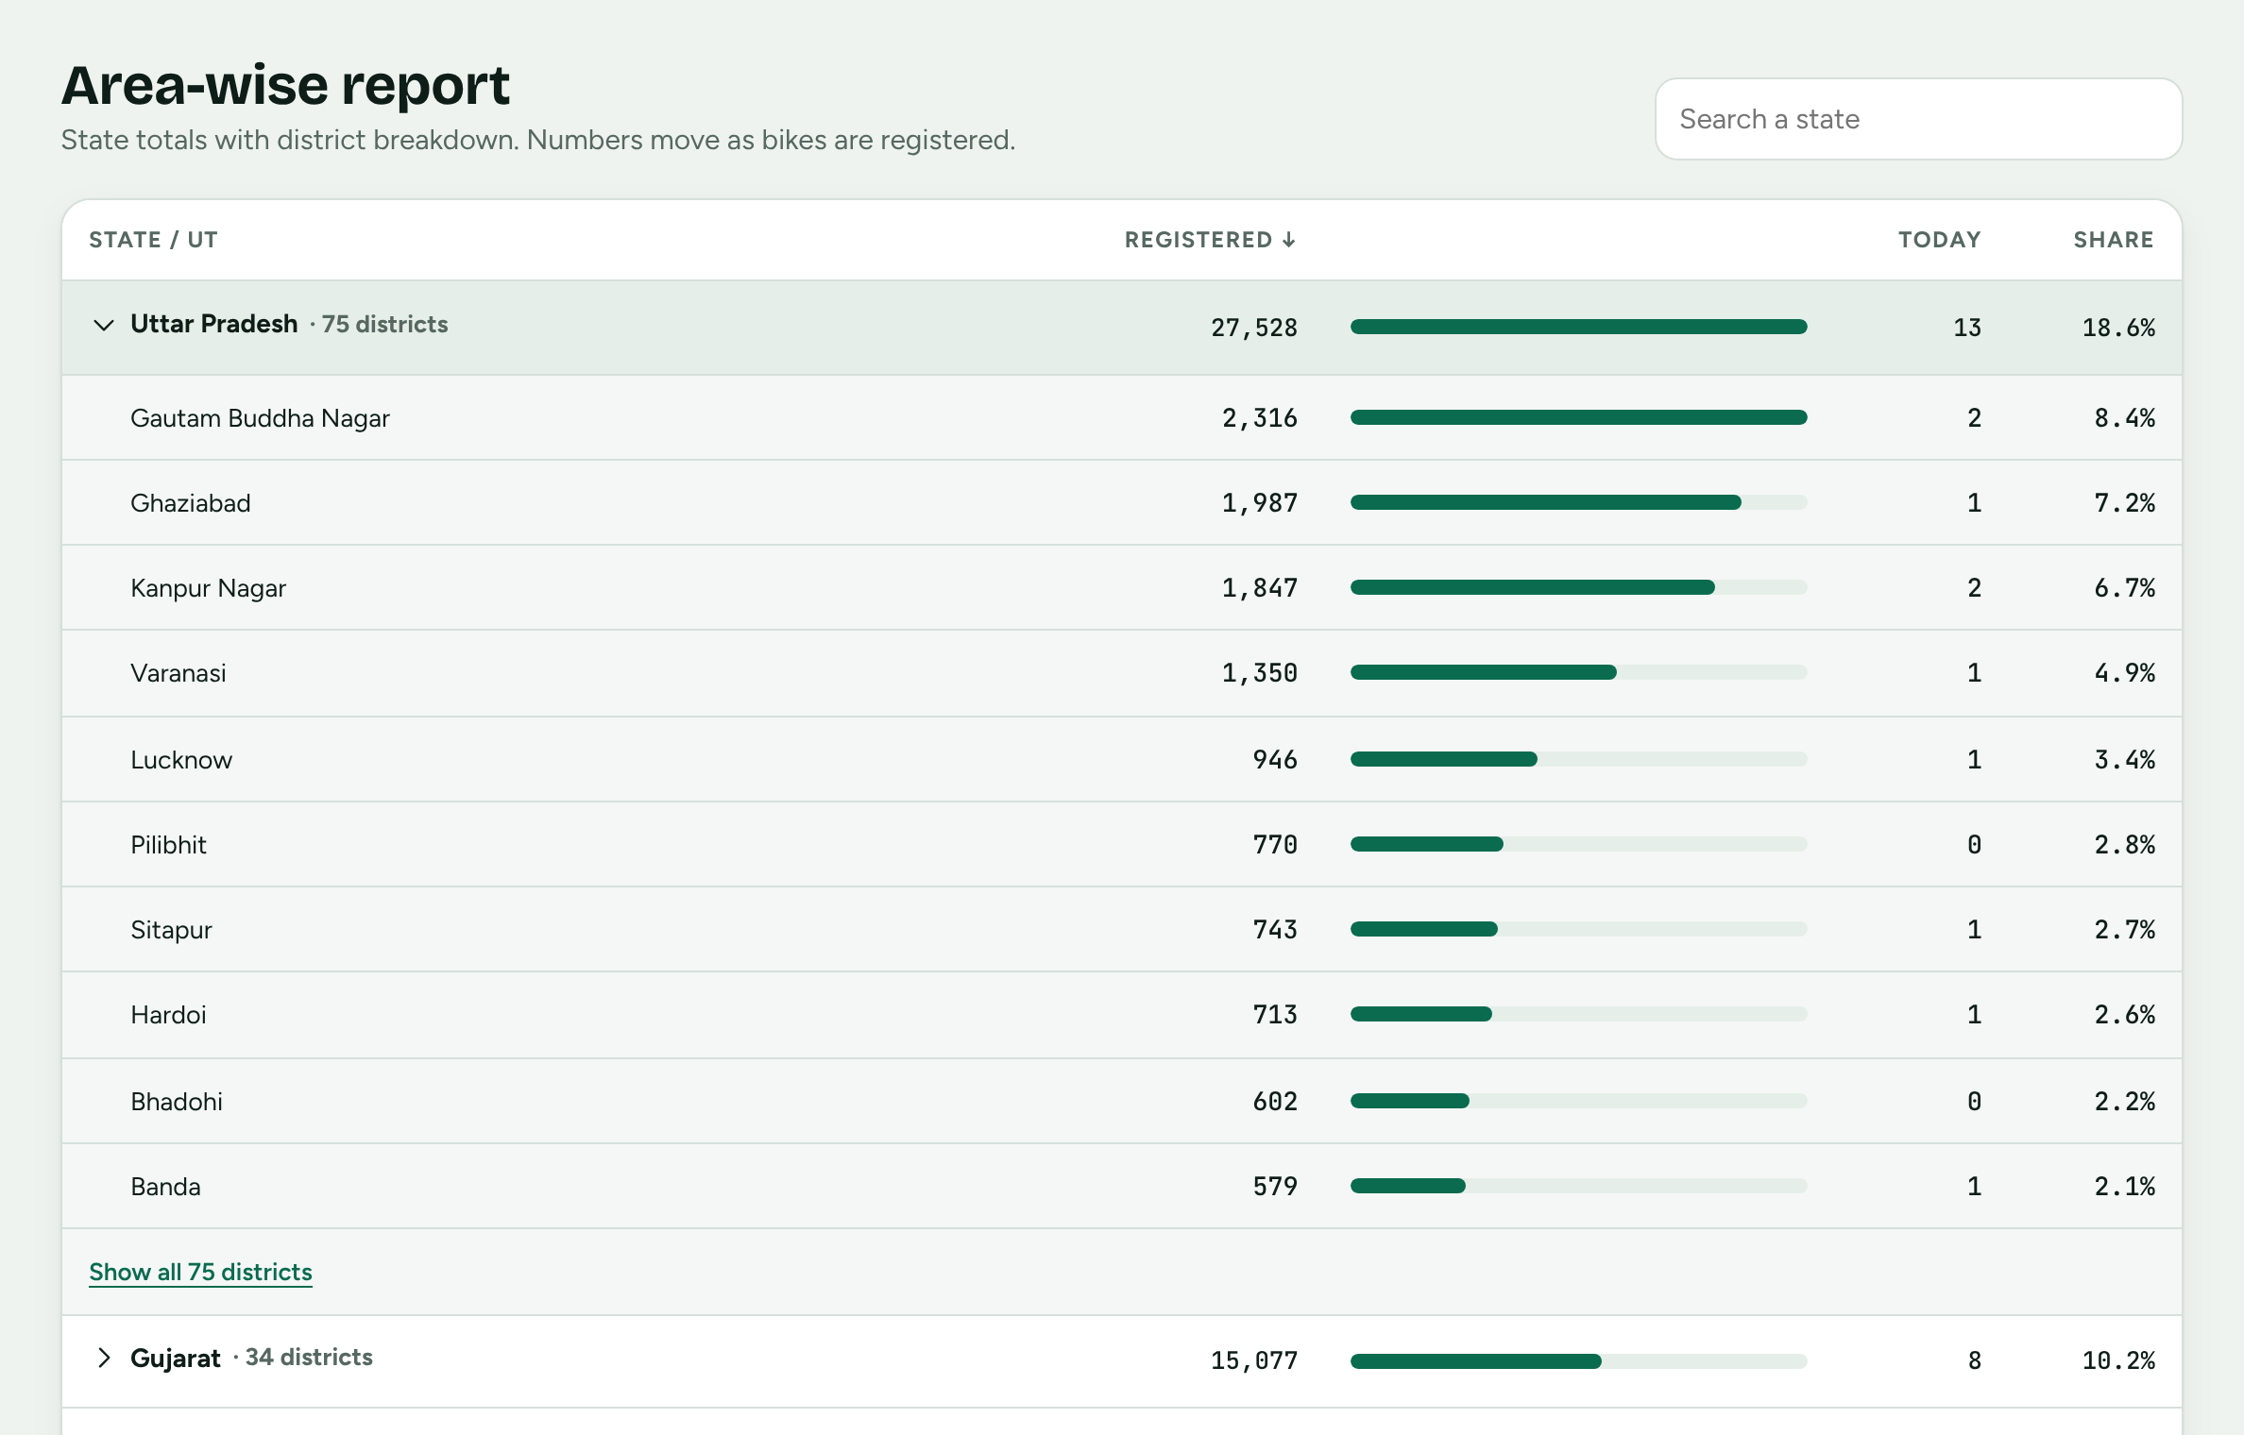
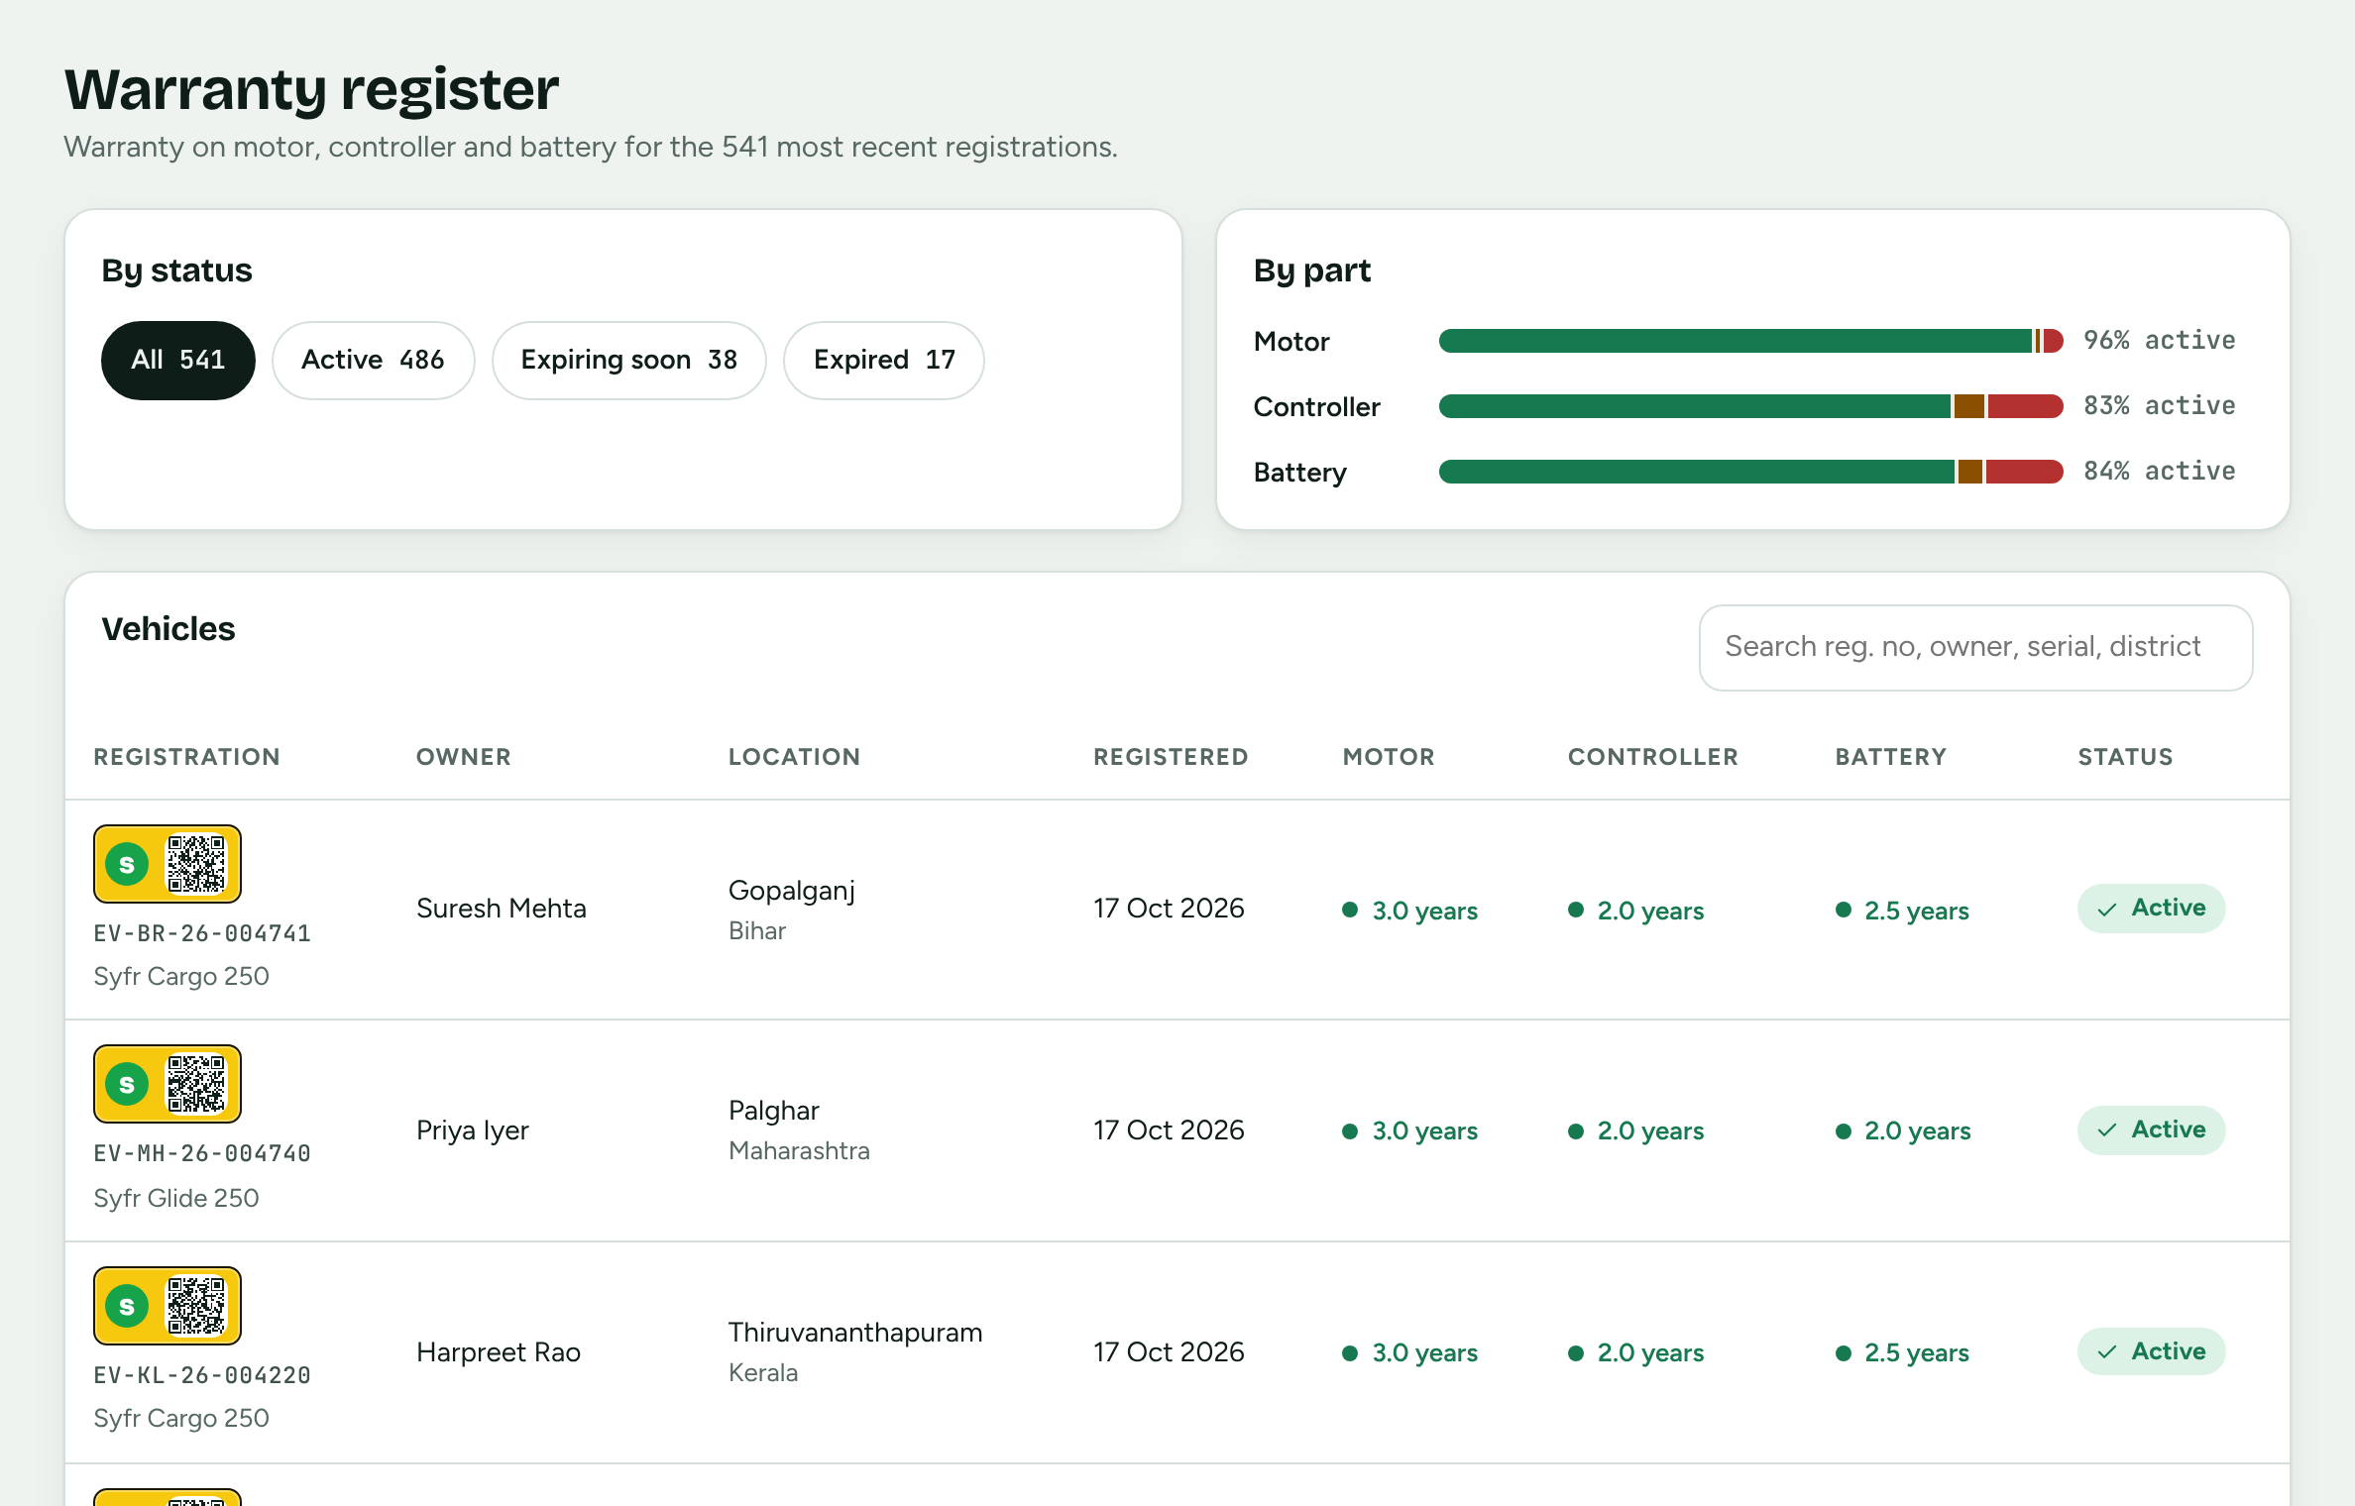
Area report and warranty register
COMPANY
Area-wise report
Warranty register
Every state and UT, with its districts underneath
Sort by registered, today or name
Motor, controller and battery warranty per vehicle
Filter by status; search by serial number
Notes:
The warranty register lists the most recent registrations. Each vehicle row opens the full record.

Slide 7
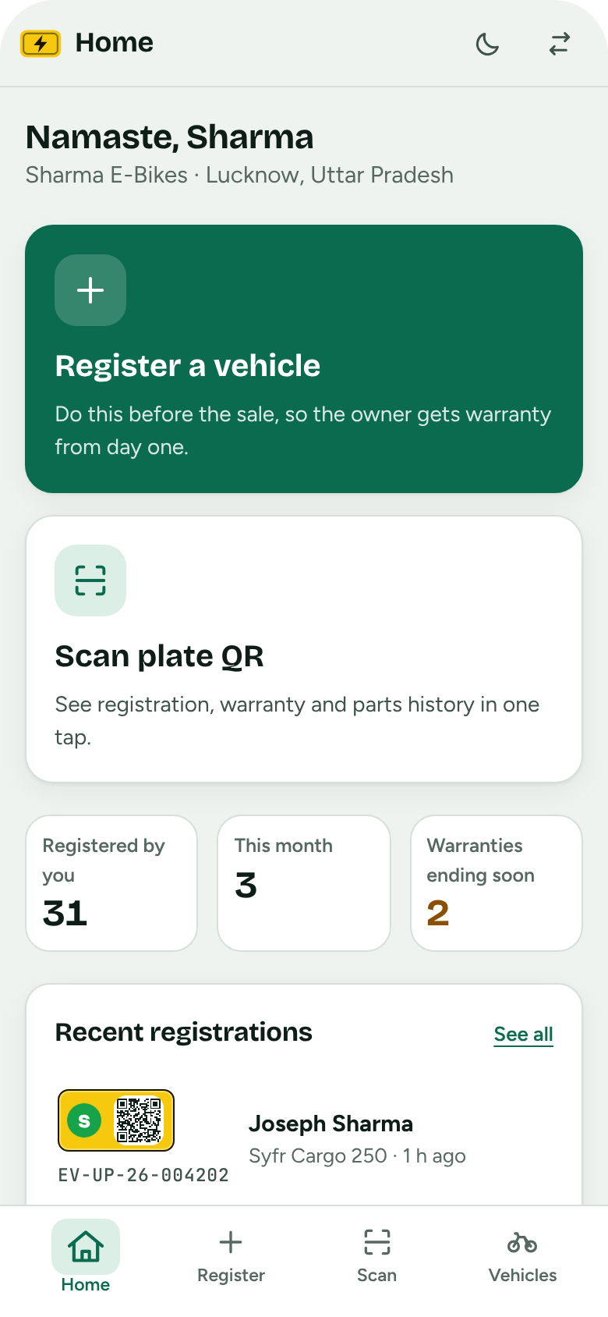
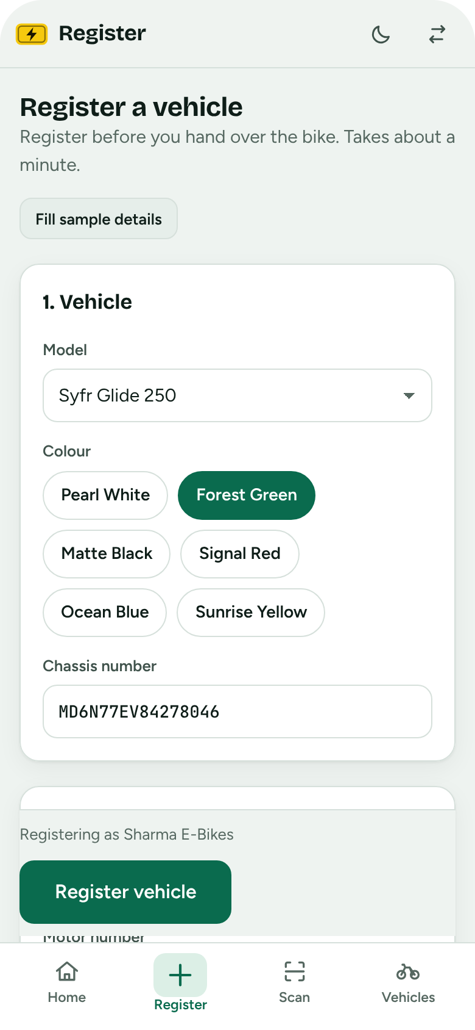

Register, scan and service from a phone
DEALER
Register before selling
One short form: model, chassis, motor number, controller and battery serials, owner.
Scan the plate QR
Camera, a photo of the plate or the typed number opens the full record.
Log part replacements
Pick the part, enter the new serial and a reason. The warranty restarts.
Notes:
Screens, left to right: dealer home, the registration form, and the plate scanner. The scanner works on any phone browser that allows the camera, and falls back to a photo upload or a typed registration number.

Slide 8

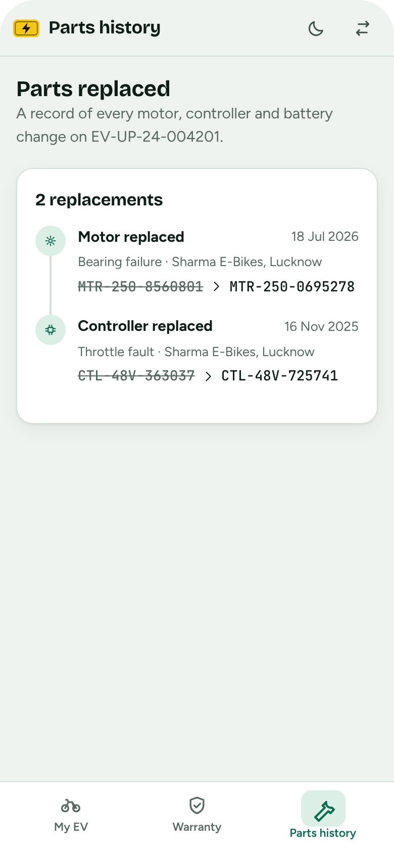



The bike's whole record in their pocket
VEHICLE OWNER
Three parts, tracked by serial number
Motor
Warranty tracked by motor number
Controller
Warranty tracked by controller serial
Battery
Warranty tracked by battery serial
5-year registration validity
Warning before a warranty ends
Old and new serial for each swap
Notes:
Screens, left to right: registration with the plate and QR code, warranty per part, and the parts-replaced timeline. A replaced part starts its own new warranty.

Slide 9
What the demo does, and what comes next
WHAT'S NEXT
In the demo today
Proposed next steps
Company, dealer and owner views with sample data
Live district map, area report, warranty register
Vehicle registration, plate QR and scanning
Part replacement with fresh warranty
Runs in any browser; no backend to set up
Real database and API behind the screens
Sign-in for each role, with OTP for owners
Warranty-ending reminders by SMS or WhatsApp
Dealer onboarding and bulk QR plate printing
Warranty claim workflow and report exports
Notes:
The next steps are proposals, not commitments. The first one unlocks the rest: the demo generates its data in the browser.

Slide 10
See it running
Pick a role on the first screen: Company, Dealer or Vehicle owner. Try registering a bike, then open it from the owner view.
Open the live demo
Code: ev-registry/ in the fans-app repo, branch claude/dreamy-allen-lo4if2
syfr.live | All data shown is sample data.
Notes:
The demo link is a private page; share it from its Share menu before sending it to others.

