Slide 1

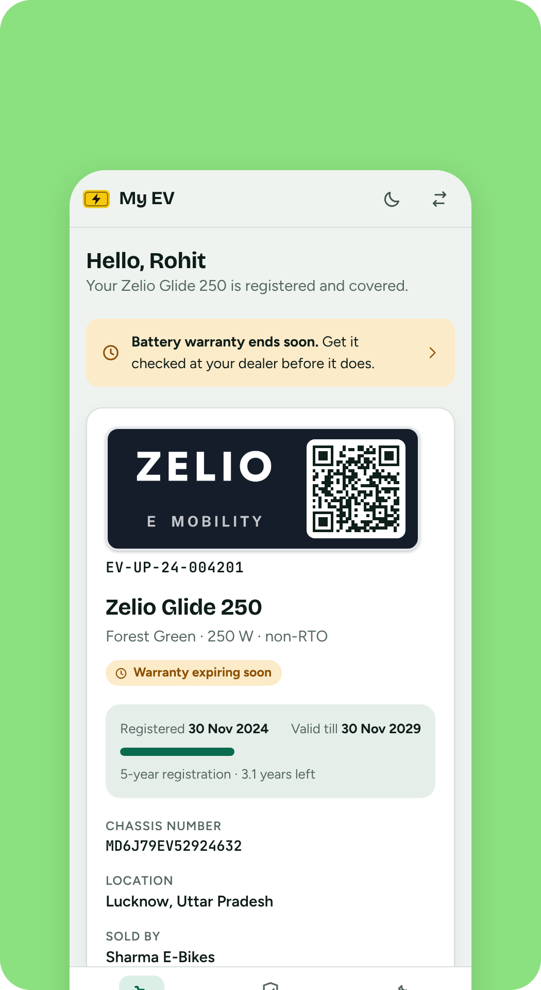
One registry for every non-RTO e-bike
Registration, warranty and parts history, from the factory to the dealer to the owner.
COMPANY
PRODUCT
DATA
Zelio
Vehicle registry portal
Sample data only
Notes:
Zelio vehicle registry portal. The Zelio wordmark used here is a placeholder drawn for the demo, not the official logo. Everything is shown with sample data.

Slide 2

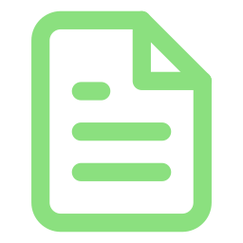


Non-RTO e-bikes leave no record behind
THE GAP
Paper warranty
A claim depends on a bill the owner may have lost
No central record
Unseen part swaps
Nobody can say how many bikes are on the road, who owns them or where they were sold.
Dealers rely on their memory of the sale
A new motor, controller or battery is fitted and what was replaced, and when, is lost.
Nobody can check which part carries which warranty
The Zelio portal gives each bike a QR plate and one record that company, dealer and owner can all read.
Notes:
Low-speed e-bikes do not go through the RTO, so there is no government registry to lean on. The portal fills that gap for the manufacturer and its dealer network.

Slide 3
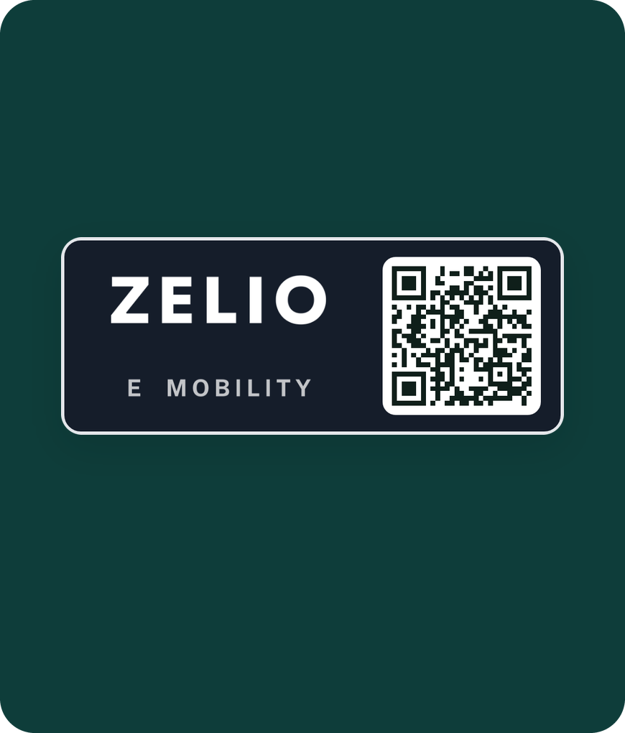
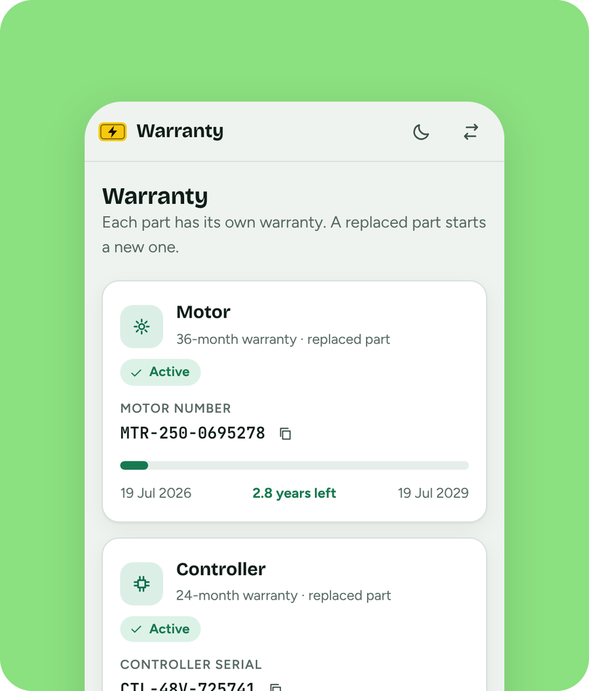

One QR plate. One record for everyone
THE SOLUTION
The dealer registers the bike before it is sold
The plate carries the Zelio logo and a QR code
Owner, dealer and company read the same record
Scan the plate, see the whole bike
Notes:
The plate links the physical bike to its record. Scanning it opens registration, warranty per part and the parts history.

Slide 4



Three users, one registry
WHO IT'S FOR
Company
Dealer
Vehicle owner
Live map, area report and every warranty on record. Desktop first.
Register before selling, scan the plate, log part swaps. Phone and tablet.
Registration period, warranty per part and parts history. On the phone.
Built for the control room, the shop counter and the owner's pocket

Slide 5
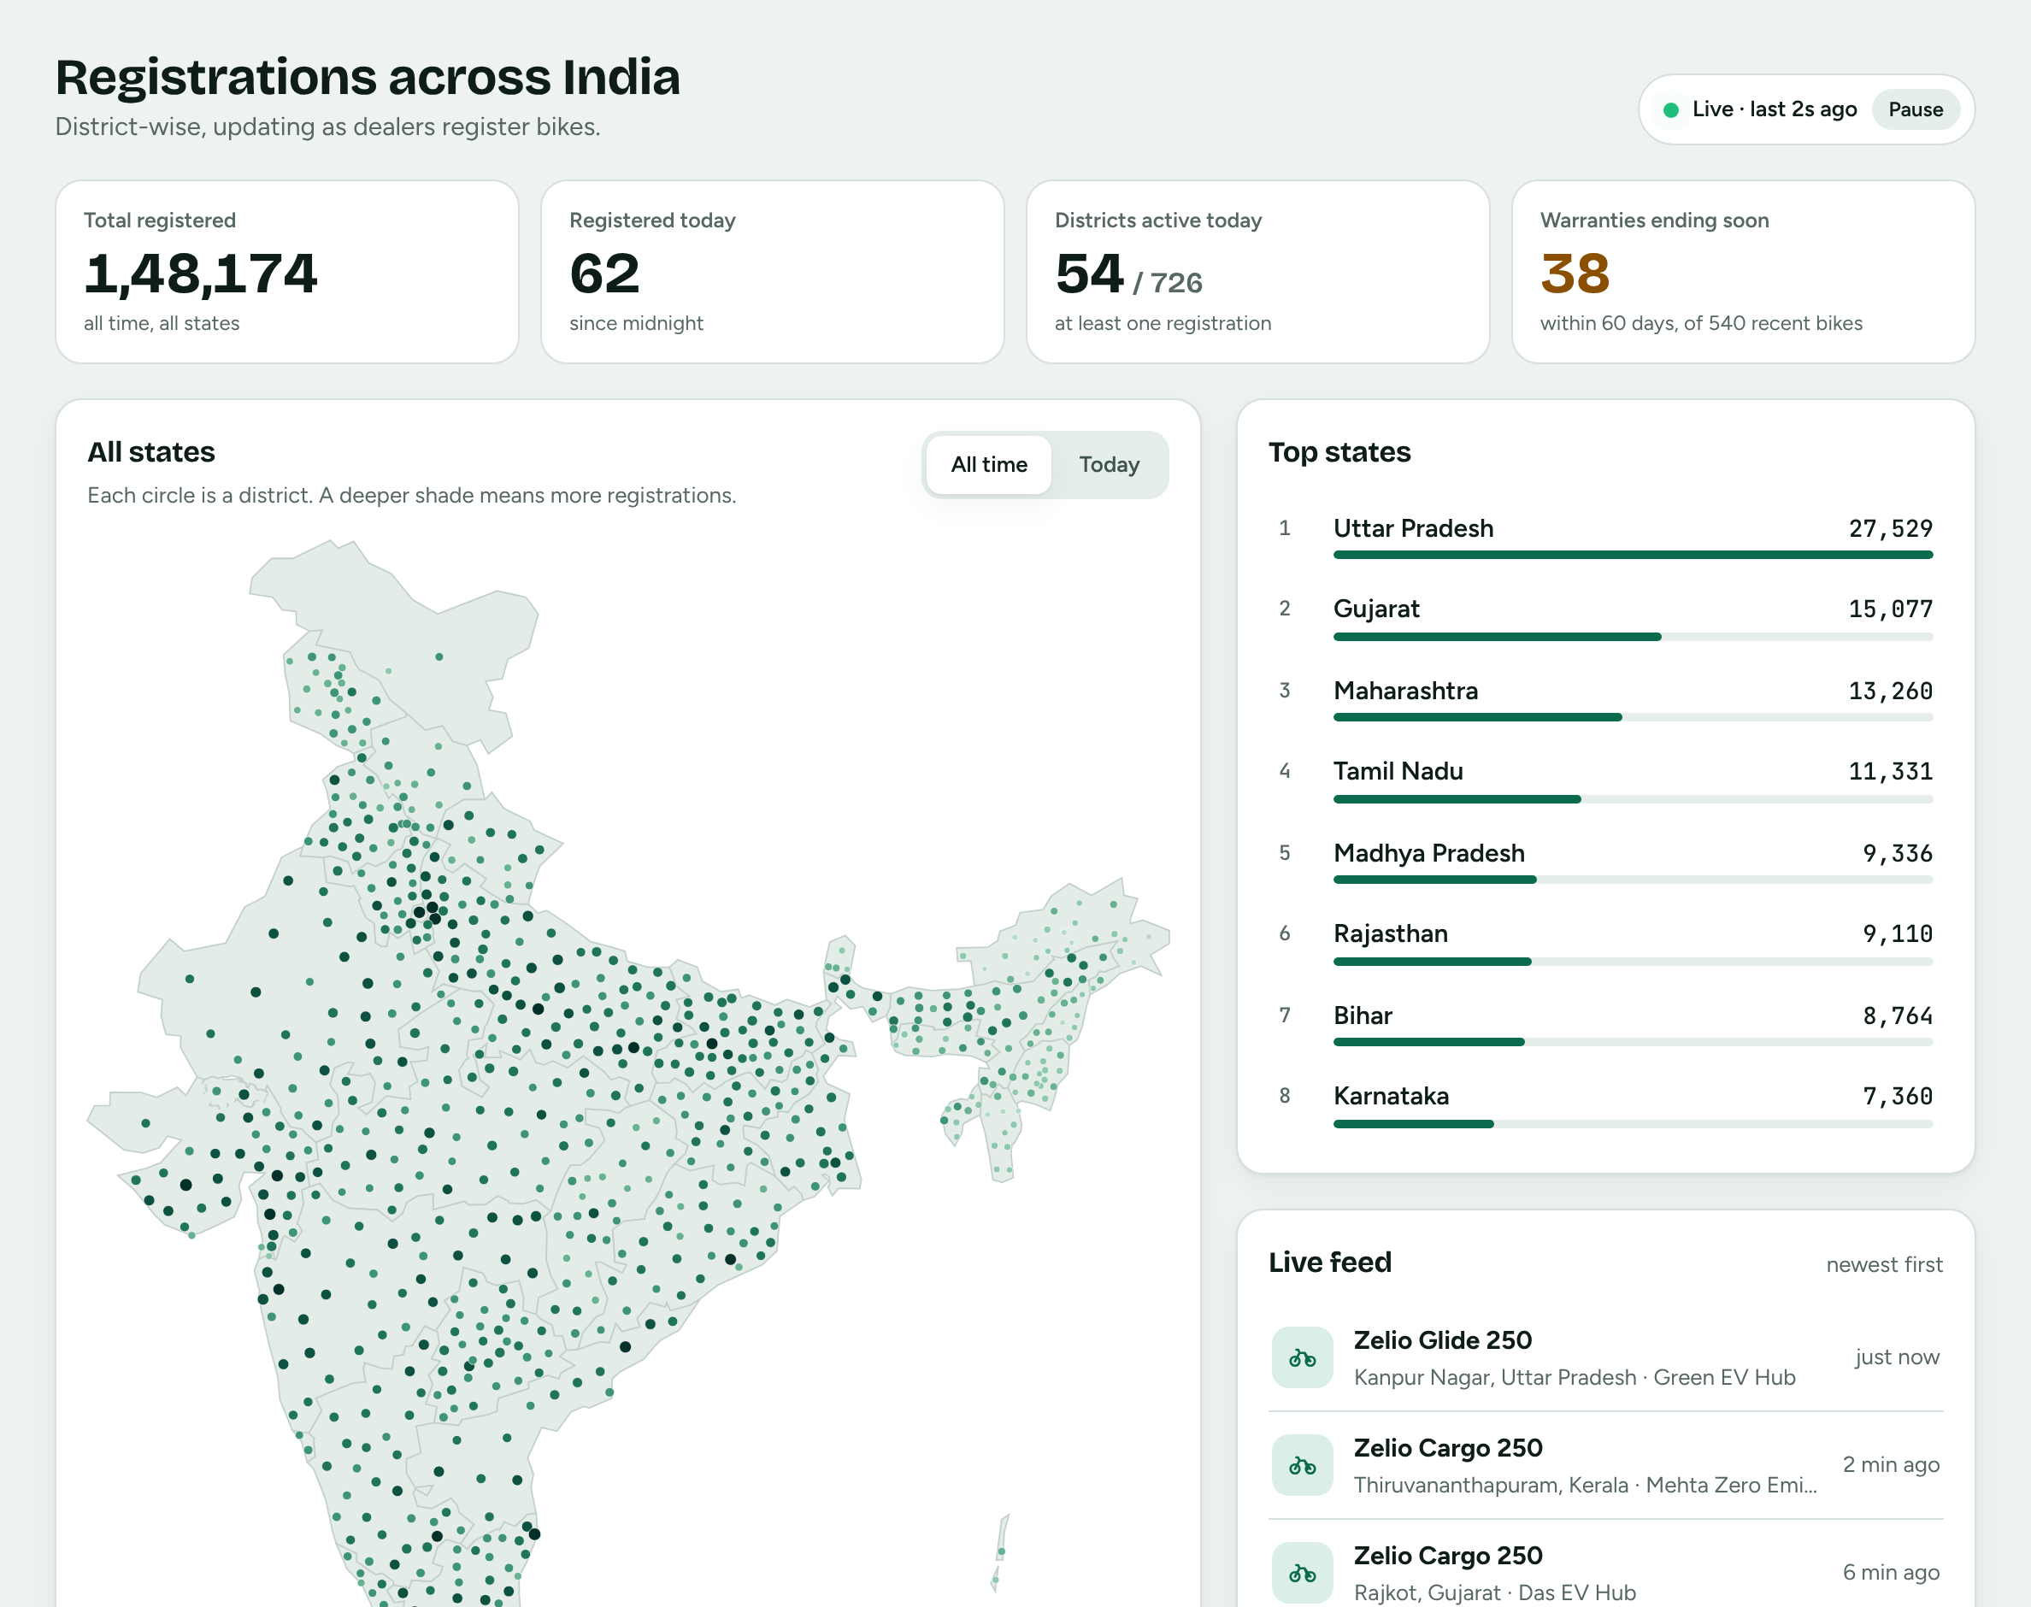
The whole network at a glance
COMPANY PORTAL
1,48,174
bikes on the registry
All time, across every state and union territory.
52%
sit in just five states
Uttar Pradesh, Gujarat, Maharashtra, Tamil Nadu and Madhya Pradesh.
38
warranties end within 60 days
Of the 540 most recent registrations.
Notes:
Sample data. 52% = the five largest states (76,533) over the 1,48,174 total. The 38 comes from the 540 most recent registrations in the warranty register.

Slide 6
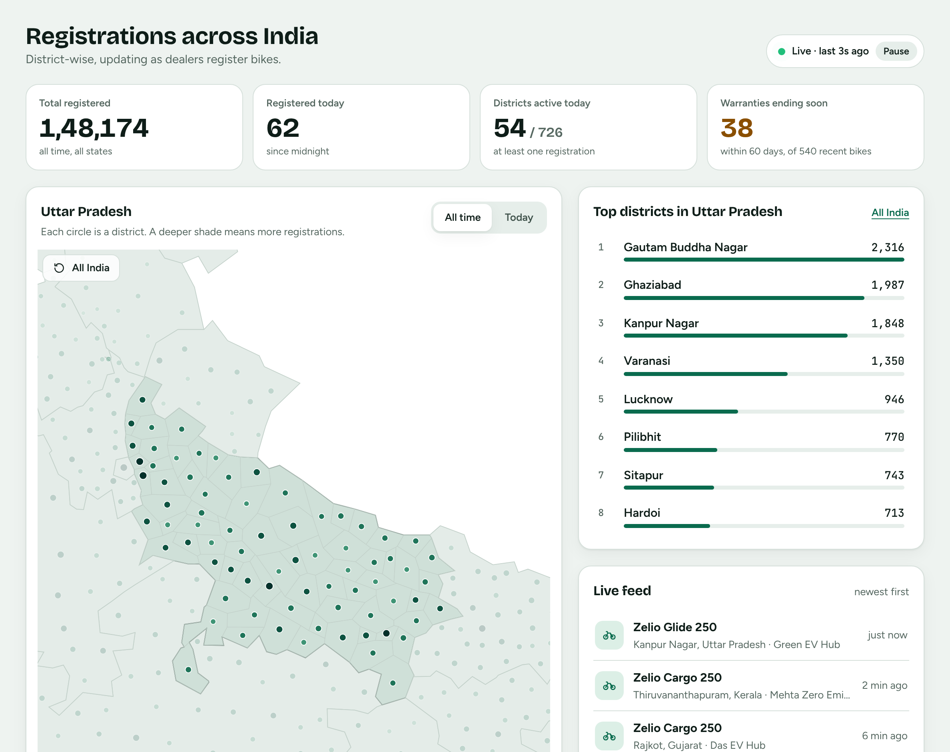
Click a state, see its districts
COMPANY PORTAL
27,529
registered in Uttar Pradesh
The largest state, ahead of Gujarat on 15,077.
2,316
in Gautam Buddha Nagar
The busiest district, then Ghaziabad (1,987) and Kanpur Nagar (1,848).
1 click
to zoom and re-rank
The side list switches from states to the busiest districts.
Notes:
Sample data. Districts use real boundaries; the counts are made up.

Slide 7

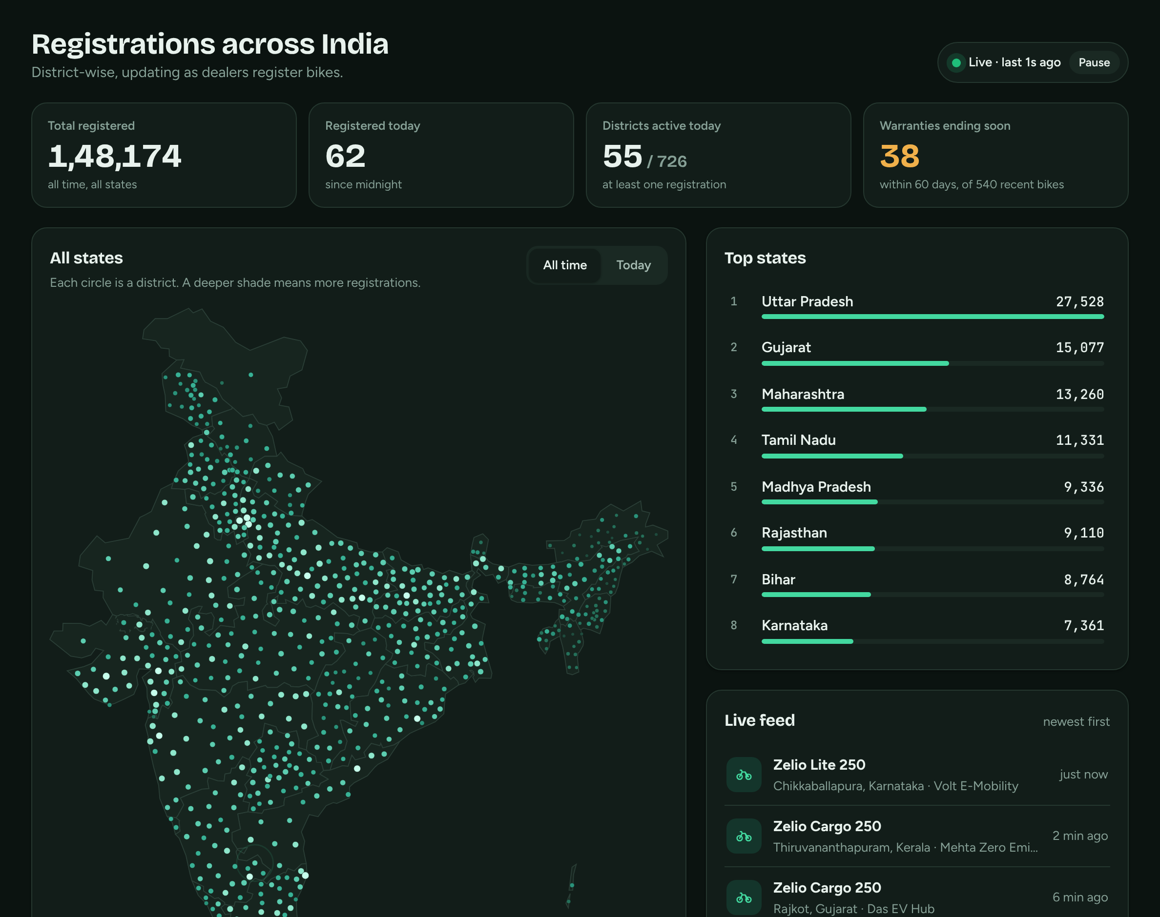
Today's sales, in light or dark
COMPANY PORTAL
Today view
Dark theme
Switch the map to today's registrations to see where bikes are selling right now.
Stronger colour means more registrations in both themes.

Slide 8
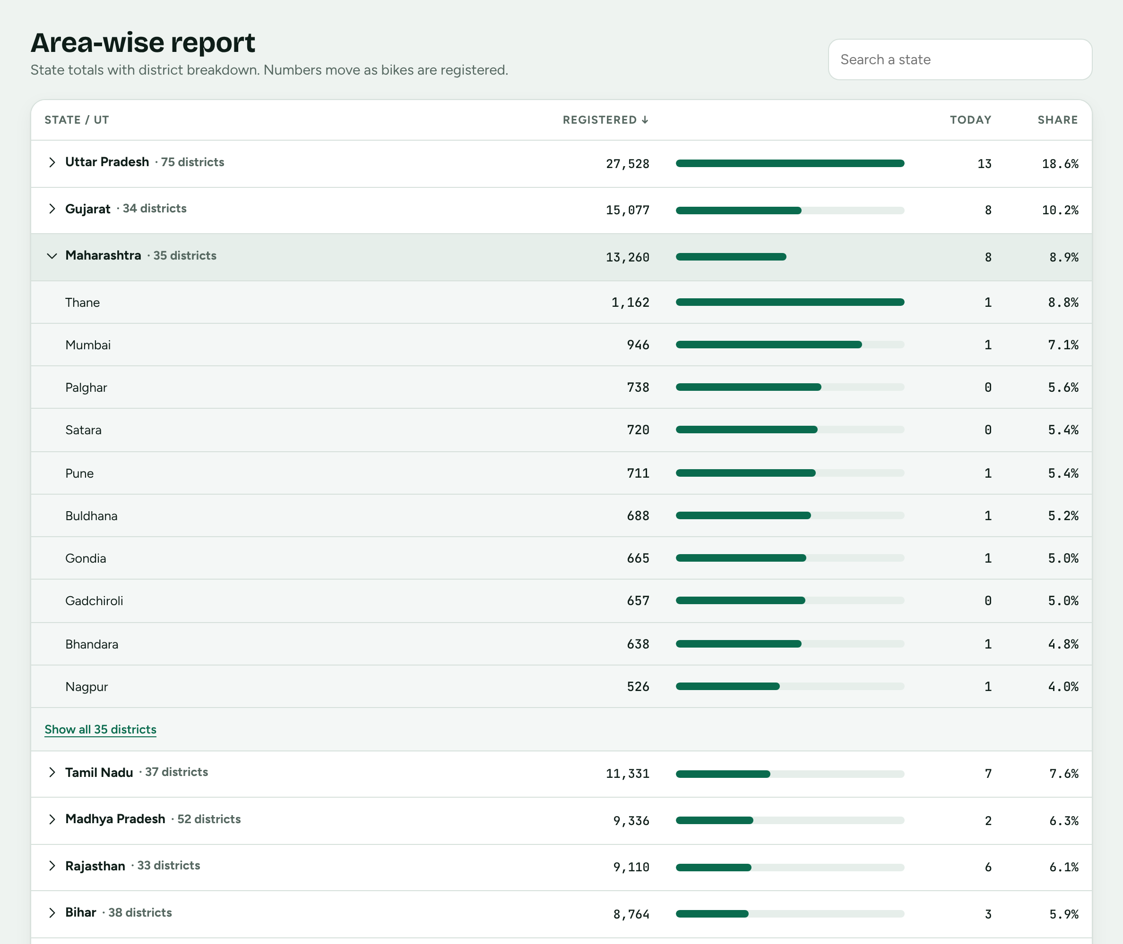
Area report with district breakdown
COMPANY PORTAL
36
states and union territories
Sort by registered, today or name, or search a state.
Share
of each state and district
Every row shows its percentage of the total or of its state.
Live
totals
Numbers move as dealers register bikes.

Slide 9
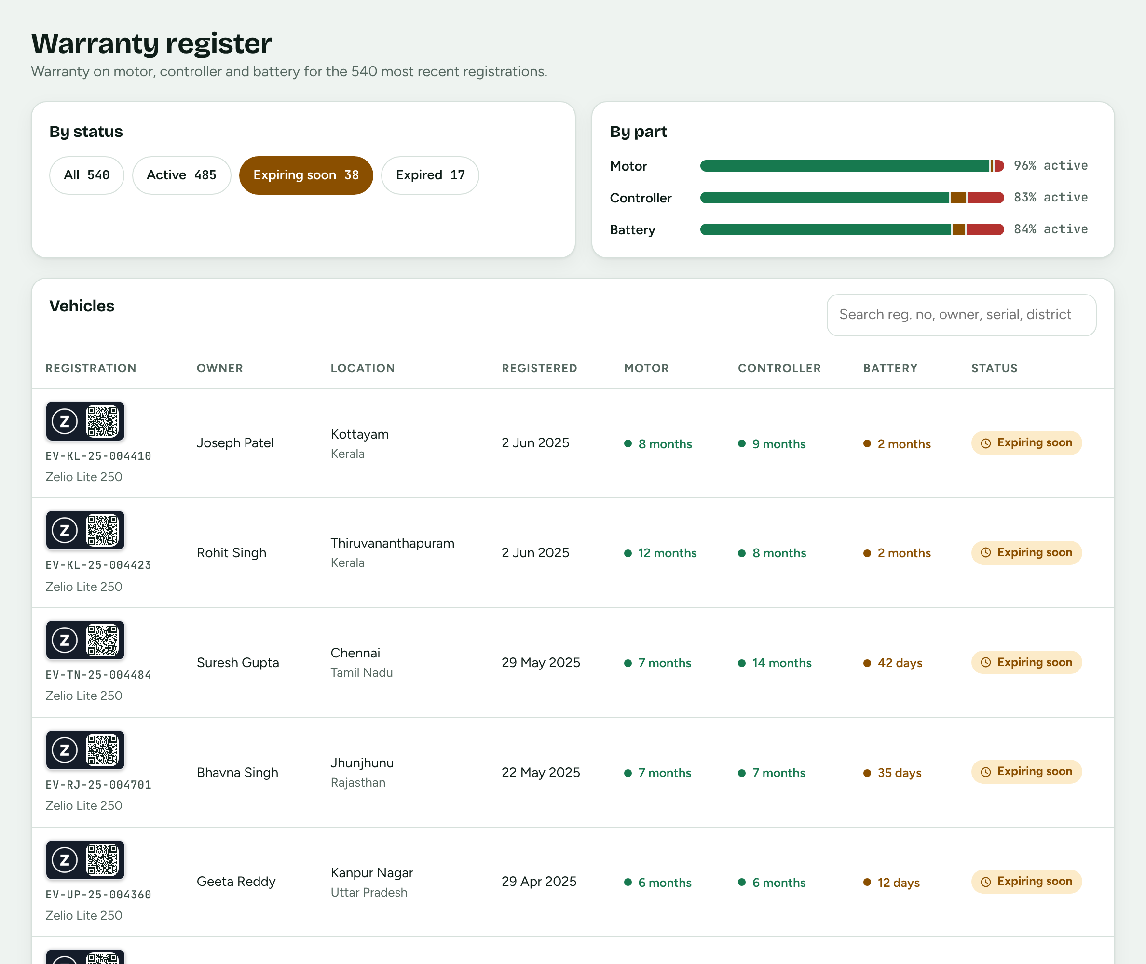
Warranties ending soon, by part
COMPANY PORTAL
38 of 540
end within 60 days
One click on Expiring soon lists them, with the time left on each part.
83%
of controllers still active
Batteries 84%, motors 96%. Controllers and batteries run out first.
17
already expired
Search by registration, owner, serial or district.
Notes:
Sample data: 540 recent registrations, 485 active, 38 expiring soon, 17 expired. Per-part active shares are from the By part bars.

Slide 10
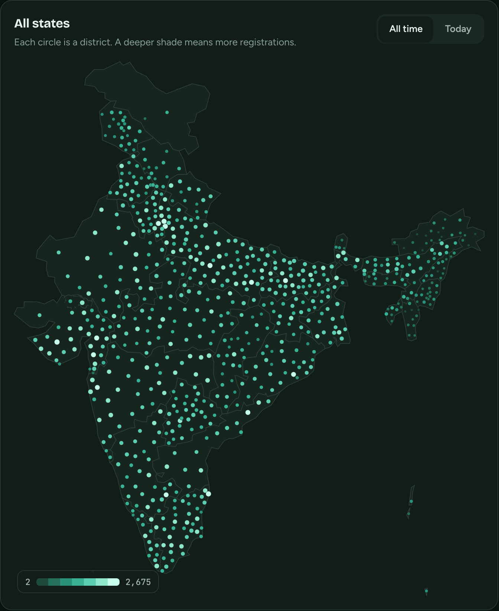
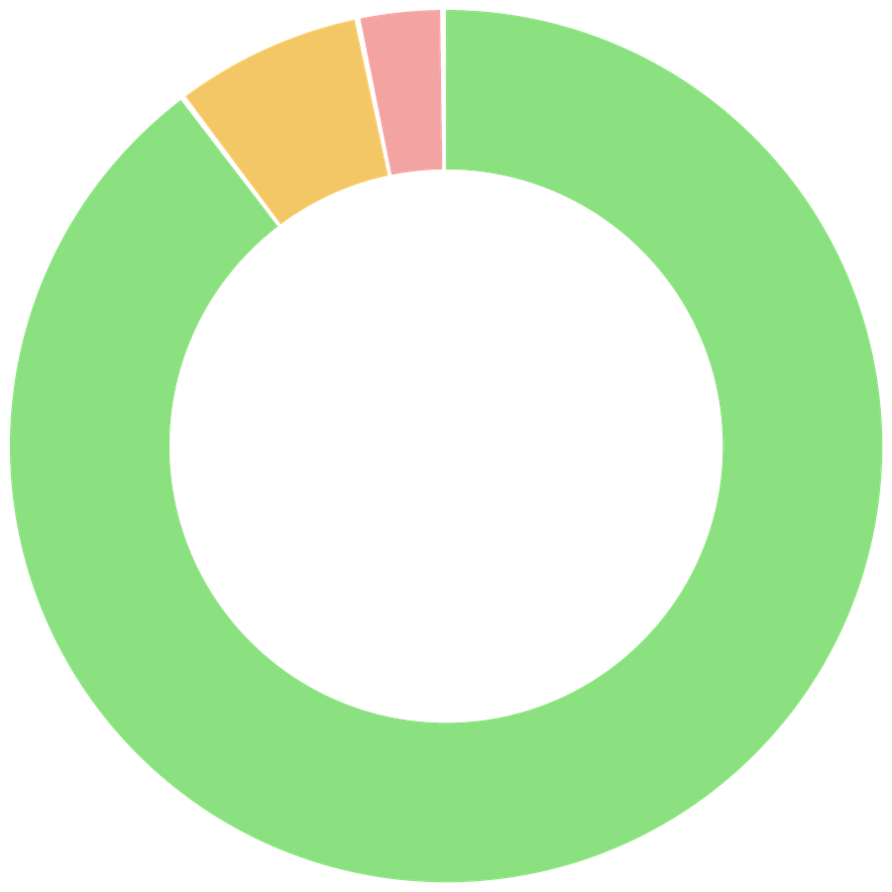
Where the bikes are, and how covered they are
INSIGHTS
TOP FIVE STATES
WARRANTY STATUS
Uttar Pradesh
27,529
Gujarat
15,077
540
recent bikes
Maharashtra
13,260
Tamil Nadu
11,331
Active
485
Expiring soon
38
Madhya Pradesh
9,336
Expired
17
Five states hold 52% of registrations. 90% of recent bikes are fully covered; 7% need attention within 60 days.
Notes:
Sample data. 76,533 of 1,48,174 registrations are in the five states shown (52%). Of 540 recent bikes: 485 active (90%), 38 expiring soon (7%), 17 expired (3%).

Slide 11
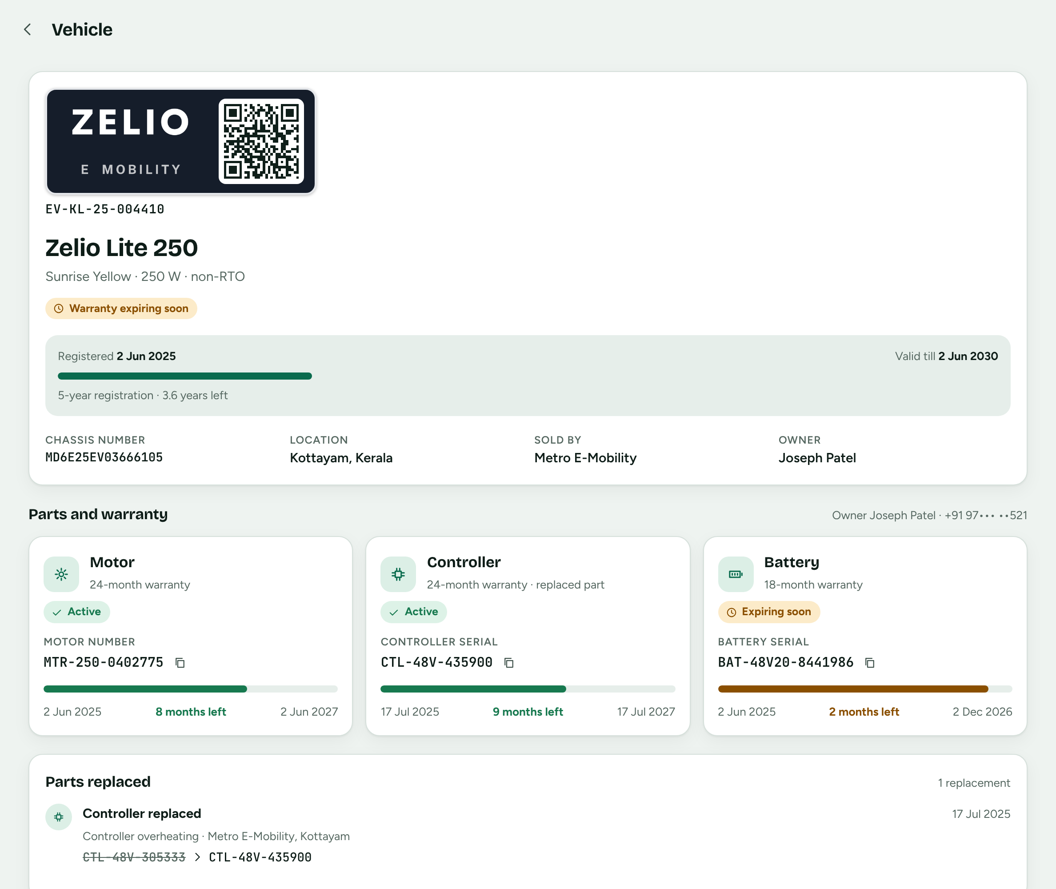
Open any bike for its full record
COMPANY PORTAL
Plate
and registration period
Registered and valid-till dates, chassis, location and the selling dealer.
3 parts
each with its own warranty
Motor number, controller and battery serials with the time left.
History
of every replacement
Old and new serial for each part swap.

Slide 12
Three parts, each with its own warranty
PARTS
CONTROLLER
MOTOR
BATTERY
24 months
24-36 months
18-30 months
Tracked by controller serial
Tracked by motor number
Tracked by battery serial
CTL-48V-725741
MTR-250-8695278
BAT-48V20-7257410
A replacement starts a new warranty
A replacement starts a new warranty
A replacement starts a new warranty
Terms vary by model. Shown from the demo's model list.

Slide 13
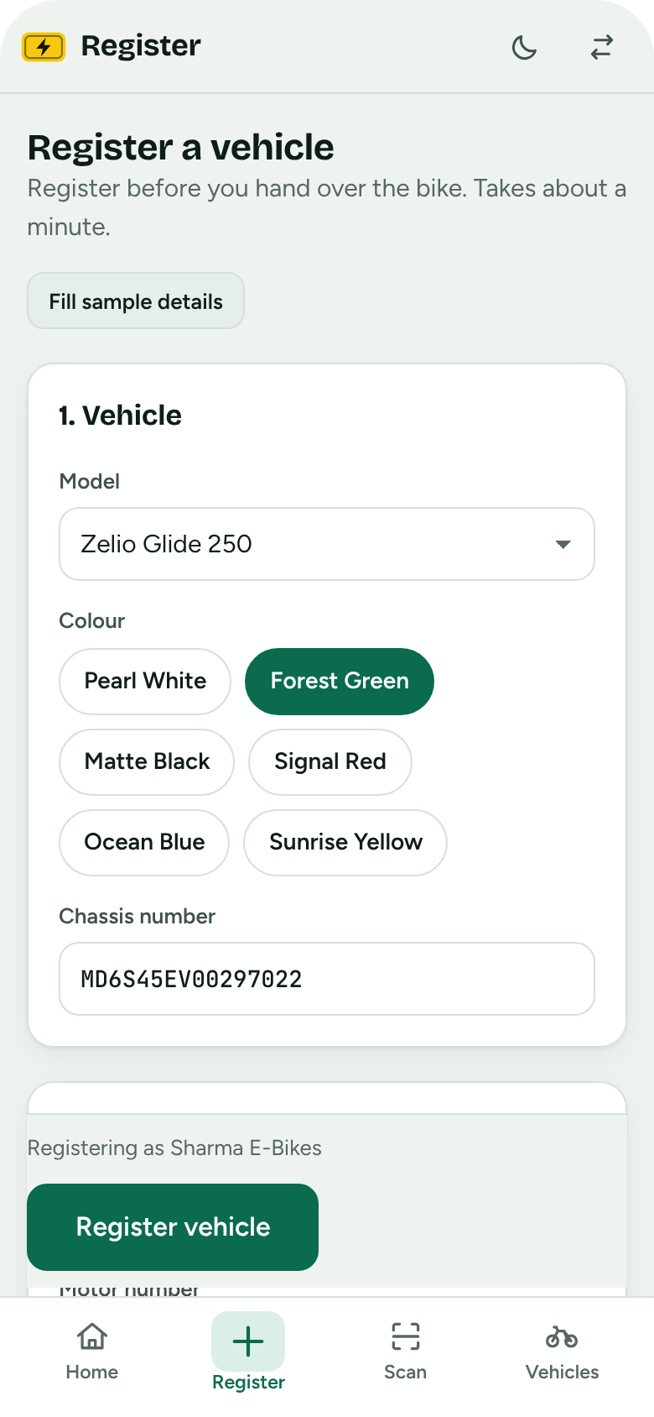

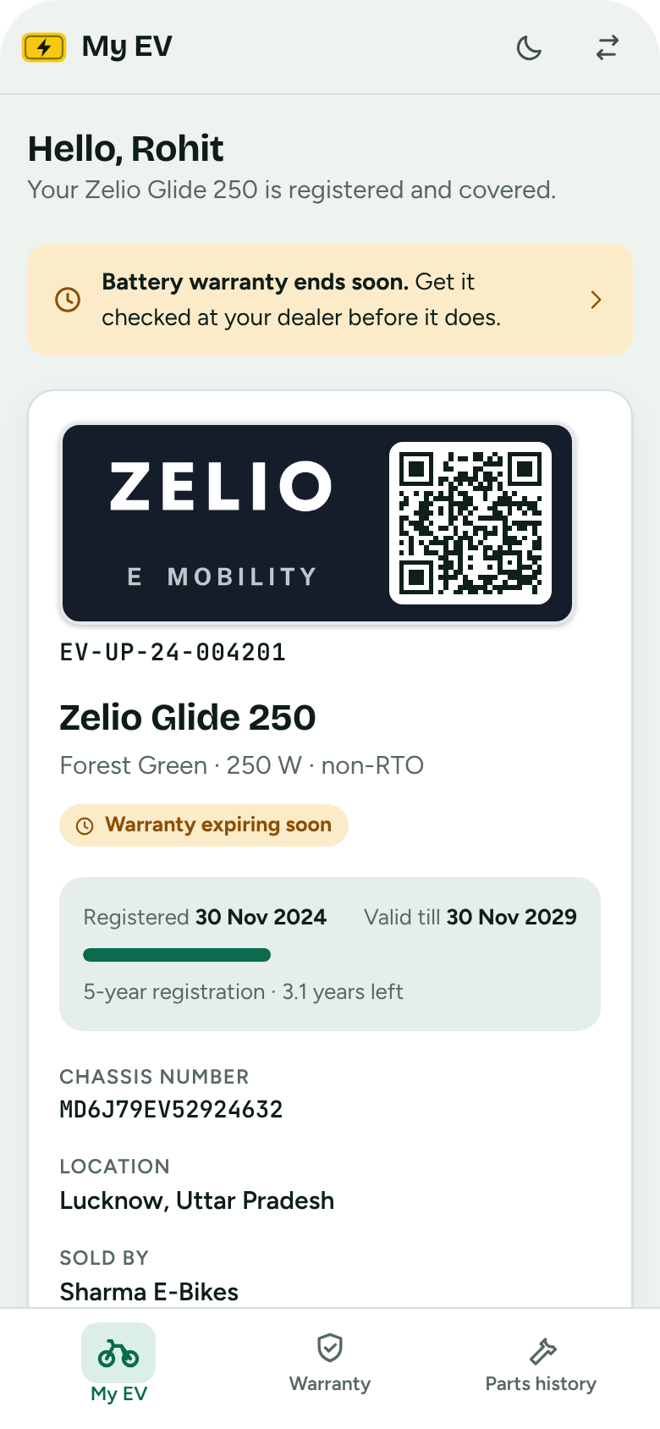

Built for the shop counter and the owner's pocket
ON THE PHONE
Dealers
Vehicle owners
Register in one form
Scan the plate QR
Registration and QR
Warranty per part

Slide 14
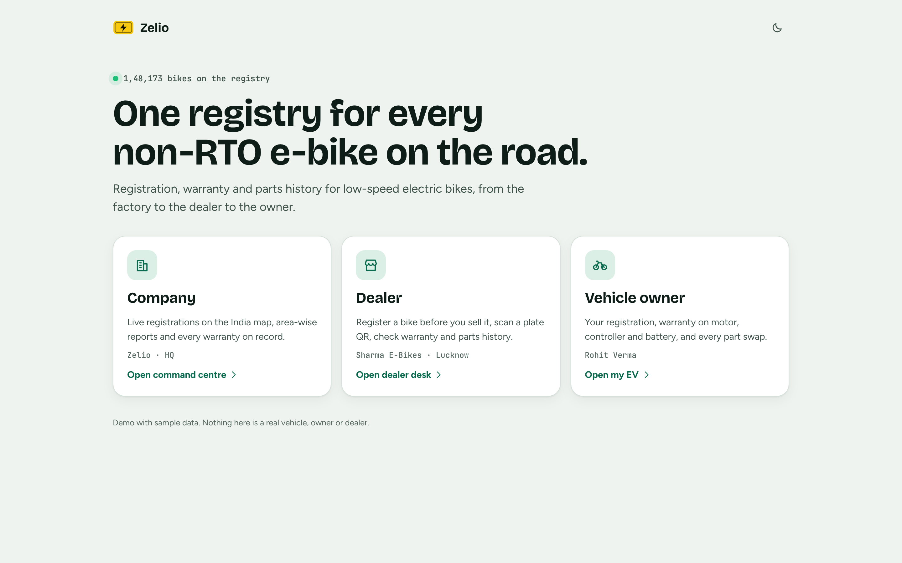
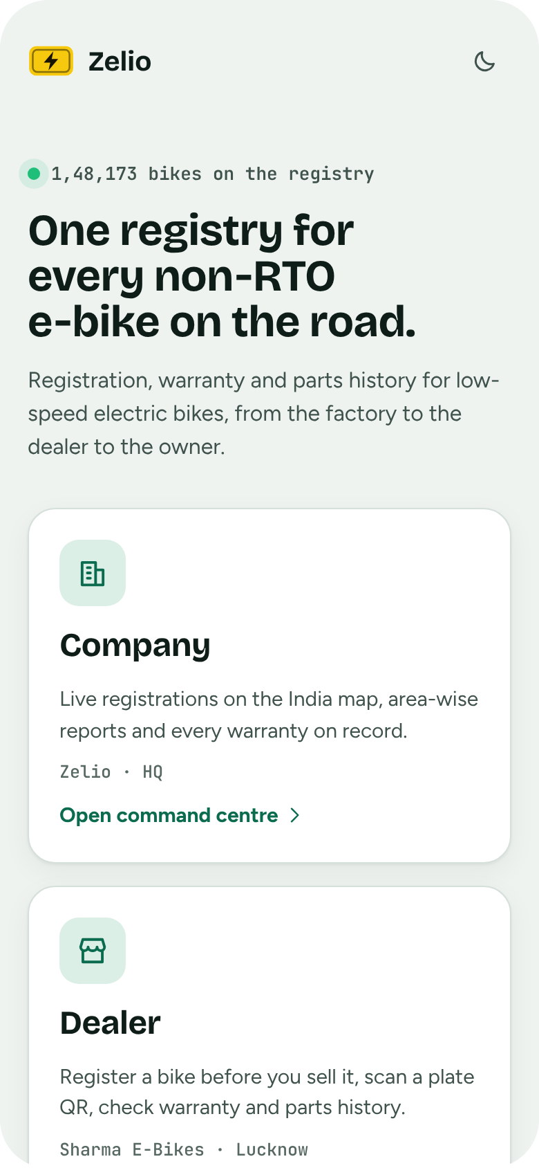
Start screen: pick a role
SAMPLE UI
Company, dealer or vehicle owner, on a computer or a phone

Slide 15
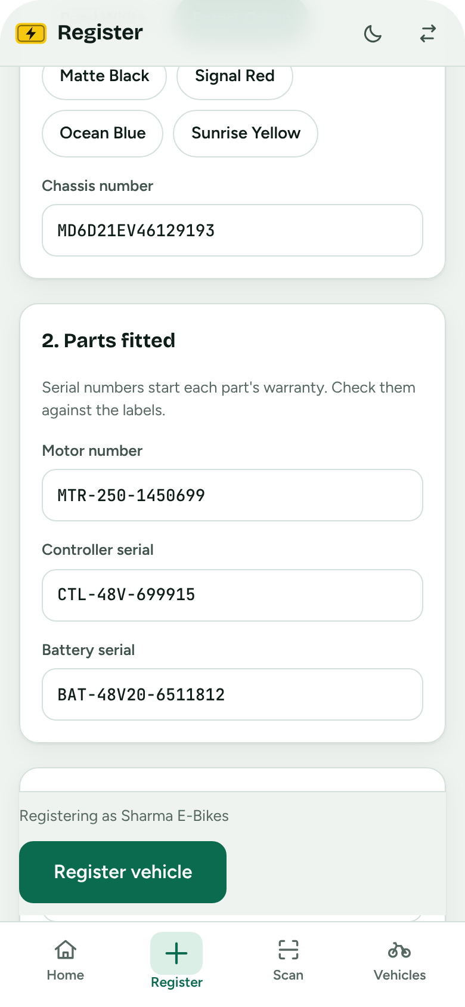
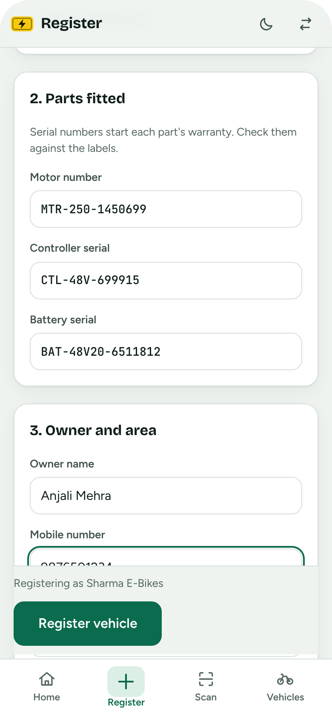
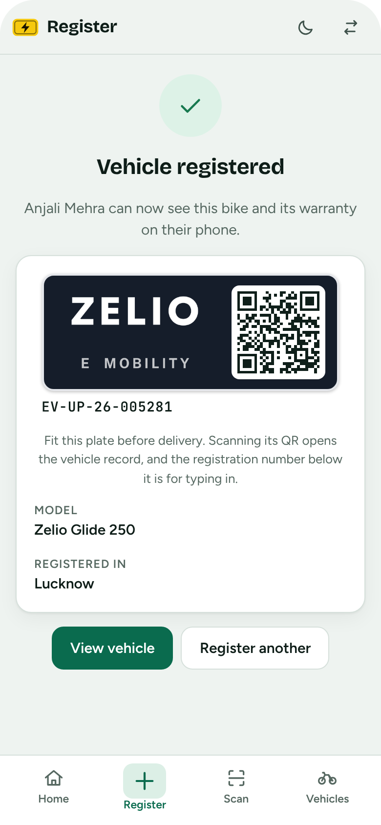
Dealer: register a bike in three steps
SAMPLE UI
1. Vehicle and parts
2. Owner and area
3. Plate and QR
Chassis, motor, controller, battery
Name, mobile, state and district
Ready to fit before delivery

Slide 16
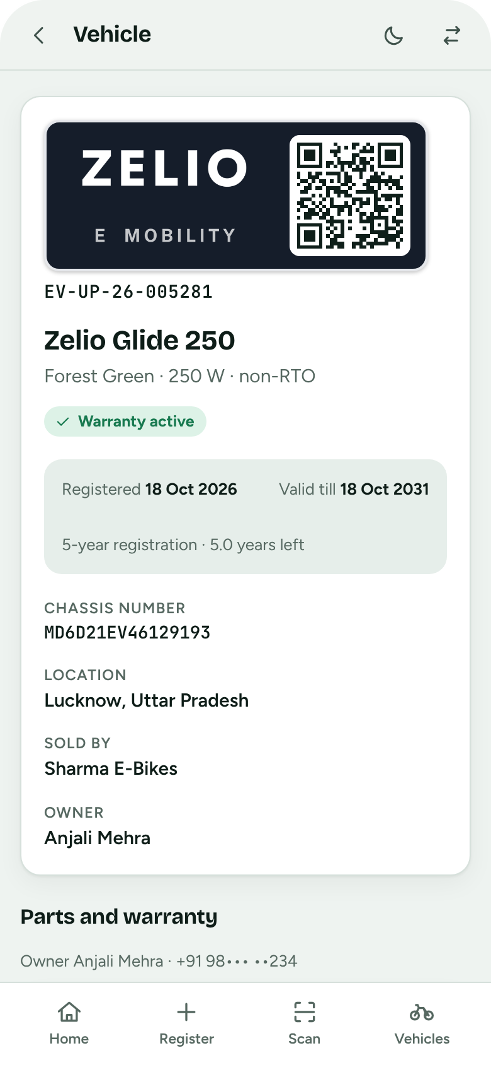
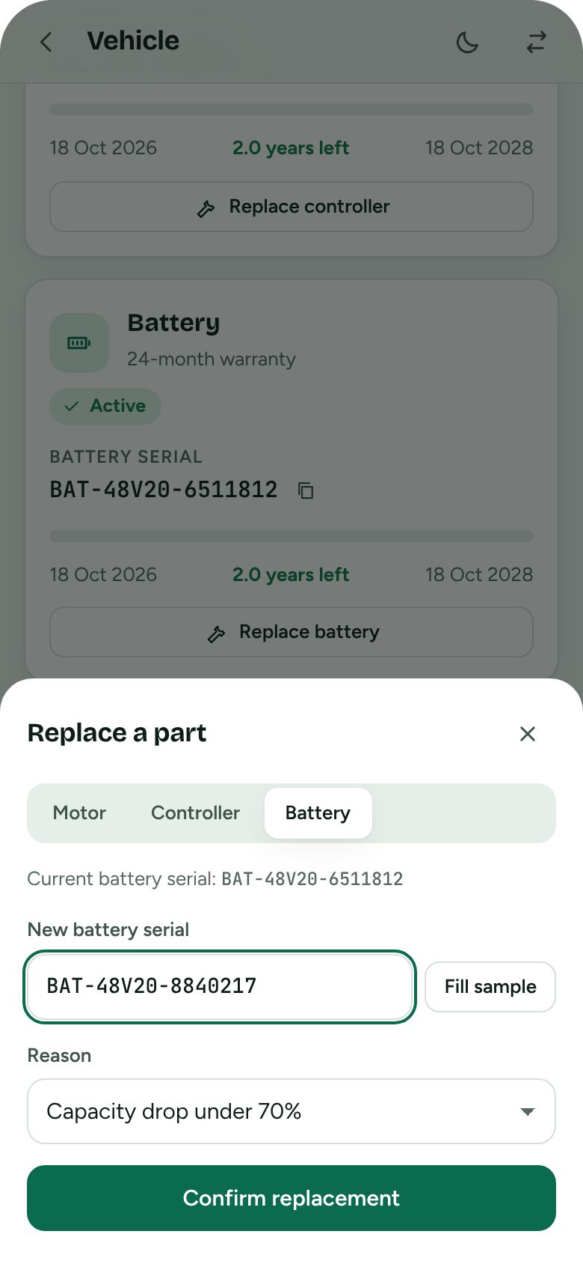
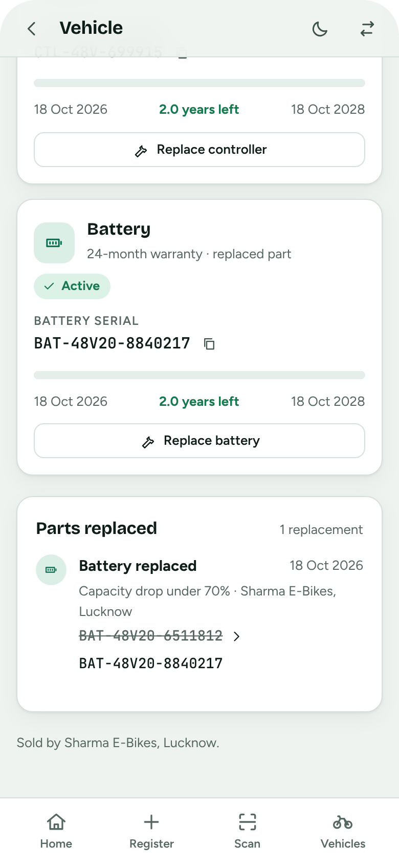
Dealer: open a bike and replace a part
SAMPLE UI
Full record
Replace a part
Logged in history
Plate, registration and owner
New serial and a reason
Old and new serial, new warranty

Slide 17
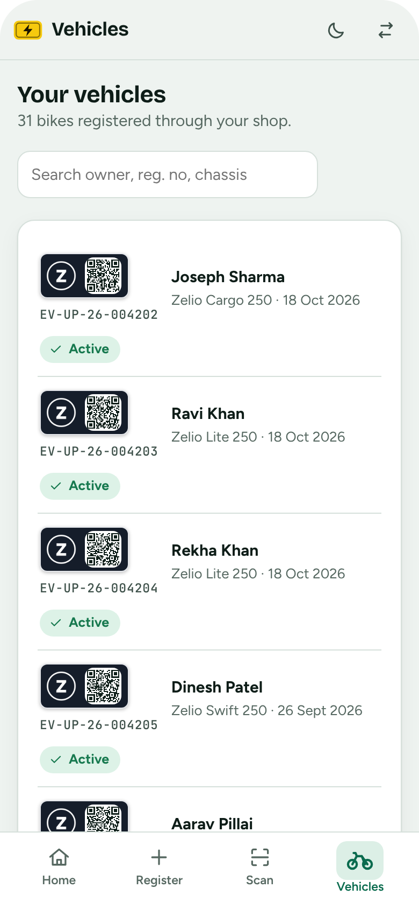
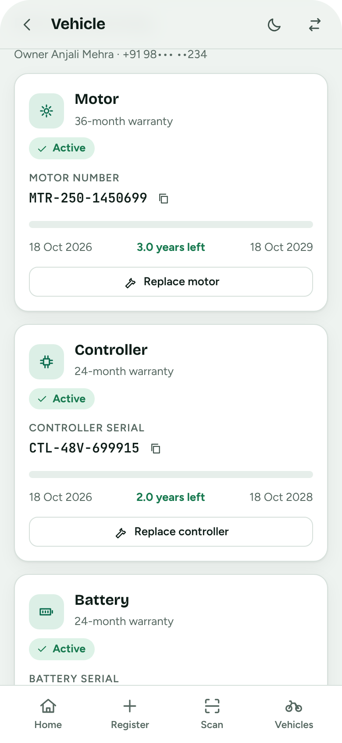
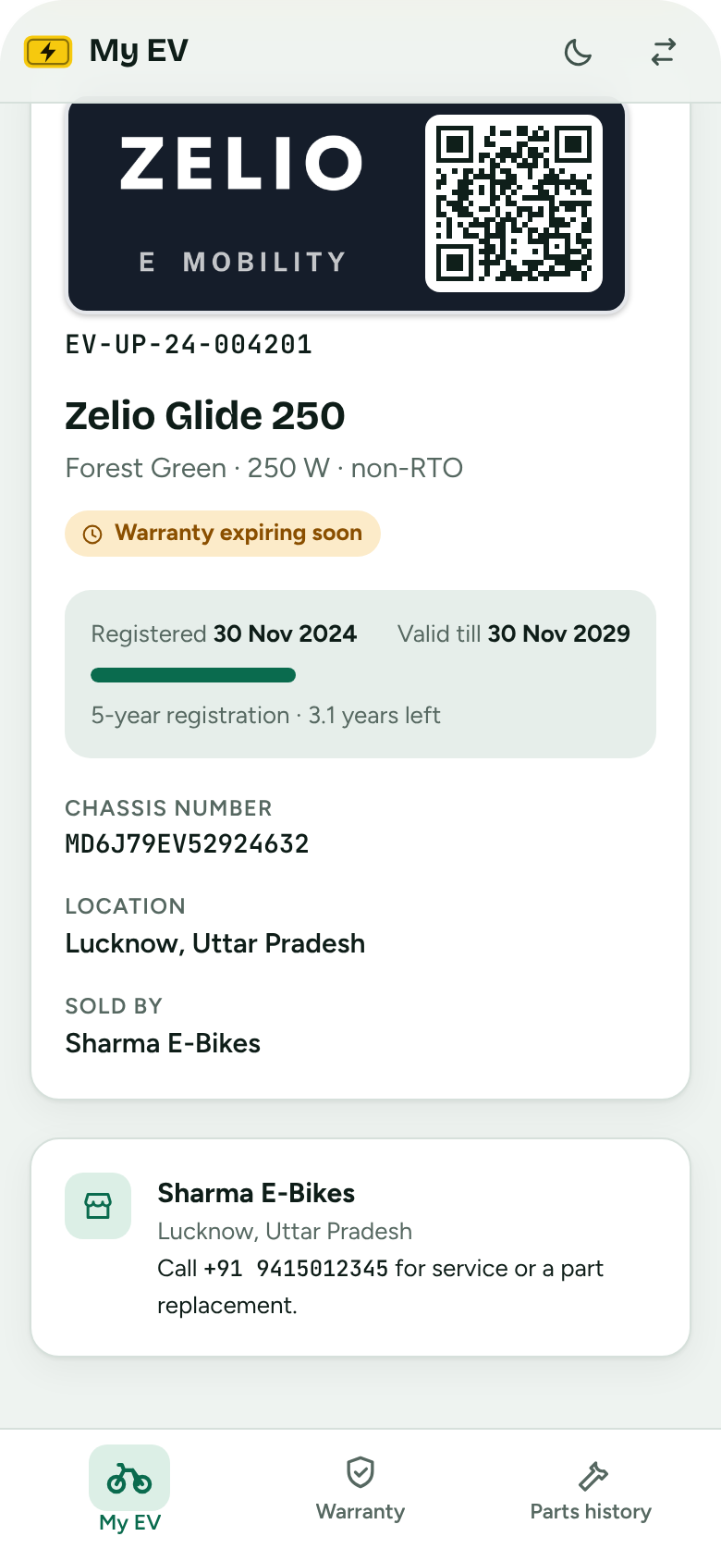
Your vehicles, and the owner's view
SAMPLE UI
Dealer: your vehicles
Dealer: warranty by part
Owner: registration
Search by owner, number or chassis
Replace a part from the card
Valid-till date and selling dealer

Slide 18
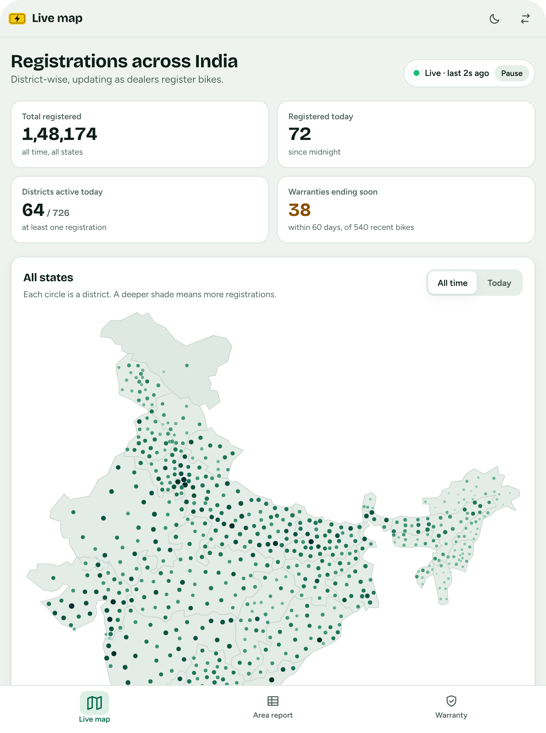
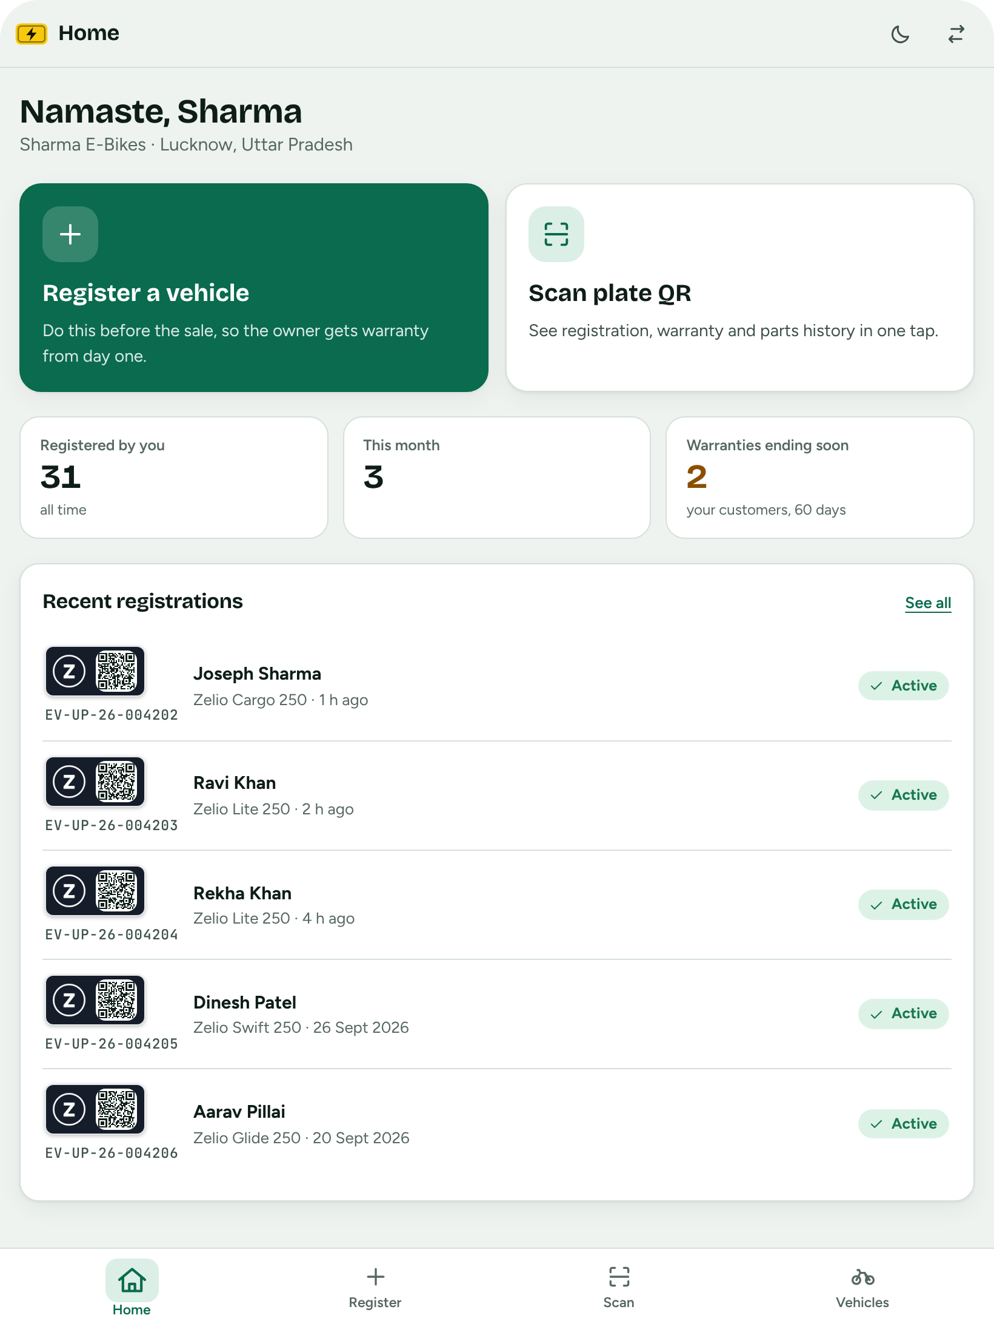
Works on tablets too
SAMPLE UI
Company portal
Dealer home

Slide 19
From scattered paper to one registry
BEFORE AND AFTER
What changes for a small e-bike once it has a plate that opens a record.
Feature | Paper and memory | Zelio portal
Central record of every bike | No | Yes
Warranty visible to the owner | No | Yes
Part replacement history | No | Yes
Live area-wise numbers | No | Yes
Plate that opens the record | No | Yes
One record that company, dealer and owner can all read.

Slide 20
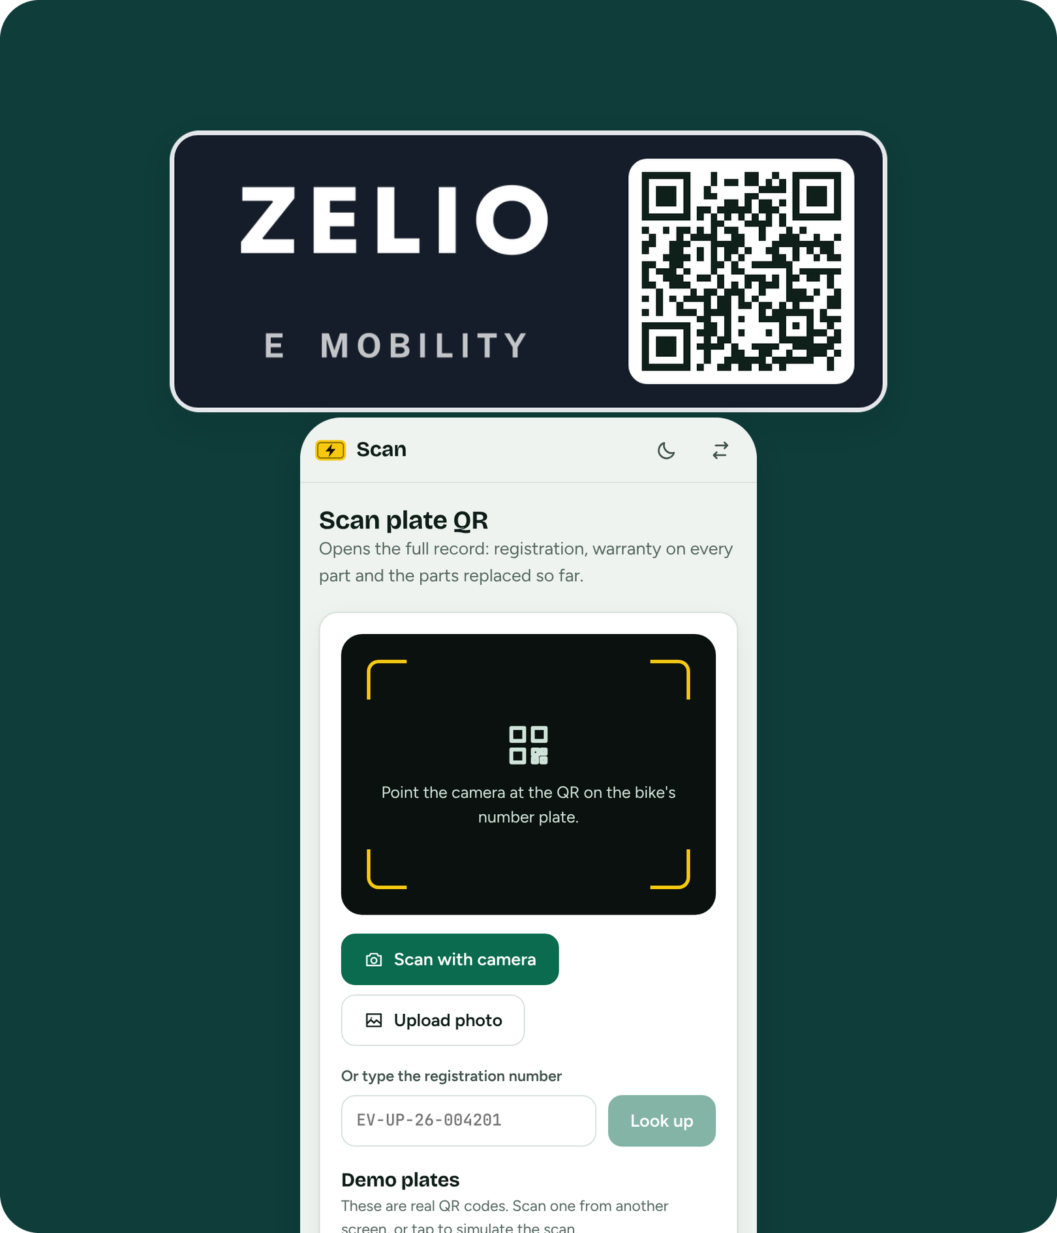



One QR plate.
One registry.
Zelio.
TRY IT
See the live demo
Code: ev-registry/ in the fans-app repo
All data shown is sample data
Notes:
The demo link works once GitHub Pages is switched on for the gh-pages branch (Settings, Pages). The Zelio logo is a placeholder wordmark.

