Slide 1

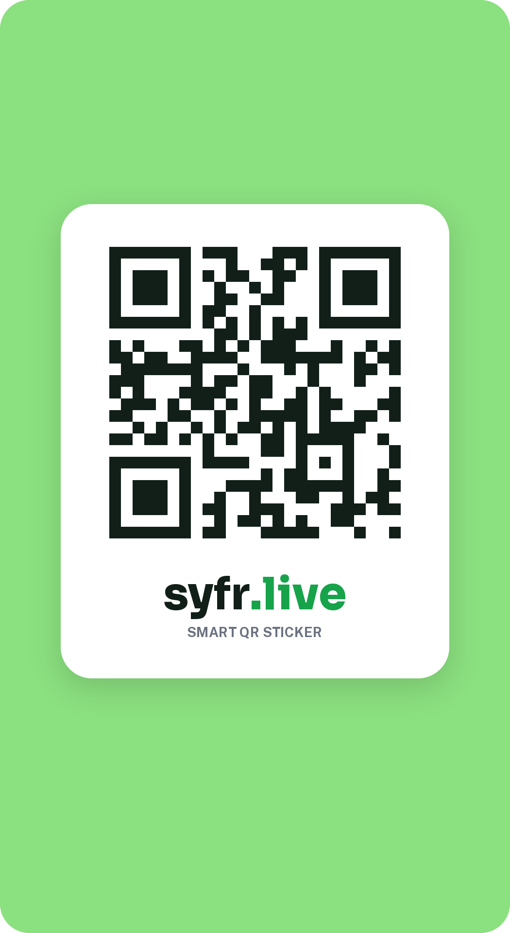
Smart QR stickers for car owners
syfr.live
A clean, trustworthy, green-forward consumer product.
COMPANY
WEB
Syfr
syfr.live
Notes:
Company overview. Built from the Syfr design system notes: it describes the product as smart QR stickers for car owners and lists the storefront, order and admin surfaces. No business figures are included because none were provided.

Slide 2



A sticker, a storefront and an order desk
ABOUT SYFR
Smart QR stickers
A simple storefront
Orders and delivery
Stickers with a scannable QR code, made for car owners.
Product cards with prices and discount tags, and a sticky checkout bar on mobile.
Every order carries a clear status, from awaiting payment to shipped.
syfr.live: clean, trustworthy and green-forward, on the web and on mobile
Notes:
The three surfaces named in the Syfr design system: the product and checkout screens, the order screens, and the admin tools.

Slide 3


One product, two kinds of user
WHO USES IT
Car owners
Admin team
Browse sticker products and see prices
Check out, with a sticky bar on mobile
Follow an order from awaiting payment to shipped
Reassign the courier on an order
Sync order statuses
Use utility blue for admin actions, never for the main call to action
Notes:
Car owners use the storefront and order screens. The admin team uses utility actions such as reassigning a courier and syncing statuses.

Slide 4
From browsing to a shipped sticker
ORDER JOURNEY
1
2
3
4
5
Browse
Check out
Pay
Courier
Shipped
Product cards show the sticker, price and any discount tag
One main green button; on mobile it sits in a sticky bar
The order shows awaiting payment until it is paid
The admin team assigns, or reassigns, the courier
The order is marked shipped
An order can also end as cancelled or failed
Notes:
The steps follow the order states and admin actions in the Syfr design system notes. Anything beyond these, such as delivery tracking, is not described there and is left out.

Slide 5
Every status has its own colour
ORDER STATUSES
Each order state uses a tinted badge, so a person can read the state at a glance. Green is kept for success and the main action.
Badge | Used for
Shipped | Success: the order is on its way
Awaiting payment | Pending: the order is not paid yet
Cancelled | Failed or cancelled orders
Info | Neutral information
Blue is for admin and utility actions, never the main call to action.
Notes:
Status colours are from the usage rules in the Syfr design system: brand tint for success or shipped, amber for pending, red for cancelled or failed, blue for neutral information.

Slide 6
Green-forward, clean and easy to trust
THE SYFR LOOK
One core green carries the main action, prices, links and success. Near-black greens set the headlines, and soft tints fill badges and panels.
Brand green
Deep green
Brand ink
Tint
Surface
#16A34A
#15803D
#111F18
#DCFCE7
#F3F8F4
Sora
PUBLIC SANS
Aa
Aa
Headlines and hero text
Paragraphs, buttons and labels
Notes:
Colours and fonts are from the Syfr design system notes. Cards use 16px corners and the main button is a pill.

Slide 7
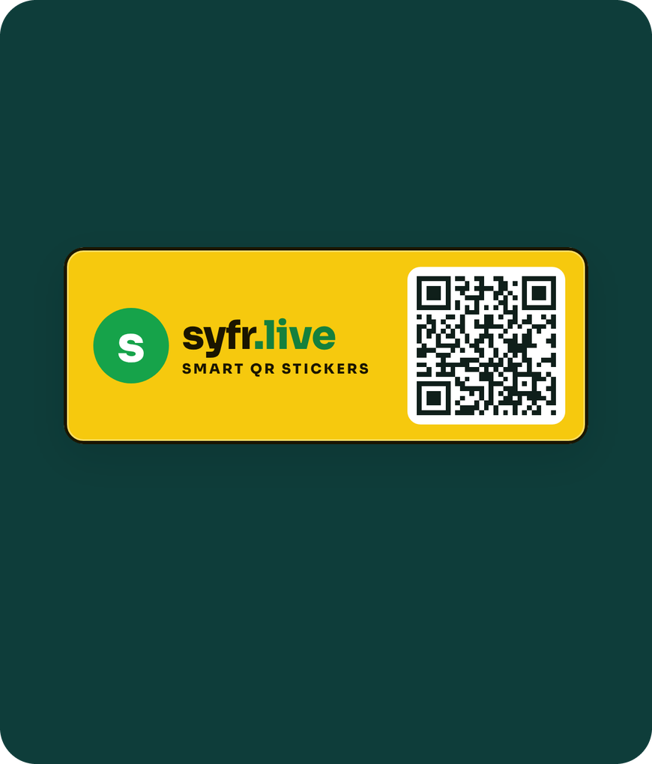
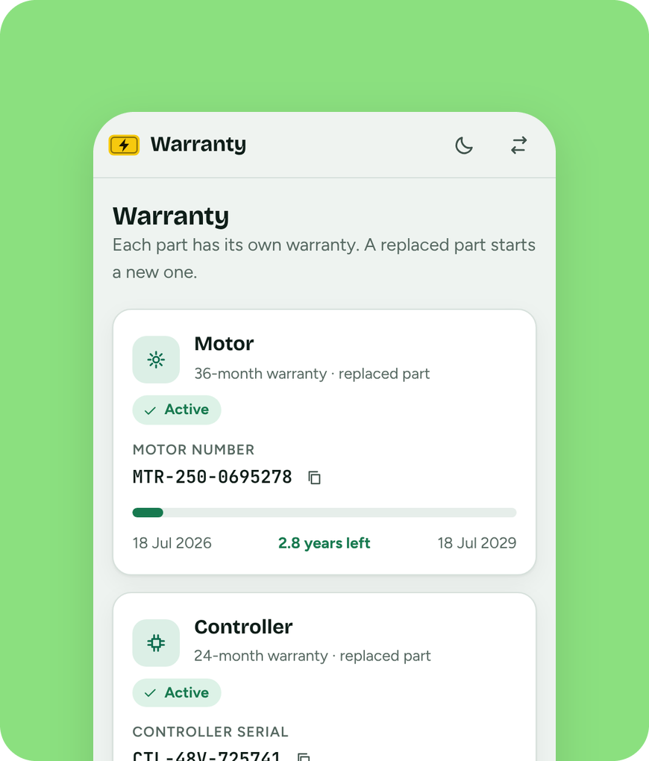

The same QR idea on an e-bike's number plate
SYFR AND E-BIKES
Non-RTO e-bikes have no government registry to lean on
The plate carries the syfr.live logo and a QR code
Scanning it opens registration, warranty per part and parts history
A working demo with sample data
Notes:
This links the company overview to the e-bike registry demo built earlier: the plate, the owner view and the warranty screens use sample data.

Slide 8
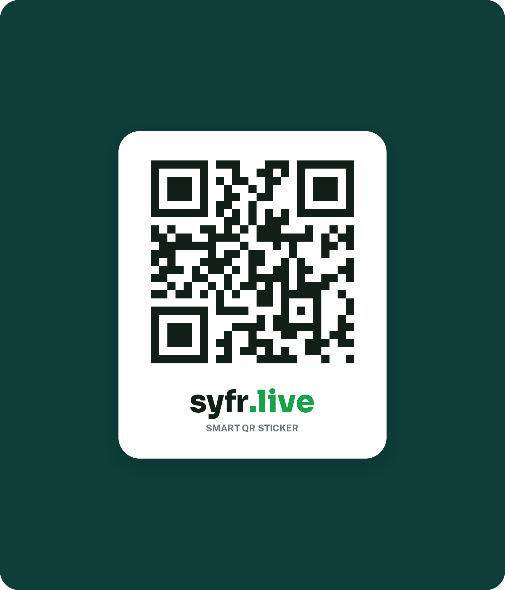



Smart QR stickers
for car owners.
syfr.live.
SYFR.LIVE
syfr.live
Clean, trustworthy, green-forward
Built from the Syfr design system notes
Notes:
Add figures, pricing, team and contact details here once available; none were provided.

