Slide 1

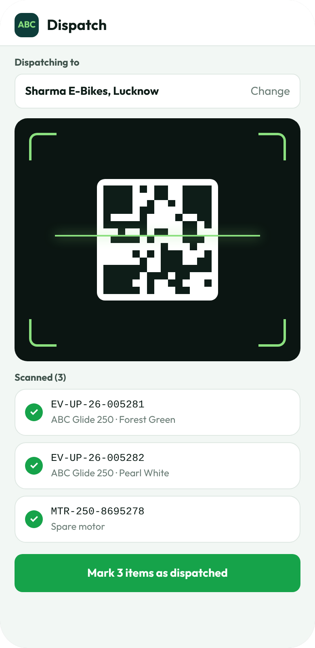
Inventory management for ABC EV Bikes
Every part, every bike and every dispatch in one place. Found in under a second.
COMPANY
SCOPE
DATA
ABC EV Bikes
Our EV bikes only
Sample data only
Notes:
Proposal for an inventory system for ABC EV Bikes, covering our own EV bikes and their parts only. All screens are mock-ups with sample data. ABC EV Bikes is a placeholder name.

Slide 2
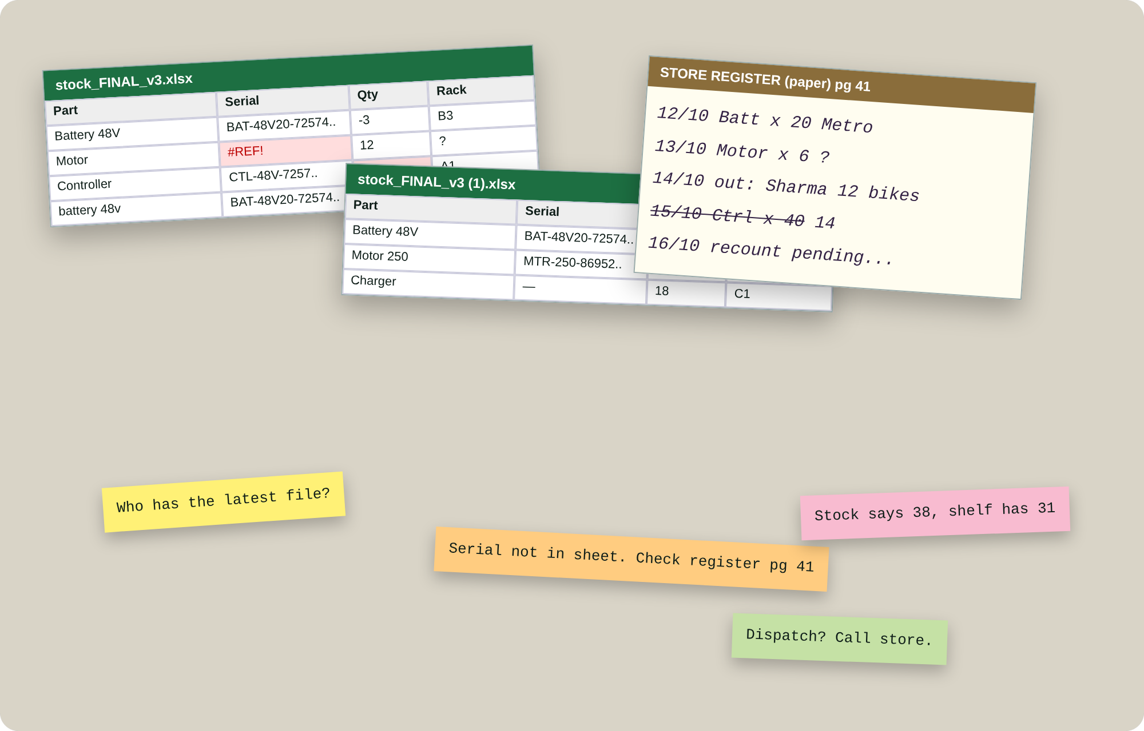



Excel files and paper registers hide the truth
TODAY
Finding takes minutes
Open the right file, filter, then check the register to be sure.
Many versions, no truth
stock_FINAL_v3 (1).xlsx. Who has the latest?
Errors creep in
Typos, #REF!, negative stock, and a shelf that never matches the sheet.
Notes:
The mock-up is an illustration of typical spreadsheet and register problems, not a photo of ABC's records.

Slide 3
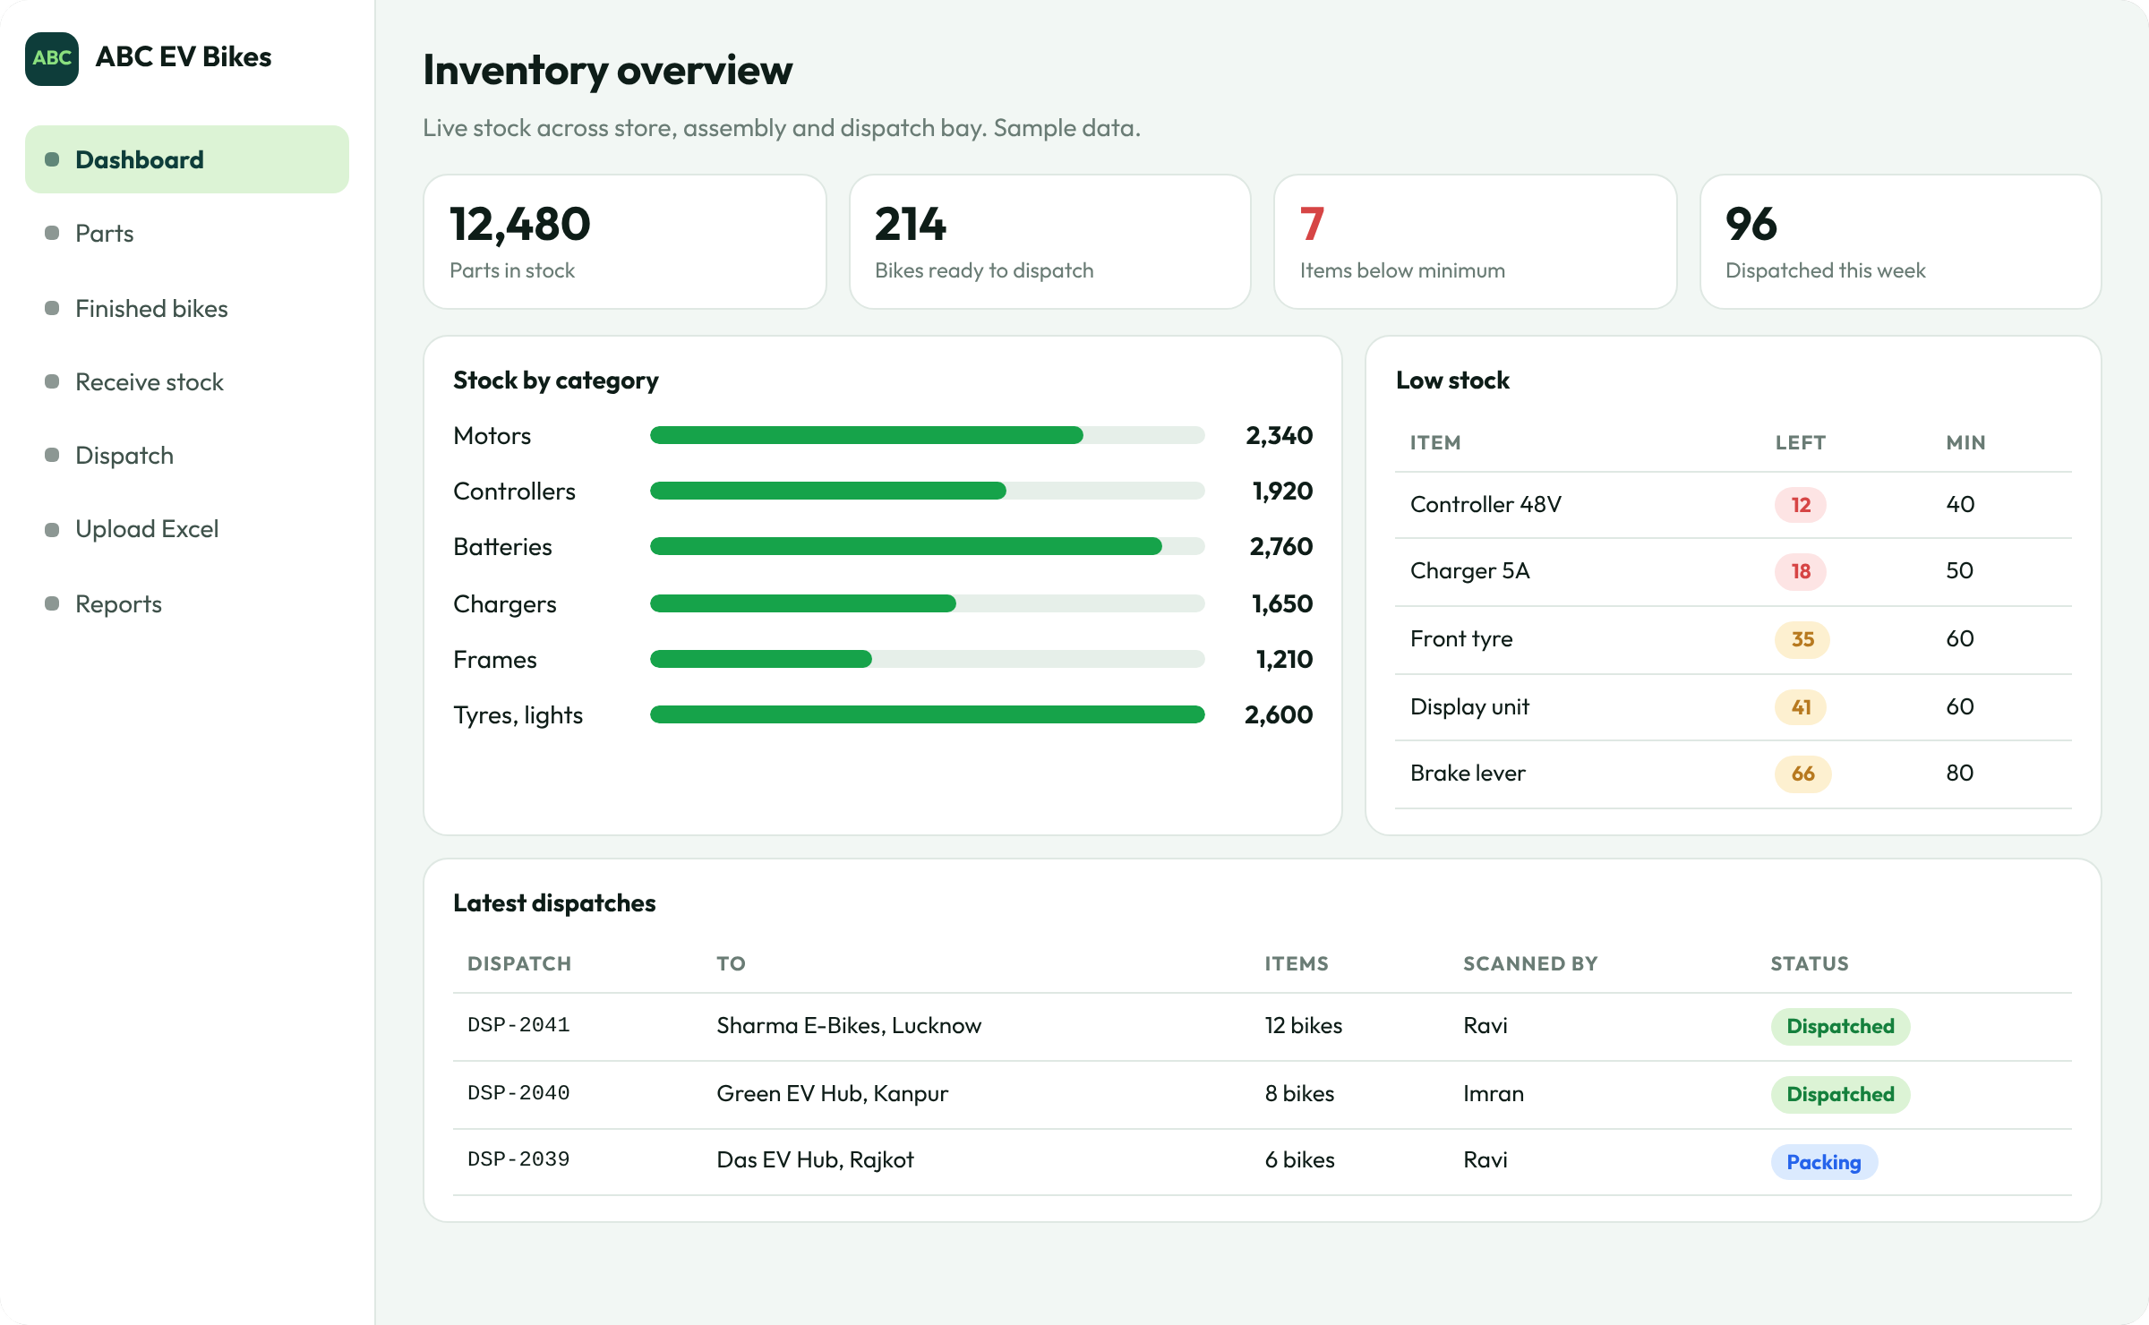
The whole store on one screen
ONE DASHBOARD
12,480
parts in stock
Motors, controllers, batteries, chargers, frames and more.
214
bikes ready to dispatch
Finished bikes waiting in the dispatch bay.
7
items below minimum
Low stock is flagged before the shelf is empty.
Notes:
Sample numbers on a mock-up.

Slide 4





From the supplier's truck to the dealer
HOW IT WORKS
Receive
Store
Assemble
Dispatch
Report
Scan or type each part when it arrives.
Rack and shelf recorded for every item.
Motor, controller and battery serials linked to the bike.
Scan the bike's QR, tap once, done.
Ledger, dispatch register and low stock, on demand.
Every step updates the same record, so the store, assembly and dispatch always agree.

Slide 5



Manage every part, down to the serial number
PARTS
TRACKED BY SERIAL NUMBER
Motor
Controller
Battery
Motor number
Controller serial
Battery serial
MTR-250-8695278
CTL-48V-725741
BAT-48V20-7257410
TRACKED BY QUANTITY
Chargers
Frames
Tyres
Lights
Display units
Brake levers
Wiring harness
Fasteners
Each part also carries supplier, received date, rack, minimum level and a full movement history.
Notes:
Motor number, controller serial and battery serial match what the vehicle registry already records for each bike.

Slide 6
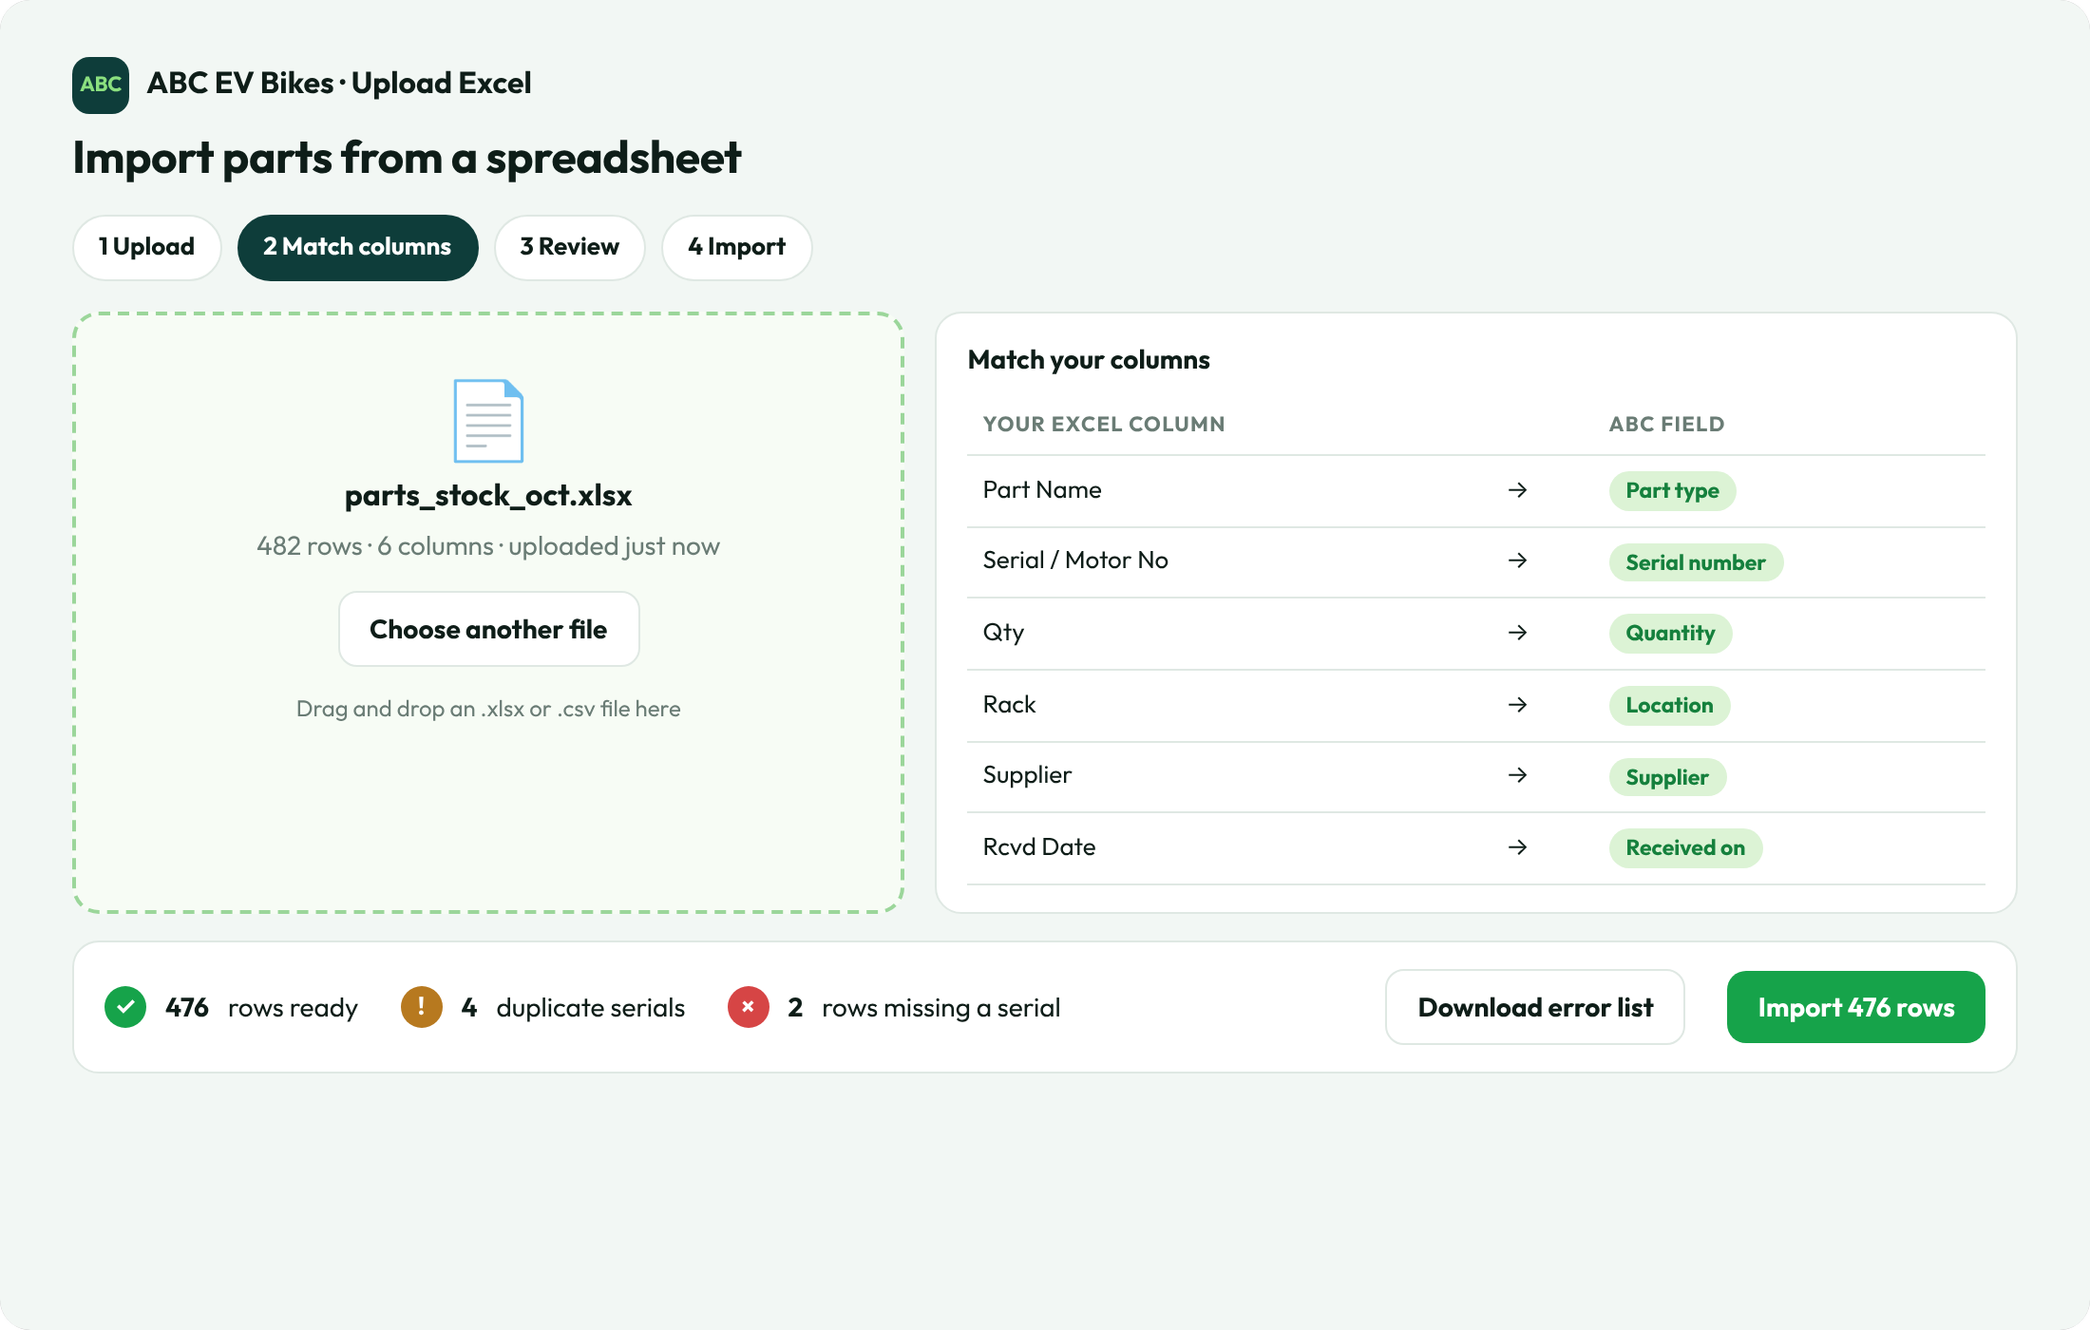
Bring your existing sheets in minutes
EXCEL UPLOAD
1
Upload the sheet you have
.xlsx or .csv, any column order.
2
Match columns once
Your headings map to ABC fields, saved for next time.
3
Fix errors before import
Duplicate or missing serials are listed, with a downloadable error file.

Slide 7
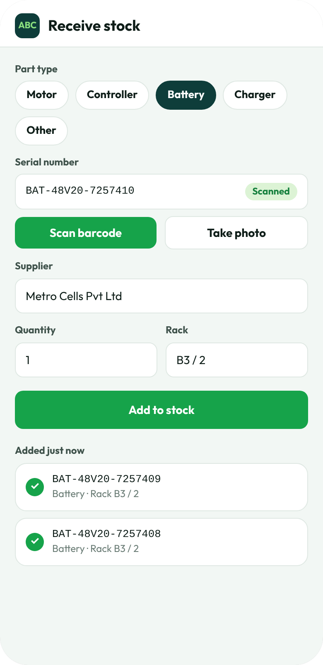
Fill stock from the shop floor
ON THE PHONE
1
Scan the barcode, don't type
The phone camera reads the serial from the part label.
2
Pick type, supplier and rack
Chips and dropdowns keep entries clean.
3
Tap Add to stock
The dashboard updates for everyone straight away.
4
Works for new and returned parts
Receive, count and move stock from one screen.

Slide 8
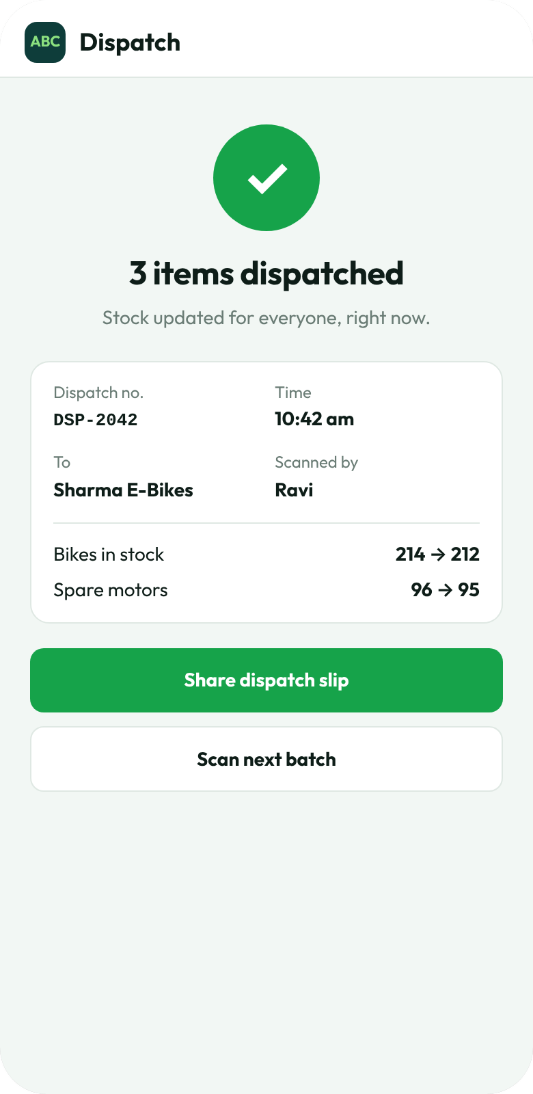
Scan to dispatch. One tap marks it sent
DISPATCH
1
Scan the QR on the bike
Or the barcode on a spare part. Each scan adds it to the dispatch.
2
Mark as dispatched
Stock drops, the dealer is recorded, the time and person are logged.
3
Share the slip
A dispatch slip is ready, with no handwriting.

Slide 9
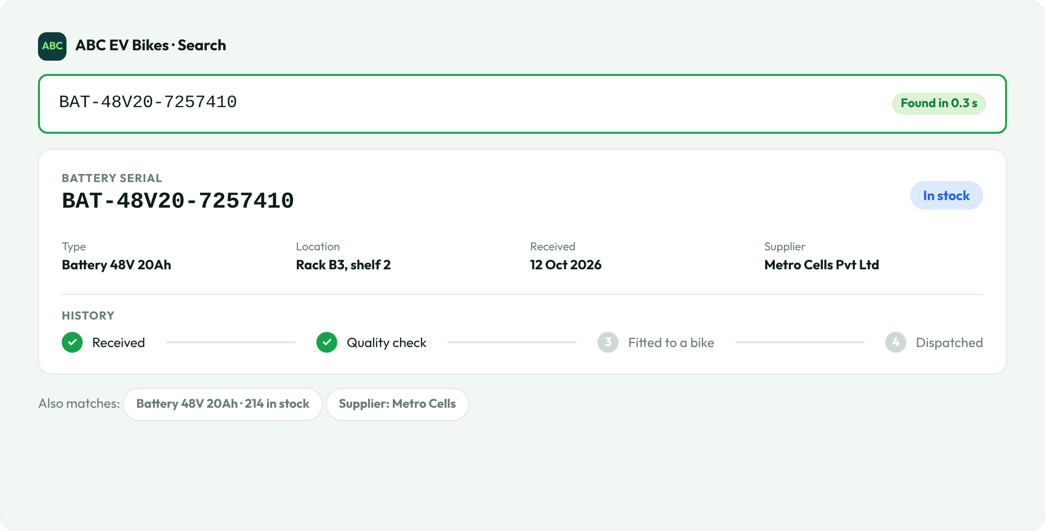
Find anything in under a second
SEARCH
< 1 s
from typing to the full record
Serial, part name, rack, supplier or dealer.
Any serial
shows its whole history
Received, checked, fitted, dispatched.
No file to open
and no register to turn
The answer is one search away, for everyone.
Notes:
The sub-second figure is a design target for a search that looks up an indexed database. It should be confirmed on ABC's own data volume during the pilot.

Slide 10
Excel and paper, compared with ABC inventory
BEFORE AND AFTER
What you need | Excel and paper | ABC inventory
Find a record | Open files, filter, check the register | Type or scan: under 1 second
Add stock | Type into a sheet, copy to a register | Scan once on the phone
Dispatch | Write the challan, update the sheet later | Scan, tap, slip ready
Mistakes | Typos, #REF!, duplicate files | Duplicate serials are blocked
Reports | Hours of pivot tables | Ready-made, export to Excel or PDF
Who did what | Unknown | Every movement logged with person and time
Notes:
A qualitative comparison between common spreadsheet-and-register practice and the proposed system.

Slide 11
Hours saved every month, just on looking things up
TIME SAVED
TIME TO FIND ONE RECORD
~87 h
Paper register
about 5 min
a month with a paper register
Excel file
about 90 s
~26 h
ABC inventory
under 1 s
a month with Excel files
~17 min
Example: 40 lookups a day, 26 working days a month. These are illustrative estimates. Replace them with ABC's own numbers from a week of timing.
a month with ABC inventory
Notes:
Arithmetic: 40 lookups x 300 s x 26 days = 86.7 h. 40 x 90 s x 26 = 26 h. 40 x 1 s x 26 = 17 min. All three are assumptions for illustration, not measurements.

Slide 12
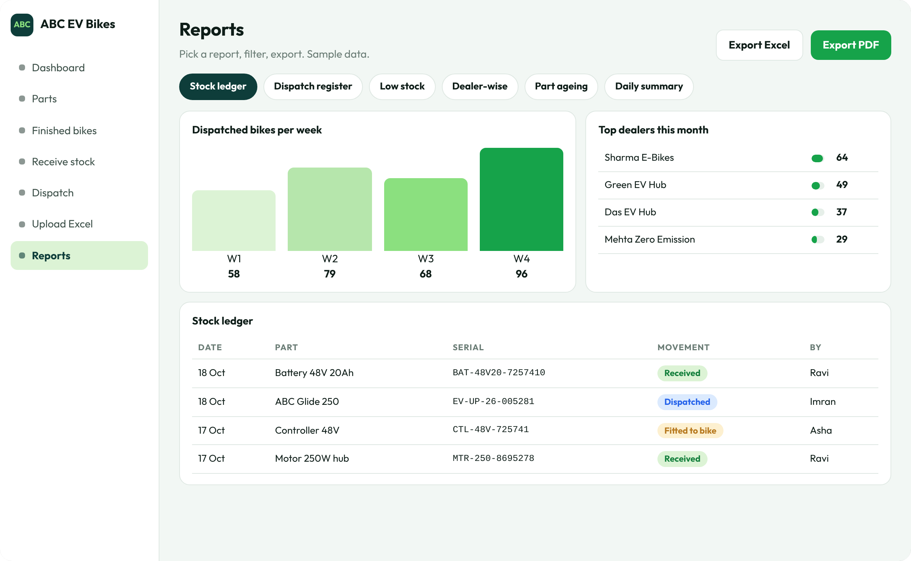




Reports are always ready
REPORTS
Stock ledger
Every receipt, fit and dispatch, by date and person.
Dispatch register
Which dealer got what, and when.
Low stock
What to reorder, before it runs out.
Export
To Excel or PDF in one click.

Slide 13
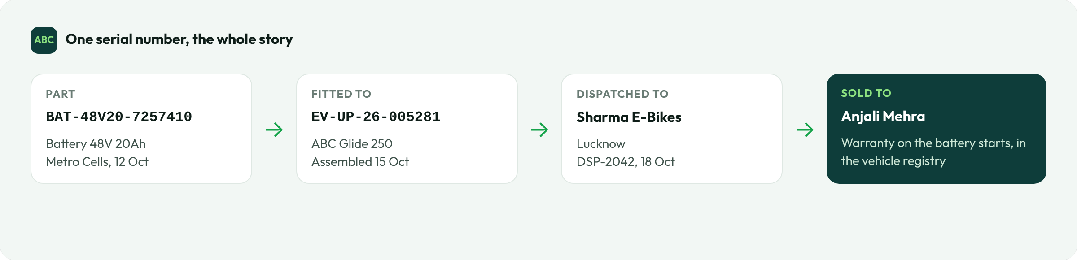
One serial number tells the whole story
TRACEABILITY
Part, bike, dealer and owner stay linked. If a batch of parts has a problem, you can list every bike that has one.
Connects to the vehicle registry, where the same serials carry each part's warranty.

Slide 14






Control without extra paperwork
BUILT-IN CONTROLS
Low-stock alerts
Roles
Audit trail
Minimum level per part, flagged on the dashboard.
Storekeeper, dispatch and manager see and do different things.
Every change records who did it and when.
No duplicates
Phone and desktop
One source of truth
A serial number can only exist once.
Scan on the floor, review at a desk.
Everyone sees the same live numbers.

Slide 15








Features we can add next
NEW FEATURES
PROPOSED
PROPOSED
PROPOSED
PROPOSED
Purchase orders
Label printing
Multi-warehouse
Reorder suggestions
Raise orders to suppliers and track what is pending.
Print QR and barcode labels for parts and bikes.
Move stock between stores and keep each count.
Suggested quantities from past usage.
PROPOSED
PROPOSED
PROPOSED
PROPOSED
Dealer ordering
Returns and claims
Accounting export
WhatsApp alerts
Dealers request bikes and see their order status.
Faulty parts back to the supplier, warranty claims.
Send stock and dispatch entries to your accounts software.
Low stock and dispatch messages to the right person.
Notes:
These are suggestions to discuss, not commitments. Order of work can follow what ABC needs first.

Slide 16
Start with your own Excel sheet
NEXT STEPS
1
2
3
Share one stock sheet
Pilot for a week
Go live
We import it and show your own parts in the dashboard.
Receive and dispatch with phone scans, and time a few lookups.
Move the store and dispatch bay over, then add features.
Every screen in this deck is a mock-up with sample data. ABC EV Bikes is a placeholder name.

