Slide 1


Impact of COVID on residential real estate in urban India
Team: Aakash, Arati, Anitha, Dilip, Sarang, Naresh
Mentors: Dr. Narayana, Anwesh

Slide 2

When will the world see an end to Corona virus?
What should I do? Invest in real estate or not?
Man I am fed up of this COVID news and the claims. Can someone do a decent analysis?

Slide 3
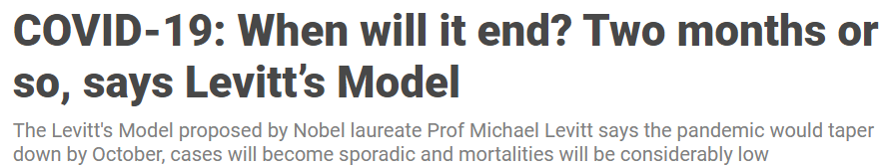
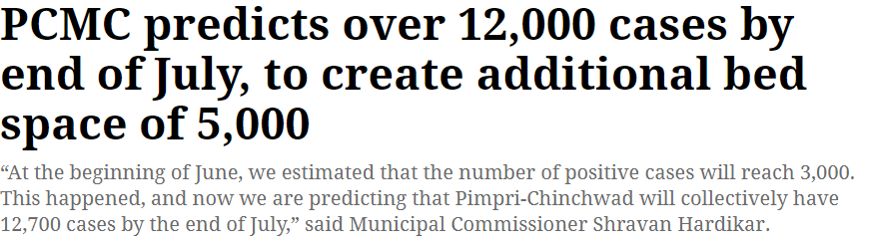
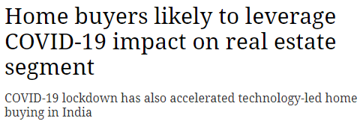
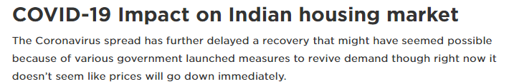
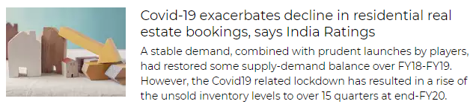
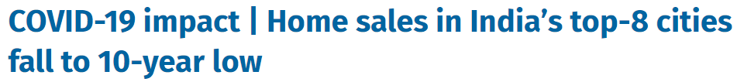
What’s the real issue?
thefederal.com
Indian express
theweek.in
Housing.com
Economic times
moneycontrol.com
Many claims, multiple theories.
Which is correct?

Slide 4
The impact of COVID-19 on residential real estate for urban India
Valuation post COVID
COVID stabilization in metros
Public opinion on real estate investment

Slide 5
Approach
Valuation post COVID
T test for prices before and after COVID was done
COVID stabilization in metros
Beta & gamma derived from past data till 10th July for each city
Public opinion on real estate investment
Survey to analyse the market sentiments about real estate
SIR model for each city
Data scraped from websites for 2020
Kaggle used for 2019 proxy data
Validated with data from 11th July to 17th July
Inferences were drawn based on peoples’ perception.

Slide 6
Modelling – T Stat

Slide 7
Modelling – SIR Model

Slide 8
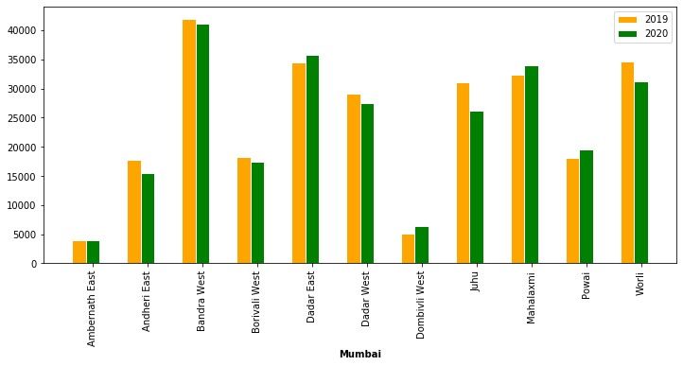
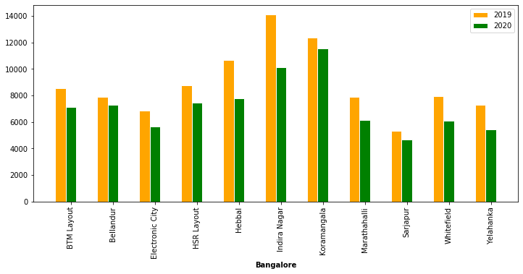
Results – T Stat
City | Locations
Bengaluru |  | 5 | 6
Chennai |  | 5 | 2
Delhi |  | 5 | 1
Hyderabad | 2 | 1 | 6
Mumbai | 6 |  | 11

Slide 9
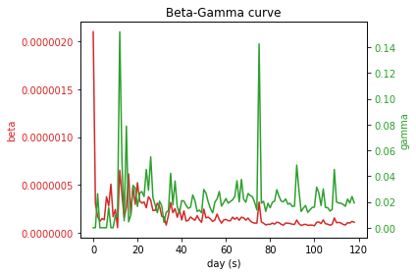
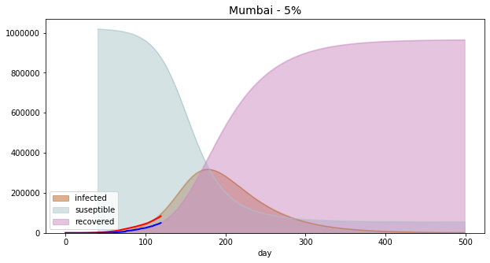
Results – SIR Model
City | Population In million | City % over state | % Infected | Infection Peak | Peak date
Bengaluru | 12.327 | 50% | 3 | 120,312 | 12.09.2020
 |  |  | 5 | 202,202 | 22.09.2020
Chennai | 10.971 | 53% | 3 | 103,110 | 04.08.2020
 |  |  | 5 | 157,024 | 16.08.2020
Delhi | 19.298 | 100% | 3 | 159,652 | 05.08.2020
 |  |  | 5 | 240,493 | 16.08.2020
Hyderabad | 10.000 | 75% | 3 | 84,356 | 25.08.2020
 |  |  | 5 | 127,794 | 02.09.2020
Mumbai | 20.411 | 34% | 3 | 198,348 | 26.08.2020
 |  |  | 5 | 317,165 | 08.09.2020

Slide 10
Results – Survey
1
People feel real estate prices will decrease
2
~50% of them are postponing their decision
3
Changed plans due to uncertainty in economy and job insecurity
4
Expecting builders to reduce rates, give offers and discounts
5
Trust more the medium sized builders followed by big builders
6
Exempting GST, Service Tax, Interest Rate reduction

Slide 11
Conclusion
~35% of the areas valuation decreased while 60% was just stable and only 5% of the areas saw value increasing
Peak between mid-August to mid-September 2020 with all the major cities touching 1 to 2 lakh active cases
A large percentage of people, expect that the prices would come down and are uncertain while ~40% changed their plans of buying

Slide 12
Questions?

Slide 13
Thank you…
Follow
Maintain social distance

Slide 14
Checklist
1920x1080 pixels at a 16:9 aspect ratio
Don't put anything on corners
Use font size of 34 points or bigger
Don't keep more than one point of focus on one slide. It's difficult to focus on multiple points or things at a time.
Choose a common sans serif font (like Helvetica or Verdana)
Only use images that you own or have permission to use. If you use an image under a Creative Commons(CC) license, cite the source at the bottom of your Slide.
10 slides maximum excluding title slide - to be presented in 15 mins + 5 min Q/A
11th slide for Q/A
Slide breakup :-
1 - Problem definition
2.- MarketGap references - What's already there and where is the gap? - 1 or 2 well known references
3&4 - Data sources and high level architecture for the product
5&6 - Modelling and Mathematical justification if needed
7&8 - Training/Testing and result description
9 - Inferences
10 - MVP - Effort and Capital requirements -- ROI - 2-5 years
Q/A - 5 min (11th Slide)

