Slide 1
Laser leak
Laser excitation
FOV = cameraDetector/magnification = a^2
cameraDetector = 16um* 16um*512*512 = 2^26=
Magnification = 150x
a=54.61 um
A=4.47e5 um^2
LS0 :Laser source (mW)
LF: laser excitation flux (nW/um2 = mW/mm2)
A: FOV: field of view (mm2)
LS = LS0 *filterCube*FOVcrop;
LF = LS/A
FOVcrop
FOV
LASER

Slide 2

wL
wL
bfpLens
MO

Slide 3
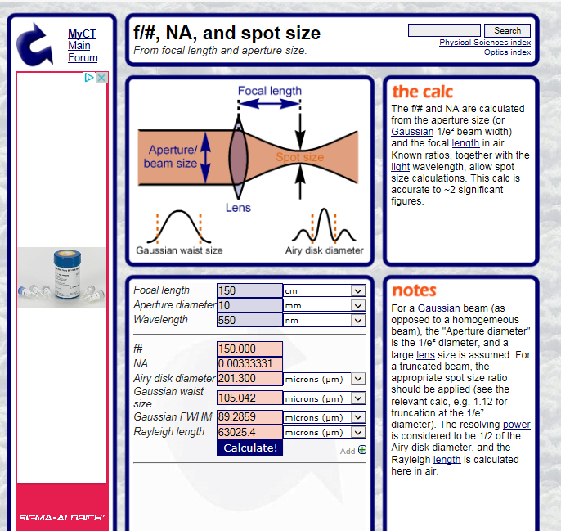
http://www.calctool.org/CALC/phys/optics/f_NA

Slide 4
