Slide 1
End-to-End Reproducible Data Science Workflows
Version Control and Repositories
Notes:
Welcome & Overview
Brief session structure:
30 min talk
90 min hands-on
Who this is for: researchers, analysts, data users
Why this matters: collaboration, reproducibility, open science

Slide 2
What you’ll take away today
Understand the basics of GitHub
Learn how to structure a data science project
Learn to track and manage code and data
Collaborate through GitHub using branches and pull requests
Build confidence in reproducible research
Notes:
Today’s Goals

Slide 3
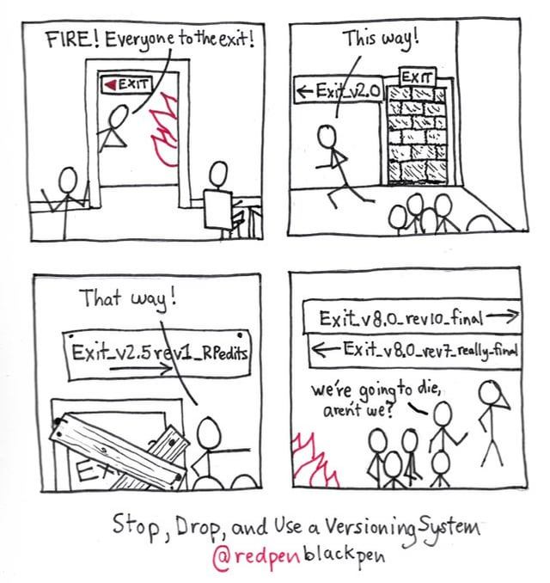
Chaos Without Version Control!
Code overwritten by mistake
Can't reproduce results
Collaboration becomes emailing files
Loss of trust in research outputs
Notes:
Case Study – What Can Go Wrong Without Git? Real-life examples
“We spent a week just figuring out which script had the right results.”

Slide 4
The Tools Behind Clean Research
Git | GitHub
Tracks changes locally | Remote storage & collaboration
Command line tool | Web interface for teams
Branches, commits, merges | Issues, pull requests, releases
Git = tracking history
GitHub = sharing and collaborating
Notes:
What is Git? What is GitHub?

Slide 5
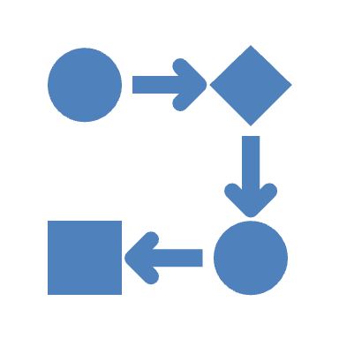
Science is Iterative – So Should Your Code Be
Data science = fast, messy, iterative
Github helps:
Go back to previous versions
Try new ideas without fear
Collaborate without stepping on toes
Document everything automatically
Notes:
Why Data Science Needs Version Control

Slide 6
Basic Github terminologies
Repository (Repo): A project folder tracked by Git. It contains your code, history of changes, branches, and configuration.
Commit: A snapshot of your project at a point in time. Each commit has a unique ID, message, and author.
Staging Area: The place where changes are added before committing.
Branch: A parallel version of your repository to work on features or fixes independently from main.
Merge: Combining changes from one branch into another (usually into main).
Conflict: Occurs when two branches edit the same part of a file differently. Git asks you to manually decide which changes to keep.
Remote: A copy of your repo on GitHub or another platform. Enables team collaboration.
Push: Sends your local commits to the remote GitHub repository.
Pull: Fetches and merges the latest changes from the remote repository.
Clone: Makes a local copy of a remote repository.
Notes:
What is Git? What is GitHub?

Slide 7
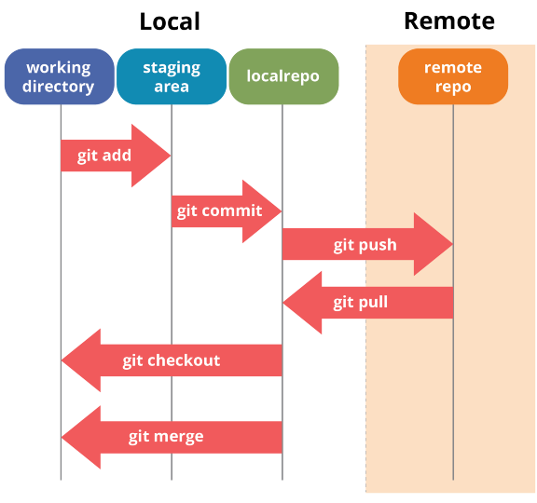
How Github Tracks Changes
Notes:
The Github Workflow
Github tracks what changed, who changed it, why, and when

Slide 8
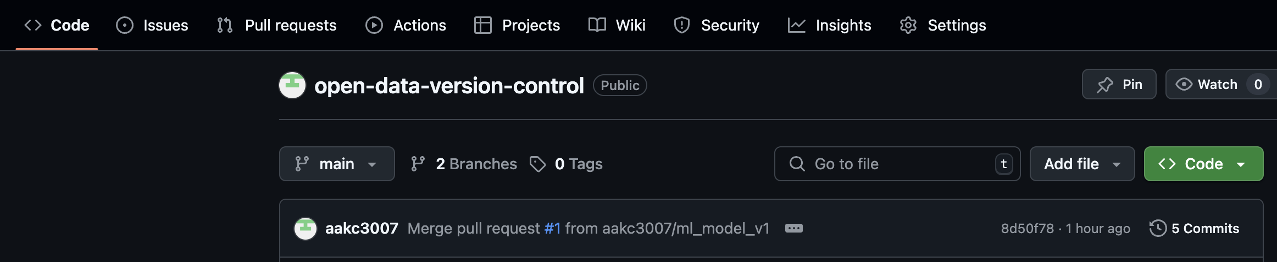
Inside a GitHub Project
View files, folders, README, and branches
Propose, discuss, and merge code changes
Project documentation hub
Report bugs, suggest features, assign tasks
(CI/CD automation – engg use)
Track changes and history
Notes:
GitHub Repository Tour
GitHub makes collaboration transparent, structured, and trackable.

Slide 9
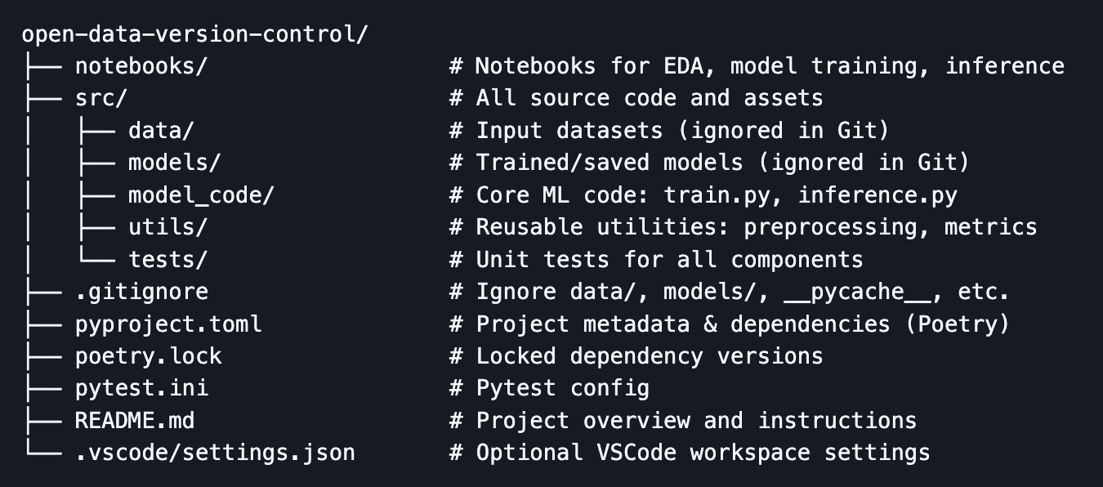
Reusable, Readable, Reproducible
Notes:
Standard Project Structure
Standardization = easier onboarding and sharing
🟦 What is pyproject.toml?
Think of pyproject.toml as the "control panel" for your Python project.
It tells Python what your project is called, what version it is, and what packages (like pandas or scikit-learn) it needs to work.
Instead of having lots of files for different settings, everything is in one neat file.
Poetry is like a project manager for Python.
It helps you install the right tools for your project.
It creates a safe space (called a virtual environment) so your packages don’t clash with others on your computer.
It makes it easy to add, update, or remove packages.
It keeps track of exact versions so the project works the same on any machine.
🟦 In simple terms:
requirements.txt is like a shopping list — but it doesn’t say which brand or version you got last time.
pyproject.toml + Poetry is like a recipe box — it tells you exactly what to get, where from, and how to set everything up exactly the same way every time.

Slide 10
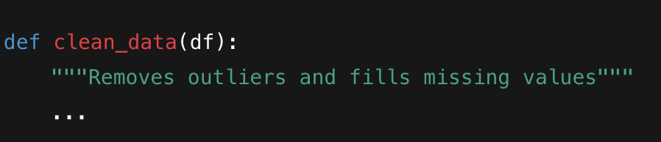
Code That’s Easy to Read, Share, and Debug
Use small functions with clear names
Keep one purpose per script
Comment & document
Write meaningful commit messages
Notes:
Clean Coding Practices

Slide 11
Real Workflow Example
Scenario:
You’re cleaning survey data
You try 3 different approaches
You use branches:
main – current best version
label_encoding_data
one_hot_encoding_data
manually_encoding_data
You test, then merge
git checkout main
git merge label_encoding_data
Outcome: You preserved old versions, tested new ideas, and stayed organized.
Notes:
Version Control in Practice – A Day in the Life

Slide 12
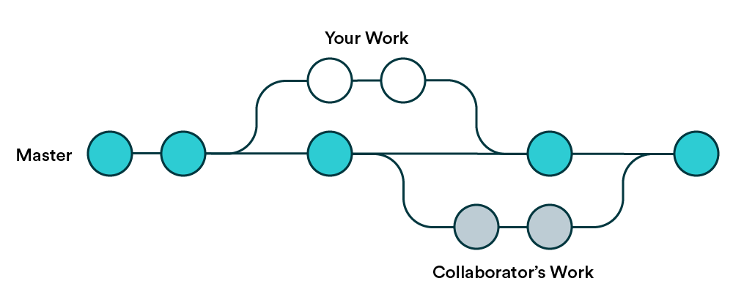
Safe Experimentation with Branching
Main (master): your stable branch
feature/cleaning, feature/modelling: new work
Use git checkout –b to create
Use git merge to combine
Notes:
Working with Branches

Slide 13
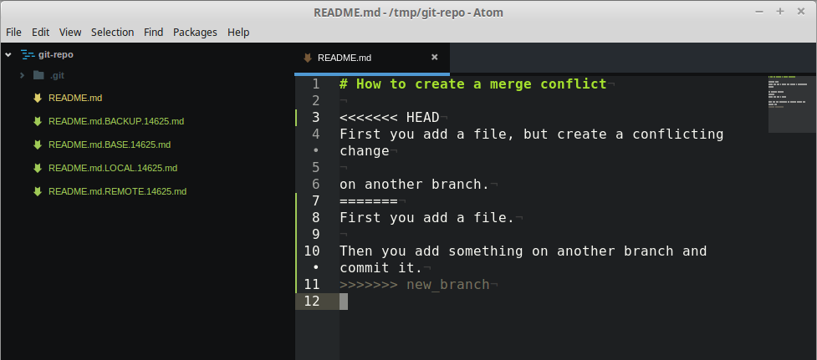
What Happens When Two People Edit the Same File?
Git will prompt you to resolve the conflict
You choose what to keep
You commit the resolution
Notes:
Solving Merge Conflicts

Slide 14
From Local to Global with GitHub
Push your changes:
git push origin feature_modeling
Open a Pull Request (PR) on GitHub
Ask teammates to review and approve
Notes:
Sharing Your Work

Slide 15
Pull Requests - Collaboration, Feedback, Traceability
PRs let you:
Review changes before merging
Leave comments
Track progress
Everyone knows what changed and why
Encourages reproducible science
Notes:
Code Reviews & Collaboration

Slide 16
Make Sure Others Can Run Your Code
Use virtual environments – venv, conda env
Always put requirements.txt, poetry/pyproject.toml
Update documentation frequently
Don’t forget to commit these changes!!!!
Notes:
Sharing Your Work

Slide 17
Avoid Clutter, Explain Everything
.gitignore: tells Git what not to track (data, logs, envs)
README.md: describes the project, how to run it, goals
Notes:
.gitignore and README.md

Slide 18
Real-World Use Cases

Slide 19
You’re Ready – Let’s Build a Repo Together!!!
Clone a repo
Make a change
Push, branch, and merge
Solve conflicts
Share results
And moreeeeeeeee!
Notes:
Sharing Your Work

